Slide 1


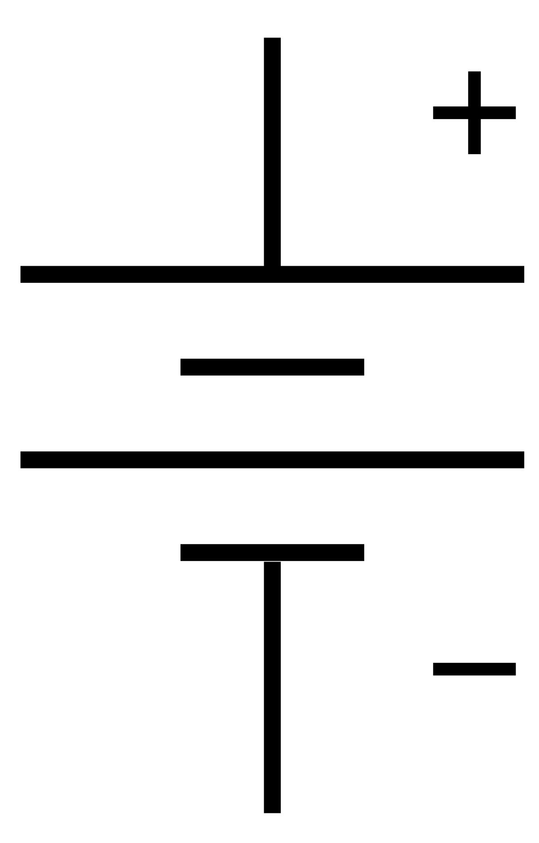

RC/Servo Input
5V
Left Channel
Power
Setpoint Potentiometers
13V
5V
PWM
H-Bridge
Direction
Right Channel
PWM
5V
Direction
13V
RC/Servo Input

Slide 2
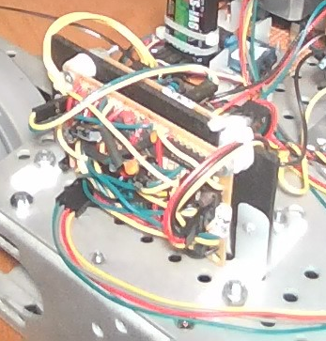
Step/Direction
Diagnostic LEDs
Power
Stepper Out

Slide 3
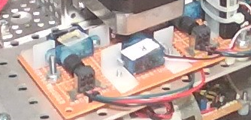
Servo
Pot

Slide 4
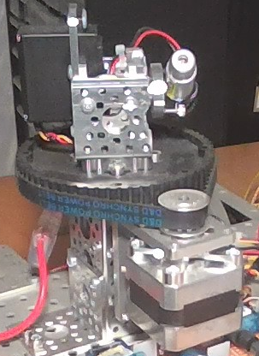
Servo Block
Servo
Pulley
Pulley
Timing Belt
Stepper

Slide 5
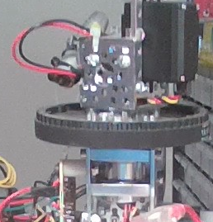
Pillow Blocks
Tube

Slide 6
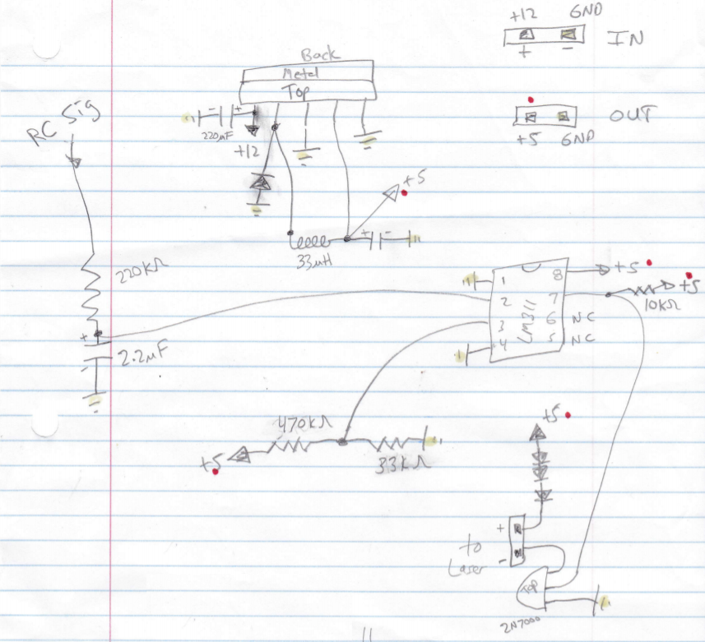
NTE7222
NTE586
100 uF

Slide 7
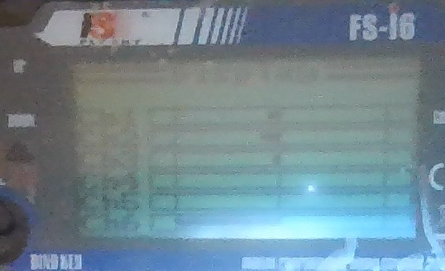
Ch1
Ch2
Ch3
Ch4
Ch6

Slide 8
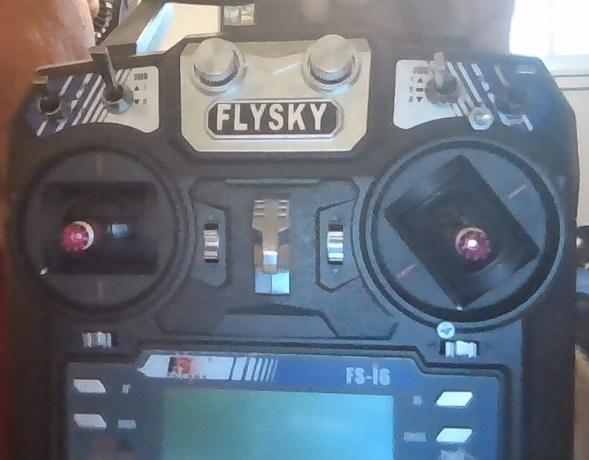
Laser Power
Laser Movement
Chassis Drive

