Slide 1
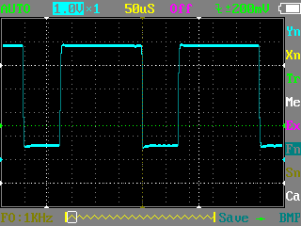
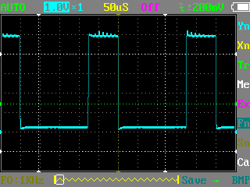
1729 Pin 8 output
NOR Gate Pin 13 output
69% duty cycle, 4kHz frequency
30% duty cycle, 4kHz frequency

Slide 2
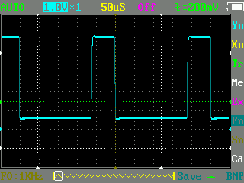
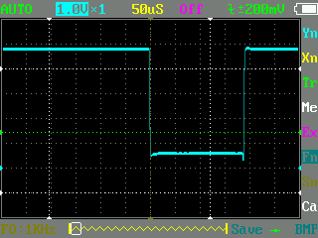
Pin 13 = Gnd or Unconnected
Pin 13 = +5V

