Slide 1
Tableau Generated Visuals
File created on: 2/15/26 9:34:38 PM CST

Slide 2
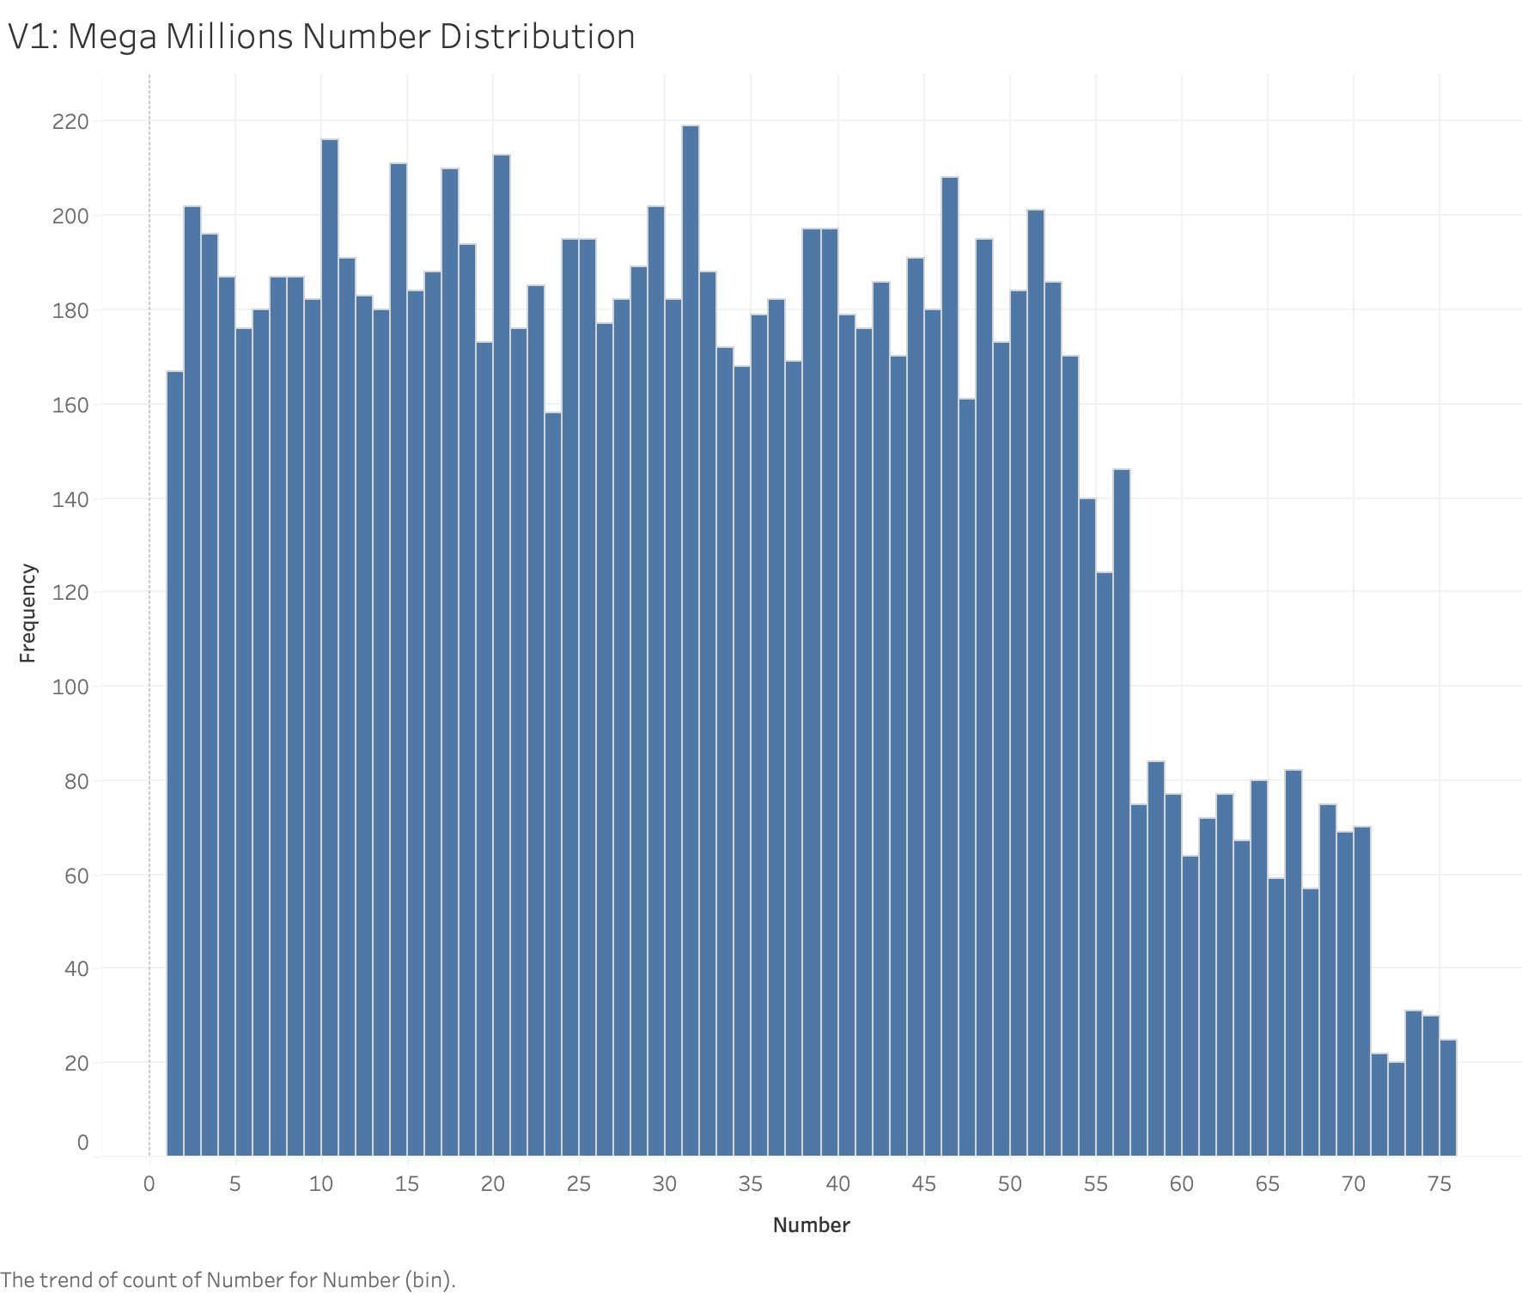

Slide 3
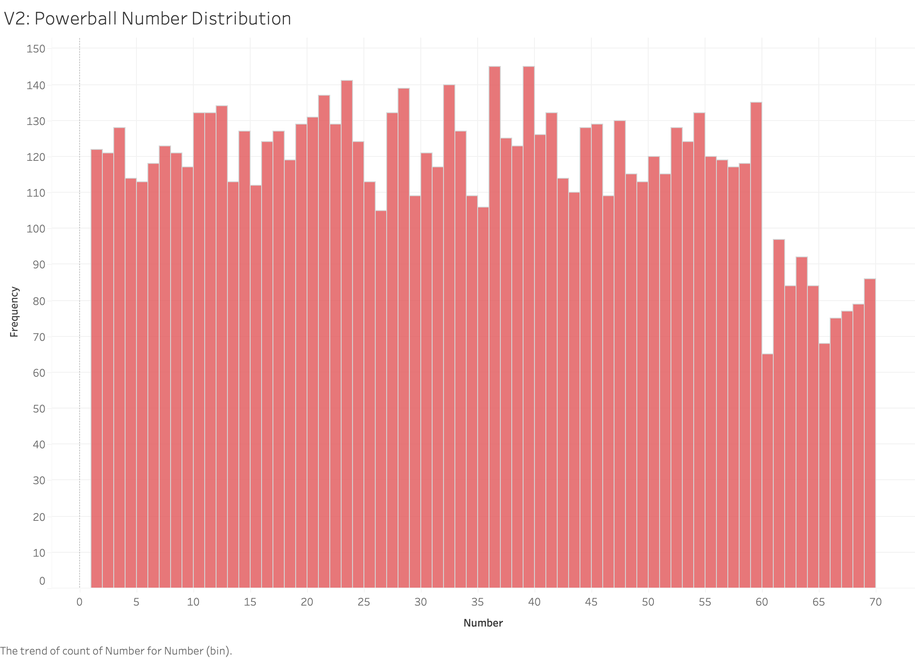

Slide 4
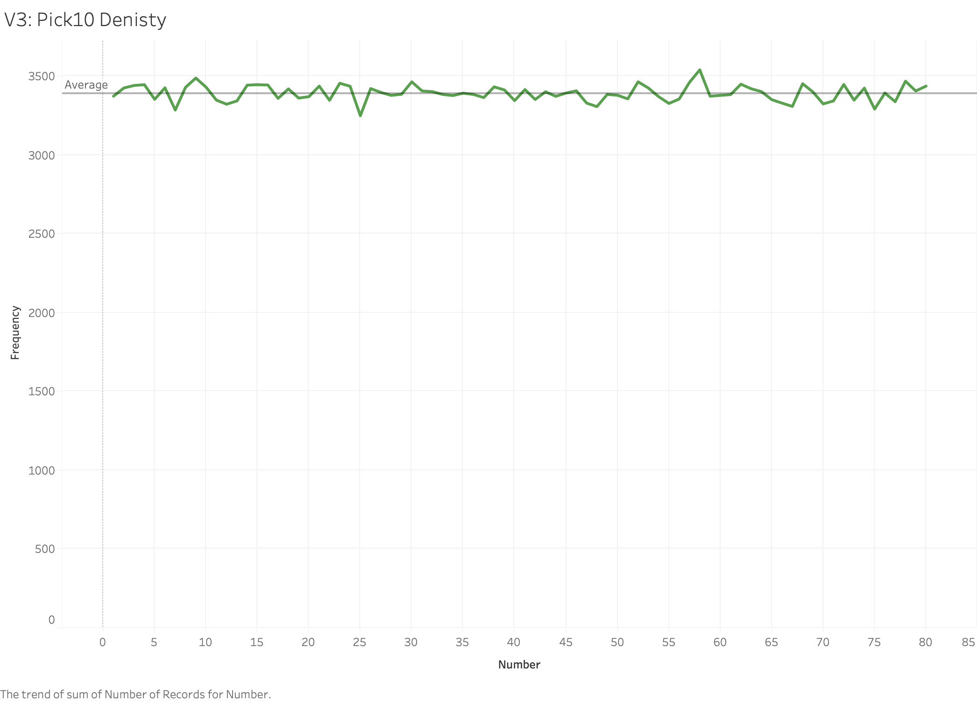

Slide 5
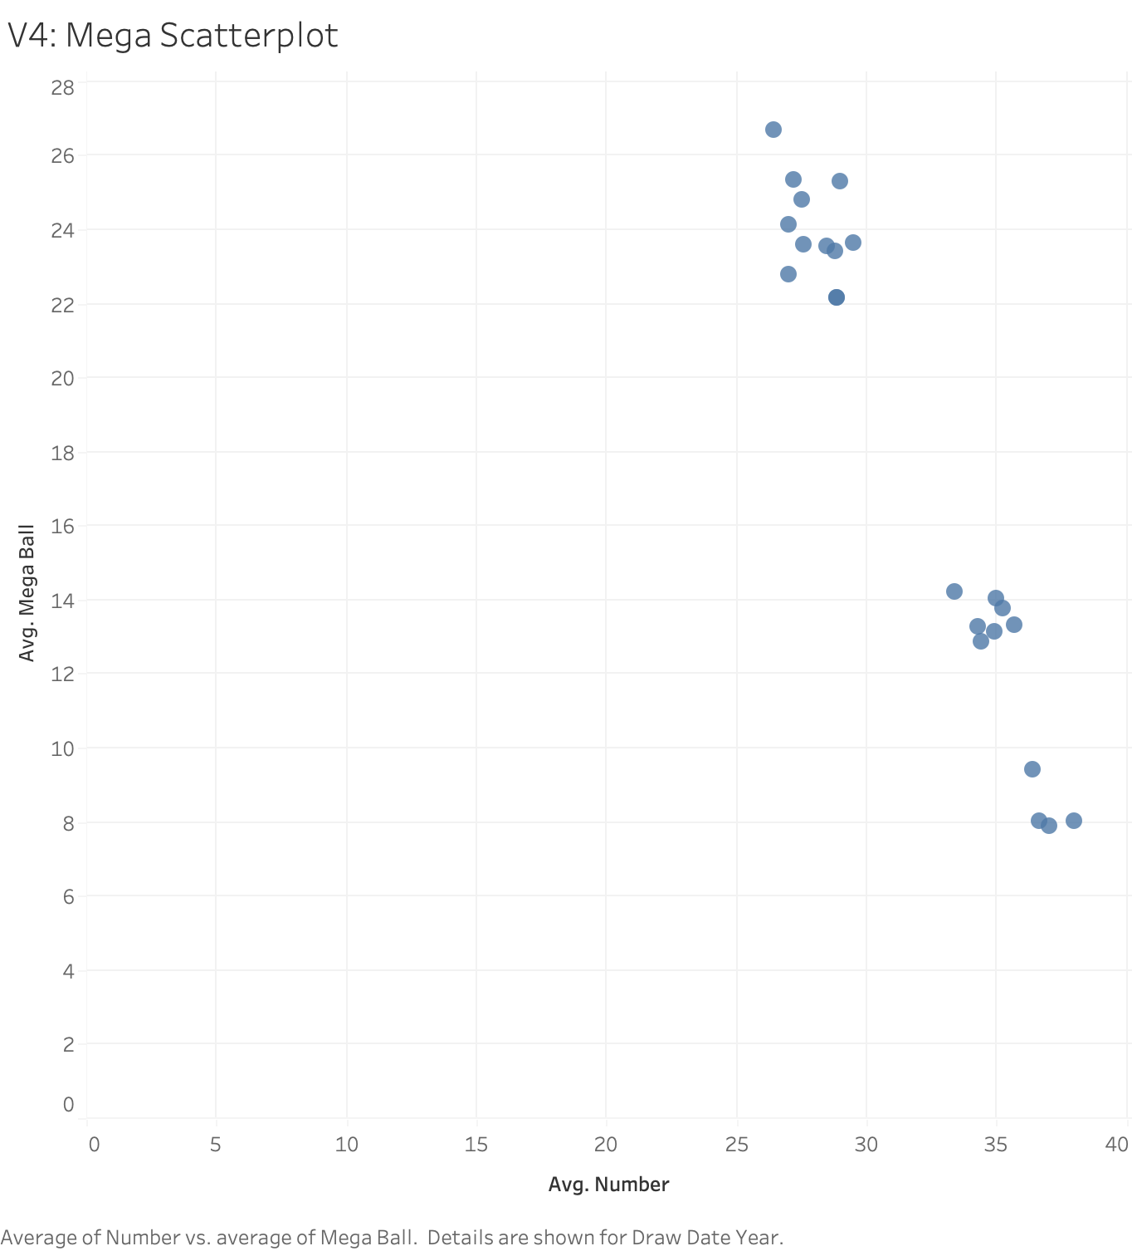

Slide 6
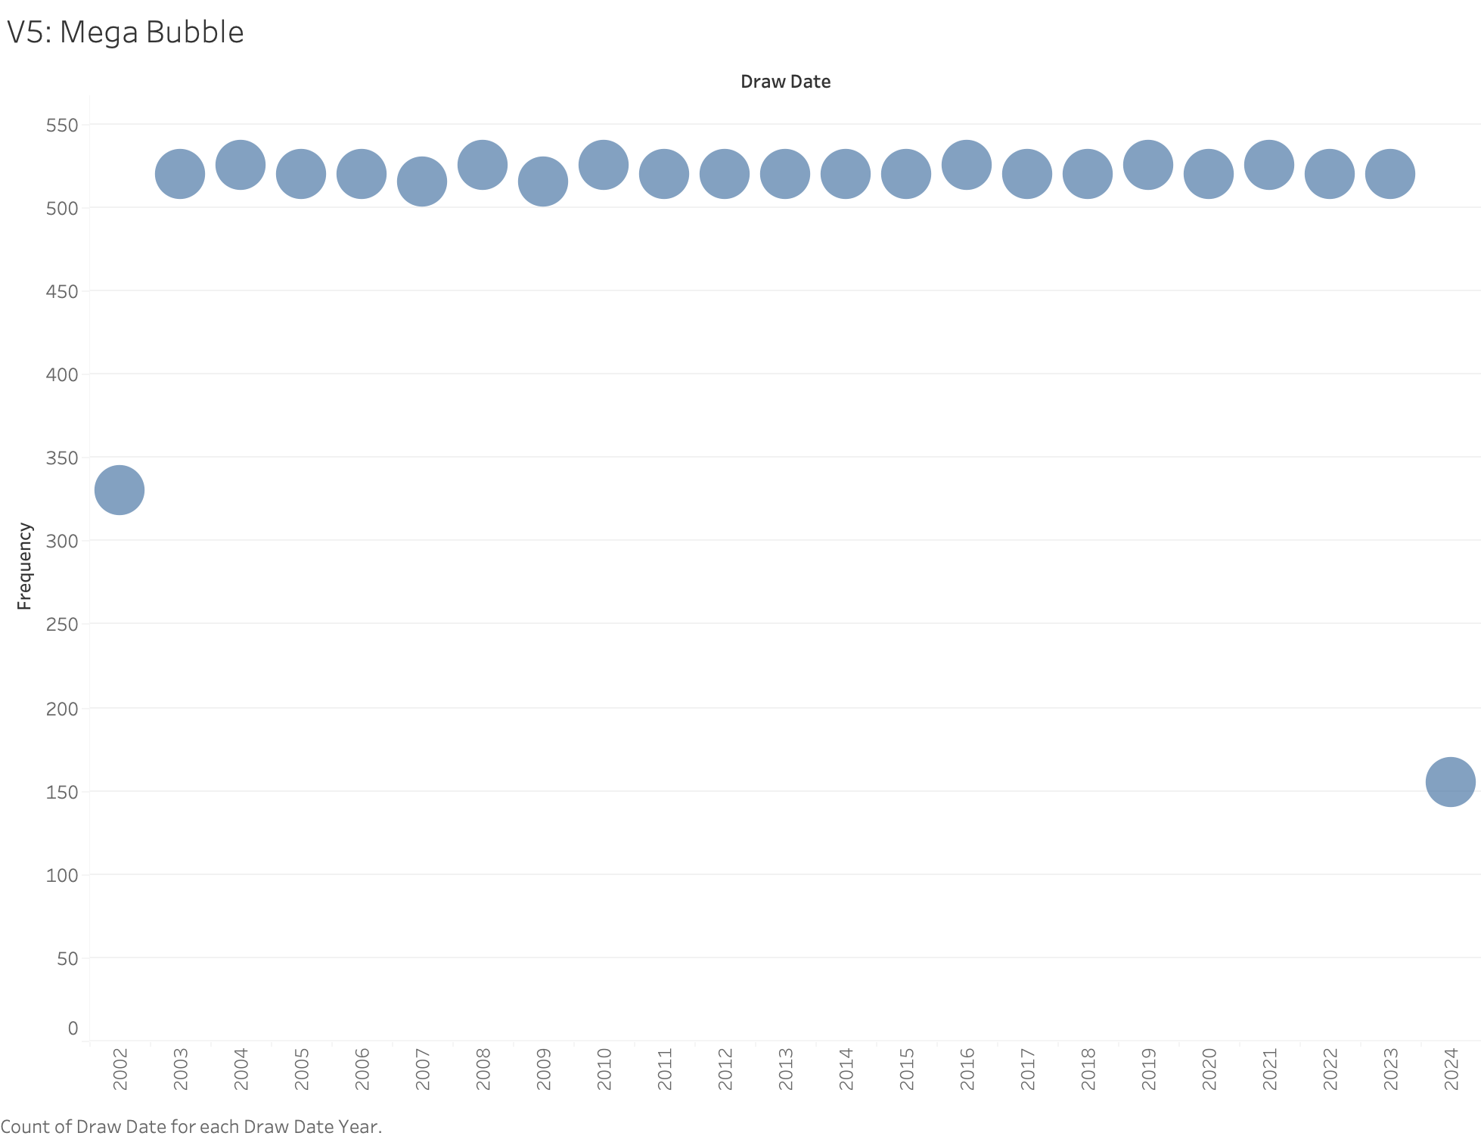

Slide 7
