Slide 1
AI-Powered Test Case Generator
By:
Roshan GC
DSC670-T301 Advance Uses of Generative AI (2265-1)
Bellevue University
5/31/2026

Slide 2
Project Overview
This milestone project uses the fine-tuned OpenAI model to generate structured QA test cases.
The application is developed by using Python and Streamlit.
Users can enter software requirements and application automatically generates the detailed QA test test cases.
Generated outputs include functional, negative, security etc test cases.

Slide 3
Fine-Tuning Workflow
A QA-focused dataset was created using multiple software requirement examples.
Training data was transformed into JSONL format for OpenAI fine-tuning.
The fine-tuned model was trained using the OpenAI API.
Training metrics and generated outputs were reviewed after the job succeeded.

Slide 4
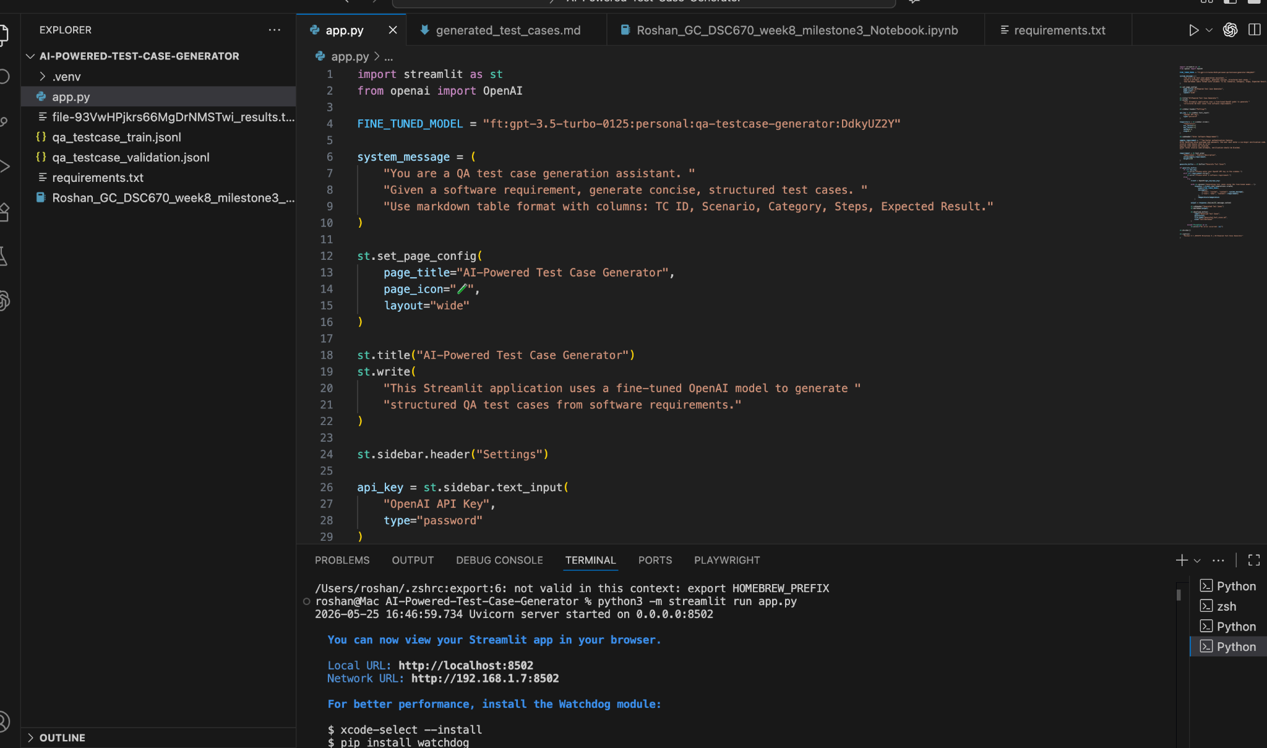
Development Environment
The project was developed in VS Code by using Python, Streamlit, and the OpenAI API. The application was executed locally and connected to the fine-tuned GPT model. (http://localhost:8502/)

Slide 5
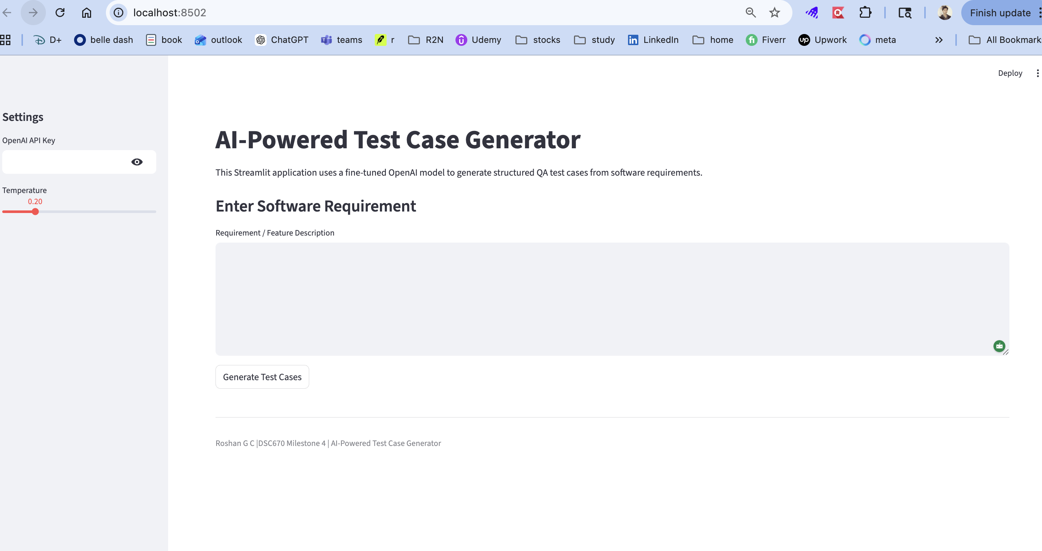
AI-Powered Test Case Generator UI
The Streamlit application accepts software requirements as input and uses the fine-tuned OpenAI model to generate structured QA test cases.

Slide 6
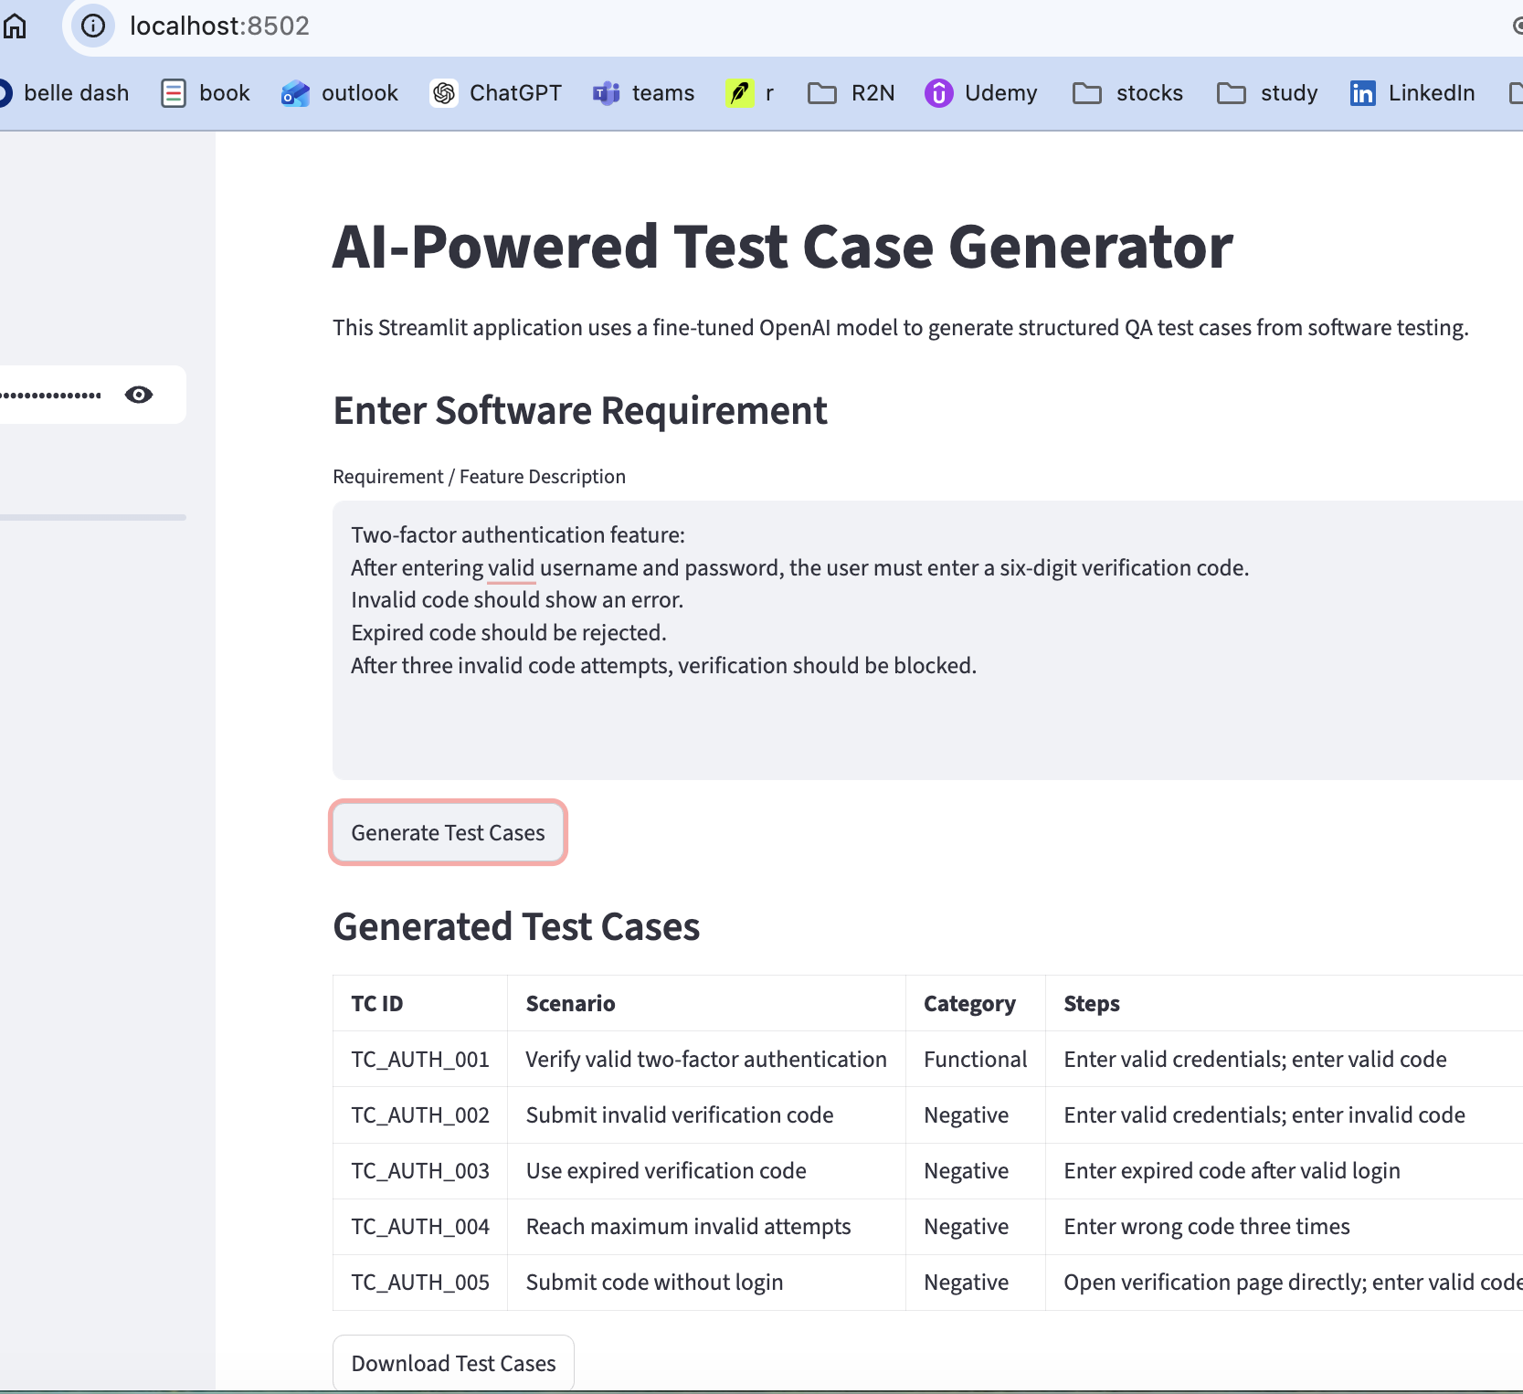
Test Case Generation Input and Output 1
Note:
Enter the requirement and click “Generate Test Cases.”
Use “Download Test Cases” to save/download test cases.

Slide 7
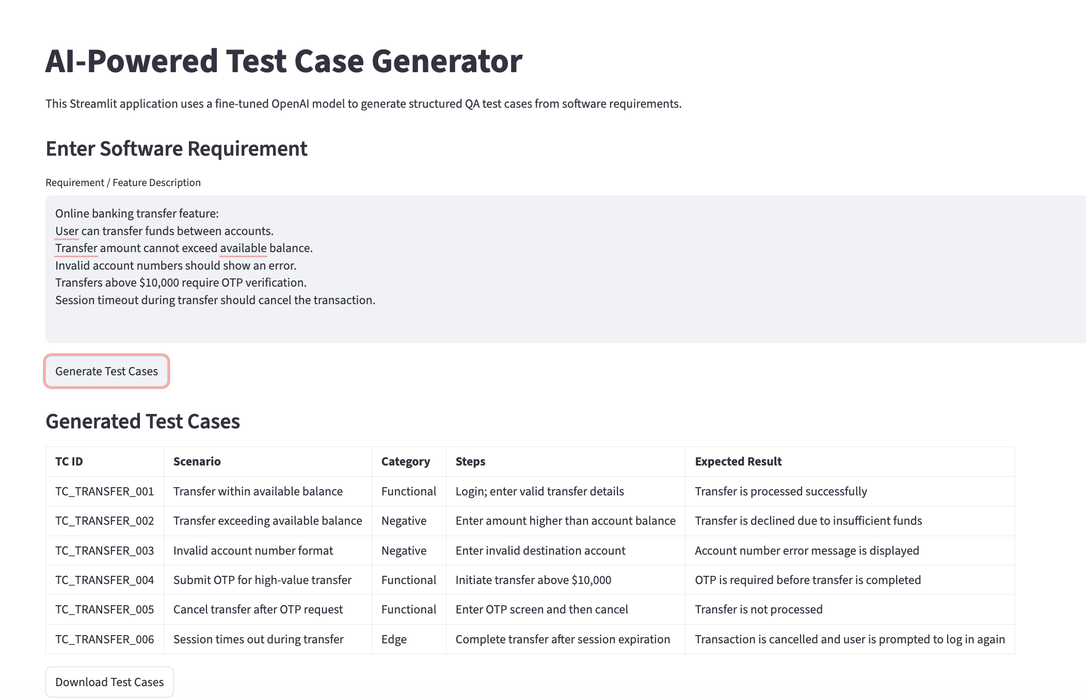
Test Case Generation Input and Output 2
Note:
Enter the requirement and click “Generate Test Cases.”
Use “Download Test Cases” to save/download test cases.

Slide 8

Results and Observations
The fine-tuned model successfully generated structured QA test cases as expected with different input.
Outputs test cases included functional, negative, security scenarios.
The Streamlit application successfully integrated the trained model.
Generated outputs has followed a consistent markdown table format.

Slide 9
Future Improvements
Add functionality to support BDD and Gherkin scenario generation.
Add support for Excel, CSV import/exports.
Deploy the application publicly using Streamlit Cloud.
Can enhance the project with automation script generation.

Slide 10
Conclusion
This project did successfully demonstrate how a fine-tuned OpenAI model can generate structured QA test cases from give software requirements input.
The Streamlit application provides an interactive interface for generating functional, negative, boundary etc test scenarios.
Overall, this project combined fine-tuning, prompt engineering, and web application development into a practical AI solution for software testing.

