Slide 1

Customer Churn Prediction
By: Roshan GC DSC680-T301 Applied Data Science Instructor: Ashton Xu Bellevue University 08/23/2026

Slide 2
Identify factors associated with customer churn.
Analyze tenure, contract type, monthly charges, and internet service.
Compare Logistic Regression, Decision Tree, and Random Forest.
Evaluate models using accuracy, precision, recall, and F1-score.
Project Overview

Slide 3
Business Problem & Research Questions
Business Problem
Customer churn can reduce revenue and increase customer acquisition costs.
Understanding churn patterns can support customer retention.
Research Questions
Which customer characteristics have the greatest influence on churn?
What is the effect of tenure, contract type, and monthly charges on customer churn?
Which machine learning model provides the best prediction performance?

Slide 4
Dataset Details
Telco Customer Churn dataset (Kaggle)
7,043 customer records and 21 variables
Demographics, services, contracts, charges, and churn
Dataset & Data Preparation
Data Preparation
Removed customerID
Converted TotalCharges to numeric and removed blank/missing records
Final cleaned dataset: 7,032 records
Converted categorical data into numbers for modeling and coded Churn as 0 (No) and 1 (Yes).

Slide 5
Exploratory Data Analysis (EDA)
80/20 Train/Test Split
Classification Models: Logistic Regression, Decision Tree & Random Forest
Model Evaluation & Validation: Accuracy, Precision, Recall, F1-score, 5-Fold Cross-Validation & Random Forest Tuning
Methodology

Slide 6
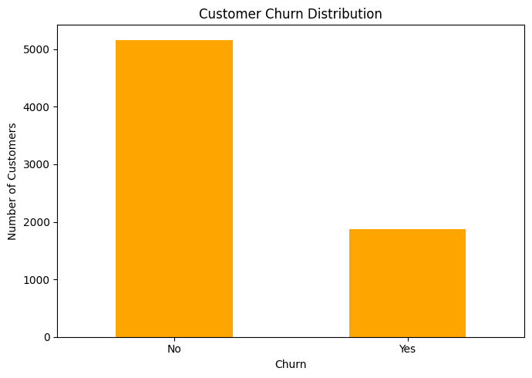
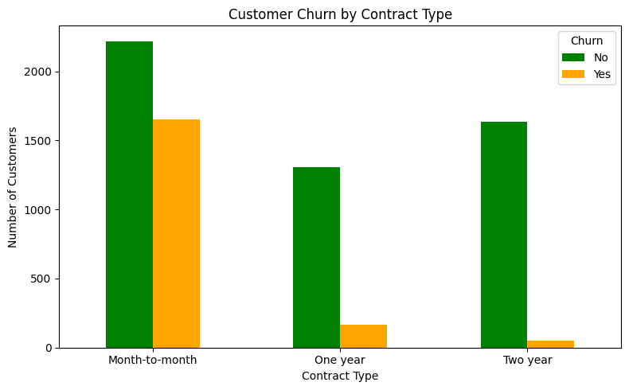
Exploratory Data Analysis (Part 1)
• Overall churn rate was 26.58%.
• Month-to-month customers had the highest churn rate at 42.71%.

Slide 7
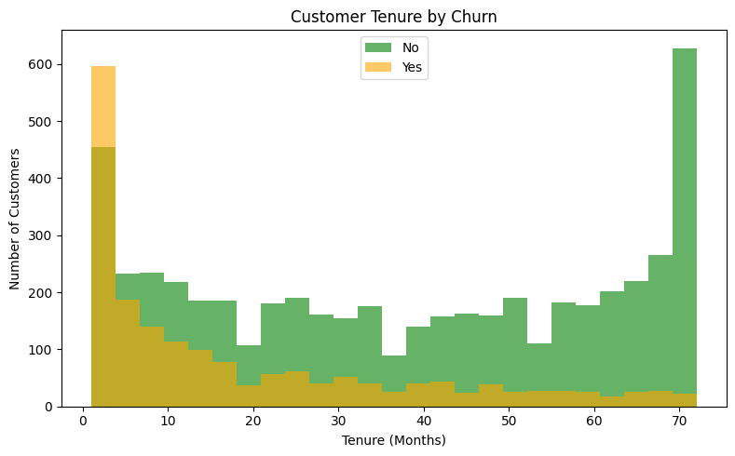
Exploratory Data Analysis (Part 2)
Customers who left had a much shorter average tenure (17.98 months) than customers who stayed (37.65 months).

Slide 8
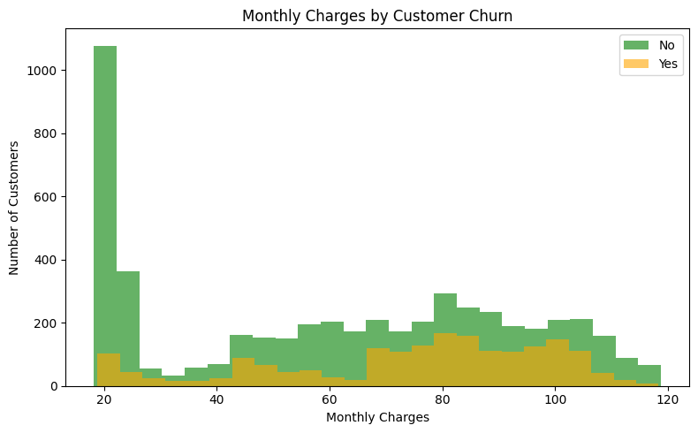
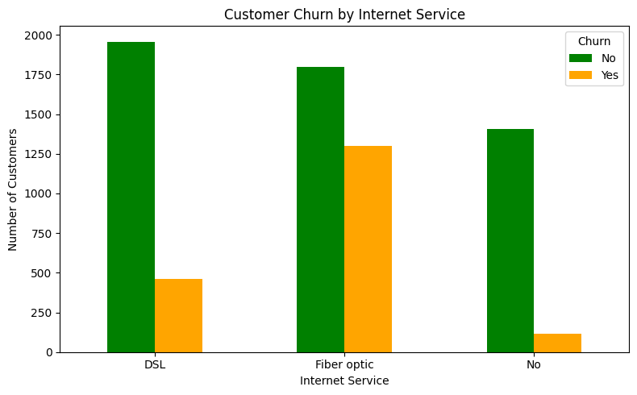
Exploratory Data Analysis (Part 3)
Churned customers had higher average monthly charges.
Fiber-optic customers had the highest internet-service churn rate.

Slide 9
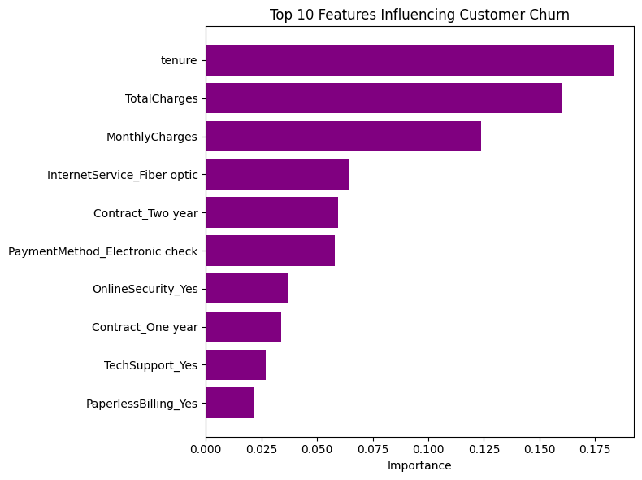
Tenure was the most important feature in the Random Forest model.
Total Charges and Monthly Charges were also among the most important features.
Top 10 Features
in the Random
Forest Model

Slide 10
Model Performance
Model | Accuracy | Precision | Recall | F1-Score
Logistic Regression | 0.805 | 0.650 | 0.575 | 0.610
Decision Tree | 0.719 | 0.470 | 0.463 | 0.466
Random Forest | 0.787 | 0.622 | 0.511 | 0.561
1. Logistic Regression performed best with 80.5% accuracy and the highest F1-score (0.610).
2. Five-fold cross-validation confirmed consistent performance, with Logistic Regression
averaging 80.4% accuracy.

Slide 11
Contract type, tenure, monthly charges, and internet service were associated with churn.
Logistic Regression performed best with 0.805 test accuracy.
Its average 5-fold cross-validation accuracy was 0.804.
Random Forest improved after tuning but did not outperform Logistic Regression.
Conclusions

Slide 12
Limitations
The dataset is sample data and is not from one specific telecom company.
Some information that may affect churn, such as customer satisfaction and complaints, is not included.
There are fewer churned customers than non-churned customers in the dataset.
Future Work
Try other machine learning models and compare the results.
Look at other ways to improve the model and handle the difference between churn and non-churn groups.
Test the model with newer data or actual customer data from a telecom company.
Limitations & Future Work

Slide 13
?
?
?
?
?
?
Thank You
Questions?
?
?
?
?

