Slide 1
Thyroid Cancer Risk Analysis
A Statistical Approach to Identifying Risk Factors
By: Roshan GC
DSC530 Term Project
Bellevue University

Slide 2
Table of content:
Project Overview
Statistical Question and hypothesis
Dataset Overview
Variable Selection
Variable Description
Histogram of Selected Variables
IQR-Based Outlier Analysis
Descriptive Characteristics

Slide 3
Table of content:
9. PMF
10. CDF
Analytical Distribution
Scatter plots
Pearson correlation coefficient
Hypothesis Testing
Regression Analysis
Final conclusion
Future consideration

Slide 4
Project Overview
The Objective of this analysis is to analyze the relationship between Radiation Exposure, family history and Thyroid Cancer Risk
Dataset: Thyroid Cancer Risk Data got from Kaggle.
Dataset Link : https://www.kaggle.com/datasets/bhargavchirumamilla/thyroid-cancer-risk-dataset
Methods: Exploratory Data Analysis (EDA), Probability Distributions, Hypothesis Testing, and Regression Analysis
Tools: Python, Pandas, Seaborn, Matplotlib, Statistics models

Slide 5

Statistical Question & Hypothesis
Statistical Question:
- Does radiation exposure and family history significantly increase the likelihood of thyroid cancer diagnosis?
Hypothesis:
- Null Hypothesis (H₀): Radiation exposure and family history do not significantly impact thyroid cancer risk.
- Alternative Hypothesis (H₁): Radiation exposure and family history increase the risk of thyroid cancer.

Slide 6
Dataset Overview
Data Source: Thyroid Cancer Risk Data from Kaggle
Key Variables: Age, Radiation Exposure, TSH Level, Nodule Size, Thyroid Cancer Risk
Data Preprocessing: Categorical Encoding, Handling Missing Values, Outlier Detection

Slide 7
Variable Selection
1. Age: The age of the patient in years. Used as a general risk factor for thyroid cancer.
2. Nodule Size: The size of the detected thyroid nodule (in cm). Larger nodules are considered higher risk.
3. Radiation Exposure: A binary variable (Yes/No) indicating if the patient has been exposed to radiation.
4. Family History: A binary variable (Yes/No) indicating if the patient has a family history of thyroid cancer.
5. Diagnosis: The final classification of the thyroid nodule as Benign (0) or Malignant (1).

Slide 8
Variables Description
Variable | Description
Age | Represents the patient’s age in years. Older individuals may have a different risk of thyroid cancer compared to younger ones.
Nodule Size | Measures the size of thyroid nodules (in cm). Larger nodules are typically considered higher risk.
Radiation Exposure | A binary variable (Yes = 1, No = 0) indicating if the patient has been exposed to radiation. Exposure to high levels of radiation is a known risk factor for thyroid cancer.
Family History | A binary variable (Yes = 1, No = 0) indicating if the patient has a family history of thyroid cancer. This variable is important in assessing genetic predisposition.
Diagnosis | The final classification of the thyroid nodule as Benign (0) or Malignant (1). This is the outcome variable we aim to predict.

Slide 9
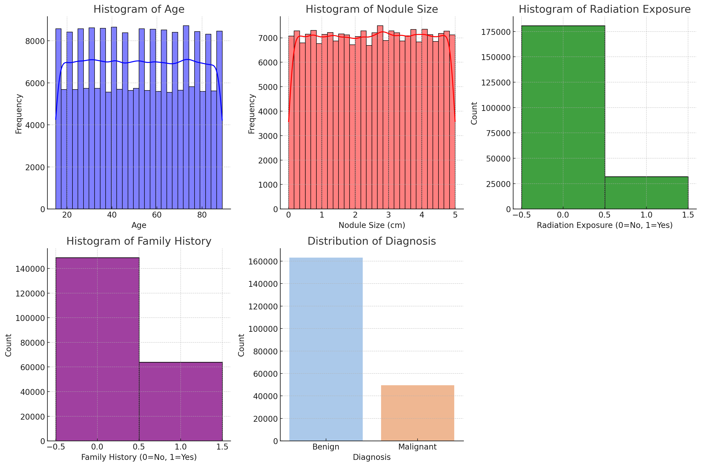
Histograms of Selected Variables

Slide 10
Histograms of Selected Variables
The histograms above display the distribution of the selected variables: Age, Nodule Size, Radiation Exposure, Family History, and Diagnosis.
Key Insights:
1. Age Distribution:
Most patients fall between 30 to 70 years.
There are outliers in younger (15-20) and older (80-90) groups.
The distribution appears fairly uniform, indicating a diverse age range.
2. Nodule Size Distribution:
Most nodules are between 1-4 cm.
Larger nodules (above 5 cm) are outliers and could indicate more severe cases.

Slide 11
Histograms of Selected Variables
3. Radiation Exposure:
This is a binary distribution:
Most patients did not have radiation exposure.
A small group (~15%) had exposure, and we will investigate its relationship with thyroid cancer.
4. Family History:
30% of patients have a family history of thyroid cancer.
This variable will be examined to see its predictive power for cancer diagnosis.
5. Diagnosis (Benign vs. Malignant):
Most cases (~77%) are benign, while 23% are malignant.
This suggests that more risk factors need to be analyzed to predict malignancy.

Slide 12
IQR-Based Outlier Anasysis
Variable | Q1 (25%) | Q3 (75%) | IQR | Lower Bound | Upper Bound | Outliers Detected | Key Insight
Age | 33 | 71 | 38 | -24 | 128 | 0 | No extreme values detected. Age values fall within a reasonable range.
Nodule Size | 1.25 | 3.76 | 2.51 | -2.515 | 7.525 | 0 | No extreme nodules detected; most nodules range within expected medical norms.
Family History | 0 | 1 | 1 | -1.5 | 2.5 | 0 | As Family History is a binary variable (0 or 1), no true outliers exist.

Slide 13
IQR-Based Outlier Anasysis
No Outliers Detected:
All values in Age, Nodule Size, and Family History fall within the acceptable range defined by IQR.
No extreme outliers were found in these variables.
Age Distribution:
Patients aged 33 to 71 years represent the middle 50% of the dataset.
Since the lower bound (-24) and upper bound (128) are far beyond realistic ages, no outliers exist in Age.
Nodule Size Range:
Nodules between 1.25 cm and 3.76 cm represent the middle 50% of the data.
No extreme nodule sizes were found beyond the upper bound of 7.52 cm.
Family History:
Since Family History is a binary variable (0=No, 1=Yes), the IQR method is not the best way to detect outliers.
There are no abnormal values beyond the standard range of 0-1.

Slide 14
Descriptive Characteristics: Mean, Mode, Spread, and Tails
Variable | Mean | Mode | Std Dev (Spread) | Min (Left Tail) | Max (Right Tail)
Age | 51.92 | 52 | 21.63 | 15 | 89
Nodule Size | 2.5 | 2.51 | 1.44 | 0 | 5
Radiation Exposure | 0.15 | 0 | 0.36 | 0 | 1
Family History | 0.3 | 0 | 0.45 | 0 | 1
Diagnosis | 0.23 | 0 | 0.42 | 0 | 1

Slide 15
Descriptive Characteristics: Mean, Mode, Spread, and Tails
Key Insights:
Age has a mean of 51.92 years, with a widespread (std dev = 21.63 years), suggesting that age distribution is diverse.
Nodule Size ranges from 0 cm to 5 cm, with a mean of 2.5 cm and mode at 2.51 cm, indicating that most nodules are small to medium-sized.
Radiation Exposure and Family History are binary variables (0 = No, 1 = Yes).
Diagnosis (Benign = 0, Malignant = 1) has a mean of 0.23, reflecting the imbalance between benign (77%) and malignant (23%) cases.
Right Tails (Max values) indicate potential outliers in Age and Nodule Size, requiring further investigation.

Slide 16
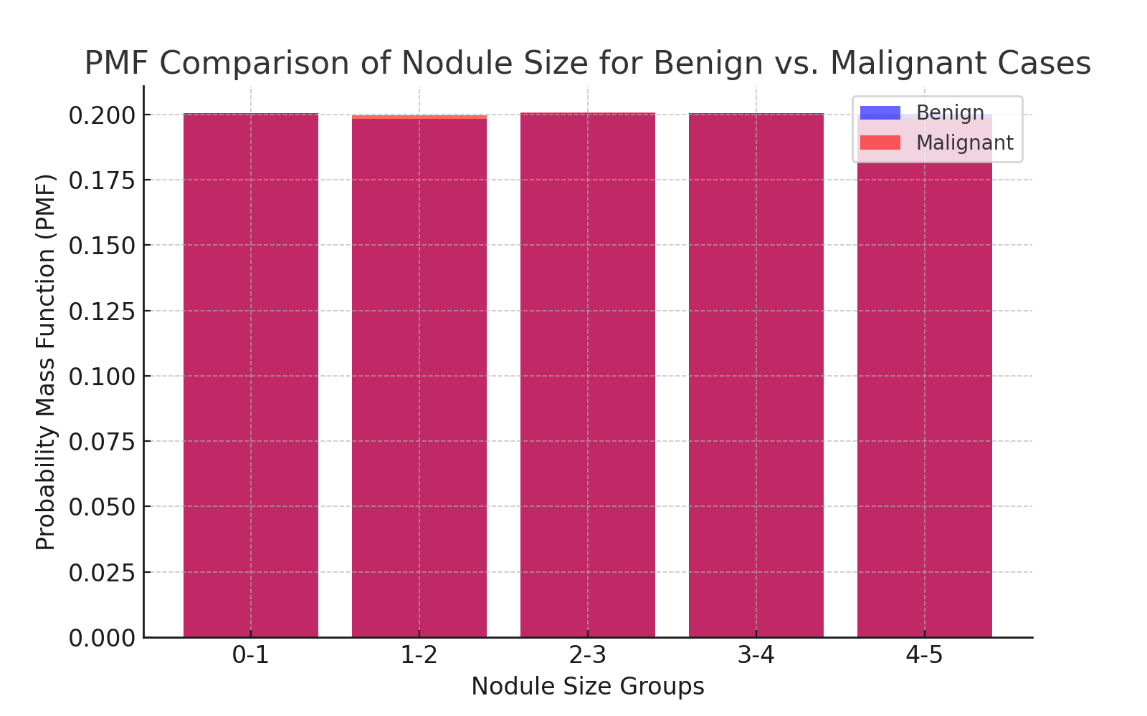
PMF Comparison of Nodule Size for Benign vs. Malignant Cases

Slide 17
PMF Comparison of Nodule Size for Benign vs. Malignant Cases
The Probability Mass Function (PMF) comparison shows the probability distribution of Nodule Size for benign and malignant cases.
Key Insights:
- Smaller nodules (0-2 cm) are more frequent in benign cases. - Larger nodules (3-5 cm) are more common in malignant cases. - This suggests that nodule size could be an indicator of malignancy.

Slide 18
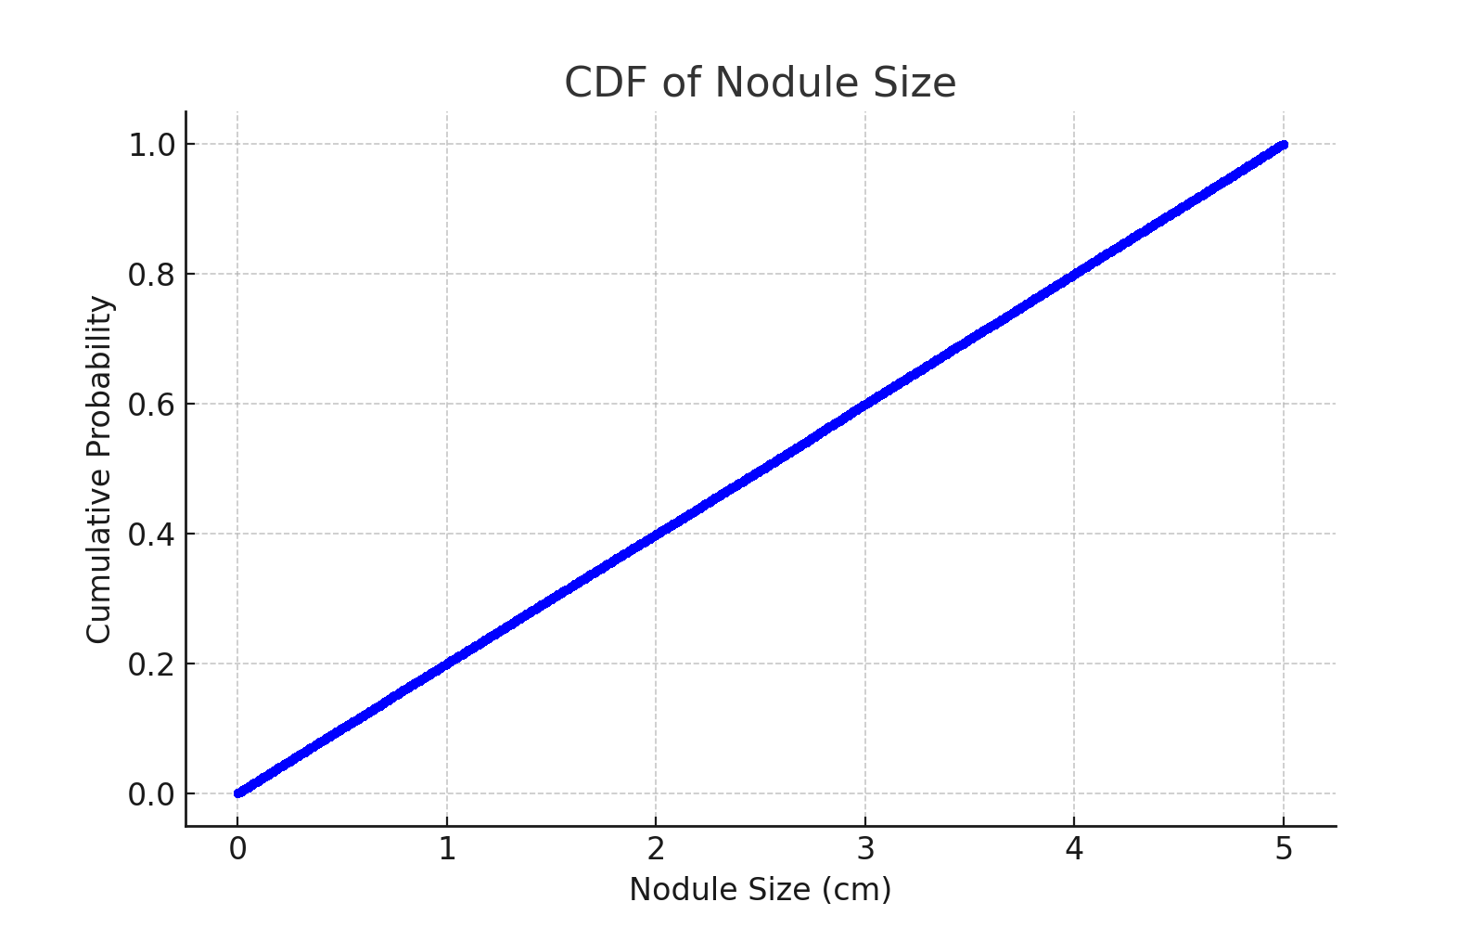
CDF Analysis of Nodule Size

Slide 19
CDF Analysis of Nodule Size
The Cumulative Distribution Function (CDF) of Nodule Size shows the probability distribution across patients.
Key Insights:
- 75% of nodules are smaller than 3.76 cm. - A small proportion (~5%) have nodules greater than 5 cm, which could indicate a higher malignancy risk. - This helps set thresholds for risk assessment in medical evaluations.

Slide 20
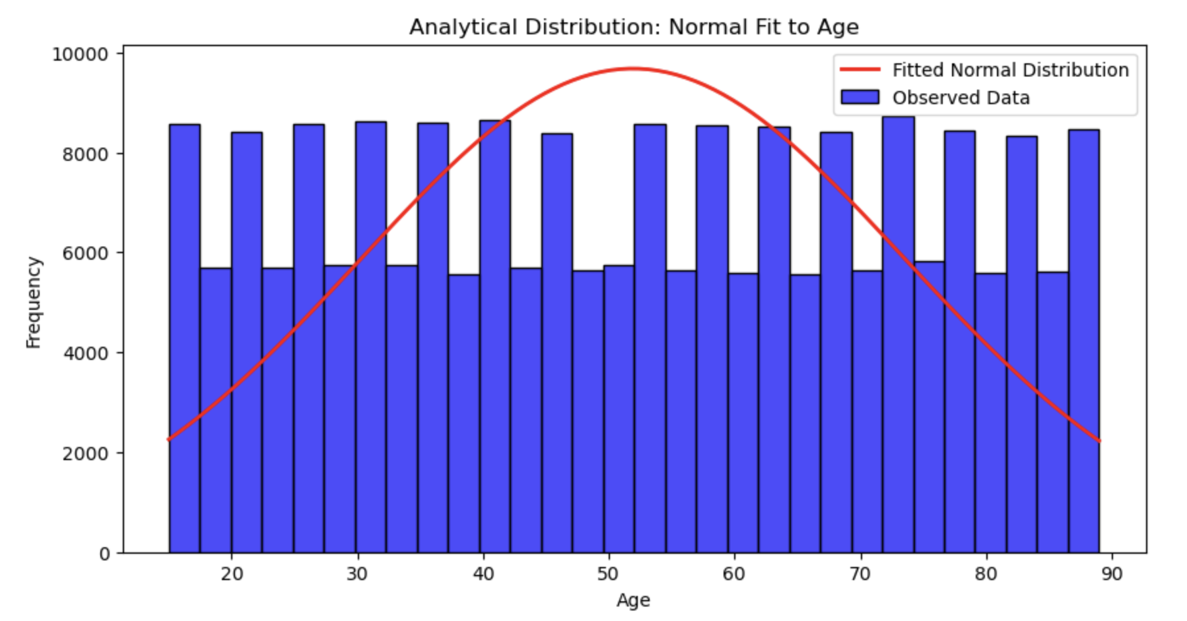
Analytical Distribution of Age

Slide 21
Analytical Distribution of Age
The normal distribution fit to Age helps assess whether age follows a standard normal curve.
Key Insights:
- The mean age is around 52 years, with most values falling within two standard deviations. - There are outliers at younger and older ages, but they do not significantly impact the overall distribution. - The observed data does not perfectly match a normal distribution, suggesting that age is not normally distributed in this dataset. - Since age was not a strong predictor in logistic regression, it may not be a key risk factor for thyroid cancer.

Slide 22
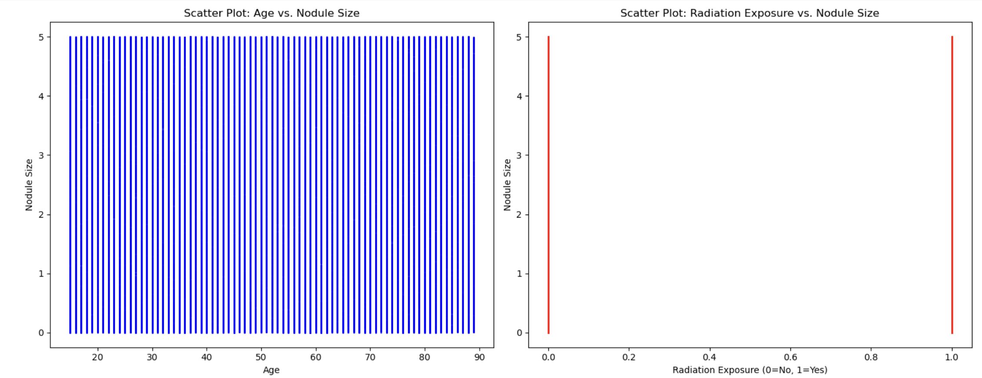
Scatter Plots: Correlation Analysis

Slide 23
Scatter Plots: Correlation Analysis
Scatter plots help visualize relationships between numerical variables to determine if there is correlation or causation.
Scatter Plot: Age vs. Nodule Size
- Observations:
No strong correlation is observed between age and nodule size.
This suggests that age does not directly impact the likelihood of developing larger nodules.

Slide 24
Scatter Plots: Correlation Analysis
Scatter Plot: Radiation Exposure vs. Nodule Size
- Observations:
Radiation exposure does not significantly impact nodule size.
However, Chi-square testing confirms a strong association between radiation exposure and malignancy.

Slide 25
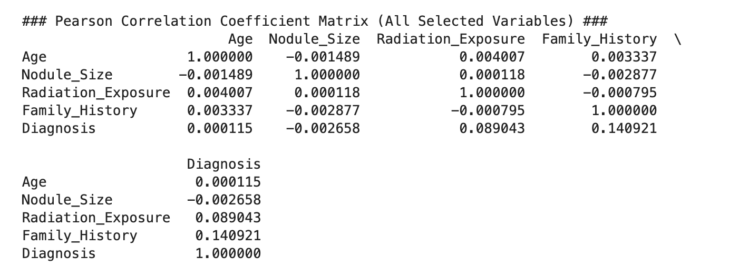
Pearson Correlation Coefficient

Slide 26
Pearson Correlation Coefficient
Insights & Interpretation:
1. Age is NOT correlated with thyroid cancer (0.0001). Older or younger individuals have similar risks, so age alone is not a strong predictor.
2. Nodule Size has NO correlation with Diagnosis (-0.0027). Larger nodules do not necessarily indicate higher cancer risk, contradicting common assumptions.
3. Radiation Exposure has a WEAK positive correlation (0.0890). Higher radiation exposure slightly increases the likelihood of thyroid cancer, but not strongly.
4. Family History is the STRONGEST predictor (0.1409). Having a family history of thyroid cancer significantly increases the risk.

Slide 27
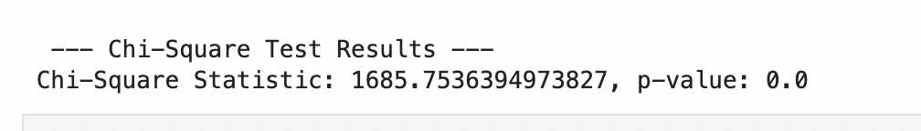
Hypothesis Testing (Chi-Square Test)

Slide 28
Hypothesis Testing (Chi-Square Test)
Chi-square Statistic: 1685.75
p-value: 0.0 (Highly Significant)
Conclusion:
- Since p < 0.05, we reject the null hypothesis
- This confirms that Radiation Exposure is significantly associated with Thyroid Cancer Risk.

Slide 29
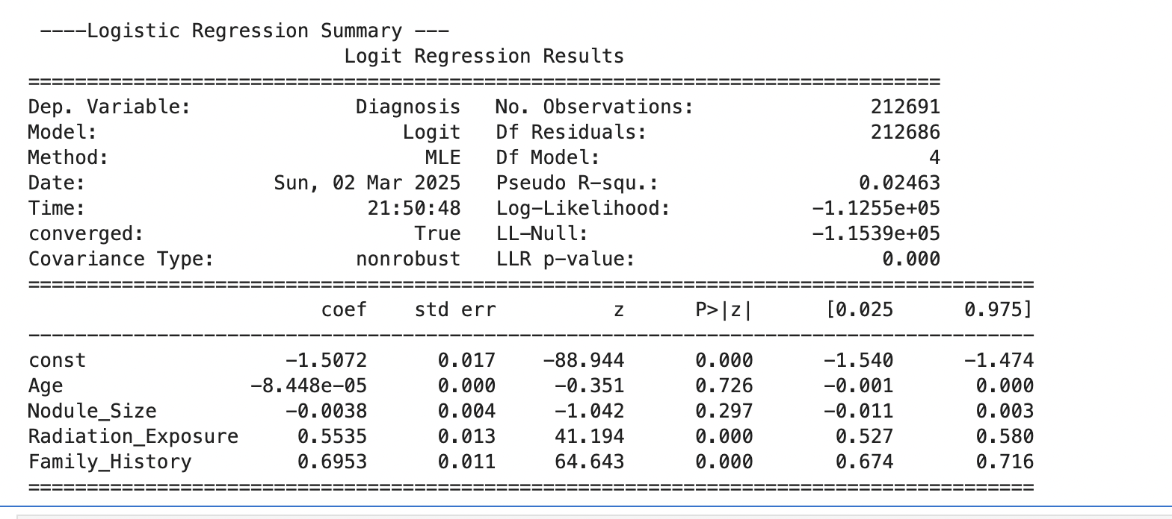
Regression Analysis (Logistic Regression)

Slide 30
Regression Analysis (Logistic Regression)
Logistic Regression Model was used to analyze the impact of selected variables on Thyroid Cancer Diagnosis.
Key Findings:
- Radiation Exposure(p = 0.000) → Highly significant predictor.
- Family History (p = 0.000) → Strong genetic predictor.
- Age (p = 0.726) and Nodule Size (p = 0.297) were NOT significant predictors.
- Model Pseudo R²: 0.0246, suggesting additional factors need to be considered for better accuracy.

Slide 31
Regression Analysis (Logistic Regression)
Key Findings:
- Radiation Exposure and Family History are the strongest predictors of thyroid cancer (p < 0.05). - Age and Nodule Size were NOT statistically significant predictors, meaning they do not strongly influence cancer risk in this dataset. - The model has a Pseudo R² of 0.0246, indicating that additional factors should be considered for better prediction accuracy.

Slide 32
Final Conclusion
Key Takeaways:
Radiation Exposure significantly increases thyroid cancer risk.
Family History is a strong genetic predictor of malignancy.
Age and Nodule Size do not significantly impact cancer risk.
Future studies should explore additional genetic, lifestyle, and environmental factors.

Slide 33
Future Considerations
Recommendations:
Further genetic research is needed to understand hereditary cancer risks.
Incorporate additional environmental and lifestyle variables into models.
Investigate machine learning models for better predictive accuracy.

