Slide 1
Building Machines to Represent Quantum States
Gregory Crosswhite
Univ. of Washington, Dept. Physics

Slide 3
Outline
Motivation: Quantum States are HUGE
1D -- Finite State Automata
2D -- Quadapolic Picture Automata (2005)

Slide 4
Quantum states are HUGE
Classical system: 8 bits

Slide 5
Quantum states are HUGE
Product system: 8 numbers

Slide 6
Quantum states are HUGE
NAIVE
Entangled system: 2⁸ complex numbers
(only 16 of 256 shown here!)

Slide 7
W state
(O(N) size definition)

Slide 8
W state
A linear combination of all states with one and only one particle spin-down, and the rest spin-up.
(O(1) size definition)

Slide 9


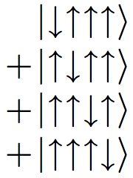
basis

Slide 10

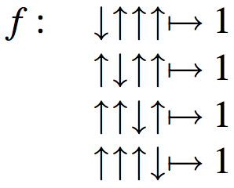
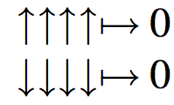
basis
alphabet

Slide 11

Simplified formalism…
How can we characterize
the set of strings which is
“accepted” by this function?
In the case of the W-state,
this is the set of strings
with exactly one down
arrow symbol.

Slide 12



Slide 13
transitions
start
state
accept
state

Slide 14


Slide 35


Slide 44
???

Slide 46


Slide 50


Slide 61
Formalism
Alphabet
Set of states
Transition rules
Starting state
Accept state(s)

Slide 62
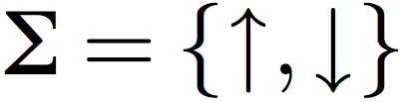

Slide 63
1

Slide 64
2

Slide 65
3

Slide 66
4

Slide 67
5

Slide 69
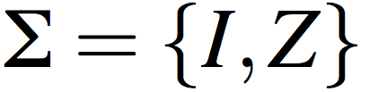
I
I
Z

Slide 70
I
I
Z
I I I I Z I I I I

Slide 71
I
I
Z
I I I I Z I I I I

Slide 72
I
I
Z
I I I I Z I I I I

Slide 73
I
I
Z
I I I I Z I I I I

Slide 74
I
I
Z
I I I I Z Z I I I I ?

Slide 75
I
I
Z
Z
I I I I Z Z I I I I

Slide 76
I
I
Z
Z
I I I I Z Z I I I I

Slide 77
I
I
Z
Z
I I I I Z Z I I I I

Slide 78
I
I
Z
Z
I I I I Z Z I I I I

Slide 79
I
I
Z
Z
I I I I Z Z I I I I

Slide 80
I
I
Z
Z
I I I I Z Z I I I I

Slide 81
X X
Z Z
X X
Z Z
X
I
X
I
I
Z
Z

Slide 82
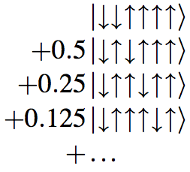
But what about the weights?

Slide 84


RULE: The weight assigned to a string is the product of all the factors along the path.

Slide 85
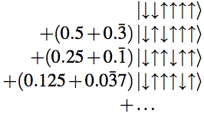

RULE: The weight assigned to a string is the sum of the of the weight of all possible paths through the automata, where each path has a weight equal to the product of weights along it.

Slide 87
1
1
1
1
2
2
2
2

Slide 88
1
1
1
1
2
2
2
2

Slide 89
1
1
1
1
2
2
2
2

Slide 90
1
1
1
1
2
2
2
2

Slide 91
1
1
1
1
2
2
2
2

Slide 92
1
1
1
1
2
2
2
2

Slide 93
1
1
1
1
2
2
2
2
0
1
0
0
0
0
1

Slide 94
1
1
1
1
2
2
2
2
0
1
0
0
0
0
1
L
A
B
C
R

Slide 95
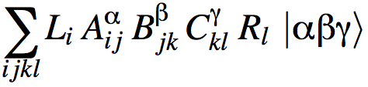
1
1
1
1
2
2
2
2
0
1
0
0
0
0
1
L
A
B
C
R

Slide 96
1
1
1
1
2
2
2
2
1
2
1
0
1
0
2
0
0
0
1
L
A
B
C
R

Slide 97
1
1
1
1
2
2
2
2
1
2
1
0
1
0
2
0
0
0
1
L
A
B
C
R

Slide 98
1
1
1
1
2
2
2
2
1
2
1
0
1
0
2
0
0
0
1
L
A
B
C
R

Slide 99
1
1
1
1
2
2
2
2
1
2
1
0
1
0
2
0
0
0
1
L
A
B
C
R

Slide 100
1
1
1
1
2
2
2
2
1
2
1
0
1
0
2
0
0
0
1
L
A
B
C
R

Slide 101
1
1
1
1
2
2
2
2
0
1
0
0
0
0
1
L
A
B
C
R

Slide 102
i
j
k
l
i
j
k
l
0
1
0
0
0
0
1
L
A
B
C
R

Slide 103
i
j
k
l
i=1
j=1
k=2
l=2
i
j
k
l
0
1
0
0
0
0
1
L
A
B
C
R

Slide 104
i
j
k
l
i=1
k=1
j=2
l=2
i
j
k
l
0
1
0
0
0
0
1
L
A
B
C
R

Slide 105
i
j
k
l
i
j
k
l
0
1
0
0
0
0
1
L
A
B
C
R

Slide 106
Outline
Motivation: Quantum States are HUGE
1D -- Finite State Automata
2D -- Quadapolic Picture Automata (2005)
(a.k.a. Finite Signaling Agents)
Mäurer, I. Characterizations of recognizable picture series. Theoretical Computer Science 374 (2007) 214-228

Slide 107
Two Dimensions
I
I
I
I
I
I
Z
I
I
I
I
I
I
I
I
I
I
I
I
I
I
I
I
I
I

Slide 108
Two Dimensions
I
I
I
I
I
I
Z
I
I
I
I
I
I
I
I
I
I
I
I
I
I
I
Z
I
I
I
I
I

Slide 109
Two Dimensions
I
I
I
I
I
I
Z
I
I
I
I
I
I
Z
I
I
I
I
I
I
I
I
Z
I
I
I
I
I

Slide 110
Two Dimensions
I
Z
I
I
I
I
I
I
I
Z
I
I
I
I
I
Z
I
I
I
I
I
I
I
I
I
I
I
I
I
I
I
I
Z

Slide 111
Two Dimensions
I
Z
I
I
I
I
I
I
I
I
Z
I
I
I
I
I
I
Z
I
I
I
I
I
I
I
I
I
I
I
I
I
I
I
I
I
I
I
I
Z
I
I
I
I
I
I

Slide 112
Two Dimensions
I
I
I
I
I
Z
I
I
I
Z
I
I
I
I
I
I

Slide 113
Two Dimensions
I
I
I
I
I
Z
I
I
I
Z
I
I
I
I
I
I

Slide 114
I
I
Z

Slide 115
Signal Response Table
I
I
Z

Slide 116
Signal Response Table
I
I
Z

Slide 117
Signal Response Table
I
I
Z

Slide 118
Signal Response Table
I
I
I
Z

Slide 119
Signal Response Table
I
I
I
Z
Z

Slide 120
Signal Response Table
I
I
I
Z
Z
I

Slide 121
Signal Response Table
I
I
I
Z
Z
I
I
Z
I
I

Slide 122
Signal Response Table
I
I
I
Z
Z
I
I
I
I
Z
I
I
Z
I

Slide 123
I
I
I
I
I
I
I
I
I
Z
I
I
I
I
I
I
Signal Response Table
I
Z
I

Slide 124
I
I
I
I
I
I
I
I
I
Z
I
I
I
I
I
I
Signal Response Table
I
Z
I

Slide 125
I
I
I
I
I
I
I
I
I
Z
I
I
I
I
I
I
Signal Response Table
I
Z
I
I
I

Slide 126
I
I
Z
I
I
I
I
I
I
Z
I
I
I
I
I
I
Signal Response Table
I
Z
I
I
I

Slide 127
I
I
I
I
I
I
I
I
I
Z
I
I
I
I
I
I
Signal Response Table
I
Z
I
I
I

Slide 128
I
I
I
I
I
I
I
I
I
Z
I
I
I
I
I
I
Signal Response Table
I
Z
I
I
I

Slide 129
I
I
Z
I
I
I
I
I
I
Z
I
I
I
I
I
I
Signal Response Table
I
Z
I
I
I

Slide 130
I
I
Z
I
I
I
I
I
I
Z
I
I
I
I
I
I
Signal Response Table
I
Z
I
I
I

Slide 131
Conclusions
Finite state machines can efficiently encode many classes of quantum states.
Recent work in simulations using matrix product states is deeply connected to fundamental ideas in computability.

Slide 132
Future Questions?
Can we go the opposite way, and use automata theory to improve simulations of quantum states?

Slide 133
Chomsky Hierarchy
Minimal Automaton
Formal Language
Turing Machine
Context-sensitive
Pushdown Automata
Context-free
Finite State Automata
Regular

