Slide 1

Building Machines to Represent Quantum States
Gregory Crosswhite

Slide 3
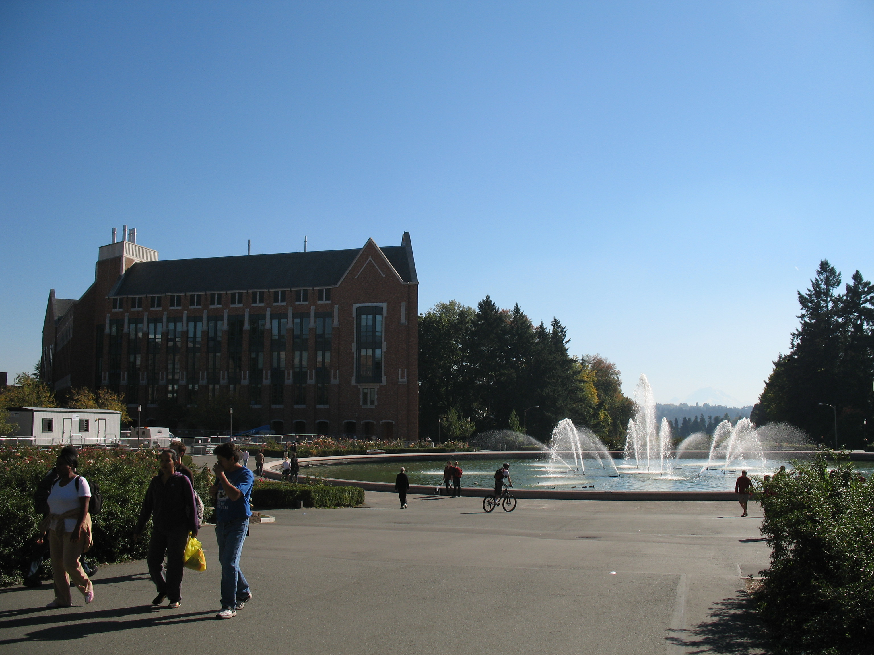

Slide 4
Outline
Motivation: Quantum States are HUGE
1D -- Finite State Automata
2D -- Finite Signaling Agents

Slide 5
Quantum states are HUGE
Classical system: 8 bits

Slide 6
Quantum states are HUGE
Separable system: 8 numbers

Slide 7
Quantum states are HUGE
Entangled system: 2⁸ complex numbers
(only 16 of 256 shown here!)

Slide 8
Quantum states are HUGE
NAIVE
Entangled system: 2⁸ complex numbers
(only 16 of 256 shown here!)

Slide 9
W state

Slide 10
W state
A linear combination of all states with one and only one particle spin-down, and the rest spin-up.
(O(1) size definition)

Slide 11



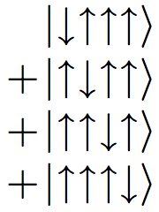
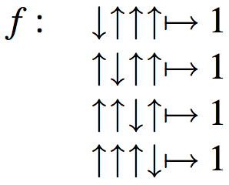
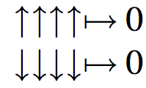
basis
alphabet

Slide 12

Even simpler…
How can we characterize
the set of strings which is
“accepted” by this function?

Slide 13


_x0004_
_x0004_

Slide 14
_x0004_
_x0004_
start
state
accept
state

Slide 15

_x0004_
_x0004_

Slide 16
_x0004_
_x0004_

Slide 17
_x0004_
_x0004_

Slide 18
_x0004_
_x0004_

Slide 19
_x0004_
_x0004_

Slide 20
_x0004_
_x0004_

Slide 21
_x0004_
_x0004_

Slide 22
_x0004_
_x0004_

Slide 23
_x0004_
_x0004_

Slide 24
_x0004_
_x0004_

Slide 25
_x0004_
_x0004_

Slide 26
_x0004_
_x0004_

Slide 27
_x0004_
_x0004_

Slide 28
_x0004_
_x0004_

Slide 29
_x0004_
_x0004_

Slide 30
_x0004_
_x0004_

Slide 31
_x0004_
_x0004_

Slide 32
_x0004_
_x0004_

Slide 33
_x0004_
_x0004_

Slide 34
_x0004_
_x0004_

Slide 35
_x0004_
_x0004_

Slide 36
_x0004_
_x0004_

Slide 37
_x0004_
_x0004_

Slide 38
_x0004_
_x0004_

Slide 39
_x0004_
_x0004_

Slide 40
_x0004_
_x0004_

Slide 41
_x0004_
_x0004_

Slide 42
_x0004_
_x0004_

Slide 43
_x0004_
_x0004_

Slide 44
_x0004_
_x0004_

Slide 45
_x0004_
_x0004_

Slide 46
_x0004_
_x0004_

Slide 47
_x0004_
_x0004_

Slide 48
_x0004_
_x0004_

Slide 49
_x0004_
_x0004_

Slide 50
_x0004_
_x0004_

Slide 51
_x0004_
_x0004_

Slide 52
_x0004_
_x0004_

Slide 53
_x0004_
_x0004_

Slide 54
_x0004_
_x0004_

Slide 55
_x0004_
_x0004_

Slide 56
_x0004_
_x0004_

Slide 57
_x0004_
_x0004_

Slide 58
_x0004_
_x0004_

Slide 59
_x0004_
_x0004_

Slide 60
_x0004_
_x0004_

Slide 61
_x0004_
_x0004_

Slide 62
_x0004_
_x0004_

Slide 63
_x0004_
_x0004_

Slide 64
_x0004_
_x0004_

Slide 65
_x0004_
_x0004_

Slide 66
_x0004_
_x0004_

Slide 67
_x0004_
_x0004_

Slide 68
_x0004_
_x0004_

Slide 69
_x0004_
_x0004_

Slide 70
_x0004_
_x0004_

Slide 71
_x0004_
_x0004_

Slide 72
_x0004_
_x0004_

Slide 73
_x0004_
_x0004_

Slide 74
_x0004_
_x0004_

Slide 75
_x0004_
_x0004_

Slide 76
_x0004_
_x0004_

Slide 77
_x0004_
_x0004_

Slide 78
_x0004_
_x0004_

Slide 79
_x0004_
_x0004_

Slide 80
_x0004_
_x0004_

Slide 81
_x0004_
_x0004_

Slide 82
_x0004_
_x0004_

Slide 83
_x0004_
_x0004_

Slide 84
_x0004_
_x0004_

Slide 85
_x0004_
_x0004_

Slide 86
_x0004_
_x0004_

Slide 87
_x0004_
_x0004_

Slide 88
_x0004_
_x0004_

Slide 89
_x0004_
_x0004_

Slide 90

_x0004_
_x0004_

Slide 91
_x0004_
_x0004_

Slide 92
_x0004_
_x0004_

Slide 93
_x0004_
_x0004_

Slide 94
_x0004_
_x0004_

Slide 95
_x0004_
_x0004_

Slide 96
_x0004_
_x0004_

Slide 97
_x0004_
_x0004_

Slide 98
_x0004_
_x0004_

Slide 99
_x0004_
_x0004_

Slide 100
_x0004_
_x0004_

Slide 101
_x0004_
_x0004_

Slide 102
_x0004_
_x0004_

Slide 103
_x0004_
_x0004_

Slide 104
_x0004_
_x0004_

Slide 105
_x0004_
_x0004_

Slide 106
_x0004_
_x0004_

Slide 107
_x0004_
_x0004_

Slide 108
_x0004_
_x0004_

Slide 109
_x0004_
_x0004_

Slide 110
_x0004_
_x0004_

Slide 111
_x0004_
_x0004_

Slide 112
_x0004_
_x0004_

Slide 113
_x0004_
_x0004_

Slide 114
_x0004_
_x0004_

Slide 115
_x0004_
_x0004_

Slide 116
_x0004_
_x0004_

Slide 117
_x0004_
_x0004_
WTF???

Slide 118
_x0004_
_x0004_

Slide 119
_x0004_
_x0004_

Slide 120
_x0004_
_x0004_

Slide 121
_x0004_
_x0004_

Slide 122
_x0004_
_x0004_

Slide 123
_x0004_
_x0004_

Slide 124
_x0004_
_x0004_

Slide 125
_x0004_
_x0004_

Slide 126
_x0004_
_x0004_

Slide 127
_x0004_
_x0004_

Slide 128
_x0004_
_x0004_

Slide 129
_x0004_
_x0004_

Slide 130
_x0004_
_x0004_

Slide 131
_x0004_
_x0004_

Slide 132
_x0004_
_x0004_

Slide 133
_x0004_
_x0004_

Slide 134
_x0004_
_x0004_

Slide 135
_x0004_
_x0004_

Slide 136

_x0004_
_x0004_

Slide 137
_x0004_
_x0004_

Slide 138
_x0004_
_x0004_

Slide 139
_x0004_
_x0004_

Slide 140
_x0004_
_x0004_

Slide 141
_x0004_
_x0004_

Slide 142
_x0004_
_x0004_

Slide 143
_x0004_
_x0004_

Slide 144
_x0004_
_x0004_

Slide 145
_x0004_
_x0004_

Slide 146
_x0004_
_x0004_

Slide 147
_x0004_
_x0004_

Slide 148
_x0004_
_x0004_

Slide 149
_x0004_
_x0004_

Slide 150
_x0004_
_x0004_

Slide 151
_x0004_
_x0004_

Slide 152
_x0004_
_x0004_

Slide 153
_x0004_
_x0004_

Slide 154
_x0004_
_x0004_

Slide 155
_x0004_
_x0004_

Slide 156
_x0004_
_x0004_

Slide 157
_x0004_
_x0004_

Slide 158
_x0004_
_x0004_

Slide 159
_x0004_
_x0004_

Slide 160
_x0004_
_x0004_

Slide 161
_x0004_
_x0004_

Slide 162
_x0004_
_x0004_

Slide 163
_x0004_
_x0004_

Slide 164
_x0004_
_x0004_

Slide 165
_x0004_
_x0004_

Slide 166
_x0004_
_x0004_

Slide 167
_x0004_
_x0004_

Slide 168
Formalism
Alphabet
Set of states
Transitions rules
Starting state
Accept state(s)

Slide 169
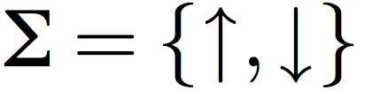
_x0004_
_x0004_

Slide 170
1
_x0004_
_x0004_

Slide 171
2
_x0004_
_x0004_

Slide 172
3
_x0004_
_x0004_

Slide 173
4
_x0004_
_x0004_

Slide 174
5
_x0004_
_x0004_

Slide 175
_x0004_
_x0004_

Slide 176
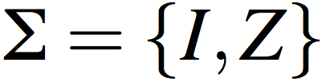
I
I
_x0004_
_x0004_
Z

Slide 177
I
I
_x0004_
_x0004_
Z
I I I I Z I I I I

Slide 178
I
I
_x0004_
_x0004_
Z
I I I I Z I I I I

Slide 179
I
I
_x0004_
_x0004_
Z
I I I I Z I I I I

Slide 180
I
I
_x0004_
_x0004_
Z
I I I I Z I I I I

Slide 181
I
I
_x0004_
_x0004_
Z
I I I I Z Z I I I I ?

Slide 182
I
I
_x0004_
_x0004_
_x0004_
Z
Z
I I I I Z Z I I I I

Slide 183
I
I
_x0004_
_x0004_
_x0004_
Z
Z
I I I I Z Z I I I I

Slide 184
I
I
_x0004_
_x0004_
_x0004_
Z
Z
I I I I Z Z I I I I

Slide 185
I
I
_x0004_
_x0004_
_x0004_
Z
Z
I I I I Z Z I I I I

Slide 186
I
I
_x0004_
_x0004_
_x0004_
Z
Z
I I I I Z Z I I I I

Slide 187
I
I
_x0004_
_x0004_
_x0004_
Z
Z
I I I I Z Z I I I I

Slide 188
X X
Z Z
X X
Z Z
X
I
X
I
I
Z
Z

Slide 189
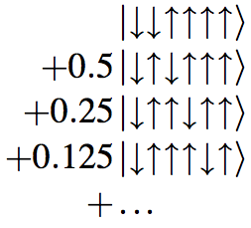
But what about the weights?

Slide 191


RULE: The weight assigned to a string is the product of all the factors along the path.

Slide 192
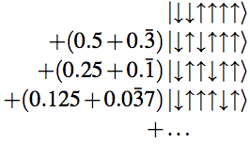

RULE: The weight assigned to a string is the sum of the of the weight of all possible paths through the automata, where each path has a weight equal to the product of weights along it.

Slide 194
1
2

Slide 195
1
1
1
1
2
2
2
2

Slide 196
1
1
1
1
2
2
2
2
0
1
0
0
0
0
1

Slide 197
1
1
1
1
2
2
2
2
1
2
1
0
1
0
2
0
0
0
1

Slide 198
1
1
1
1
2
2
2
2
1
2
1
0
1
0
2
0
0
0
1

Slide 199
1
1
1
1
2
2
2
2
1
2
1
0
1
0
2
0
0
0
1

Slide 200
1
1
1
1
2
2
2
2
1
2
1
0
1
0
2
0
0
0
1

Slide 201
1
1
1
1
2
2
2
2
1
2
1
0
1
0
2
0
0
0
1

Slide 202
1
1
1
1
2
2
2
2
0
1
0
0
0
0
1

Slide 203
1
1
1
1
2
2
2
2
0
1
0
0
0
0
1
L
A
B
C
R

Slide 204
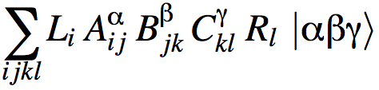
1
1
1
1
2
2
2
2
0
1
0
0
0
0
1
L
A
B
C
R

Slide 205
i
j
k
l
i
j
k
l
0
1
0
0
0
0
1
L
A
B
C
R

Slide 206
i=1
i
j
k
l
i=2
i
j
k
l
0
1
0
0
0
0
1
L
A
B
C
R

Slide 207
Outline
Motivation: Quantum States are HUGE
1D -- Finite State Automata
2D -- Finite Signaling Agents

Slide 208
Outline
Motivation: Quantum States are HUGE
1D -- Finite State Automata
2D -- Finite Signaling Agents

Slide 209
Outline
Motivation: Quantum States are HUGE
1D -- Finite State Automata
2D -- Finite Signaling Agents

Slide 210
Two Dimensions
I
I
I
I
I
I
Z
I
I
I
I
I
I
I
I
I
I
_x0004_
_x0004_
I
I
I
I
I
Z
I
I
I
I
I

Slide 211
Two Dimensions
I
Z
_x0004_
I
I
I
I
I
_x0004_
I
I
Z
I
I
I
_x0004_
I
I
Z
I
I
I
_x0004_
I
I
I
I
I
I
I
I
I
I
I
_x0004_
I
I
Z
_x0004_
_x0004_
_x0004_

Slide 212
Two Dimensions
I
Z
_x0004_
I
I
I
I
I
I
_x0004_
I
I
Z
I
I
I
I
I
_x0004_
I
Z
I
I
I
I
I
_x0004_
I
I
I
I
I
I
I
_x0004_
I
I
I
I
I
I
I
_x0004_
I
Z
I
I
I
I
I
I
_x0004_
_x0004_
_x0004_

Slide 213
Two Dimensions
I
I
I
I
I
Z
I
I
I
Z
I
I
I
I
I
I

Slide 214
Two Dimensions
I
I
I
I
I
Z
I
I
I
Z
I
I
I
I
I
I

Slide 215
I
I
_x0004_
_x0004_
Z

Slide 216
I
I
_x0004_
_x0004_
Z

Slide 217
I
I
_x0004_
_x0004_
Z

Slide 218
Signal Response Table
I
I
_x0004_
_x0004_
Z

Slide 219
Signal Response Table
I
I
I
_x0004_
_x0004_
Z

Slide 220
Signal Response Table
I
I
I
_x0004_
_x0004_
Z
Z

Slide 221
Signal Response Table
I
I
I
_x0004_
_x0004_
Z
Z
I

Slide 222
Signal Response Table
I
I
I
_x0004_
_x0004_
Z
Z
I
I
Z
I
I

Slide 223
Signal Response Table
I
I
I
_x0004_
_x0004_
Z
Z
I
I
Z
I
I

Slide 224
I
I
I
I
I
I
I
I
I
Z
I
I
I
I
I
I
Signal Response Table
I
Z
I

Slide 225
I
I
I
I
I
I
I
I
I
Z
I
I
I
I
I
I
Signal Response Table
I
Z
I

Slide 226
I
I
I
I
I
I
I
I
I
Z
I
I
I
I
I
I
Signal Response Table
I
Z
I
I
I

Slide 227
I
I
Z
I
I
I
I
I
I
Z
I
I
I
I
I
I
Signal Response Table
I
Z
I
I
I

Slide 228
I
I
I
I
I
I
I
I
I
Z
I
I
I
I
I
I
Signal Response Table
I
Z
I
I
I

Slide 229
I
I
Z
I
I
I
I
I
I
Z
I
I
I
I
I
I
Signal Response Table
I
Z
I
I
I

Slide 230
I
I
Z
I
I
I
I
I
I
Z
I
I
I
I
I
I
Signal Response Table
I
Z
I
I
I

Slide 231
Conclusions
Finite state machines can efficiently encode many quantum states.
Recent work in simulations using matrix product states are deeply connected to fundamental ideas in computability.

Slide 232
Future Questions?
Can we go the opposite way, and use automata theory to improve simulations of quantum states?

Slide 233
Chomsky Hierarchy
Minimal Automaton
Formal Language
Turing Machine
Context-sensitive
Pushdown Automata
Context-free
Finite State Automata
Regular

