Slide 1



League of Legends SoloQ matches at 15 minutes 2024
Realizado pelos alunos do grupo A2_71: António Rego – up202108666
Daniel Bernardo – up202108667 Gonçalo Martins – up202108707

Slide 2
Specification of the work to be performed
About the Dataset
This dataset contains data about the first 15 minutes of gameplay for over 24 thousand solo queue matches taken from European servers (EUNE and EUW).
Average ELO of the matches is between mid emerald to high diamond, which is around the top 10% of players.
The main purpose of the dataset is to help train models to predict the winner based on how the first 15 minutes of the match played out.
There are 14 features for red, and 14 features for the blue team (feature blueTeamFirstBlood counts for both teams since it tells us which team got the first kill), with the target feature being blueWin, a Boolean value where blueWin == 1 indicates a victory of the blue team and blueWin == 0 means that the red team won.
There should be no missing values.

Slide 3
Specification of the work to be performed
Feature explanations
matchId - ID of the match
blueTeamControlWardsPlaced - control/pink wards placed by the blue team (can have outliers)
blueTeamWardsPlaced - all types of wards placed by the blue team
blueTeamTotalKills - total kills by the blue team, killing enemy champion generates gold and experience
blueTeamDragonKills - total dragon kills by the blue team, dragons give specific permanent buffs when killed and killing the 4th dragon gives the team dragon's soul
blueTeamHeraldKills - total herald kills by the blue team, herald helps destroying enemy buildings and pushing the lane
blueTeamTowersDestroyed - total towers destroyed by the blue team
blueTeamInhibitorsDestroyed - total inhibitors destroyed by the blue team
blueTeamTurretPlatesDestroyed - total turret/tower plates destroyed by the blue team
blueTeamFirstBlood - 1 blue team first blood, 0 red team first blood; first blood generates extra gold for the kill
blueTeamMinionsKilled - total minions killed by the blue team, minions generate gold and experience
blueTeamJungleMinions - total jungle minions killed by the blue team, only the jungle player gains xP.
blueTeamTotalGold - total gold earned by the blue team
blueTeamXp - total blue team experience
blueTeamTotalDamageToChamps - total damage done by the blue team to enemy champions
blueWin - 1 blue team win, 0 red team win

Slide 4
Documentation
The Dataset – League of Legends SoloQ matches at 15 minutes 2024 Dataset
How is League of Legends played? – Wikipedia
Where can I get League of Legends and official Information? – The Game’s Website
Pandas Documentation
NumPy Documentation

Slide 5
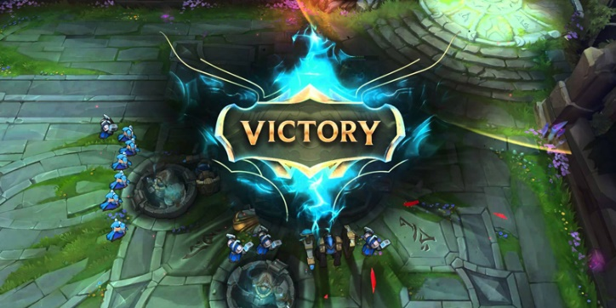

Tools and Algorithms
We used Pandas, NumPy, Pycaret, Matplotlib and seaborn as our tools for this project.
Decision Trees might be a good solution for us, based on the fact that the dataset has multiple statistics of the game and the final result. Could also have various ways of organizing the tree.
Ultimately, the goal is to discern correctly if a game, based on its 15 minute data, resulted in a win or not, and thus K-Nearest Neighbors and Support Vector Machines would also be good supervised learning algorithms to estimate results from given data.

Slide 6
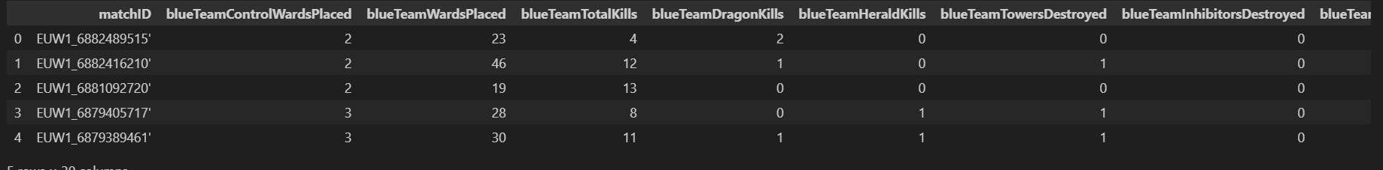
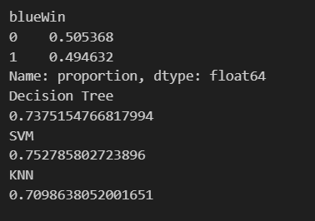
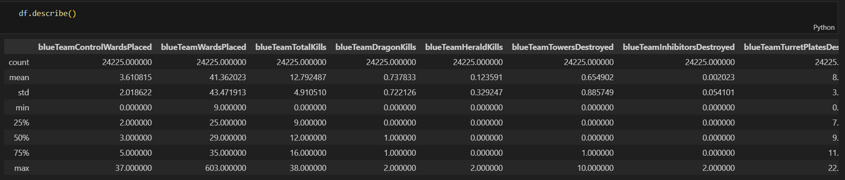
Data pre-processing
Initially, the dataset came without any headers and had an empty column with value 0 for every row, so we deleted that column and renamed the headers as it showed on the webpage.
Afterwards, we checked that there were no missing values in the dataset and calculated the accuracy for some models as a baseline.
We also analyzed the data itself and found some columns with very high values, compared to the mean and standard deviation, like the wardsPlaced column.
Therefore, we decided to do a boxplot of both teams wardsPlaced column to check how many outliers there are. (Next Slide)

Slide 7
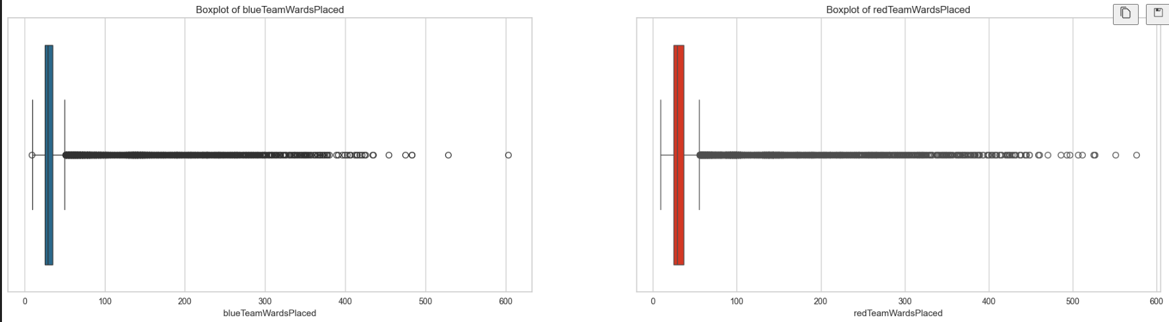
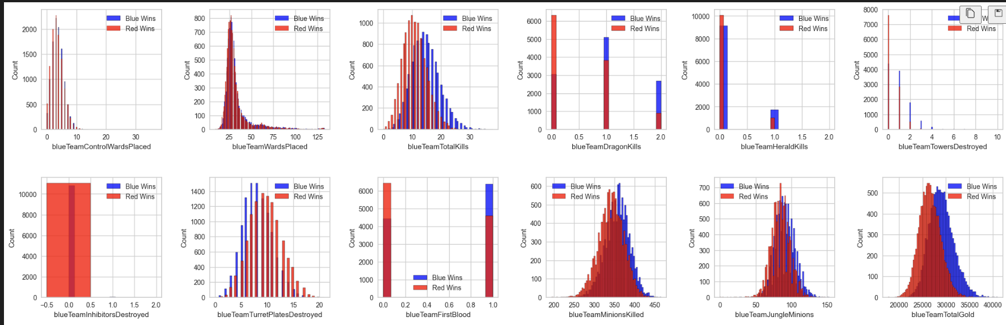
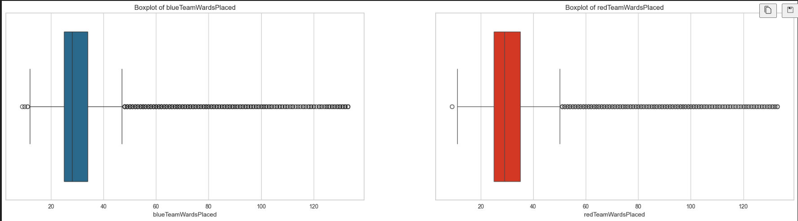
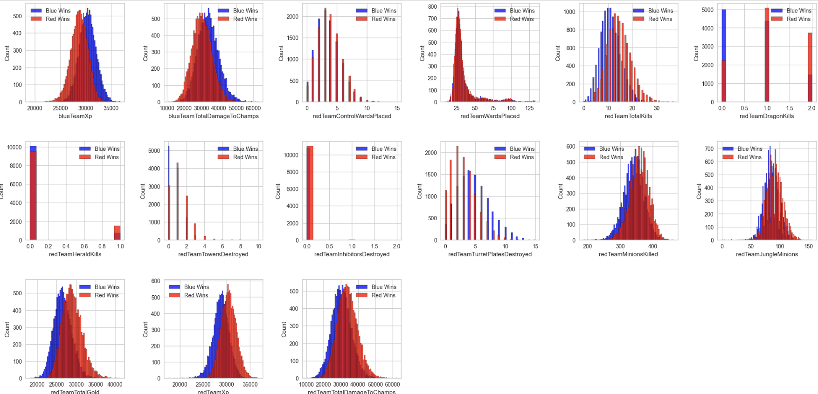
Data pre-processing
As demonstrated, there are a lot of outliers in both graphics, calculated according to the IQR method, which gave us roughly 6235 outliers (for both teams, which means some of them could be repeated rows). We decided to remove the top 5% of outliers, which eliminated circa 2400 lines from the dataset.
We also plotted some graphics to easily understand each feature.
At this point, we started to suspect there was something wrong with the platesDestroyed graphic… So we plotted the correlation heatmap to find out that the redTeamTurretPlatesDestroyed was closer to the blueWin being 1 than it being 0, and vice-versa, which could only mean that the columns were swapped.

