Slide 1


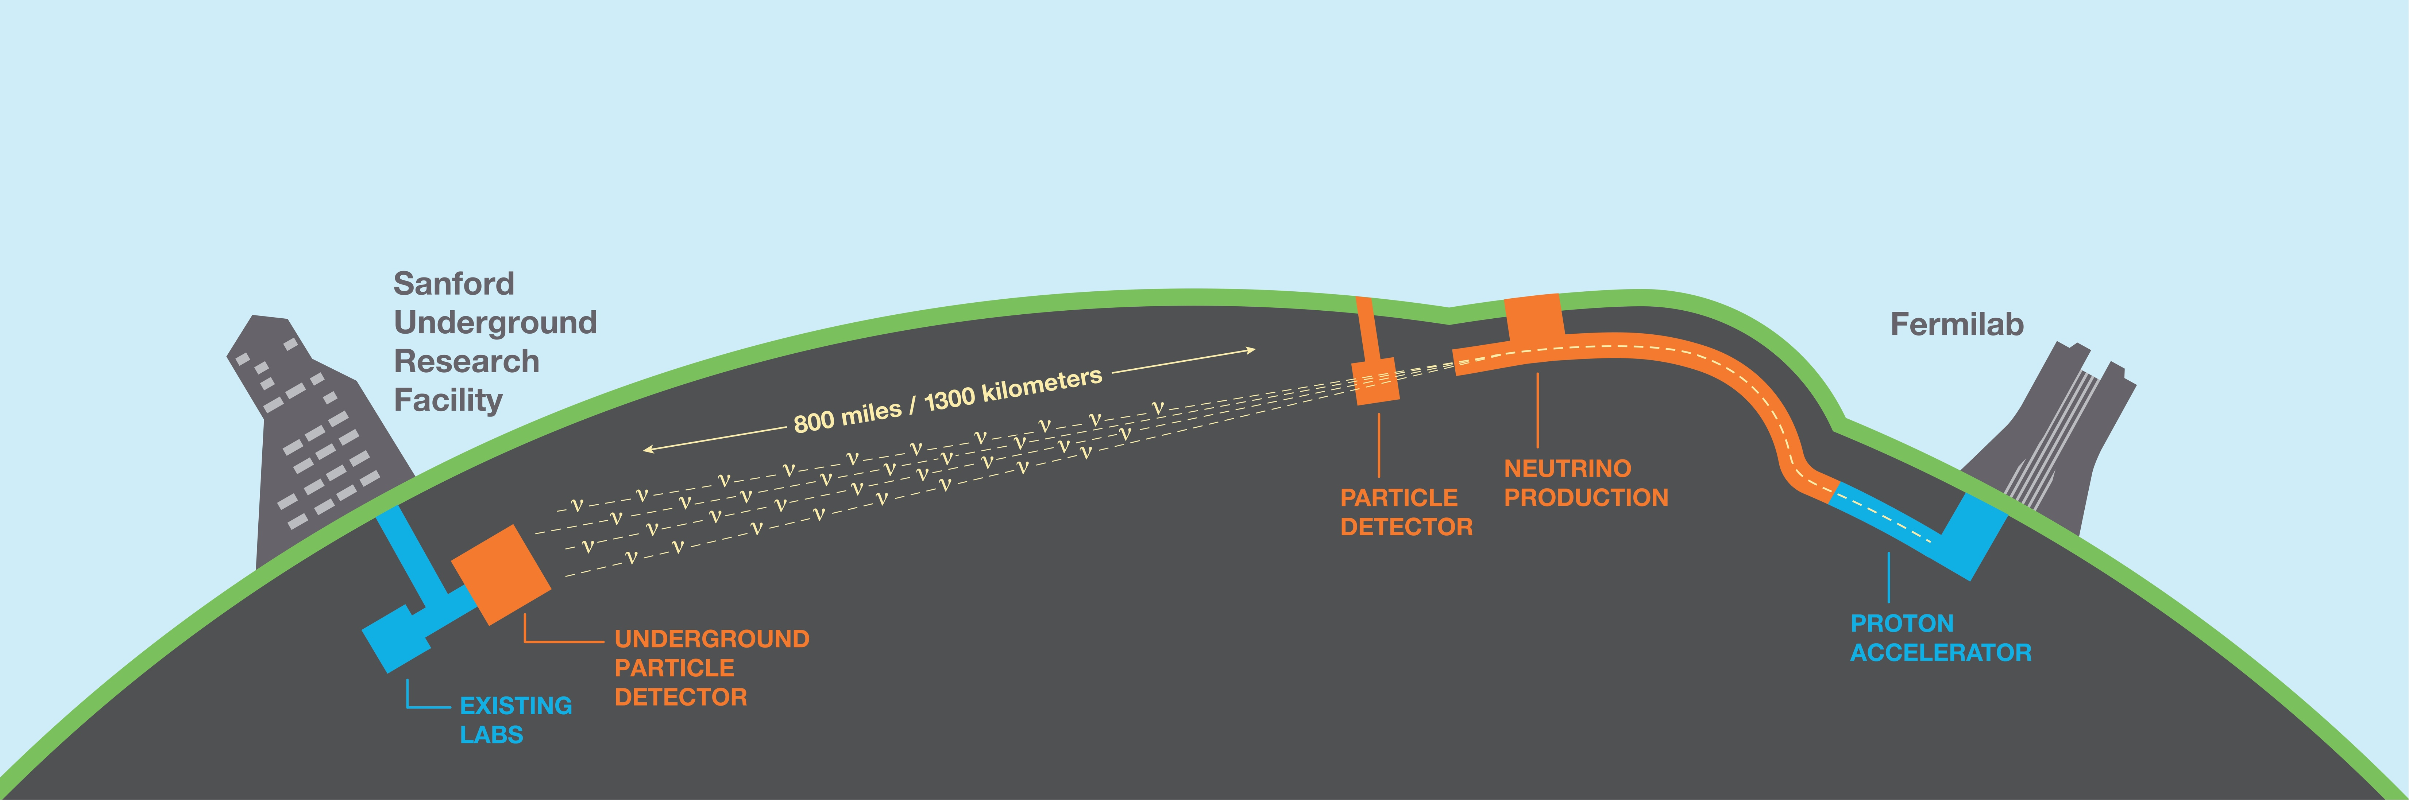
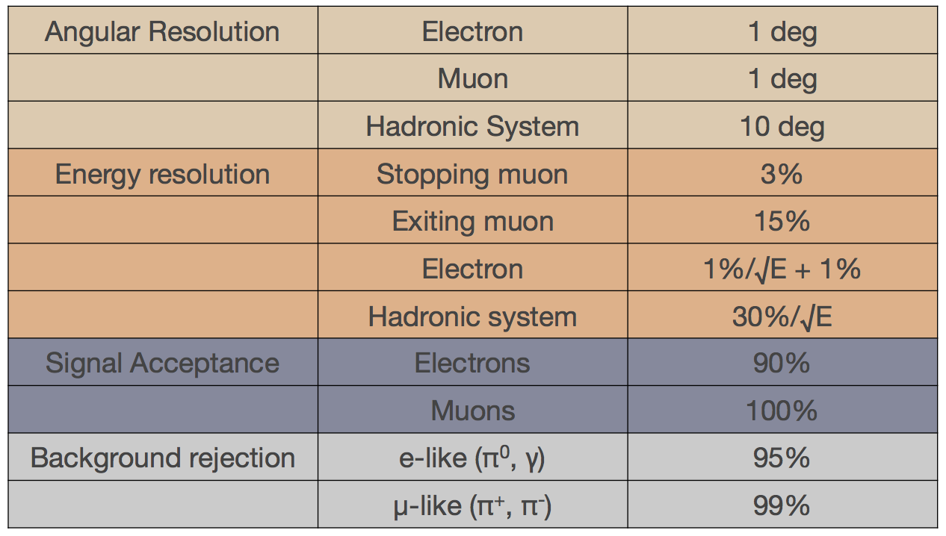

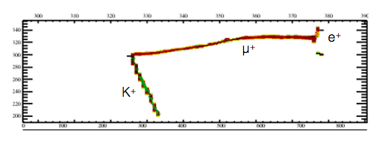
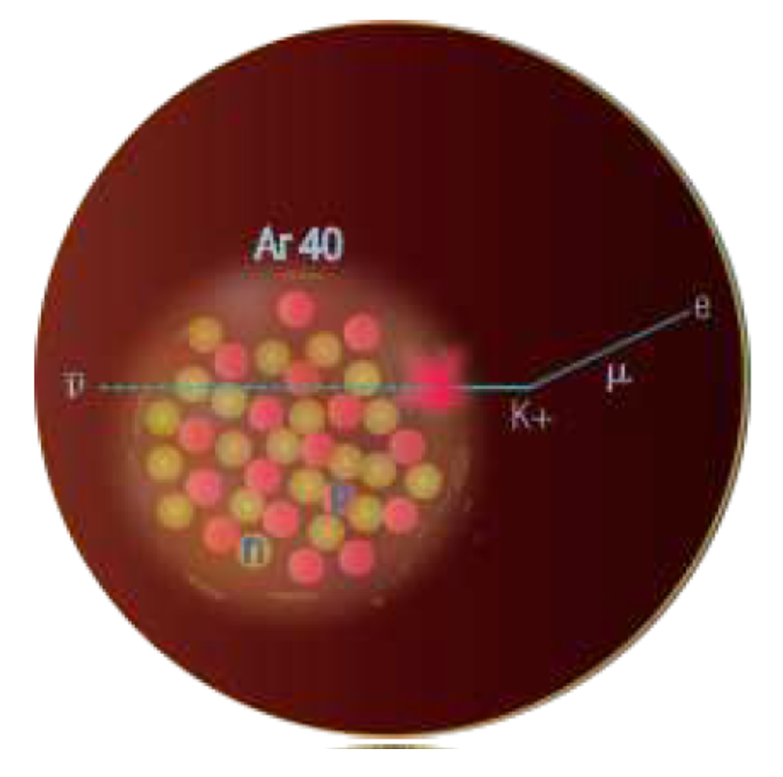
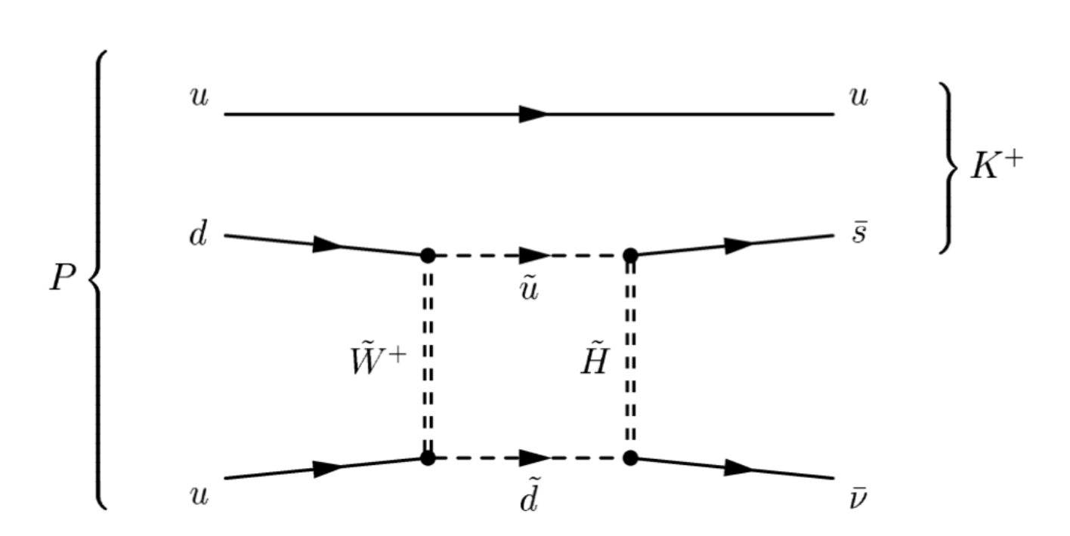
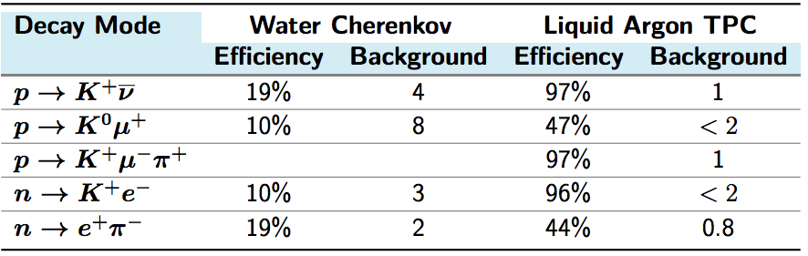
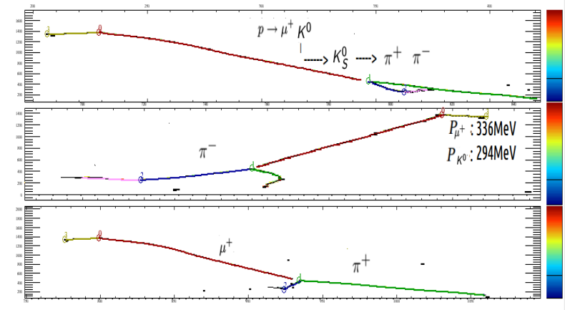
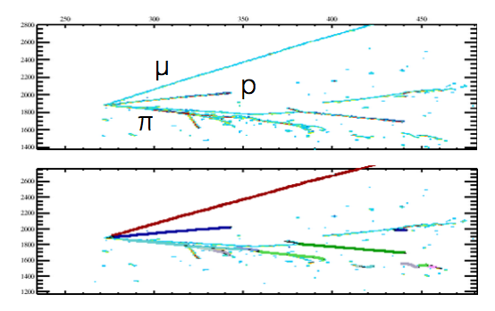
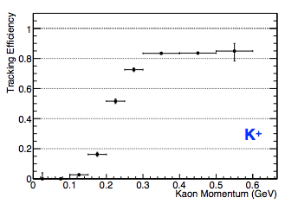
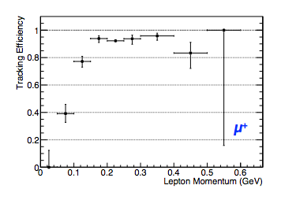
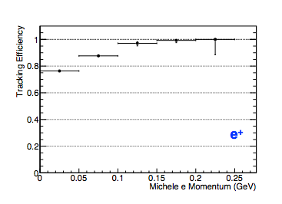
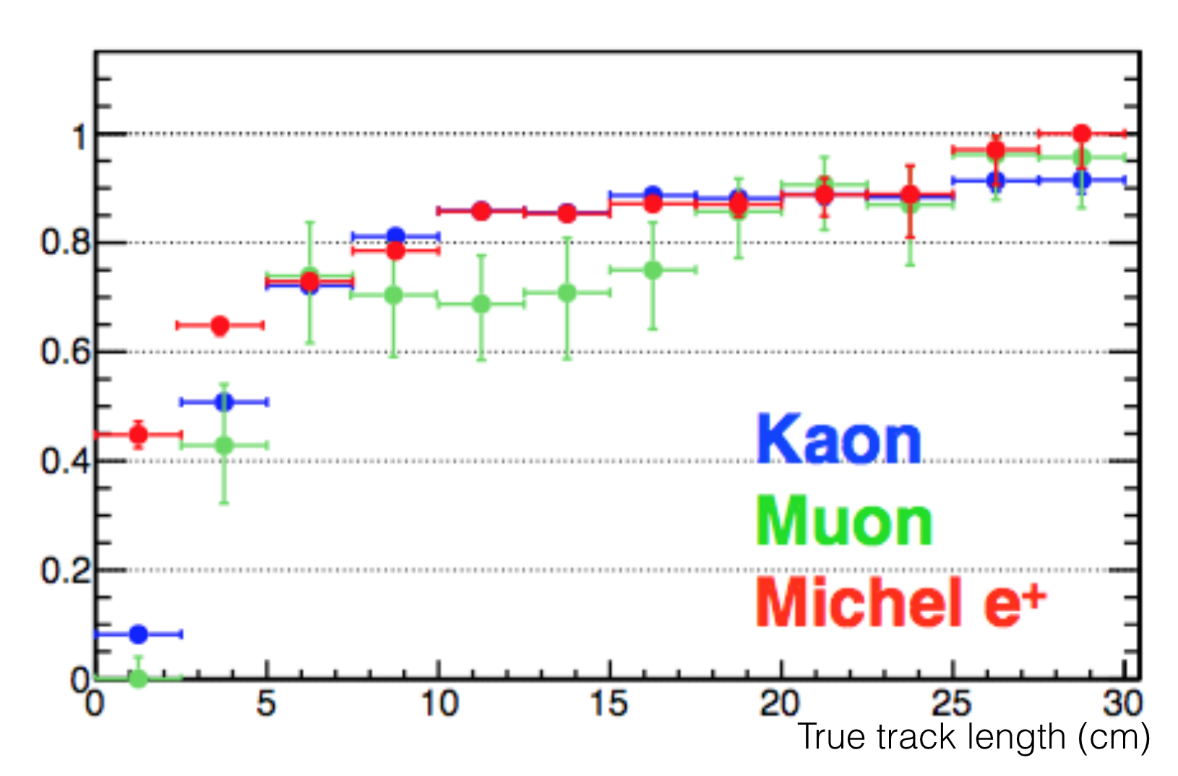
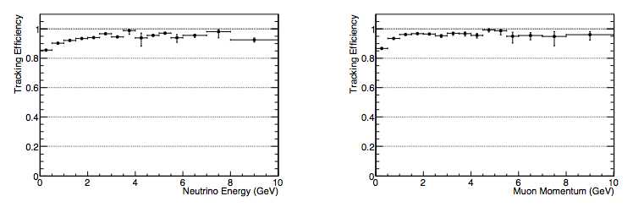
Nucleon Decay and Atmospheric Neutrino Event Reconstruction in DUNE
Gabriel Santucci¹ for the DUNE collaboration
¹ Dep. of Physics and Astronomy, Stony Brook University, Stony Brook, NY, USA
1. The Deep Underground Neutrino Experiment
An international collaboration of more than 800 scientists, hosted by Fermilab, has come together to develop the Deep Underground Neutrino Experiment. The DUNE collaboration and the Long-Baseline Neutrino Facility team will construct the neutrino beam line and the near and far detectors.
The DUNE far detector modules will be located deep underground at the Sanford Underground Research Facility in South Dakota. With 70 kton liquid Argon cryostats, 1,475 m underneath the surface, DUNE will be able to study atmospheric neutrino oscillations and perform low background searches of nucleon decay. The detector is particularly sensitive to the SUSY favored modes with kaons in the final state.
An experimental program in neutrinos, nucleon decay and astroparticle physics enabled by the Long-Baseline Neutrino Facility and hosted by Fermilab.
2. Motivation
3. Nucleon Decay
Initial DUNE results for atmospheric neutrinos and nucleon decay were obtained based on simplified assumptions of detector performances. In particular, the analyses used simple estimates for hadron/lepton direction and energy resolutions, signal efficiency, background rates and nu/nubar separation.
This work aims to validate these previous assumptions using fully simulated and reconstructed Monte Carlo events to evaluate signal efficiencies and background rejection power.
Grand Unified Theories predict the decay of protons and bound neutrons. The dominant proton decay mode in most supersymmetric GUTs is .
Estimated resolutions and efficiencies used in initial DUNE atmospheric neutrino analysis.
Event display for a golden event plus a graphical representation of the event and its Feynman diagram.
Most of the time, the kaon decays into an anti-muon and a neutrino, leaving a very clean signal in the detector (DUNE golden mode). The mono-energetic kaon has its momentum smeared by Fermi momenta of the nucleus, but the mono-energetic muon has a well defined momentum of 236 MeV for kaons decaying at rest. Thanks to high spatial resolution
Estimated event reconstruction efficiencies [1] used in initial DUNE nucleon decay analysis.
[1] A. Bueno et al., JHEP vol 0704 p. 041, 2007.
of the detector, DUNE can also identify neutral kaons through their displaced vertices (lepton plus neutral kaon modes).
h event rate.
4. Atmospheric Neutrinos
6. Preliminary Efficiencies
With energies spanning multiple decades and travel lengths from tens to thousands of km, atmospheric neutrinos are a rich source to study neutrino oscillations. They are also very useful in studying matter effects, the neutrino mass-hierarchy and the leptonic CP violating phase.
Proton Decay – DUNE Golden Mode
Work in Progress
Work in Progress
Work in Progress
Event display for a muon neutrino event.
Work in Progress
Reconstruction efficiencies as a function of true momenta and track length for DUNE golden mode.
The DUNE far detector (liquid Argon TPC) will offer excellent energy and angular resolutions together with excellent particle ID. Its large mass will provide high atmospheric event rates and the rock overburden will provide a shield against cosmic-rays, as is the case of nucleon decay analyses.
For higher energies, the present reconstruction is able to achieve high efficiencies similar to the one used in preliminary lifetime sensitivity studies for the golden mode (97%): .
5. ProtoDUNE
Atmospheric Neutrinos
The protoDUNE experimental program has been established to test and validate technologies and designs of the DUNE far detector. The detectors (single and dual phase) will be placed in a dedicated charged-particle beam line at CERN Neutrino Platform.
ProtoDUNE will be crucial for understanding nucleon decay and atmospheric neutrino event characteristics. Namely, the program will provide:
Particle ID performance: Full e/μ/π/K/p separation
Track/Shower reconstruction performance: Single particle reconstruction efficiency Displaced vertex reconstruction
Charged pions and kaons cross sections in Argon: Low kinetic energies (~100 MeV)
Track reconstruction efficiencies as a function of true neutrino and muon energies, respectively. Previous studies estimated ~100% efficiency for numu events.
Work in Progress
Work in Progress
7. Conclusions
DUNE recently started to fully simulate and reconstruct nucleon decay and atmospheric neutrino MC events in the far detector. Preliminary results show that for higher energies the efficiencies are already similar to the previous studies. There are ongoing efforts to optimize reconstruction efficiencies at lower energies.

