Slide 1
Digital Business and E-Commerce Management
Lesson 4
E-environment

Slide 2
E-environment
At the end of this lesson, you will be able to
Identify the different elements of an organization’s macro-environment that impact on an organization’s digital business and digital marketing strategy.
Assess the impact of legal, privacy and ethical constraints or opportunities on a company.
Assess the role of micro-economic factors such as economics, governmental digital business policies, taxation and legal constraints.

Slide 3
Activity 4.1
Refer to your book for Activity 4.1

Slide 4
Macro-environmental and Micro-environmental factors (SLEPT factors)
Social Factors
Legal and ethical factors
Economic factors
Political factors
Technological factors
These include the influence of consumer perception in determining the usage of the Internet for different activities
Methods by which products can be promoted and sold online.
Variations in the economic performance in different countries and regions affect spending patterns and international trade.
National governments and transnational organizations have an important role in determining the future adoption and control of the Internet
Changes in technology offer new opportunities to the way products can be marketed.

Slide 5
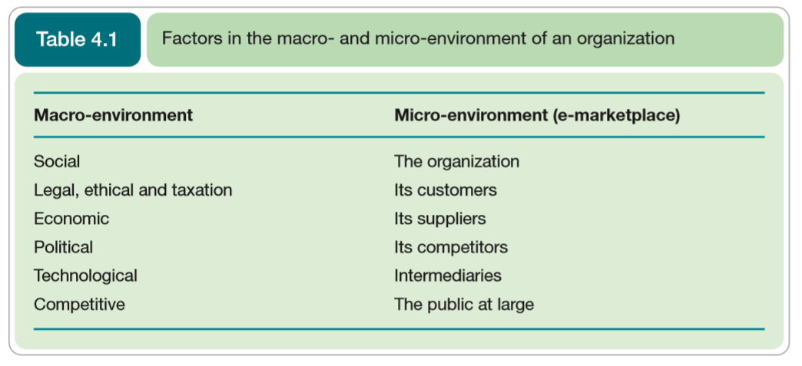
Factors in the macro-environment and macro-environment of an organization

Slide 6
Factors in the macro-environment and macro-environment of an organization
Changes in social culture and particularly pop culture tend to be very rapid
Introduction of new technologies and changes in their popularity tend to be frequent too.
Governmental and legal changes tend to happen over longer time-scales but new laws can be introduced relatively fast.
The trick for managers is to identify those factors that are critical to competitiveness and service delivery and monitor these.

Slide 7

What will happen if the organization will not monitor the environmental factors?

Slide 8
Answer
Organizations that either do not monitor these environmental factors or do not respond to them adequately will not remain competitive and may fail.

Slide 9
Significant Laws which control digital marketing
Data protection and privacy law
Disability and discrimination law
Brand and trademark protection
Intellectual property rights
Contract law
Online advertising law

Slide 10
Social and Legal Factors
The social and cultural impacts of the Internet are important from an e-commerce perspective since they govern demand for Internet services and propensity to purchase online and use different types of e-commerce service.
Behavioural Ad Targeting
- Advertisers target ads at a visitor as they move within or between sites dependent on their viewing particular sites or types of content that indicate their preferences

Slide 11
Activity 4.2
Refer to your book for Activity 4.2

Slide 12
Social and legal factors (Factors governing e-commerce service adoption)
Cost of access
Value proposition
Ease of use
Security
Fear of the unknown

Slide 13
Social and legal factors (Understanding users’ access requirements)
Usage location (from home or work)
Access device (browser and computer platform including mobile devices)
Connection speed
ISP
Experience Level
Usage type
Usage Level

Slide 14
Social and legal factors (Consumers influenced by using the online channel)
Finding information about goods and services is a common online activity.
Each organization needs to capture data about online influence in the buying process for their own market
Online buyer behaviour
- An assessment of how consumers and business people use the Internet in combination with other communication channels when selecting and buying products and services

Slide 15
Social and legal factors (Motivation for use of online services)
Community
Entertainment
Product trial
Information
Transaction
Game
Survey
Downloads
Interaction
Search
Exploration
News

Slide 16
Social and legal factors (Business Demand for digital business services)
The B2B market is more complex than B2C in that variation in demand will occur according to different types of organization and people within the buying unit in the organization.

Slide 17
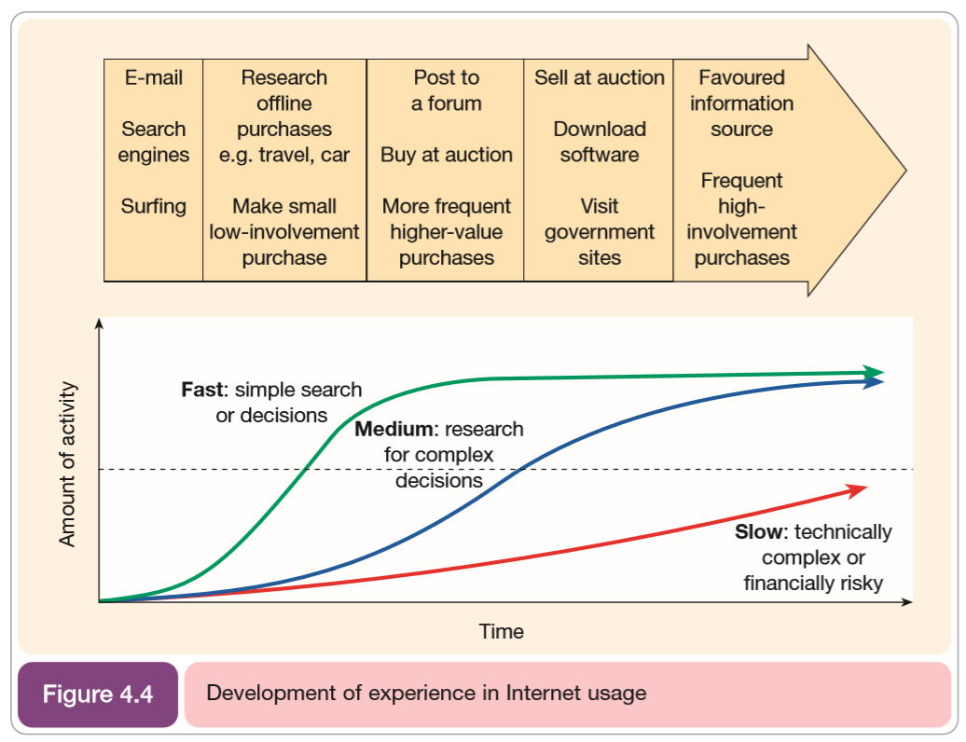
Social and legal factors (Business Demand for digital business services)

Slide 18
Social and legal factors (Business Demand for digital business services)
Variations in organization characteristics
Size of company (employees or turnover)
Industry sector and products
Division
Country and region
Individual role
Role and responsibility from job title
Role in buying decision (purchasing influence)
Department
Product Interest
Demographics: age, sex and possibly social group

Slide 19
Activity 4.3
Refer to your book for Activity 4.3

Slide 20
Social and legal factors (Privacy and trust in e-commerce)
Ethical Standards are personal or business practices or behaviour generally considered acceptable by society.
Ethical issues and the associated laws constitute an important consideration of the Internet business environment for marketers.
Privacy of consumers is a key ethical issue that affect all types of organization regardless if they have a transactional e-commerce service.

Slide 21
Social and legal factors (Why personal data are valuable for digital business)
Because through understanding customer’s needs, characteristics and behaviours it is possible to create more personalized targeted communication, which help increase sales.

Slide 22
Social and legal factors (Main information types used by Internet Marketers)
Contact information
Profile information
Platform usage information
Behavioural information (on a single site)
Behavioural information (across multiple sites)

Slide 23
Social and legal factors (Ethical Issues concerned with personal information)
Privacy
what information is held about the individual?
Accuracy
is it correct?
Property
who owns it and how can ownership be transferred?
Accessibility
who is allowed to access this information, and under which condition?

Slide 24
Social and legal factors (Alternative perspective, raising issues for both individual and marketer)
Transparency
who is collecting what information?
how do they disclose the collection of data?
how it will be used?
Security
how is information protected once it is collected by the company?
Liability
who is responsible if data is abused?
Data protection legislation is enacted to protect the individual, to protect their privacy and to prevent misuse of the personal data.

Slide 25
Activity 4.4
Refer to your book for Activity 4.4

Slide 26
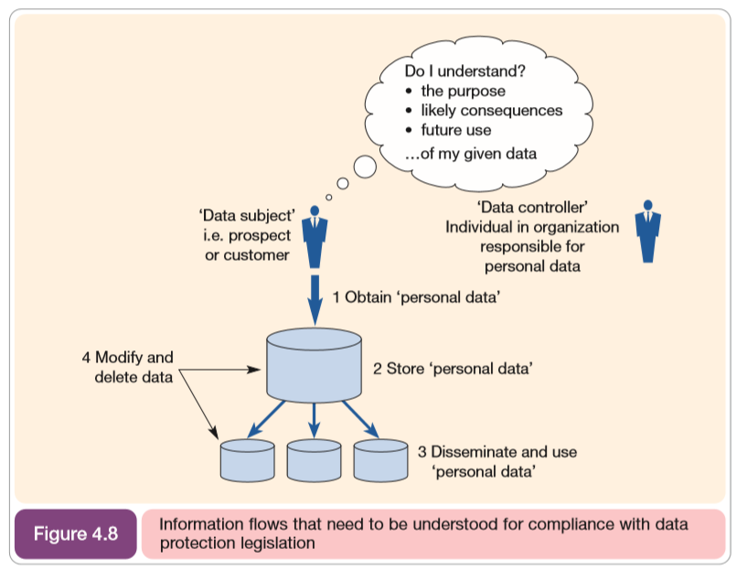
Social and legal factors (Personal Data, Data Controller, Data Subject)

Slide 27
Social and legal factors (Principles of Personal Data)
Fairly and lawfully processed
Process for limited purposes
Adequate, relevant and not excessive
Accurate
Not kept longer than necessary
Processed in accordance with the subject’s rights
Secure
Not transferred to countries without adequate protection

Slide 28
Other Legislation (1 – Marketing your digital business)
Domain Registration
Using competitor names and trademarks I meta tags (for search engine optimization)
Using competitor names and trademarks in pay-per-click advertising
Accessibility law

Slide 29
Other Legislation (2 – Forming an electronic contract)
Country of Origin Principle
Distance-selling law

Slide 30
Other Legislation (3 – Making and Accepting Payments)
The relevant laws are those referring to liability between a credit card issuer, the merchant and the buyer.

Slide 31
Other Legislation (4 – Authenticating contracts concluded over the Internet)
Establishing the identity of the purchaser. For example, to help prove a credit card owner is the valid owner, many sites now ask for authentication code.

Slide 32
Other Legislation (5 – Email Risks)
One of the main risks with e-mail is infringing an individual’s privacy. Specific laws have been developed in many countries to reduce the volume of unsolicited commercial e-mail or spam.

Slide 33
Other Legislation (6 – Protecting Intellectual Property)
Protect designs, ideas and inventions and includes content and services developed for e-commerce sites.

Slide 34
Other Legislation (7 – Advertising on the Internet)
Advertising standards that are enforced by independent agencies

Slide 35
Activity 4.5
Refer to your book for Activity 4.5

Slide 36
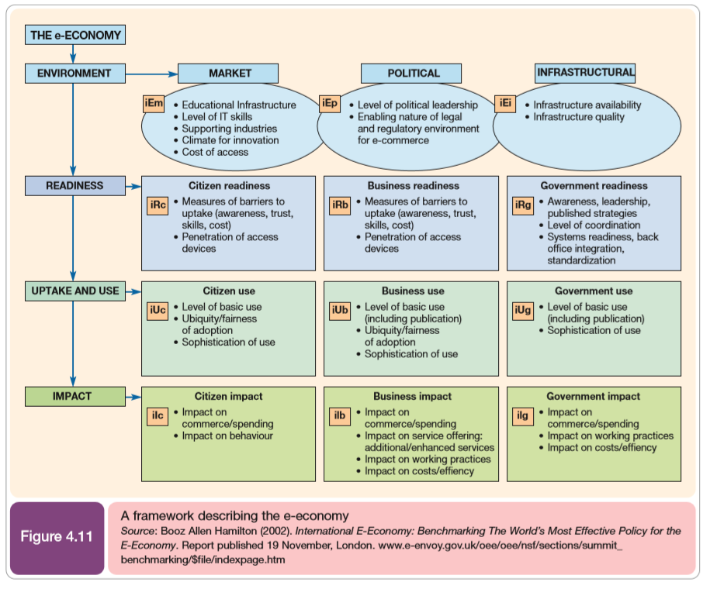
Economic and Competitive Factors (Framework describing the E-economy)
The dynamic system of interaction between a nation’s citizens, businesses and government that capitalize upon online technology to achieve social and economic good.

Slide 37
Economic and Competitive Factors (Globalization and Localization)
Globalization
- Move towards international trading in a single global marketplace and to blurring of social and cultural differences between countries.
Localization
- Tailoring of web site information for individual countries or regions.

Slide 38
Economic and Competitive Factors (A website may need to support a customers from a range of countries with:)
Different Product needs
Language Differences
Cultural Differences

Slide 39
Economic and Competitive Factors (Importance of localization)
The language that content is provided in
Tone and style of copy
Site design- certain colours or images may be unsuitable or less effective in some countries
Range of product offerings
Product Pricing
Promotional offers used to encourage acquisition of customer email address
Local contact points

Slide 40
Political Factors (Political action enacted through government agencies to control the adoption of the Internet can include:)
Promoting
promoting the benefits of adopting the Internet for consumers and business to improve a country’s economic prosperity;
Enacting
enacting legislation to protect privacy or control taxation
Providing
providing organizations with guidelines and assistance for compliance with legislation
Setting
setting up international bodies to coordinate the Internet

Slide 41
Political Factors (Internet Governance and E-governance)
Internet Governance
- The control put in place to manage the growth of the Internet and its usage.
E-Governance
- The application of e-commerce technologies to government and public services.

Slide 42
Approaches to identifying emerging technologies
Contrasting approaches to identifying new technologies which give a company a competitive edge:
Technology networks
Crowdsourcing
Technology hunting
Technology mining

Slide 43
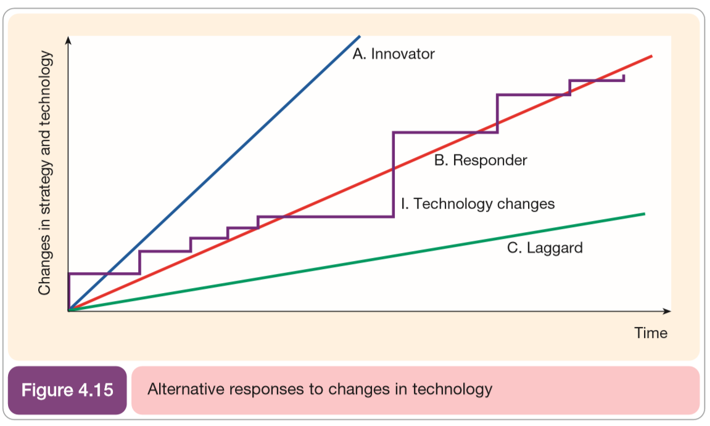
Approaches to identifying emerging technologies
This indicates that benchmarking of “best of breed” sites within sectors is essential part of environmental scanning

Slide 44
Self-Assessment Questions
Refer to Activity booklet for questions which will help you review the topics covered in this lesson.

