Slide 1


Persona Avatars
UXD
Mike Martel
2019-06-13
[4742] Personas for Aurora UI kit
Digital Collaboration Division, Chief Information Officer Branch
Treasury Board of Canada Secretariat / Government of Canada
Division de la collaboration numérique, Direction du dirigeant principal de l’information
Secrétariat du Conseil du Trésor du Canada / Gouvernement du Canada

Slide 2
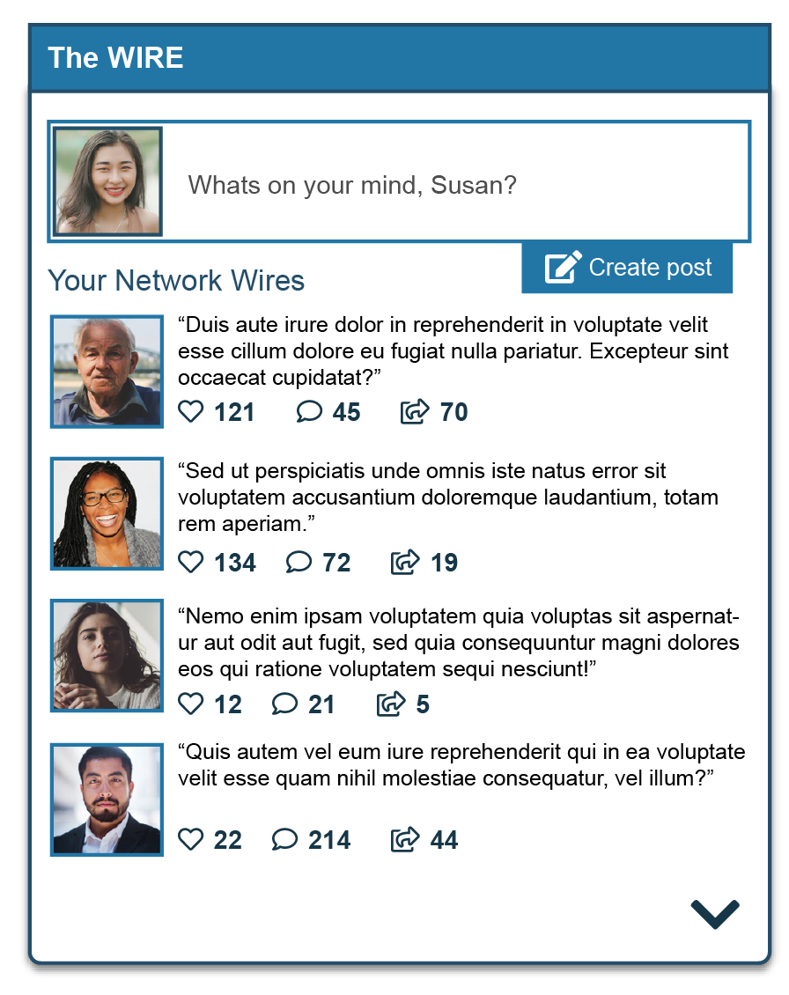
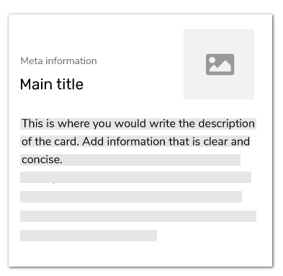
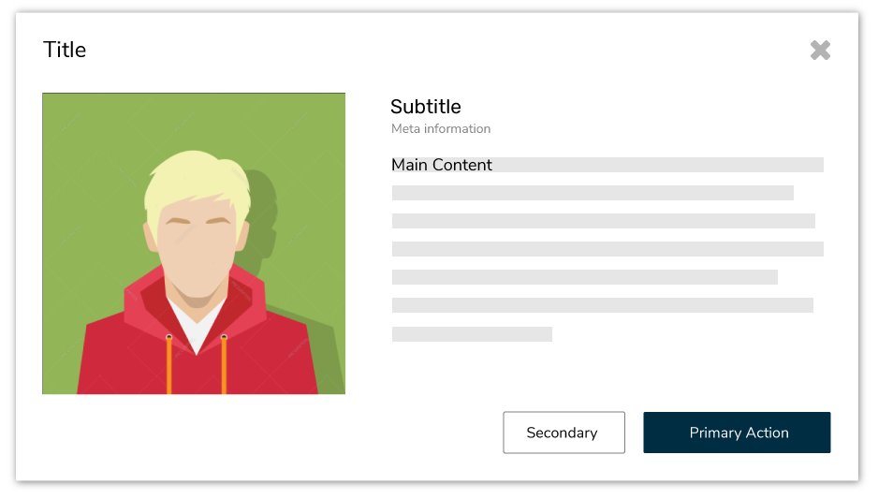
Persona Avatars – the beginning
Direction at the time suggested a WET based concept design for The 2018 CIOB Dashboard assignment
A believable Wire card showing active GoC users and external users was part of the design requirements, so images of real people were thought to help create credibility
Meantime, the Aurora Design System was nearing completion and official avatars and personas were not yet available:
Also, persona development efforts were underway for Profile/Directory but they were far from being finalized
To quickly address the needs of the deadline, avatars were sourced on the fly from www.pexels.com where there were no licensing restrictions

Slide 3
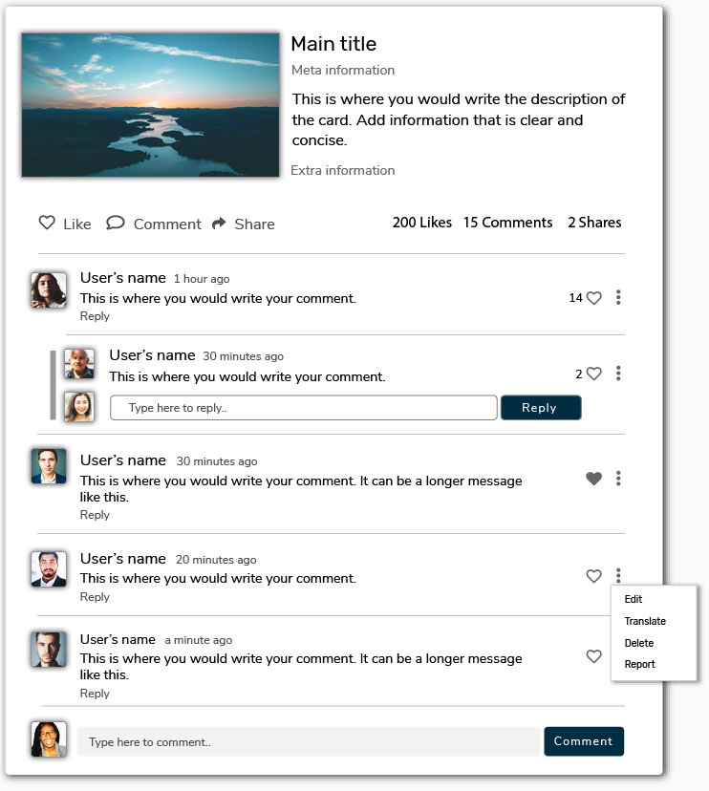

Persona Avatars – an idea
Sourcing persona avatars on the fly that were not officially vetted for use in design and development work felt off, since ideal UX best practices suggest the use of evidence based personas to inform design decisions
Easy access to a bank of official personas and their avatars for future work seemed like something worth proposing
Since evidence based personas were still in development a concept for avatar and image treatment was submitted for possible inclusion in a future version of the UI Kit, based on the previous CIOB work

Slide 4
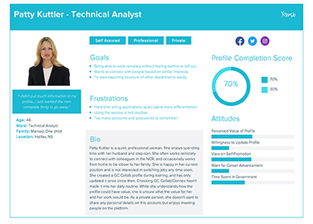
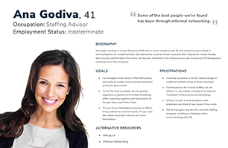
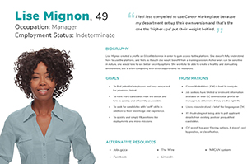
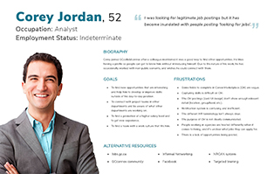
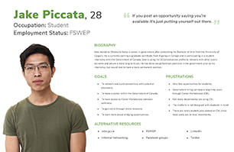
Persona Avatars – follow up
Fast forward to 2019 and the UX Research Team had created a bank of excellent, evidence-based personas while working on Profile/Directory and Career Marketplace
The personas were then given visual presence with some great design work.
The only catch was that the images of the people used for the personas were placeholders and this required a bit more leg work before a bank of persona avatars could continue

Slide 5
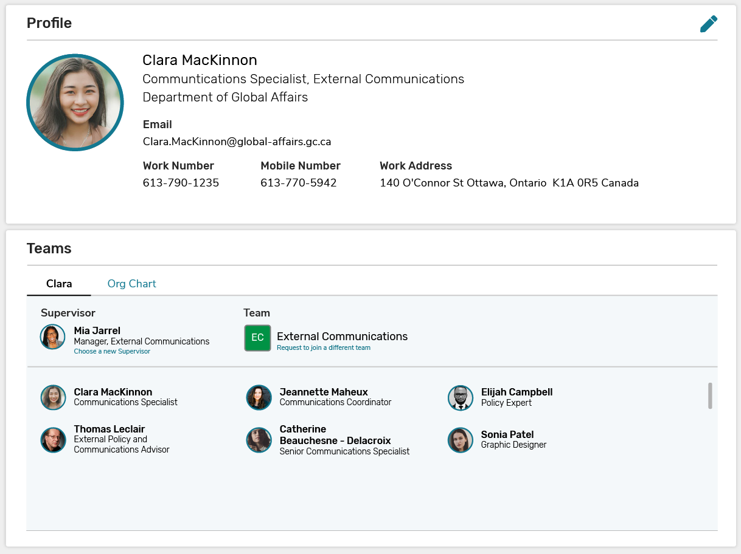
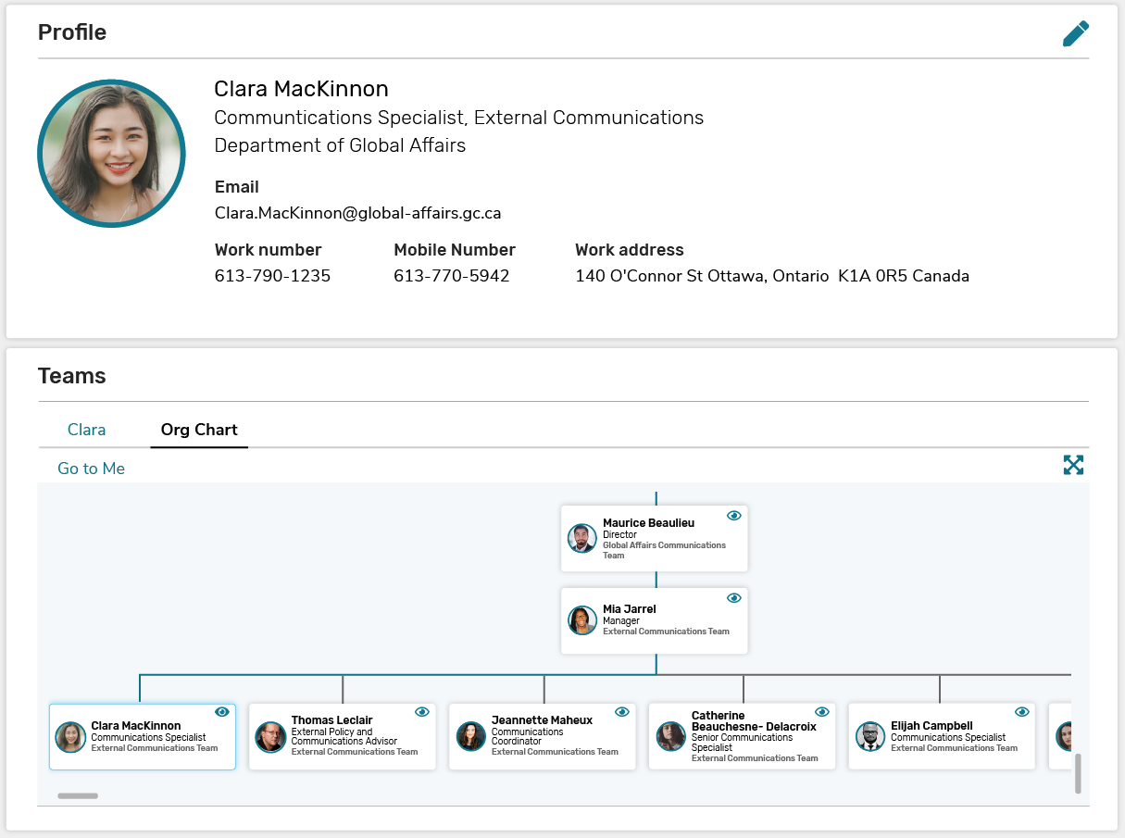

Persona Avatars – follow up
Returning to the Pexels site was a good option. Working with the images from Pexels for the high-fidelity Directory design work was a great trial run for sourcing images of people who could appear as candid, yet professional, credible users of our teams products and services

Slide 6
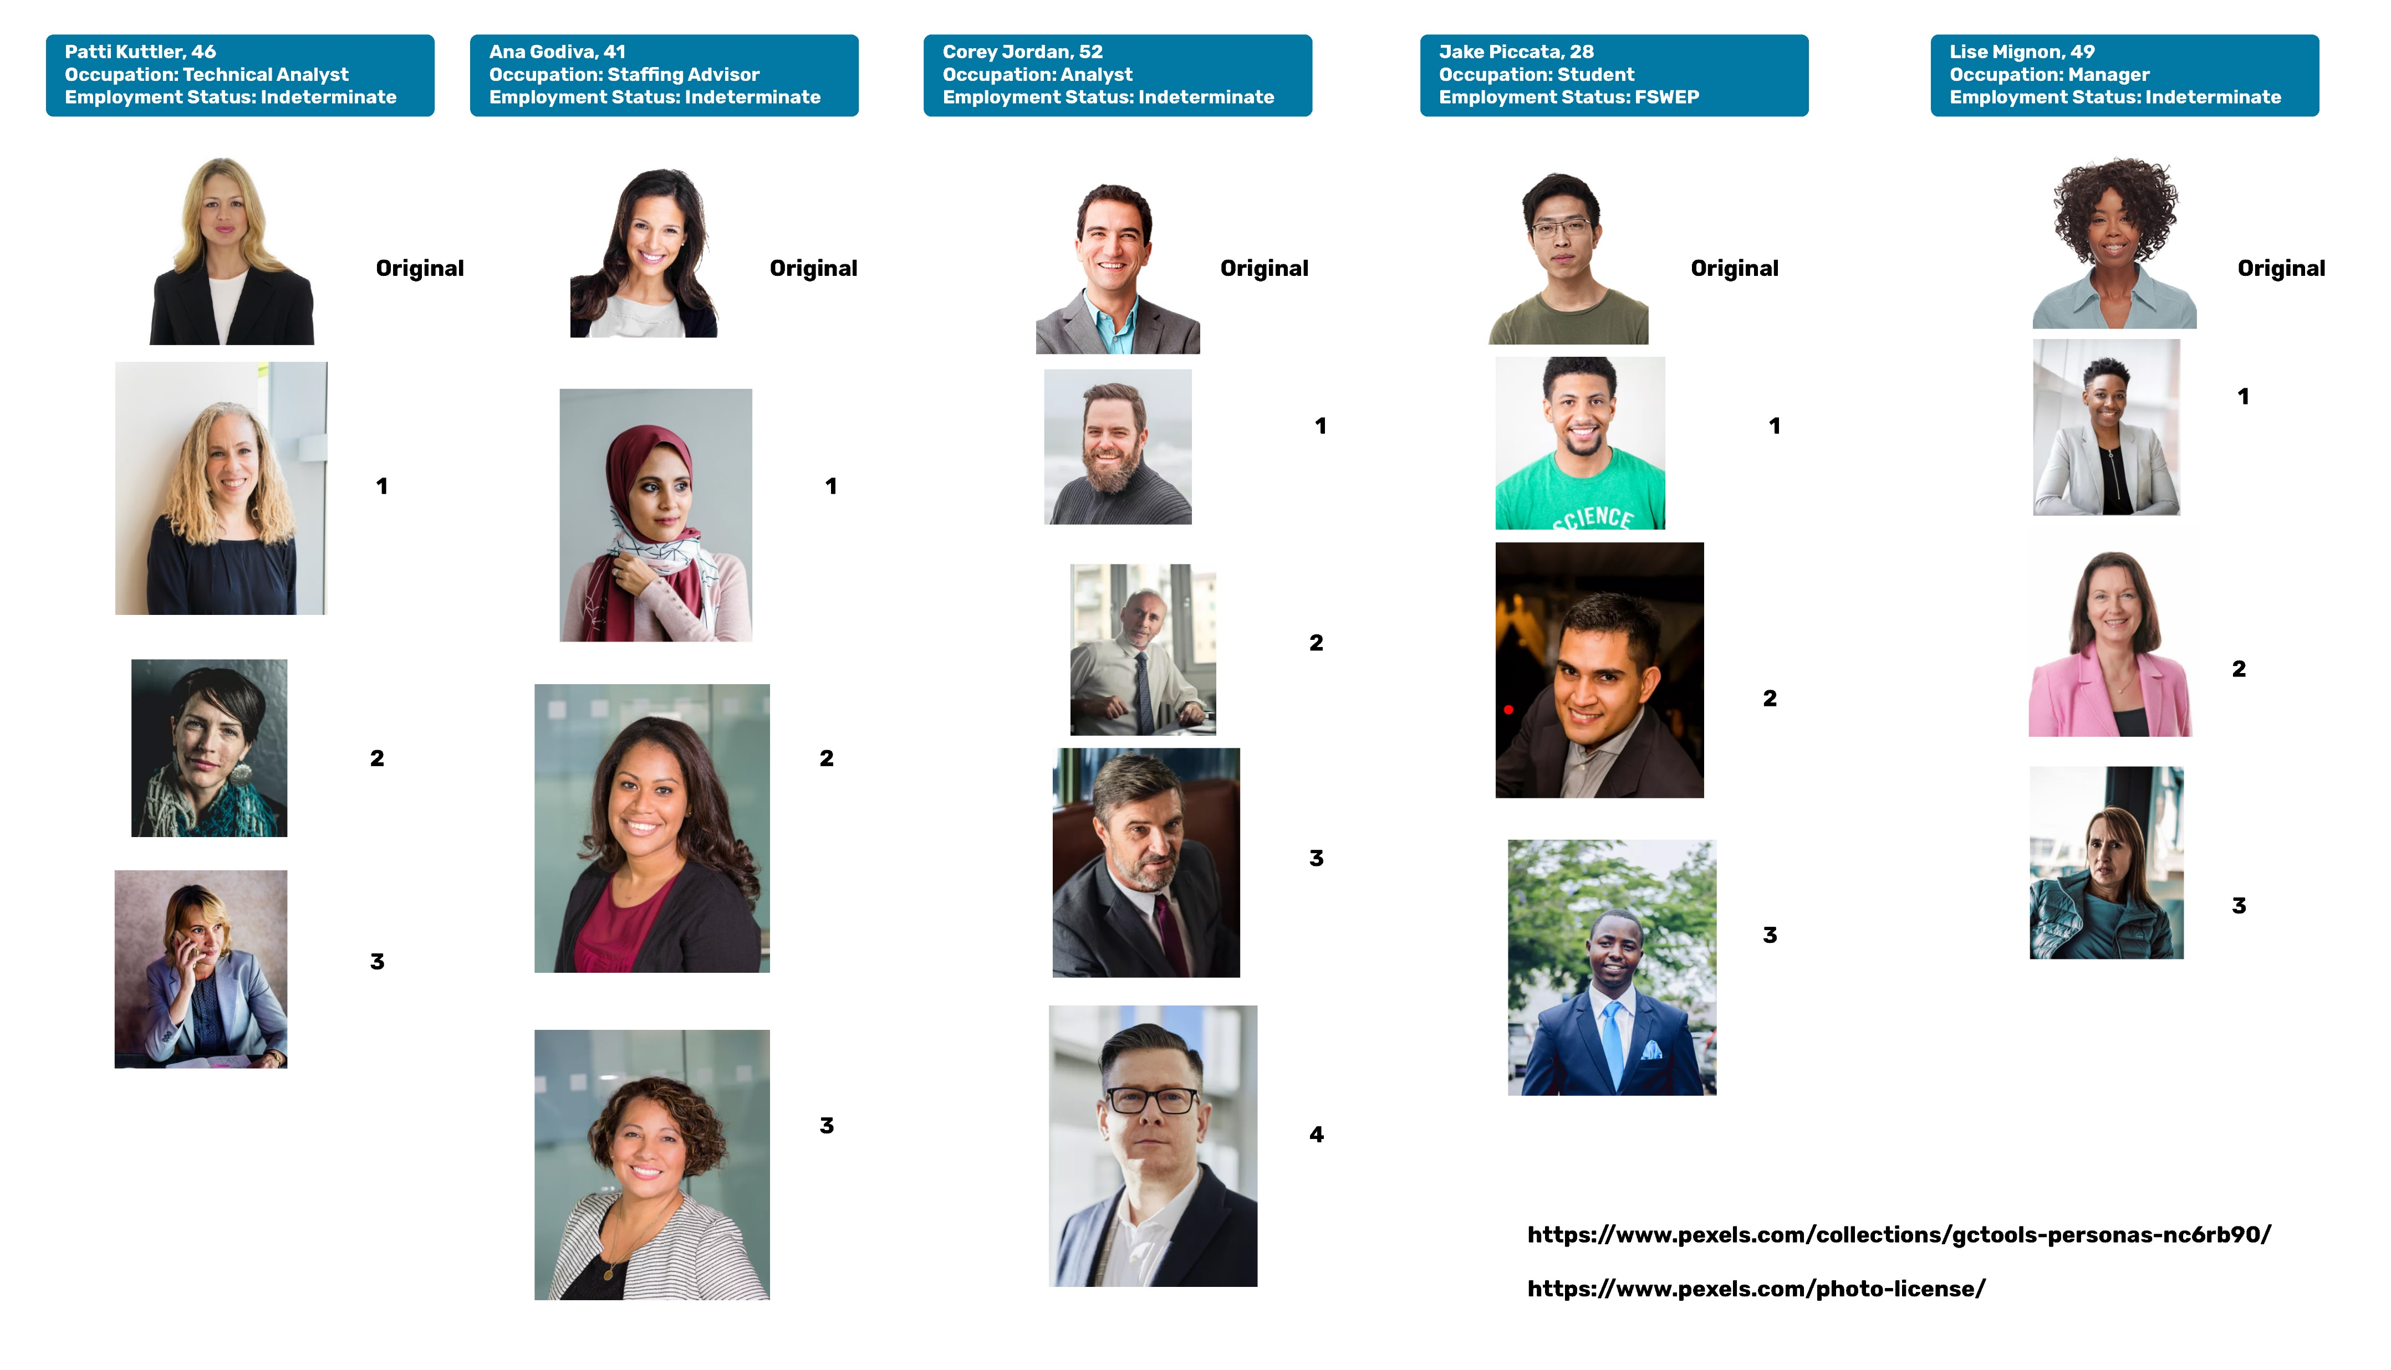

Persona Avatars – approvals
To move forward with the persona avatars, we wanted to be sure the new images would fit the actual evidence based bios created for Career Marketplace first and foremost
A contact sheet was assembled for final approval by the Product Owner before being put into the final production piece
The final images were chosen because of their neutral background, eyes forward poses and a credible match with the actual bios

Slide 7
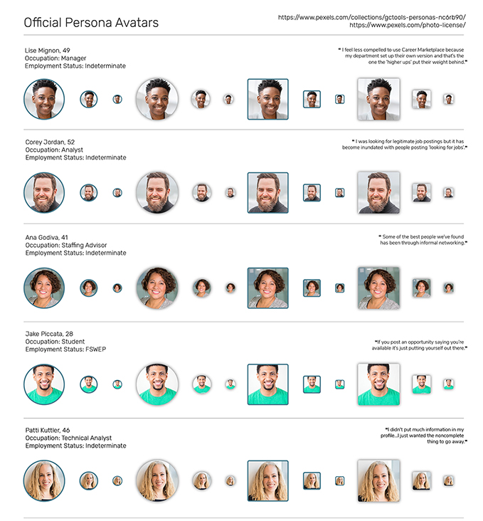
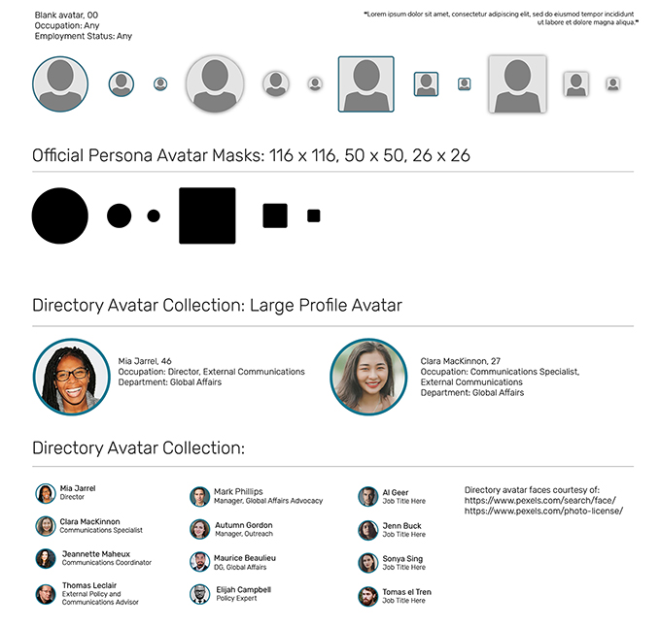
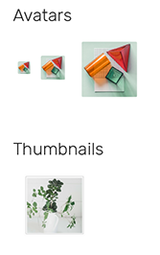
Persona Avatars – final collection
With the models chosen, the images were downloaded and saved in print rez for later use then downsized for import into the master ui kit Illustrator file
A separate artboard was added for the collection
The dimensions of the avatars were based on the existing sample avatars in the ui kit
Uses outerglow and/or stroke to accommodate images that have light backgrounds, such as professional headshots
Comprehensive, with standardized sizes with consistent framing
Persona bio and quotes included to provide the context for each user’s needs

Slide 8


Thank you/Merci !

