Slide 1

Raspberry Pi 5 Edge Traffic Monitoring System
Topic 7 – DQ 2
Steven Merkling
College of Engineering and Technology, Grand Canyon University
CST-590-O500: Computer Science Capstone Project
Dr. Aiman Darwiche
September 29, 2025

Slide 2
Raspberry Pi 5 Edge Traffic Monitoring System
Problem Statement:
Traditional traffic monitoring systems cost $15,000-50,000+ and require extensive infrastructure. Communities need affordable, accurate, and privacy-preserving solutions for traffic safety monitoring.
Project Objectives:
Deploy a proof of concept for a low-cost, scalable edge-based traffic monitoring system
Achieve real-time vehicle detection with <350ms total latency
Perform on-camera AI inference using hardware-accelerated NPU (sub-100ms)
Implement multi-sensor data fusion (radar, camera, environmental sensors)
Provide secure remote access and real-time data visualization

Slide 3
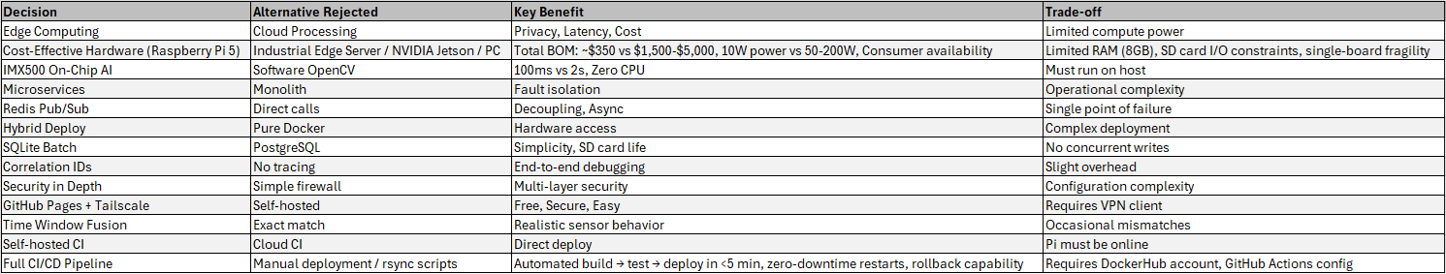
Raspberry Pi 5 Edge Traffic Monitoring System
Key Architecture Decisions:

Slide 4
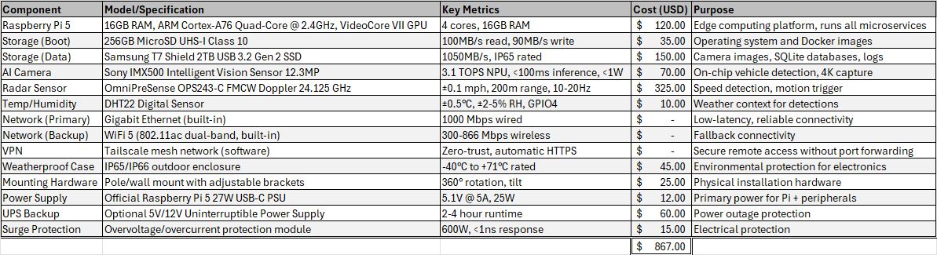
Raspberry Pi 5 Edge Traffic Monitoring System
Physical Hardware:

Slide 5
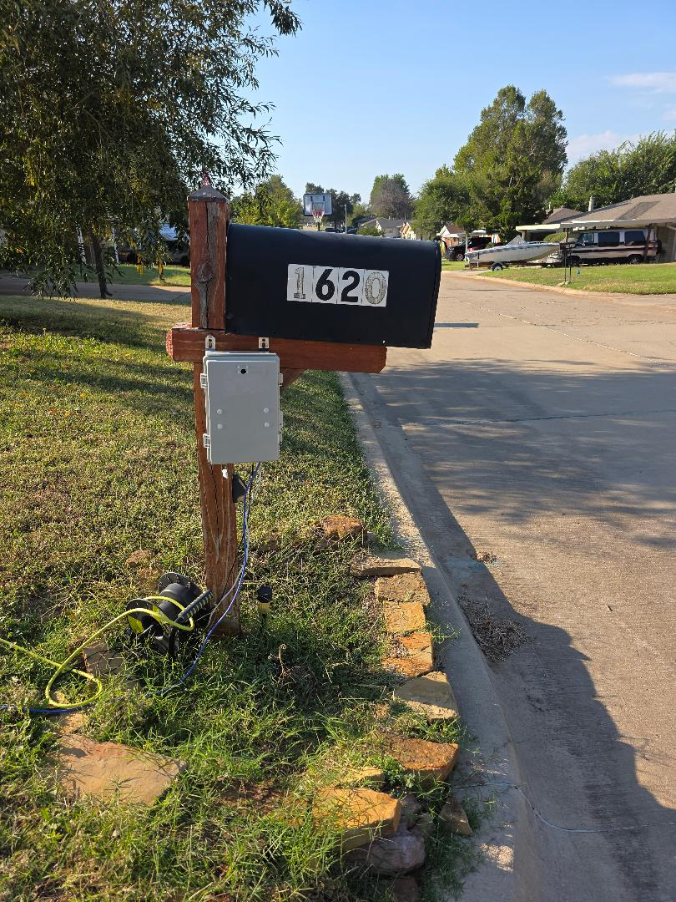
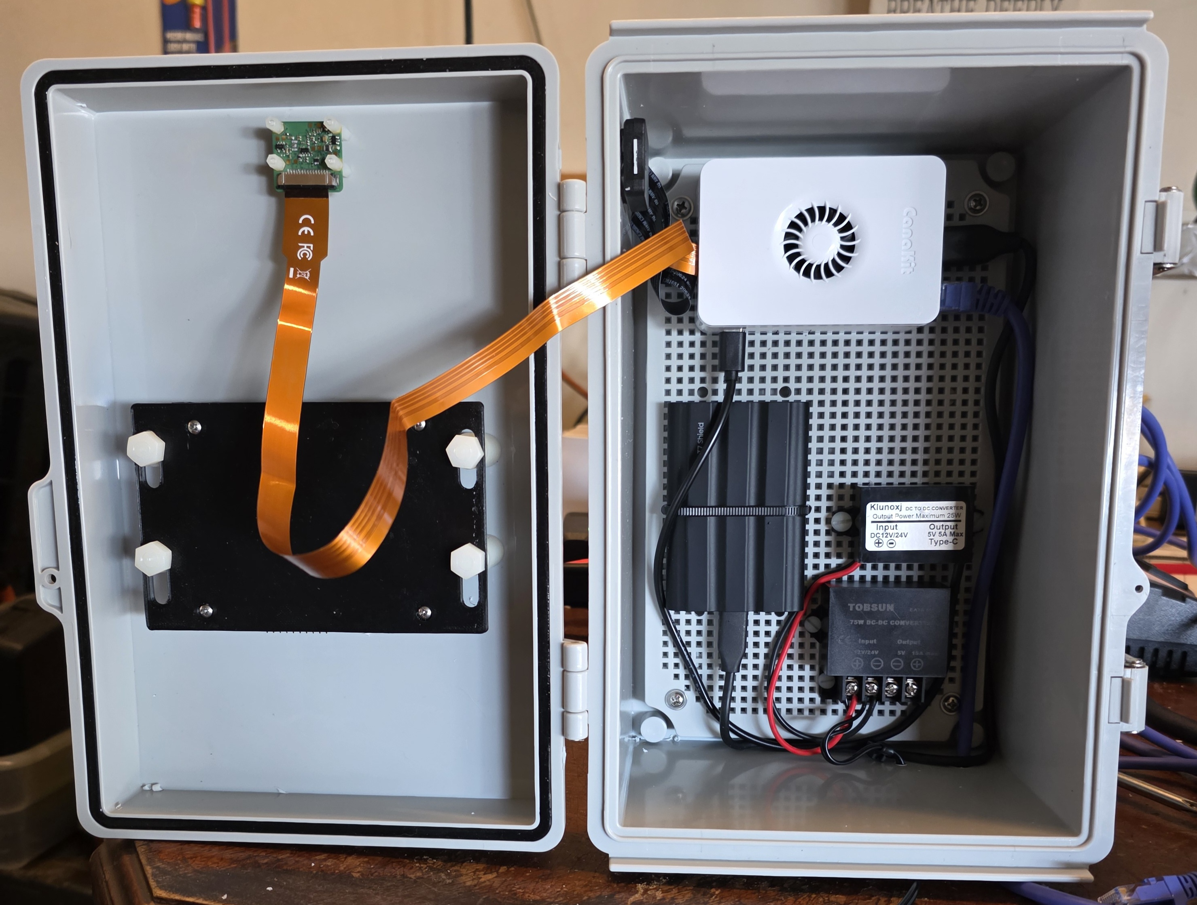
Raspberry Pi 5 Edge Traffic Monitoring System
Physical Hardware Implementation:

Slide 6
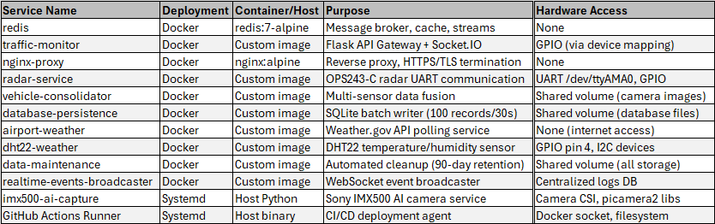
Raspberry Pi 5 Edge Traffic Monitoring System
Software Implementation:
Microservices Architecture

Slide 7
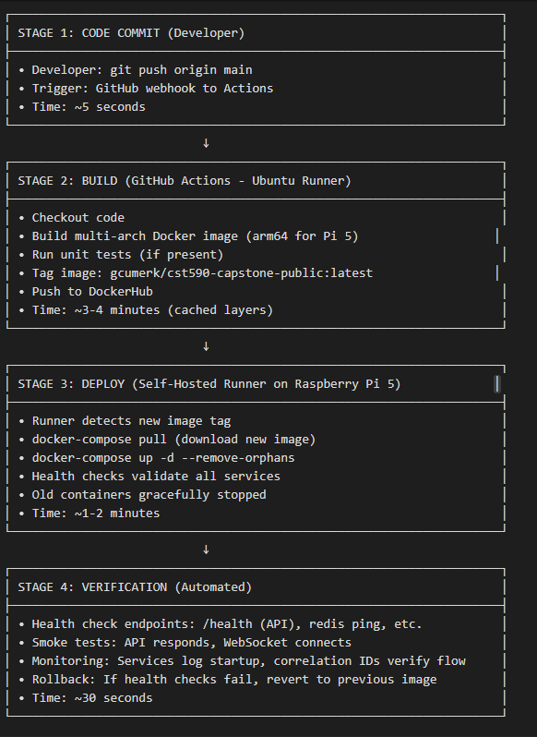
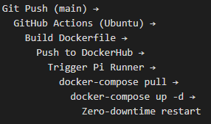
Raspberry Pi 5 Edge Traffic Monitoring System
Complete CI/CD Deployment Pipeline

Slide 8
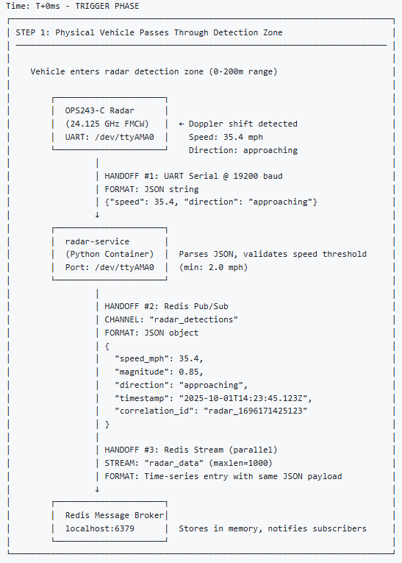
Raspberry Pi 5 Edge Traffic Monitoring System
Workflow Happy Path Step 1:

Slide 9
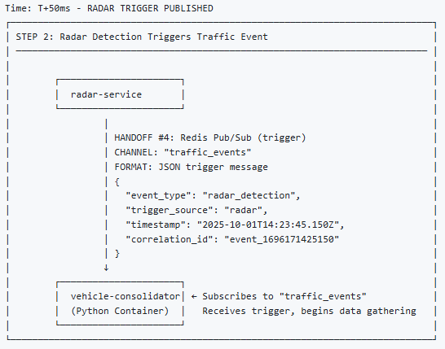
Raspberry Pi 5 Edge Traffic Monitoring System
Workflow Happy Path Step 2:

Slide 10
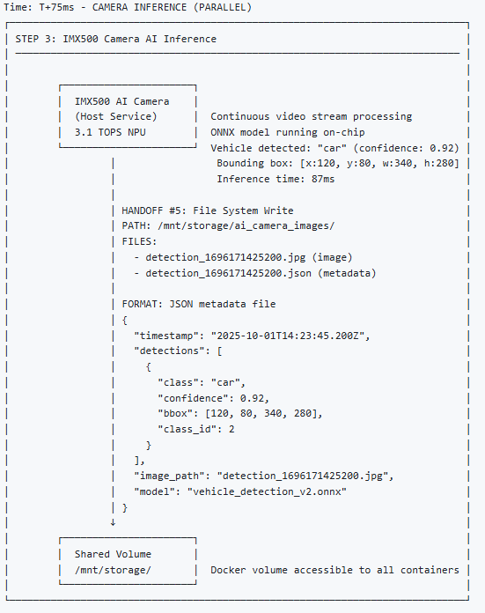
Raspberry Pi 5 Edge Traffic Monitoring System
Workflow Happy Path Step 3:

Slide 11
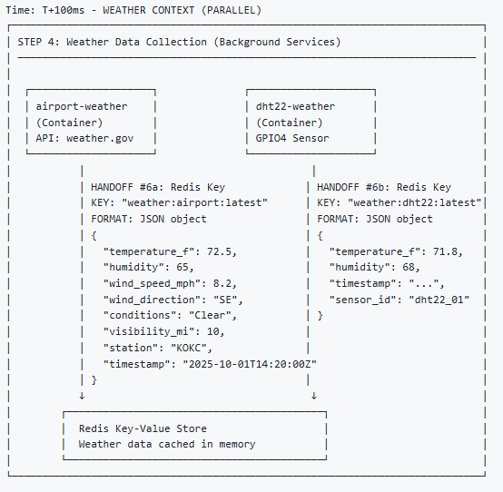
Raspberry Pi 5 Edge Traffic Monitoring System
Workflow Happy Path Step 4:

Slide 12
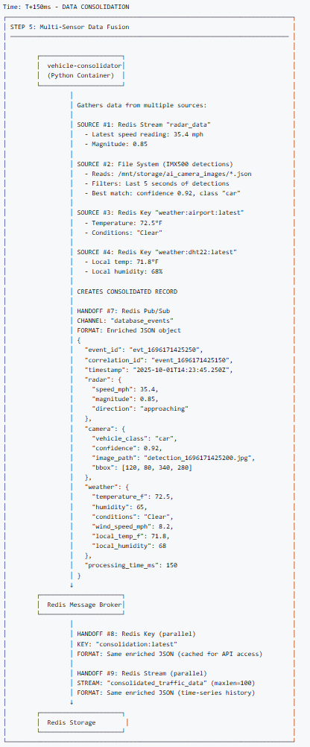
Raspberry Pi 5 Edge Traffic Monitoring System
Workflow Happy Path Step 5:

Slide 13
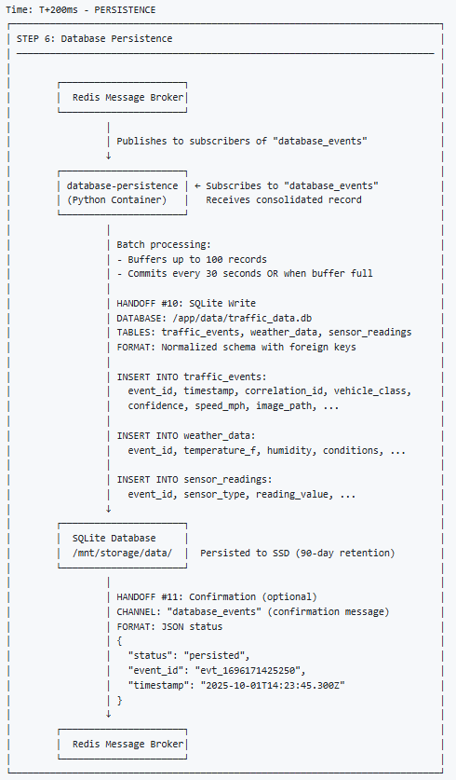
Raspberry Pi 5 Edge Traffic Monitoring System
Workflow Happy Path Step 6:

Slide 14
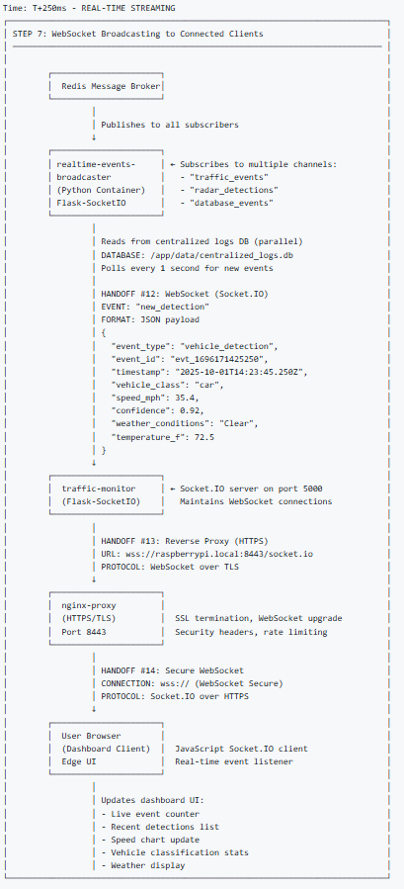
Raspberry Pi 5 Edge Traffic Monitoring System
Workflow Happy Path Step 7:

Slide 15
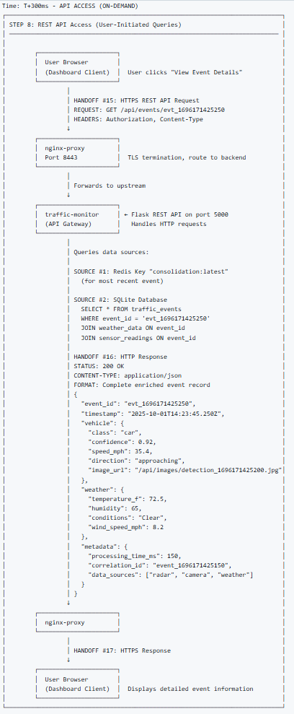
Raspberry Pi 5 Edge Traffic Monitoring System
Workflow Happy Path Step 8:

Slide 16
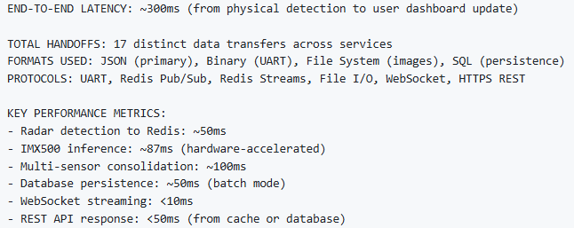
Raspberry Pi 5 Edge Traffic Monitoring System
Workflow Happy Path Overview:

Slide 17
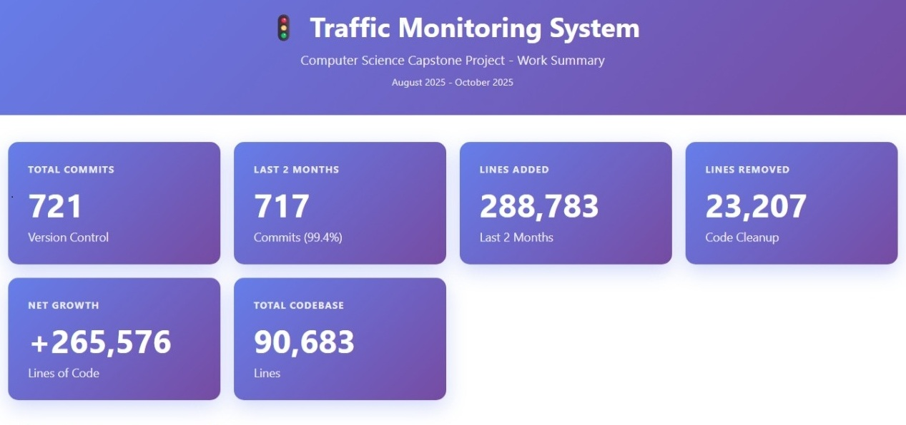
Raspberry Pi 5 Edge Traffic Monitoring System
Work Effort:

Slide 18
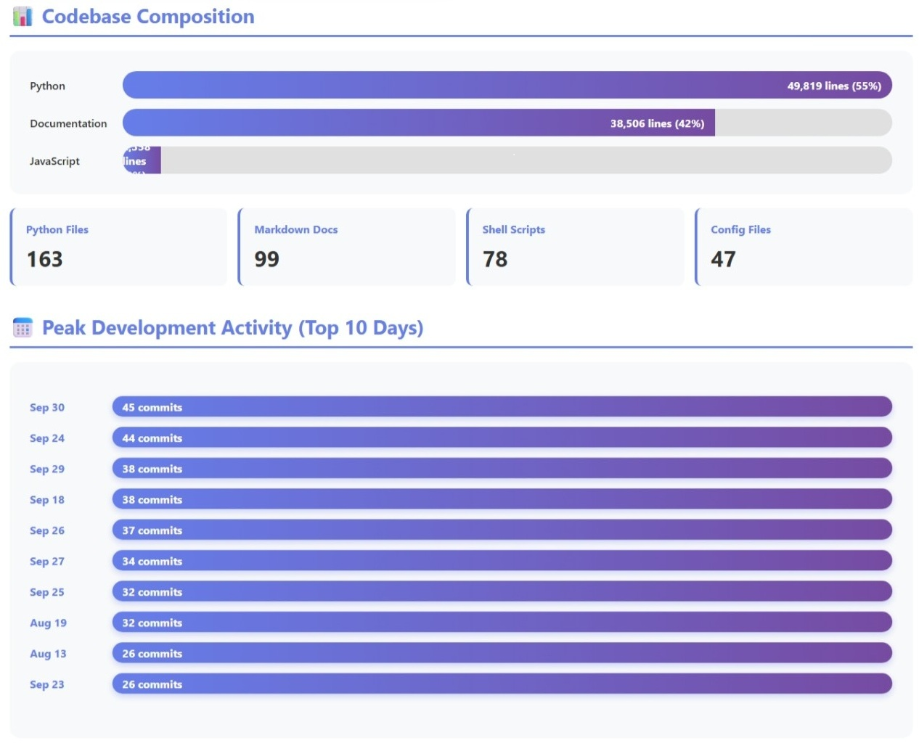
Raspberry Pi 5 Edge Traffic Monitoring System
Work Effort:

Slide 19
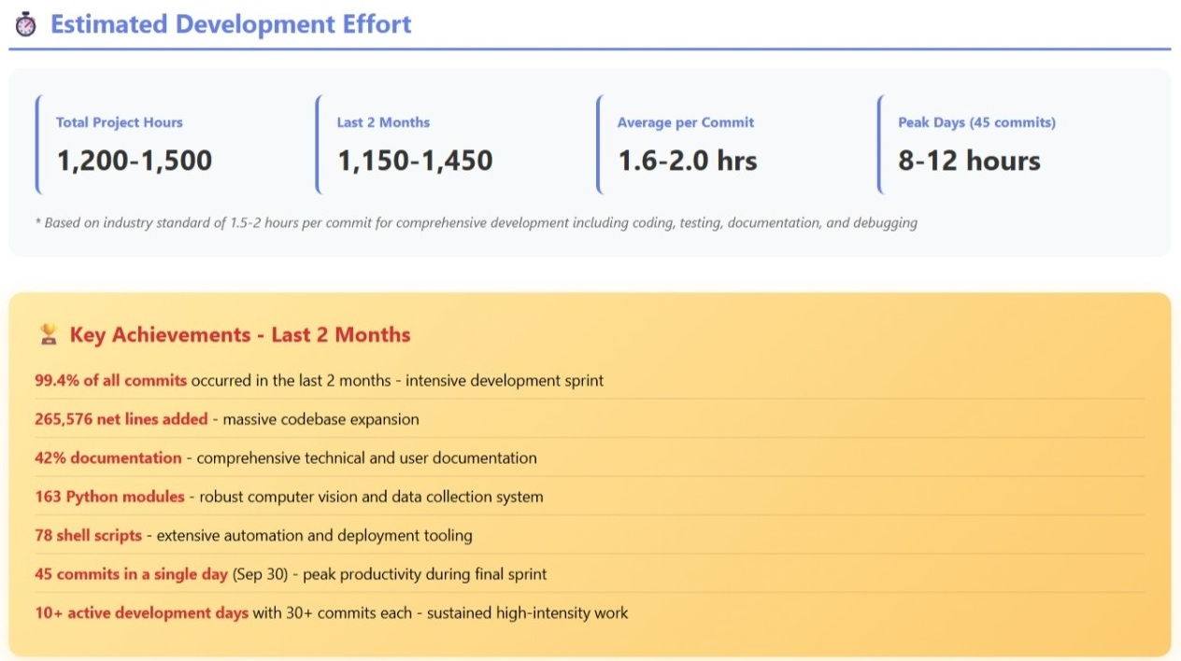
Raspberry Pi 5 Edge Traffic Monitoring System
Work Effort:

Slide 20
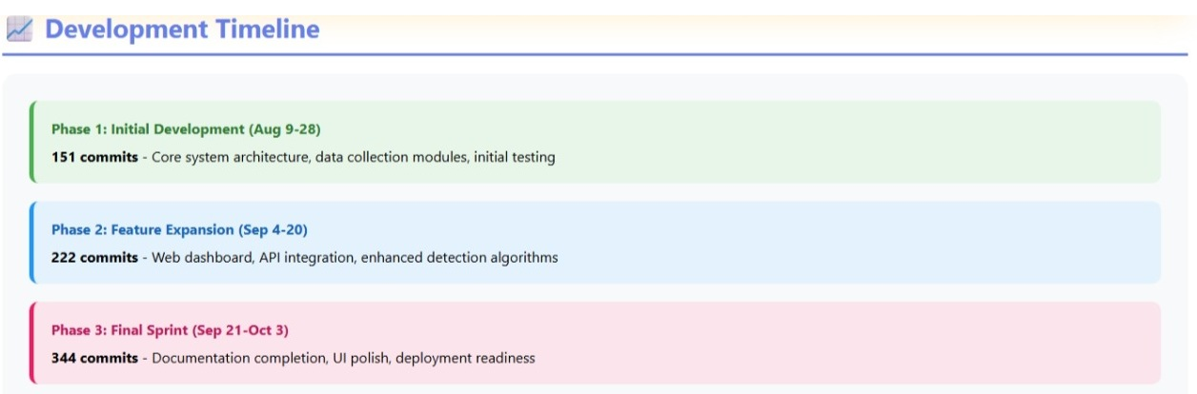
Raspberry Pi 5 Edge Traffic Monitoring System
Work Effort:

Slide 21
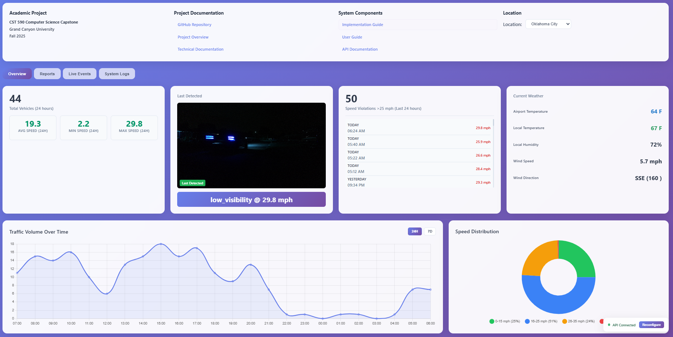
Raspberry Pi 5 Edge Traffic Monitoring System
Demo

Slide 22
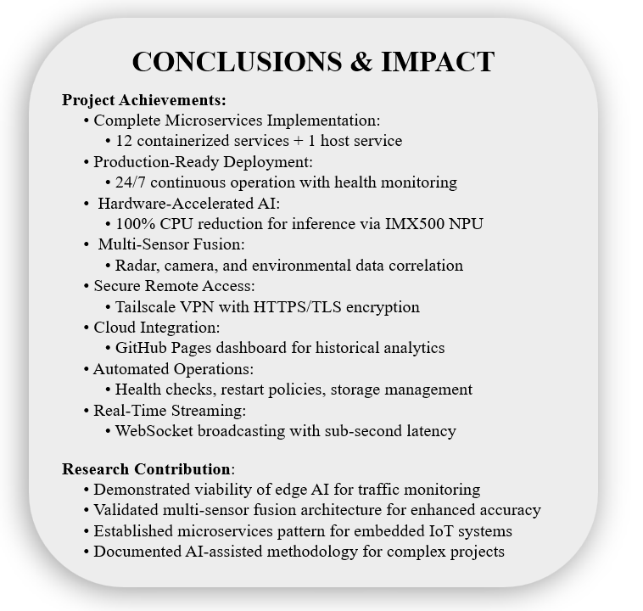
Raspberry Pi 5 Edge Traffic Monitoring System

