Slide 1
ASD Preliminary Results
GC - JOR

Slide 2
Removed UTC for all analyses
Kept 55 dat (after plating) point for microbiome analyses to say if planting erased effect.
55 Dat was removed for nutrient etc analyses. We can include it if we deem it necessary.

Slide 3
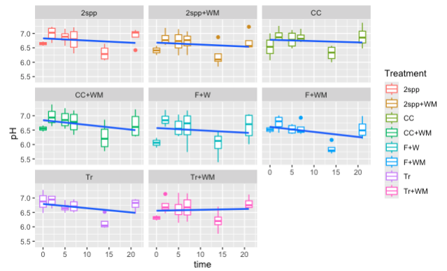
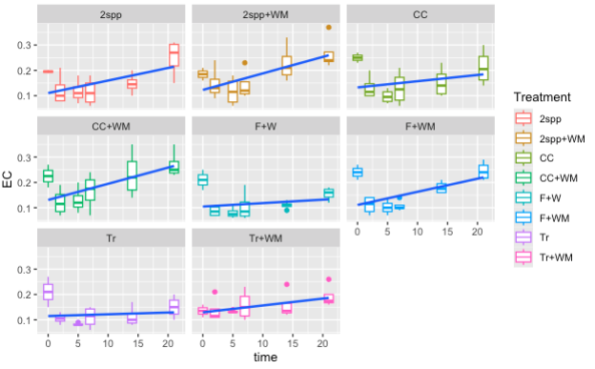
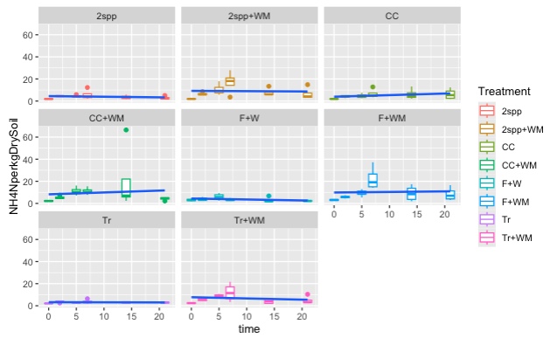
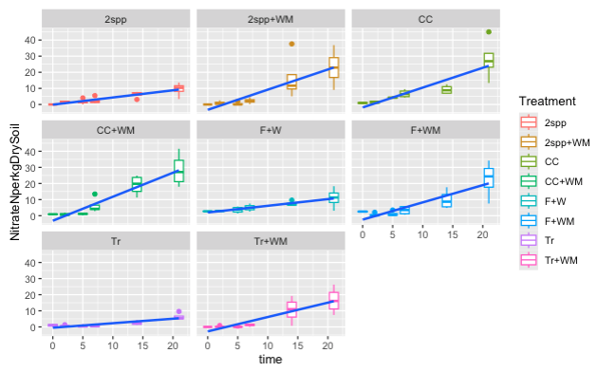
~ Time | 2spp | 2spp+wm | CC | CC+wm | F+W | F+WM | Tr | Tr+WM | Slope
pH | <0.01 | <0.01 | <0.01 | <0.01 | 0.09 | <0.01 | <0.01 | 0.17 | - (+TRWM)
EC | <0.01 | <0.01 | <0.01 | <0.01 | <0.01 | <0.01 | <0.01 | <0.01 | +
NO3 | <0.01 | <0.01 | <0.01 | <0.01 | <0.01 | <0.01 | <0.01 | <0.01 | +
NH4 | < 0.01 | 0.03 | 0.4 | 0.04 | < 0.01 | 0.04 | 0.15 | 0.01 | +/-
Non-parametric regression

Slide 4
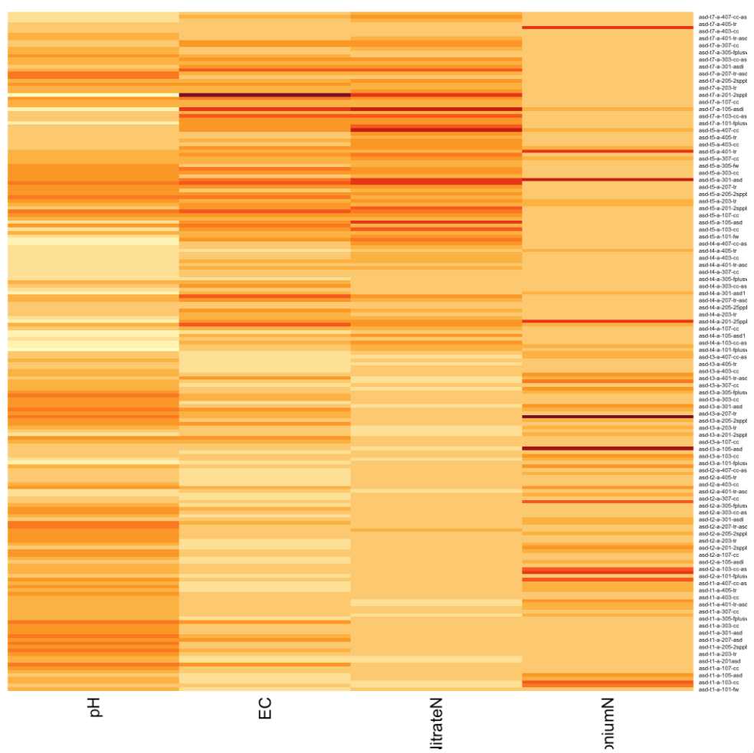
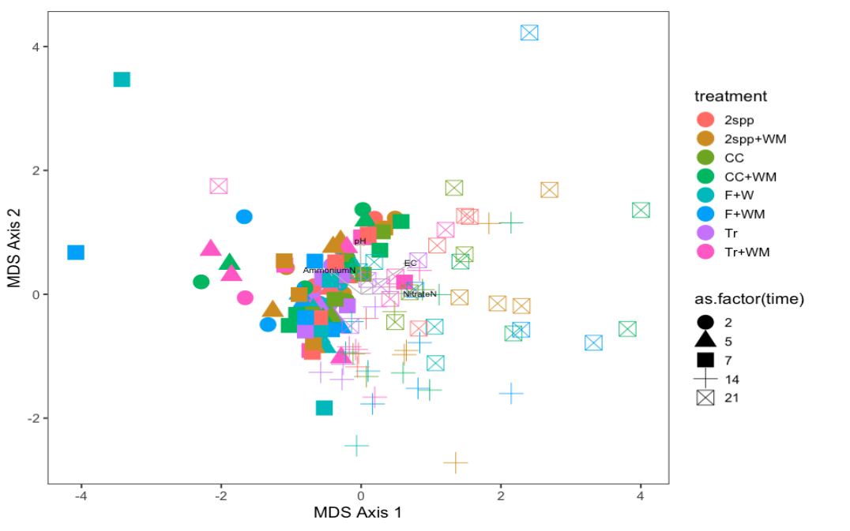
Edaphic Conditions
Late time points group together, early timepoints group together. There doesn’t seem to be a clustering by treatment, although the effect was significant (see next slide)

Slide 5
Edaphic adoins
adonis2(formula = md_dist ~ Covercrop + WheatM + Timepoint, data = md, strata = md$Timepoint)
Df SumOfSqs R2 F Pr(>F)
Covercrop 3 1526 0.04638 5.794 0.001 ***
WheatM 1 1558 0.04734 17.742 0.001 ***
Timepoint 6 12522 0.38059 23.771 0.001 ***
Residual 197 17295 0.52568
Total 207 32901 1.00000
---
Signif. codes: 0 ‘***’ 0.001 ‘**’ 0.01 ‘*’ 0.05 ‘.’ 0.1 ‘ ’ 1

Slide 6
Community data

Slide 7
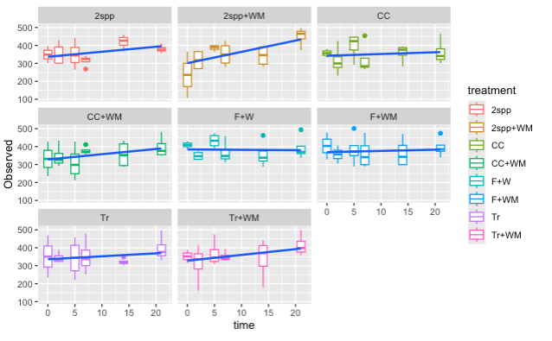
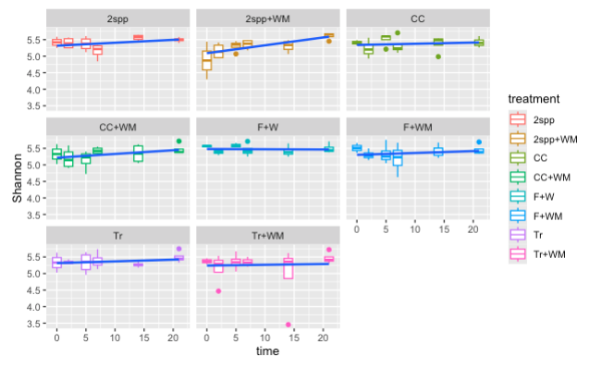
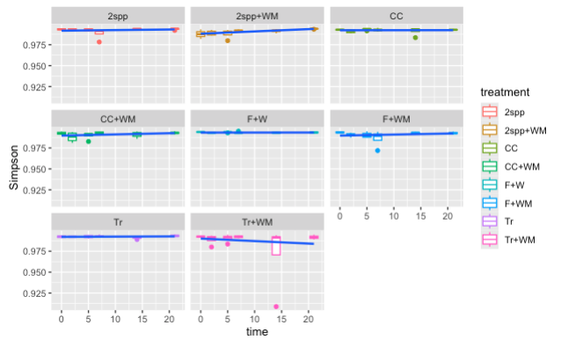
Alpha Diversity
~ Time | 2spp | 2spp+wm | CC | CC+wm | F+W | F+WM | Tr | Tr+WM | Slope
Observed | < 0.01 | < 0.001 | 0.8 | < 0.01 | 0.06 | 0.6 | 0.25 | 0.02 | +
Shannon | < 0.05 | < 0.001 | 0.4 | <0.01 | 0.2 | 0.1 | 0.24 | 0.08 | +
Simpson | < 0.01 | 0.3 | 0.3 | 0.07 | 0.3 | 0.3 | 0.3 | 0.3 | +
Note: pH affects Shannon diversity, richness, and simpson in the. Tr and CC plots. This may be worth exploring further.
Limited effects on eveness, seems to be a positive effect across the board for Shannon and richness.

Slide 8
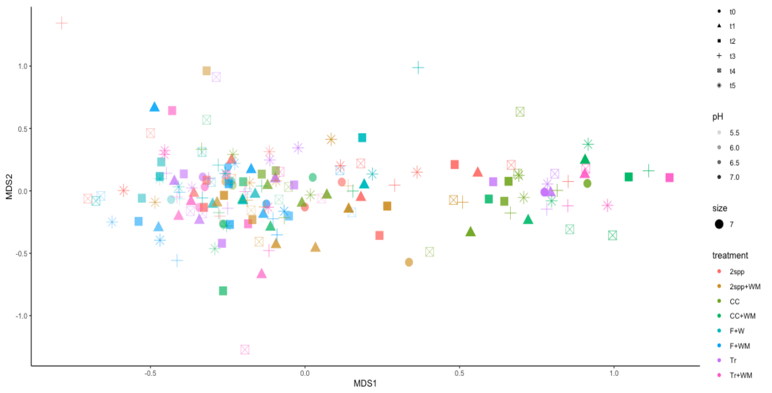
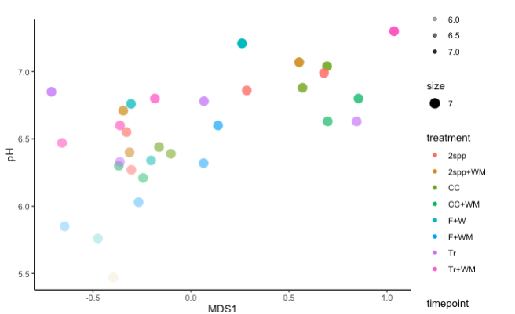
Beta Diversity
Global Adonis of all time points and treatments together:
vegan::adonis2(formula = physeq_dist ~ WheatM + Covercrop + Timepoint + pH, data = md_tab, permutations = 100)
Df SumOfSqs R2 F Pr(>F)
WheatM 1 1.007 0.03048 6.2814 0.009901 **
Covercrop 3 1.589 0.04811 3.3042 0.009901 **
Timepoint 5 1.434 0.04340 1.7886 0.009901 **
pH 1 2.552 0.07724 15.9161 0.009901 **
Residual 165 26.455 0.80076
Total 175 33.037 1.00000
Clear gradient of pH driving community structure along axis 1. pH (p < 0.001) + slope, left side of axis is later points

Slide 9
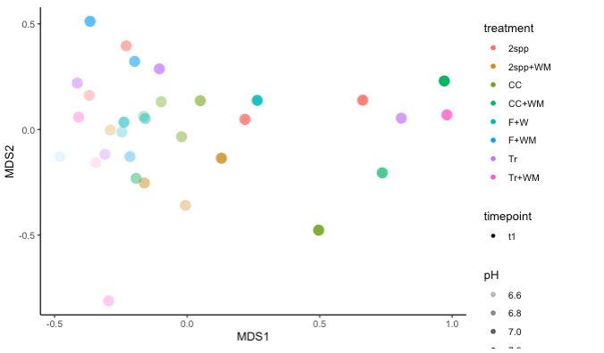
Split by time point – Pvalue of each significant predictor
D0: WheatM - 0.07, pH - 0.009
D2: WheatM – 0.009, pH – 0.009
D7: WheatM – 0.02, pH – 0.009
D14: Covercrop – 0.02, pH 0.009
D21: Covercrop – 0.03, WheatM – 0.03, pH 0.009
D55: pH-0.009
A clear trend of pH along axis 1. This is from D2, but all time points have a similar trend. Treatments are scattered, and pH drives major diffs.

Slide 10
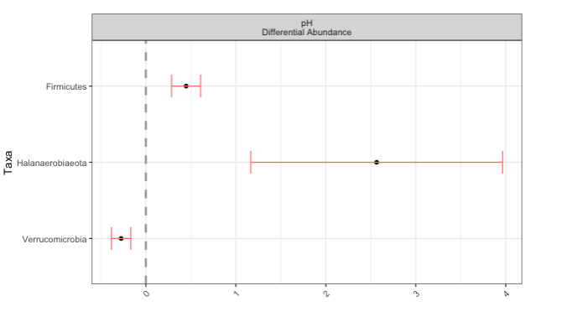
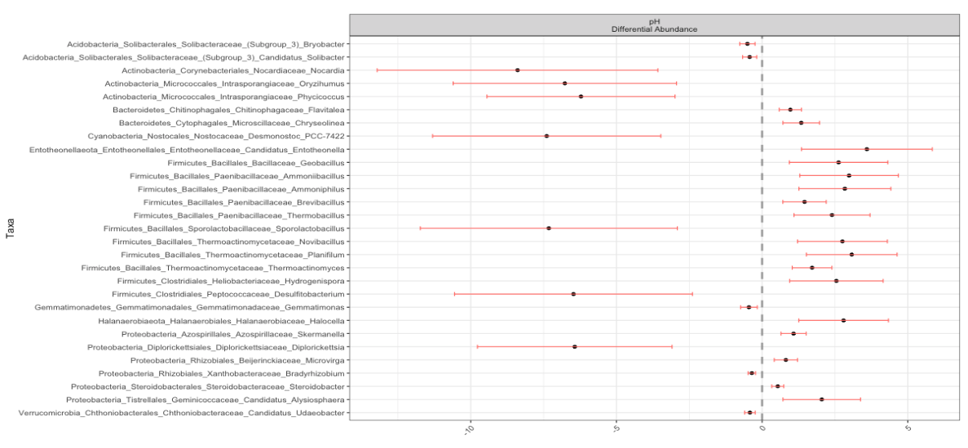
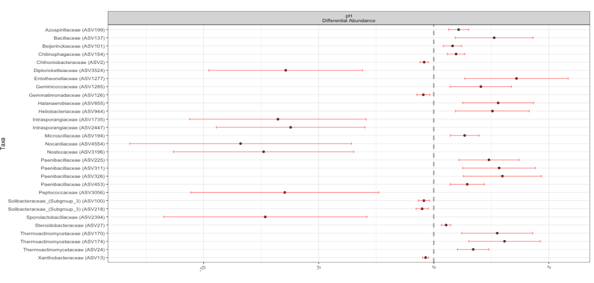
Corncob regression modeling
Identifies taxa that are significantly associated with a continuous predictor - In this case pH.
Without 55 dat point
Same figure with different levels of taxonomy.
Fairly consistent responses of firmicutes and other groups.
This could be re-run at different levels of taxonomy as well. (see small graph at phylum level)

Slide 11
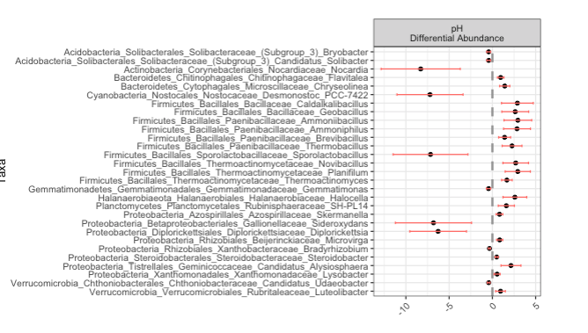
Indicators
With 55 dat (post planting)

