Slide 1
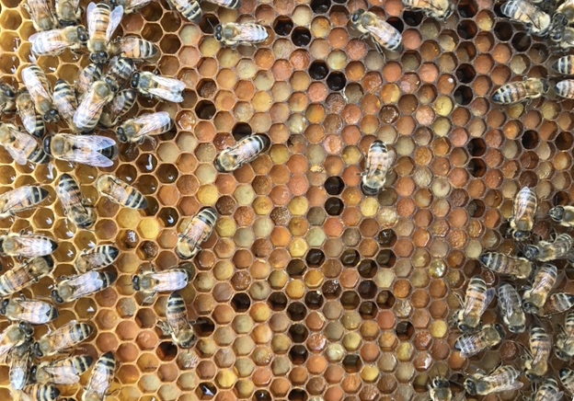
Conventional
[Amitraz]
Organic
[Formic Acid]
Miticide-free
[Control]
Chemical-free
Consistent 15-member core microbiome across miticide treatment groups and sampling locations
Bee bread was exposed to three different miticide treatments

Slide 2
Bee bread was exposed to three different miticide treatments
Conventional
[Amitraz]
Organic
[Formic Acid]
Miticide-free
[Control]
Chemical-free
Consistent 15-member core microbiome across miticide treatment groups and sampling locations

