Slide 1

Raspberry Pi Cluster
By:
George Ward &
Skylar Trendly

Slide 2
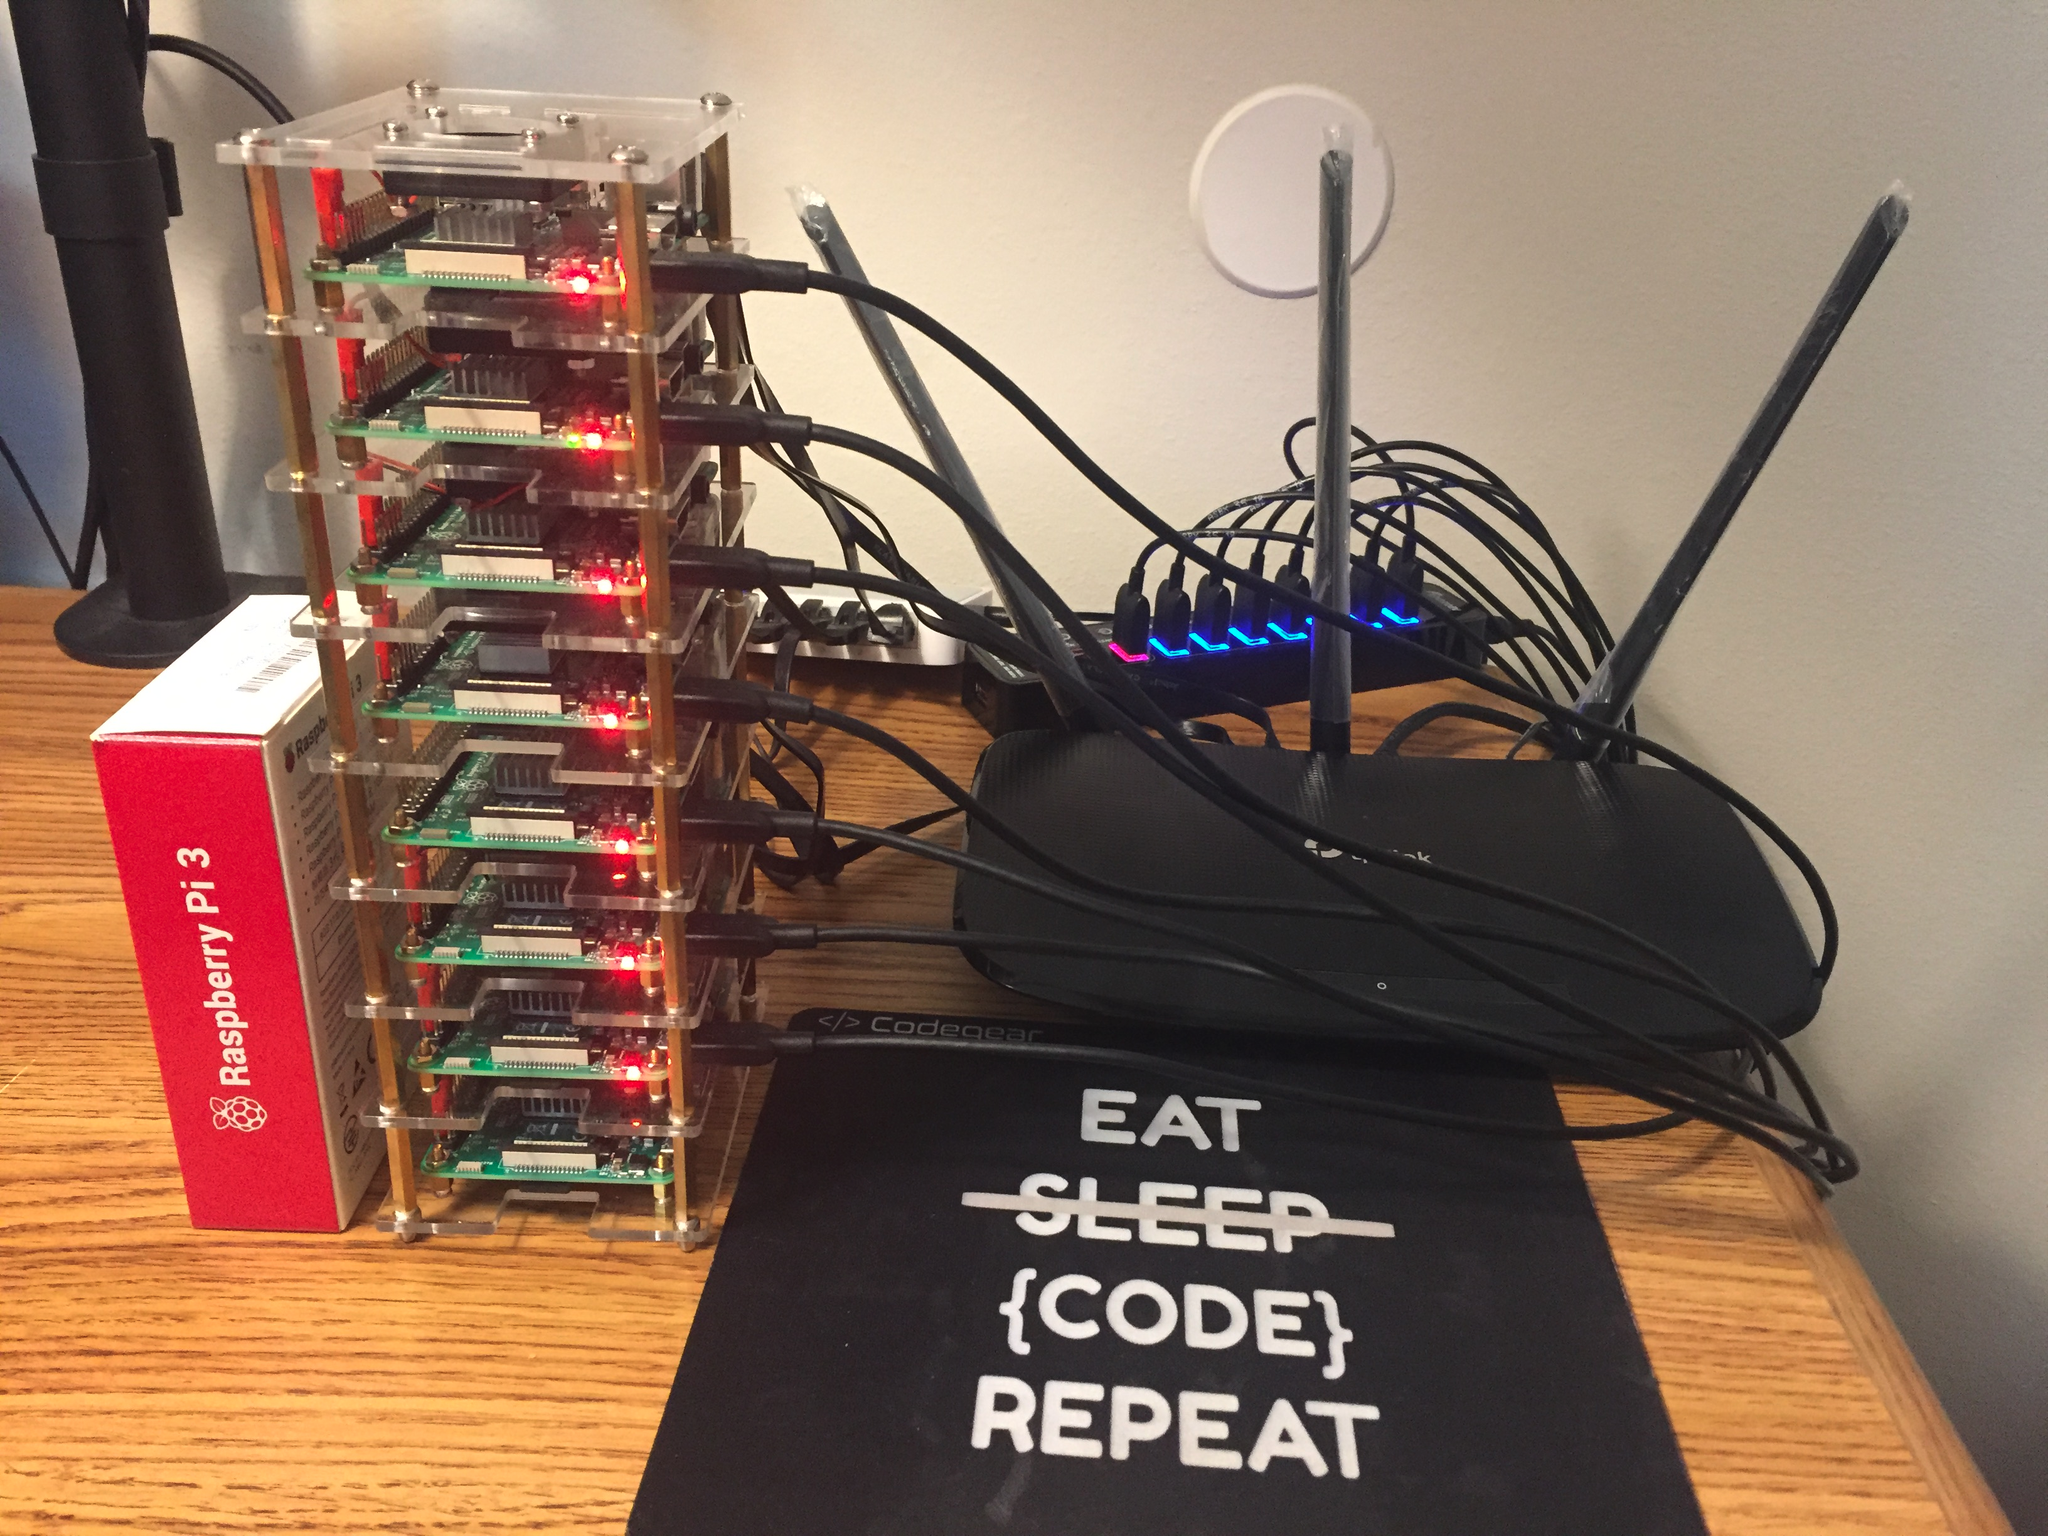
Why Build a Cluster Computer?
  Allows you to work with COOL hardware
  Relatively cheap way to improve computational performance
  Great experience if interested in working with networks
  Learn new tools and way to think about problems
  Great conversation starter during interviews

Slide 3
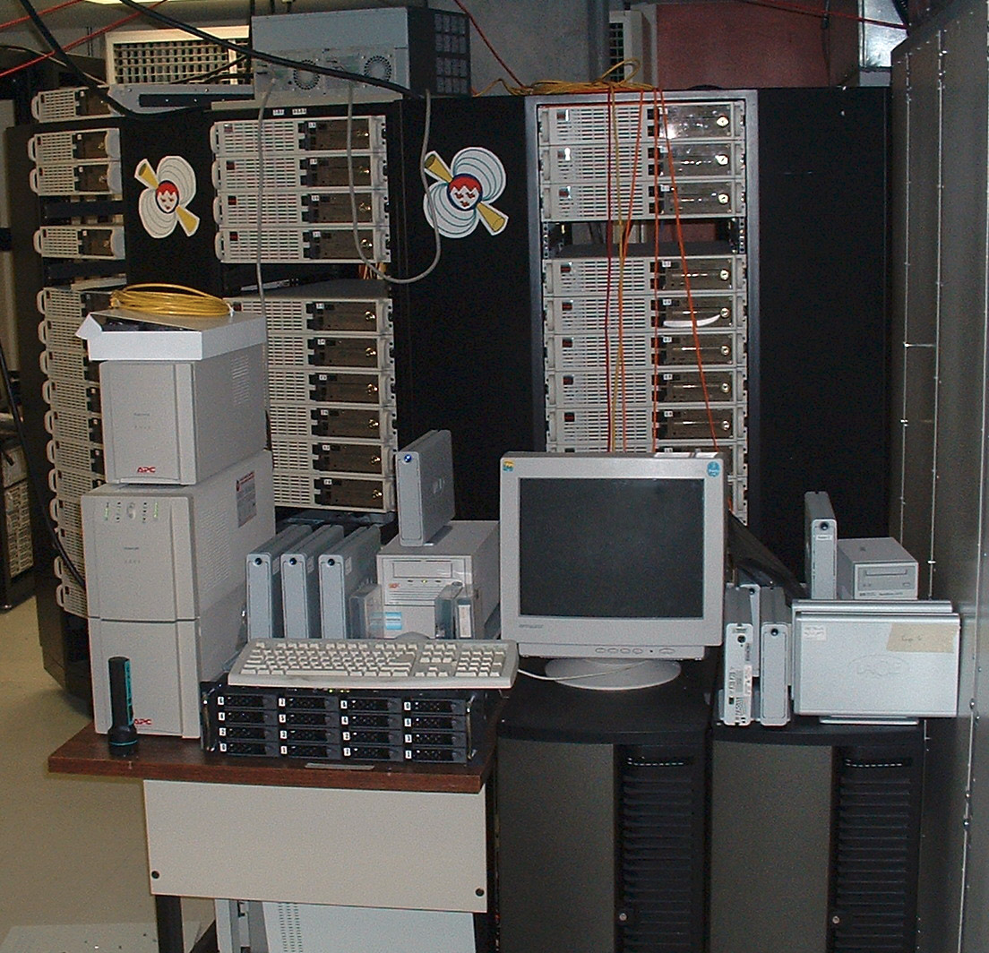
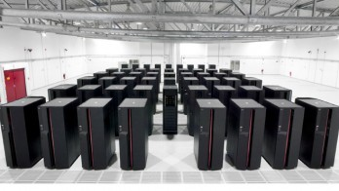
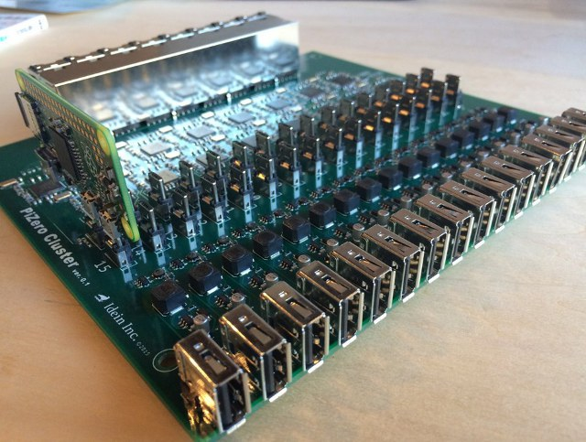
History of Network Computers
Cluster computers were first developed in the 1960’s by IBM as an alternative for linking large mainframes to provide a more cost effective for of commercial parallelism [1]
This was done because Gene Amdahl published a paper describing the how mathematically paralleling processes would increase processing speed over a serially performed task.
The first commercial cluster product was released by Data Point in the 1977.
1995 the Beowulf Cluster was invented (a cluster designed to be a super computer)
Today cluster computers can be made with cheap Raspberry Pi’s bought on Amazon with free 2 day shipping

Slide 4
What is Parallel Computing?
  Parallel computing is the means to accelerate the solution of a given computational problem by employing multiple hardware resources simultaneously
  The efficiency of a computing is dependent on the number of processors to processes, if they are equivalent then you should see the greatest efficiency

Slide 5
Required Items
Equipment
Quantity
Raspberry Pi 3 b+ 8
Micro USB cable 8
USB Hub 1
10 Port Desktop Switch 1
Ethernet Cable 8
16GB SD Card 8
Time ∞

Slide 6
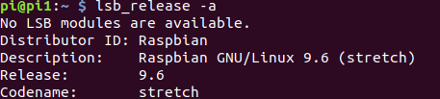
Operating System
For our project we chose to use Raspbian 9.6 as our OS for each of the Pi’s
  Raspbian is a free operating system based on Debian optimized for the Raspberry Pi hardware
  Comes with 35,000 packages, pre-compiled software that makes the installation easy and quite long
  The project was completed in June of 2012, but is still in active development

Slide 7
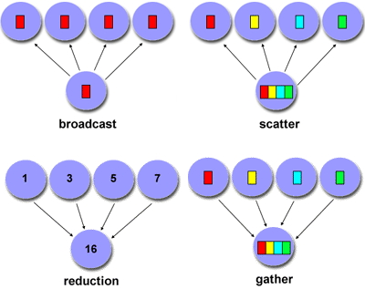
MPI (Message Passing Interface)
https://media.readthedocs.org/pdf/mpi4py/master/mpi4py.pdf
We used mpi4py for communication between each of the Pi’s
This was chosen because of the vast libraries python has for doing mathematical operations such as matrix multiplication, which we used for our tests
Although Python may potentially loose performance rather were looking at development time as this is something both of us have never done before and have a limited time to learn
KEY TERMS/OBJECTS TO KNOW:
Pickling : Process of turning data into a byte stream
Rank : Just a process with unique PID within communicator
Size : number of processes
MPI_COMM_WORLD (object) : All processes of a job, shared communicator
Point-to-Point Comm : Connection between two endpoints or nodes
Collective Comm : Connection between a group of nodes
COMMAND TO RUN IN TERMINAL:
mpiexec -machinefile machinefile -n <num> python <.py file>

Slide 8
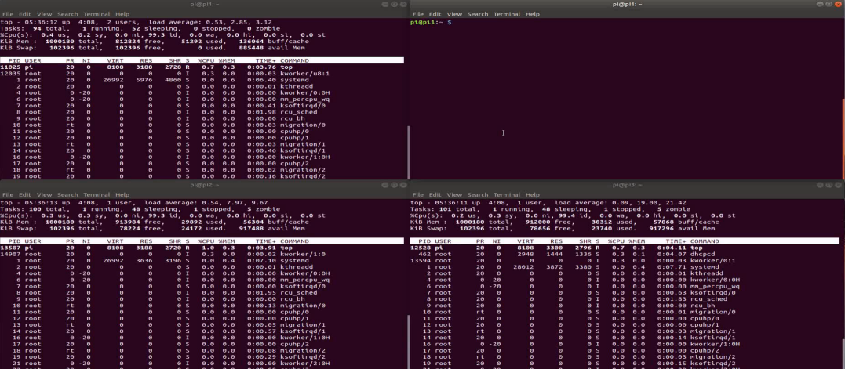
Example of MPI in use

Slide 9
Resources
  [1] https://en.wikipedia.org/wiki/History_of_computer_clusters
  [2] http://www.tinkernut.com/2014/04/make-cluster-computer/
  [3] https://github.com/JordiCorbilla/mpi4py-examples/tree/master/src/examples/matrix%20multiplication
  [4] https://www.open-mpi.org/doc/
  [5] https://mpi4py.readthedocs.io/en/stable/

