Slide 1
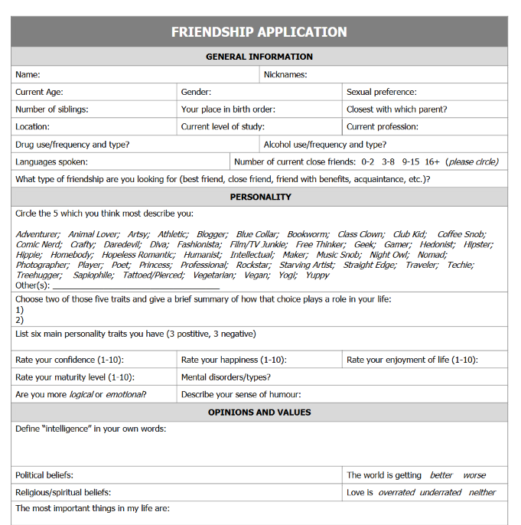
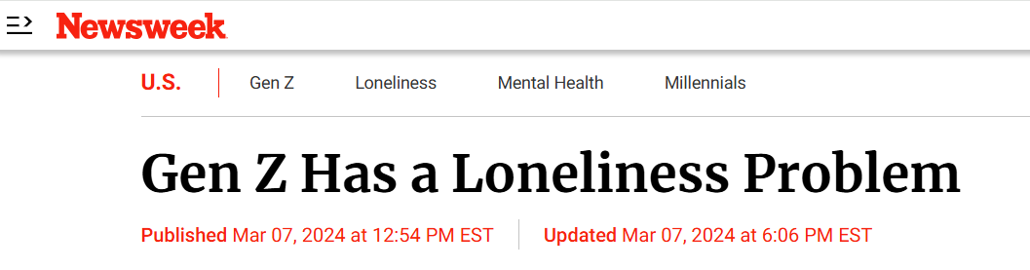

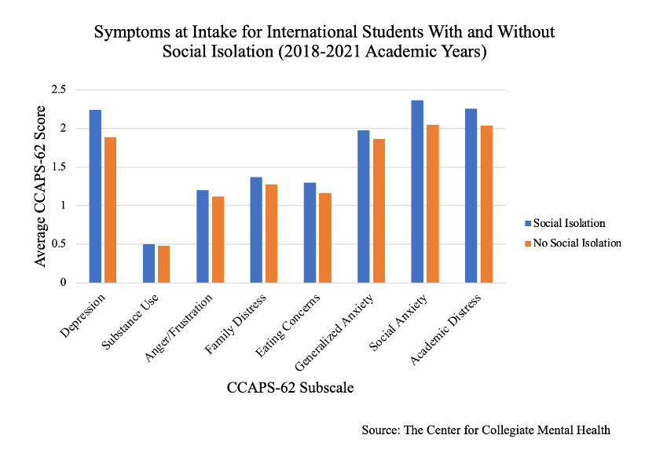
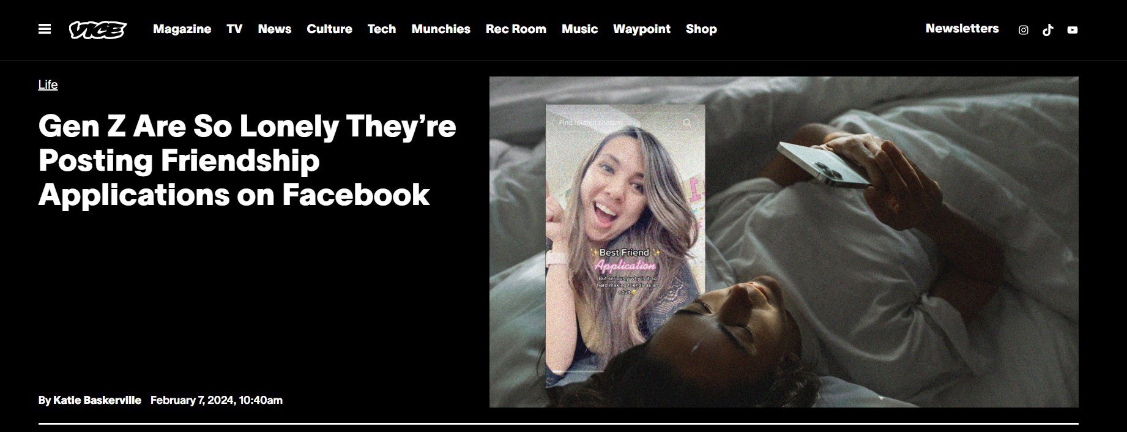
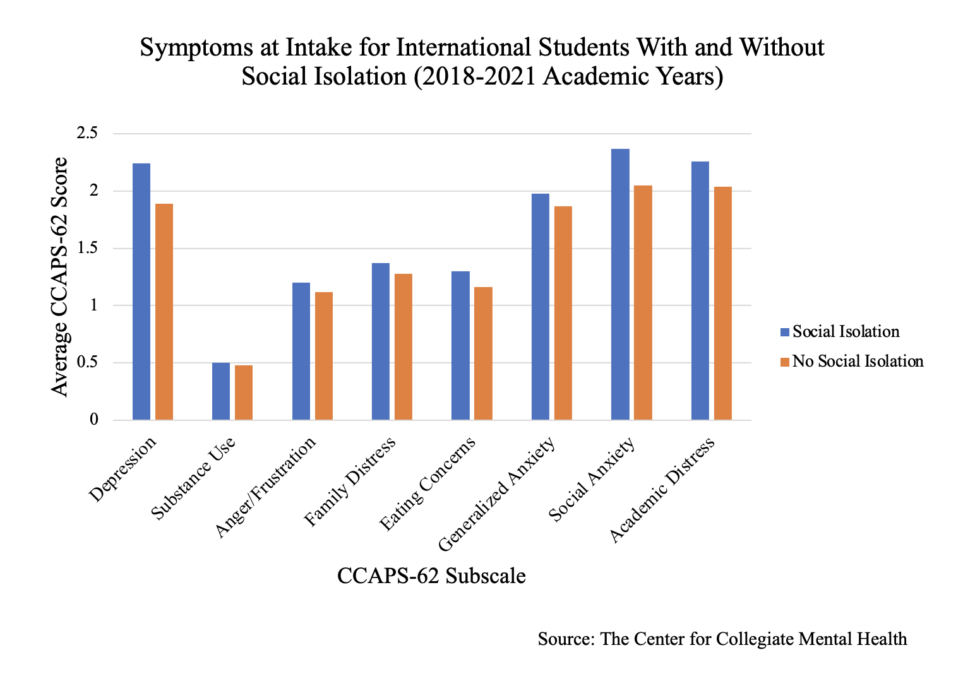


Slide 2

Lifecycle of the Project
1
Caterpillar -
Identifying the Problem
l
2
Chrysalis -
Finding a Solution
3
Butterfly -
Creating the Project

Slide 3
1
Caterpillar
Identifying the Problem

Slide 4
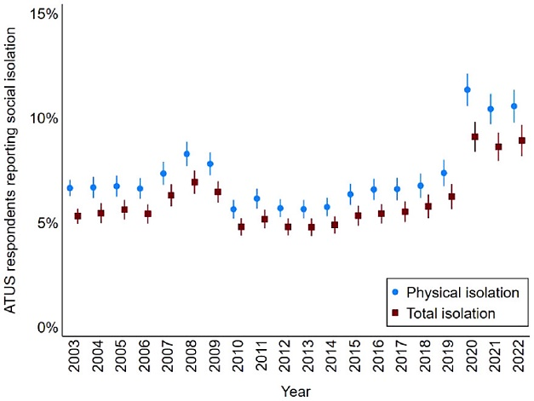
Social Isolation
Social isolation is a condition characterized by a lack of contact with other people and being disengaged from groups and social activities.
Source: BMC Public Health
Globally and across age groups, the incidence of isolation and loneliness is on the rise.
Source: Swiss Rea
Approximately 1 in every 14 ATUS respondents did not engage in a single face-to-face interaction during their diary days from 2003 to 2022.
Source: Sage Journal
American Time Use Survey (ATUS)

Slide 5
Risks of Social Isolation
According to the American Psychological Association, feeling isolated can also impact a person’s immune system.
Studies show that loneliness and social isolation are associated with higher risks for health problems such as
heart disease
depression
cognitive decline
Source: National Institutes of Health, Sapien Labs

Slide 6
2
Chrysalis
Finding a Solution

Slide 7
Changes in Socialisation
Communication is an art. Socialising in a better manner is always a worth mentioning skill. Today’s generation is more comfortable socialising on the internet than in real life.
Source: The Financial Express
Deloitte's survey found that (…) almost half (48%) of these younger generations (Gen Zs, Millennials) engage more with others on social media than in the physical world.
Source: ZDNET
New forms of relationship over the Internet are internalized as daily leisure habits.
Source: world.edu

Slide 8
Social platforms
Social media has provided young people with a number of novel ways to connect with friends, family, and strangers virtually.
Through these interactive platforms, they can share photos, videos, thoughts and emotions instantly and globally. This ability to connect immediately, coupled with a sense of anonymity, has broken down geographic barriers and made it easier for young people to connect with people from around the world.
Social media is a great way to connect people with similar interests, whether it’s sports, music, art, activism, or anything else.
Source: world.edu

Slide 9
Our Solution
A public platform where people can meet and talk
Sign up, but anonimity
Moderated chats to create a safe environment

Slide 10
3
Butterfly
Creating the Solution

Slide 11

Mariposa - The Social Butterfly

Slide 12

Mariposa is…
a messaging site on the web that lets people talk to others, while offering the chance to stay safe and anonymous.

Slide 13
What is a Social Butterfly?
A "social butterfly" describes someone who's socially oriented, outgoing, and often very charismatic and charming.
Source: mindbodygreen

Slide 14
Anatomy of the Butterfly – How it works

Slide 15
backend: Dávidra bízom a tartalmat
Adatbázis szerkezet
Hogyan működik csak az üzenetküldés
Paginator

Slide 16
backend: Dávidra bízom a tartalmat

Slide 17
backend: Dávidra bízom a tartalmat

Slide 18



Frontend
kép
Bootstrap - Floating labels, Scrollspy, Grid
SweetAlert – Popup alerts
CSS grid – Responsivity, alignment

Slide 19
Frontend
Immediate response to password input

Slide 20
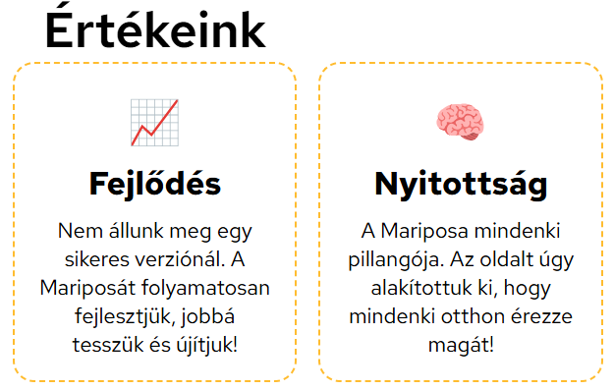
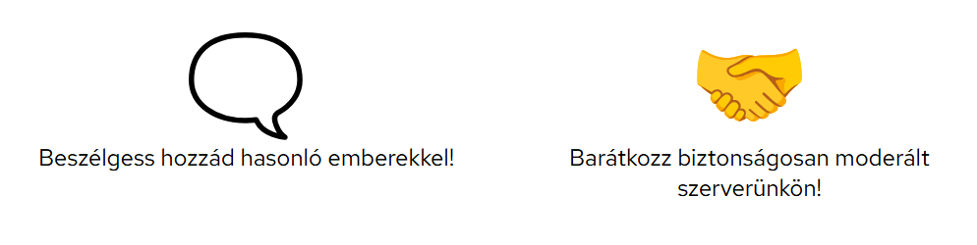
Look and Feel
1. Meaningful brand colour inspired by real butterflies
2. Use of emojis as icons for „chatty” feeling
#ffbc2f
RGB(255, 188, 47)
CMYK(0%, 26%, 82%, 0%)
„Orange is a vibrant and energetic color that represents enthusiasm, creativity, and warmth.”
Source: https: Color Psychology
Font: Noto Color Emoji

Slide 21

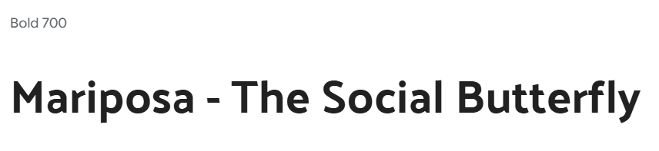

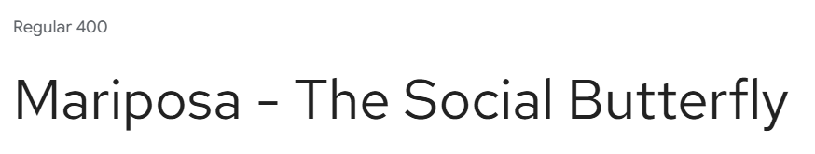
Look and Feel
3. Three different brand fonts for clearer user view
4. Cheerful, original graphics
The brand font: Palanquin
For buttons and navigation links: Albert Sans
For texts and messages: Red Hat Text
Image besides support message form
Drawn by Xénia

Slide 22
Look and Feel
5. Simple sign up form with only necessary data
6. Thematic email design

Slide 23
Inclusivity, diversity and accessibility
There is substantially less research on loneliness and isolation among [marginalised groups, such as] diverse gender identities and sexual orientations and neurodivergent population. This is important given those at the greatest social disadvantage and marginalization may have the highest rates of loneliness and social isolation, and may also have heightened risk for becoming lonely and/or isolated.
Source: BMC Public Health
Social media has become a key vector for critical thinking, (…) while promoting values ​​such as pluralism, freedom, cultural democracy, participation social, personal autonomy and human relations.
Source: world.edu

Slide 24
Inclusivity, diversity and accessibility
1. Changable gender
2. Zero tolerance for hatespeech
3. Clear policy promoting kindness and empathy
4. Using alternative text for visually impaired people

Slide 25
Test Flight
- Testing

Slide 26
Auto tests
Login
Delete partner
Report partner
Navigation

Slide 27
Manual tests
Registration

Slide 28
Working in a Colony
- Hardships and overcomings

Slide 29
Közös kép, és megvilágítás
Our Team
Dávid Gócza
Xénia Roxána Csizmadia
Kamilla Anna Horváth
Co-copywriter
Lead Designer
Project Manager
Frontend Dev

Slide 30
Jira clockwork

Slide 31
Second Metamorphosis
- Future of Mariposa

Slide 32




Future Updates
Who let the moths out?
Social Points
Night Mode including thematic change
Collecting Flowers, an opportunity for monetization
AI usage
Around the world
Implementing AI for hateword filtering
Multiple language platform, international servers

Slide 33
What is Left
Algorithm for Interests
JSON of interests
Profile settings set up to choose interests

Slide 34


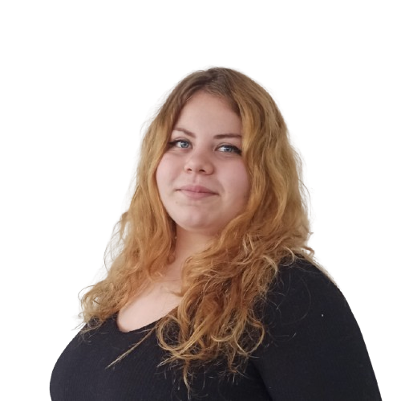


Thank You For Your Attention!
Dávid Gócza
Xénia Roxána Csizmadia
Kamilla Anna Horváth
Mariposa
This presentation includes icons by Flaticon, and pictures by Freepik. Other image sources: Google

Slide 35
Képek:
https://www.vice.com/en/article/friendship-applications-gen-z-loneliness/
https://www.weforum.org/stories/2023/11/who-lonelines-health-priority-weekly-health-roundup/
A vizsgarész során a vizsgázó gyakorlati bemutatóval összekapcsolt szóbeli előadás formájában mutatja be a
• szoftver célját,
• műszaki megvalósítását,
• működését,
• forráskódját,
• a csapaton belüli munkamegosztást, a fejlesztési csapatban betöltött szerepét, a fejlesztés során használt projektszervezési eszközöket.
A fentieken túl maximum 3-5 perces angol nyelven tartott szóbeli előadás formájában összefoglalót ad a szoftver céljáról és működéséről, valamint angolul válaszol a vizsgáztató végfelhasználói szerepben feltett maximum 2-3 kérdésére.

