Slide 1
VELALAR COLLEGE OF ENGINEERING AND TECHNOLOGY DEPARTMENT OF COMPUTER SCIENCE ENGINEERING IMPROVED DETECTION AND PREVENTION MECHANISMS FOR DDOS ATTACK IN CLOUD COMPUTING ENVIRONMENT
BATCH NO -17
GUIDED BY, PRESENTED BY,
MOHANASUNDARI M AATHISH B (18CSR003)
DHARSHAN G ( 18CSR019)
KAVIN KUMAR M (18CSR043)

Slide 2
DOMAIN
Machine learning
Machine learning (ML) is a type of artificial intelligence (AL) that allows a software application to become more accurate at predicting outcomes without being explicitly programmed to do so. Machine learning algorithms use historical data as input to predict new output values.

Slide 3
OBJECTIVE
The massive diverse network which is connected over the cloud produces various traffic patterns. These patterns are analyzed and identify the DDoS attacks based on their anomaly of its nature.
The main objective of the project is to detect the DDoS attack on the cloud computing environment effectively in less time with machine learning algorithm and show it in comparison.

Slide 4
INTRODUCTION
For effective use of cloud resources and to reduce the latency of cloud users, the cloud computing model extends the services such as networking facilities, computational capabilities, and storage facilities based on demand.
Due to its widely distributed nature many challenges occur such as privacy, security, and availability due to its dynamic resource provisioning based on the on-demand requests.
Among these various issues one of the important issues in the cloud computing paradigm is DDoS attack.
DDoS (Distributed Denial of Service) in which the attacker gains illegal administrative access to as many computers on the Internet as possible and uses multiple computers to send a flood of data packets to the target computer or a server and make it way less accessible to the user.

Slide 5
EXISTING SYSTEM
The existing system uses LSTM-cGAN, Random Forest algorithm, Naïve Bayes algorithm.
These methods are based on Signature-based detection, which detects only a specific pattern and alerts the server.

Slide 6
DRAWBACKS OF EXISTING SYSTEM
This method can be only used in the storage layer.
Consist of data storage risk
Cloud terminal risk is high
The risk of cloud terminal infection or attack by the virus cannot be solved.

Slide 7
PROPOSED SYSTEM
By employing C.4.5 algorithm based on a machine learning approach DDoS attacks can be efficiently handled in the cloud computing environment.
When flooded traffic is found in a network then immediately it is been analyzed.
The attacks will be identified and an immediate response will be taken to drop the malicious traffic.
To adapt to these patterns, machine learning algorithms are used by the cloud networks.

Slide 8
ADVANTAGES OF PROPOSED SYSTEM
DDoS attack is based on attack traffic distribution, attacking method, and attacking rate, all misclassification error models can be identified
Privacy issues are solved by using the proposed algorithm
Time execution is less
High accuracy.

Slide 9
LITERATURE SURVEY
TITLE | AUTHOR | METHODOLGY | DRAWBACKS
Detection and Prevention Mechanisms for DDoS Attack in Cloud Computing Environment | Sirisha Potluri,Suneeta Satpathy , and Monika Mangla Journal: 2020 | This paper put in plain words the DDoS attack, its detection as well as prevention mechanisms in cloud computing environment. The inclusive study also explains about the effects of DDoS attack on cloud platform and the related defense mechanisms required to be considered. | The classification method used in this paper is not accurate.

Slide 10
TITLE | AUTHOR | METHODOLGY | DRAWBACKS
DDOS Mitigation In Cloud Computing Environment By Dynamic Resource Scaling With Elastic Load Balancing | A. Somasundarama , Dr. V. S. Meenakshi Journal: 2021 | This Dynamic auto resource scaling method exploits the usage of two components such as verification module and elastic load balancer in order to detect and mitigate the DDoS attack commendably. | Dynamic auto resource scaling is much costlier and cannot be adopted in real-time by the service provider with a low budget

Slide 11
TITLE | AUTHOR | METHODOLGY | DRAWBACKS
Distributed Denial of Service Attacks in Cloud Computing | Hesham Abusaimeh Journal: 2020 | cloud security problems and some security mechanisms focus on eliminating and emphasizing them. Despite the need to reinforce existing security measures to provide more security in the cloud environment. | This damage may cause to stop the cloud service and may consume losing the data stored in the cloud without any backup or replica

Slide 12
MODULE
KDD Dataset
Numeric to Nominal Conversion
Feature Selection
Machine Learning and Evalution

Slide 13
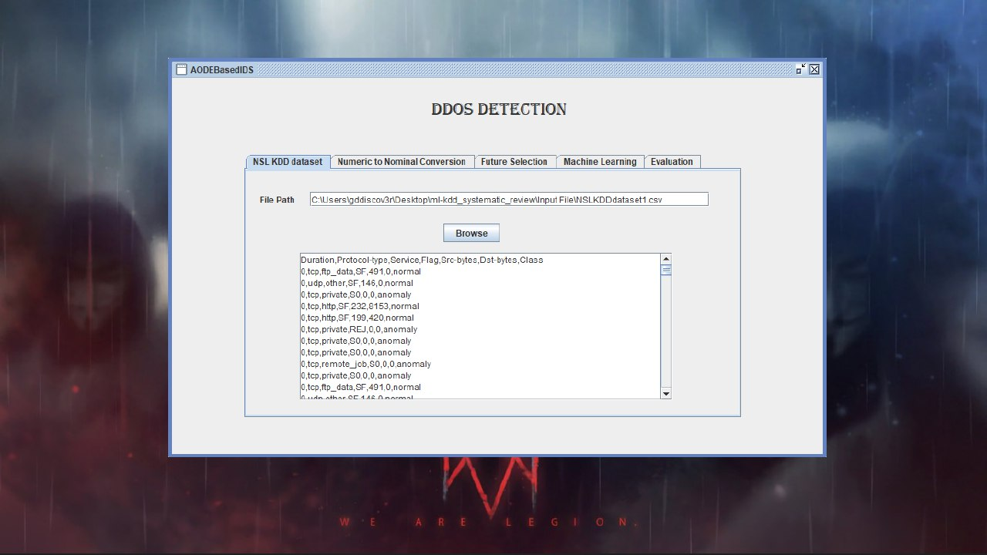
KDD DATASET
KDD Dataset which resembles the real time networks, is being used to test the Intrusion Detection System (IDS) we have built and help us check it’s performance by putting similar other existing techniques in comparison.

Slide 14
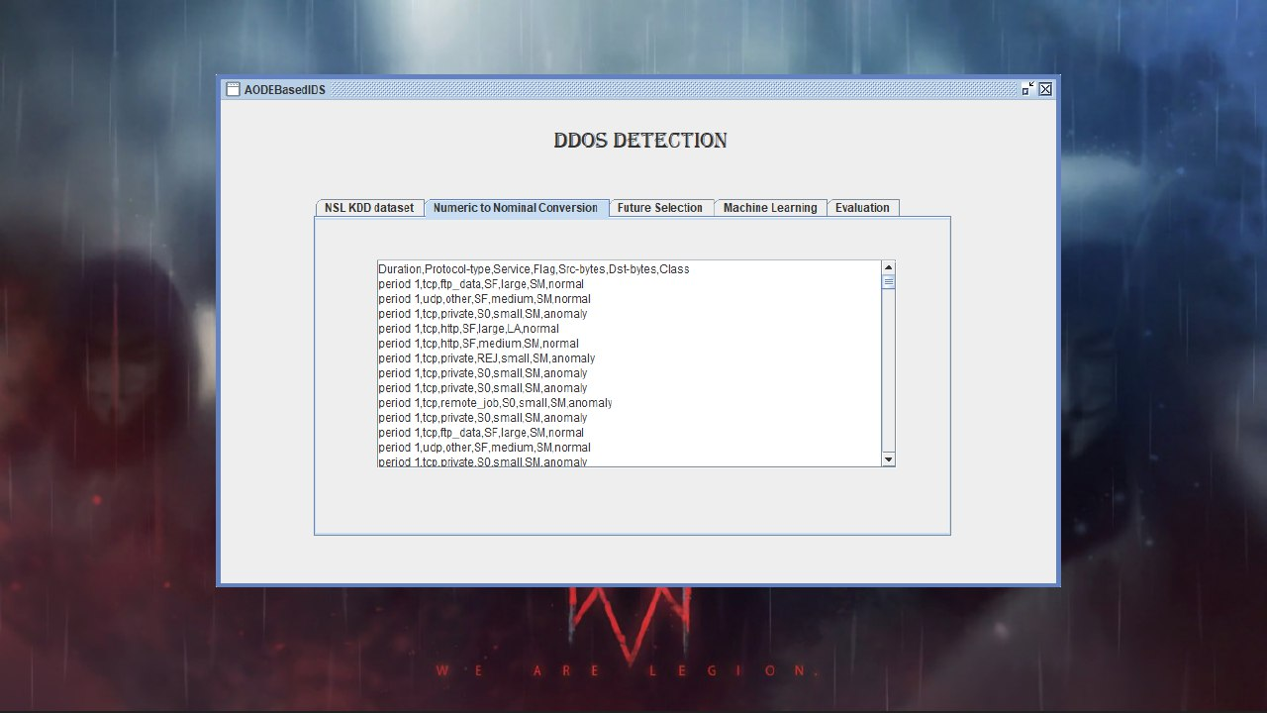
NUMERIC TO NOMINAL CONVERSION
The numeric data provided by the data set are converted into the nominal values using the numeric to nominal conversion operator and the relevant nd irrelevant data are differentiated.

Slide 15
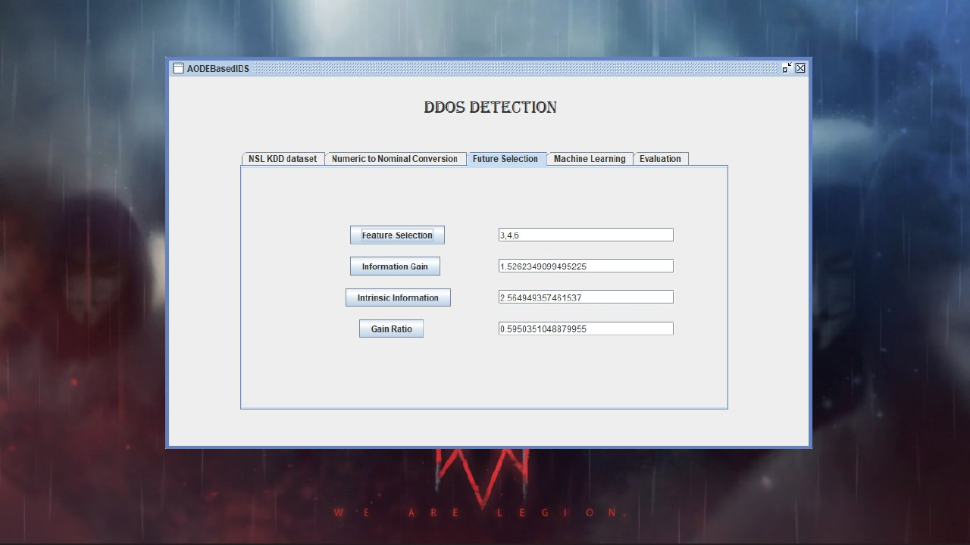
FEATURE SELECTION
In Feature selection module, we filter the nominal converted values based on its relevance and the data that are not in correlation are being filtered out. Based on this, information gain, intrinsic information and gain ratios are generated so that a better classification for the decision tree can be carried out.

Slide 16
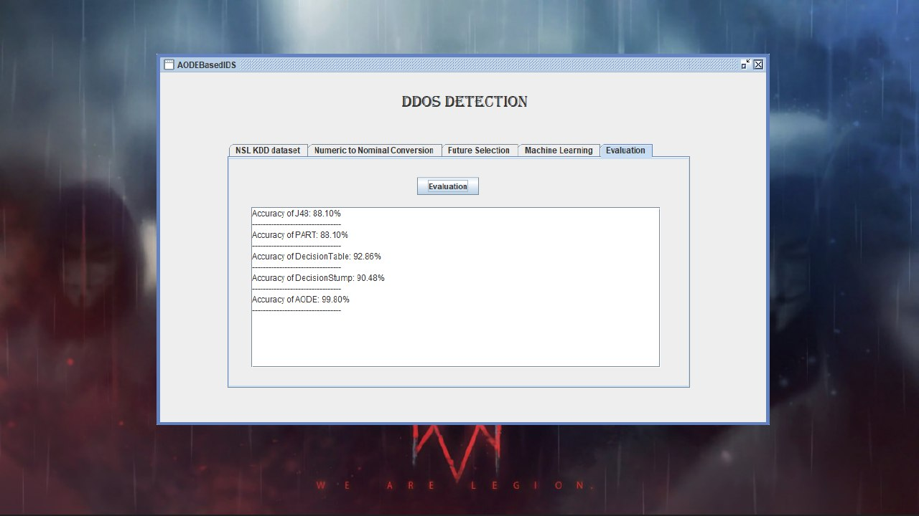
MACHINE LEARNING AND EVALUTION
After the selection process, the normal and anomaly traffics are detected by the c4.5 algorithm along with others that are also implemented and the accuracy of each algorithm are compared to show the effectiveness of the main algorithm.

Slide 17
PREVENTION OF DDOS ATTACKS
Installing and maintaining antivirus software
Establishing firewalls configuration (Cloudflare)
Implementing a CAPTCHA for your web server is purely recommended.

Slide 18
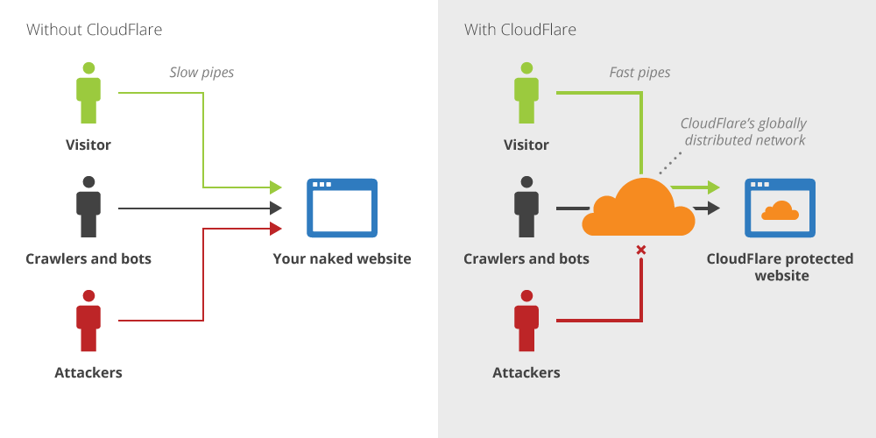
Firewall

Slide 19
CAPTCHA

Slide 20
DETECTION ACCURACY

Slide 21
CONCLUSION
It is compared with conventional detection algorithms that utilize only the distribution of the number of lost packets, exploiting the correlation between lost packets significantly improves the accuracy in detecting malicious packet drops.
Such improvement is especially visible when the number of maliciously dropped packets is comparable with those caused by link errors.
To correctly calculate the correlation between lost packets, it is critical to acquire truthful packet - loss information at individual users.
auditing architecture developed that ensures truthful packet - loss reporting by individual nodes.

Slide 22
Future work
Deep learning has given a lot more efficient and quicker results than any other algorithms. So, in the future, we will try to implement deep learning technique for the classiﬁcation of the instances.

Slide 23
REFERENCES
A. Singh, U. Chandra, S. Kumar and K. Chatterjee, "A Secure Access Control Model for E-health Cloud," TENCON 2019 - 2019 IEEE Region 10 Conference (TENCON), Kochi, India, 2019, pp. 2329-2334.
P. J. Sun, "Privacy Protection and Data Security in Cloud Computing: A Survey, Challenges, and Solutions," in IEEE Access, vol. 7, pp. 147420-147452, 2019.
W. Ahmad, S. Wang, A. Ullah, Sheharyar, Z. Mahmood, "ReputationAware Trust and Privacy-Preservation for Mobile Cloud Computing," in IEEE Access, vol. 6, pp. 46363-46381, 2018.
W. Jiannan, W.Xiaojie, L. Nan, Y. Guomin, M. Yi, "A PrivacyPreserving Fog Computing Framework for Vehicular Crowdsensing Networks" (2018). Faculty of Engineering and Information Sciences, vol. 6, pp. 43776-43784, 2018 .
M. Zekri, S. E. Kafhali, N. Aboutabit and Y. Saadi, "DDoS attack detection using machine learning techniques in cloud computing environments," 2017 3rd International Conference of Cloud Computing Technologies and Applications (CloudTech), Rabat, 2017, pp. 1-7.

Slide 24
ThankYou

