Slide 1



Disaster Recovery with Google Cloud Firestore Backup
Implementing a robust disaster recovery solution leveraging Google Cloud Platform's Firestore and Cloud Workflows.

Slide 2
Disaster Recovery Solution Overview
Continuous Backup
Rapid Restoration
Automated backups of Firestore data on a scheduled basis.
Quick recovery of data using Cloud Workflows in the event of an outage.
Secure Storage
Scalable Solution
Backups stored securely in a separate GCP region.
Handles growing data volumes and changing business needs.

Slide 3
Leveraging Google Cloud Platform
Firestore Database
Cloud Workflows
Cloud Storage
Fully managed NoSQL document database for storing application data.
Serverless workflow orchestration for automating backup and recovery processes.
Highly durable and secure object storage for backing up Firestore data.

Slide 4
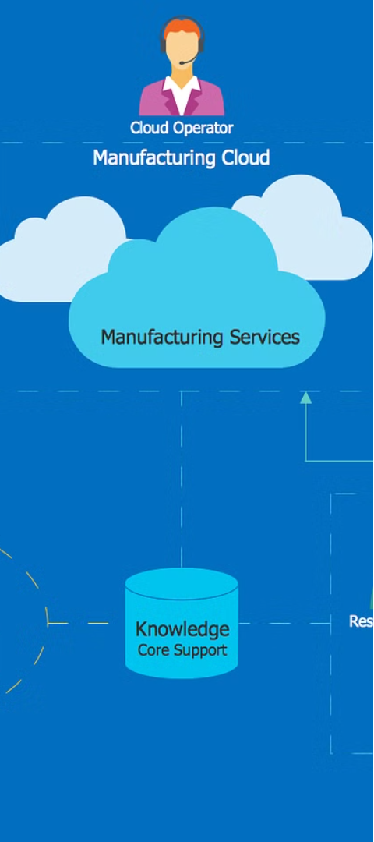
Firestore Backup with Cloud Workflows
1
Backup Trigger
Cloud Workflow triggered on a scheduled basis to initiate Firestore backup.
2
Data Extraction
Workflow exports Firestore data to Cloud Storage as a backup file.
3
Backup Verification
Workflow checks the integrity of the backup file before completing.

Slide 5




Workflow Design and Automation
Workflow Orchestration
Leveraging Cloud Workflows to coordinate backup and recovery steps.
Automated Execution
Scheduled workflows run without manual intervention for consistent backups.
Scalable Workflows
Workflows scale to handle increasing data volumes and changing requirements.

Slide 6
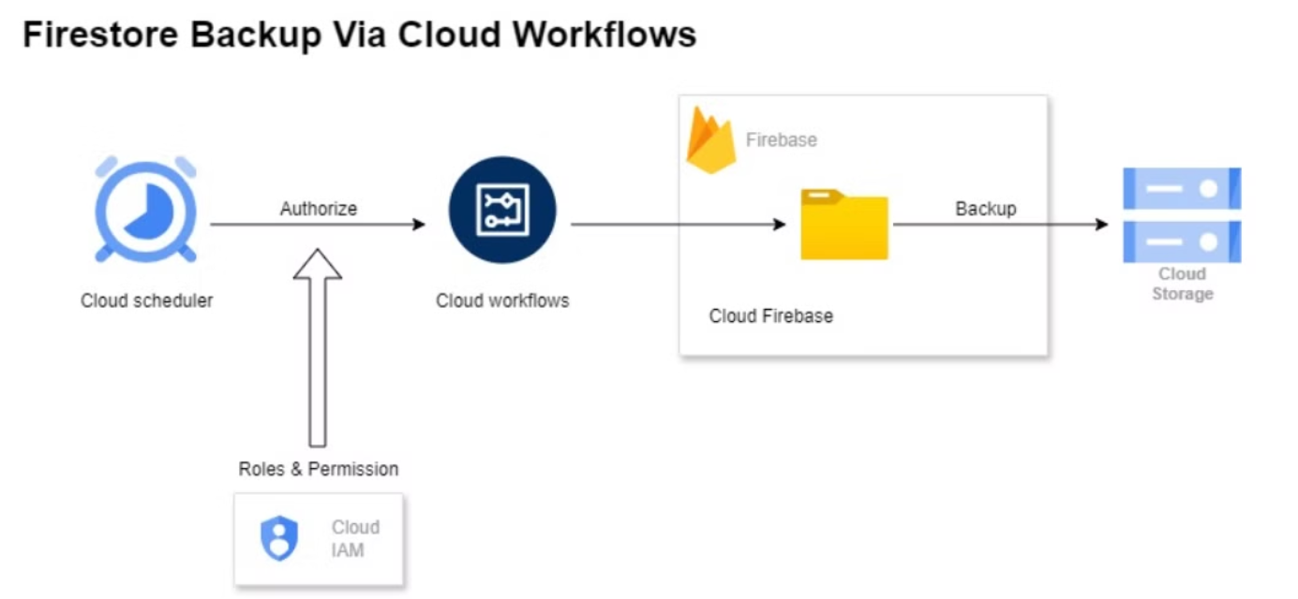
ARCHITECTURE DIAGRAM

Slide 7
Conclusion and Key Takeaways
1
Resilient Solution
2
Automated Workflows
Robust disaster recovery capabilities to protect critical business data.
Streamlined backup and recovery processes with minimal manual intervention.
3
Cost-Effective
4
Continuous Improvement
Leveraging the scalability and efficiency of Google Cloud Platform.
Ongoing testing and optimization to ensure the solution remains effective.

