Slide 1
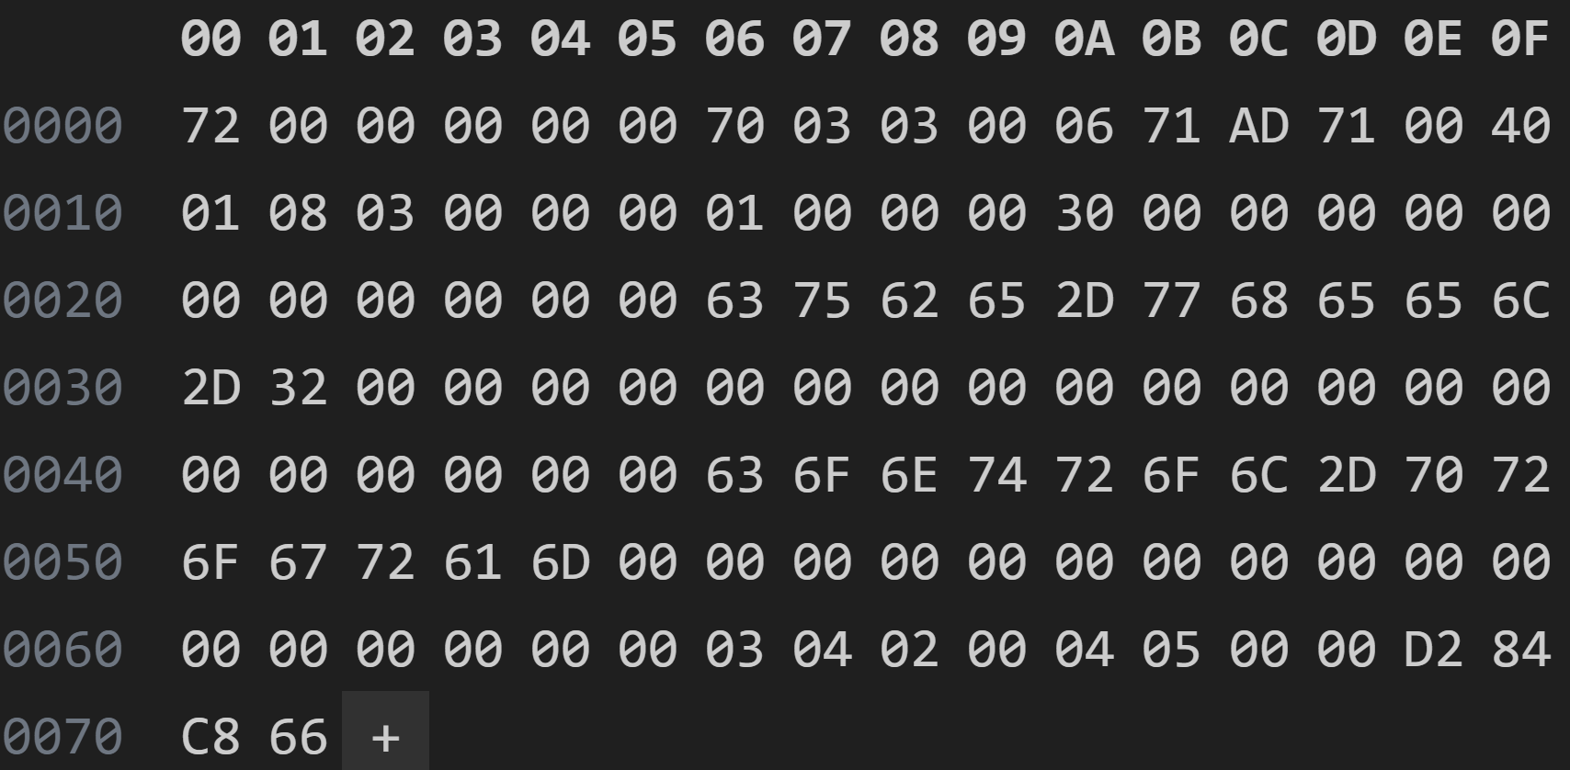
Header Length File Length CRC Write Address UNK
Device Label Software Label Firmware # Version # Build Time

