Slide 1
基于深度学习的掌纹识别算法研究
Reporter: Jinyang Yang Student ID: 18S051015
Set 08,2019

Slide 2
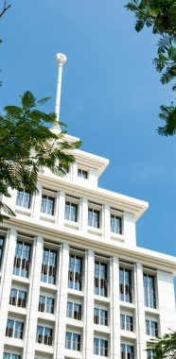
01
Research Background
02
Literature Review
03
Research Method
04
Conclusion

Slide 3
Research Background
PART I

Slide 4
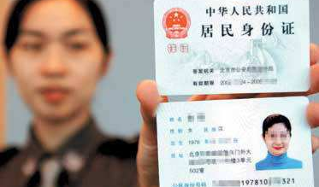
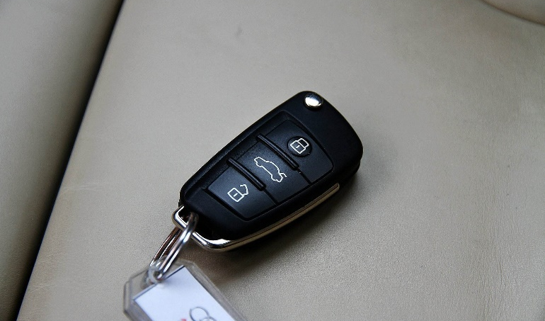
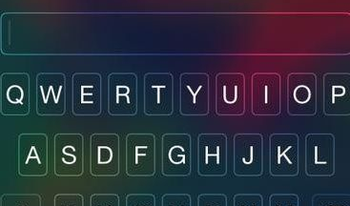
1 Traditional Identity Authentication
ID card
Forget to take,
Can forge.
Keys
Forget to take,
Be stollen.
Password
Vulnerable if too short,
Hard to remember,
Can be guessed.

Slide 5
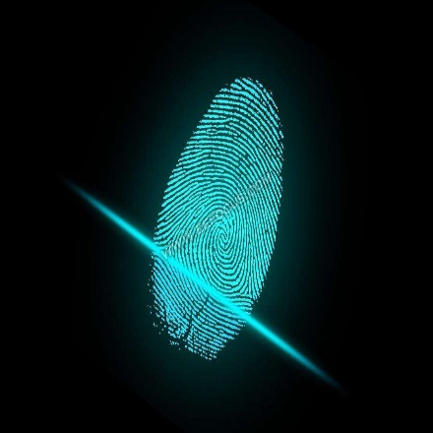
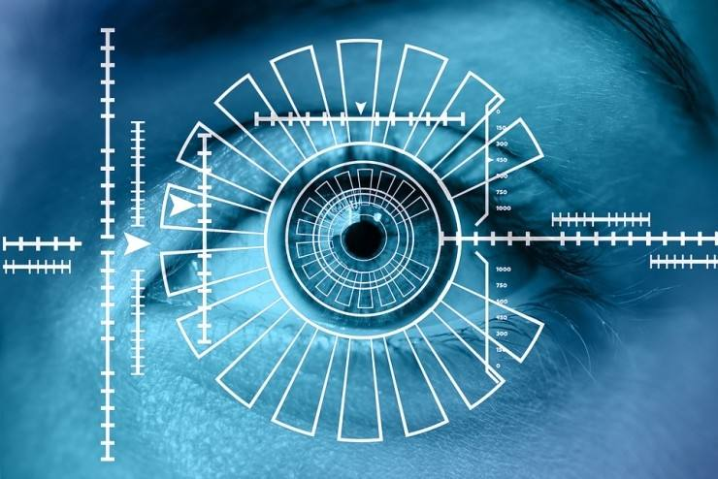
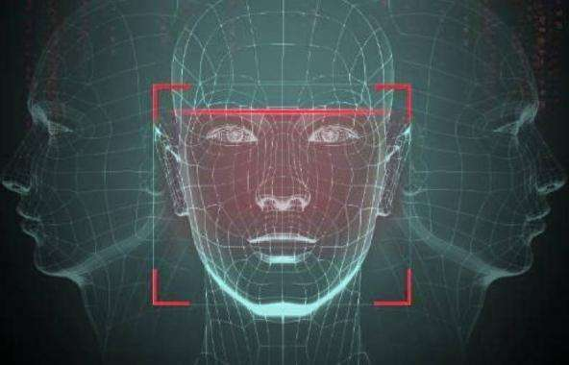
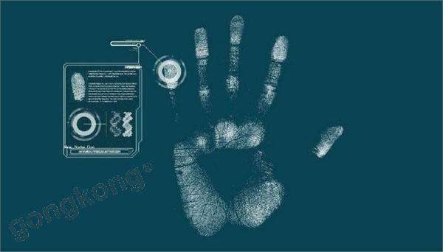
2 Biometric Identity
Fingerprint
Small
Quick
Cheap
Iris
Secure
Face
Convenient
Precise
Palmprint
Convenient
Quick
Precise
Cheap

Slide 6
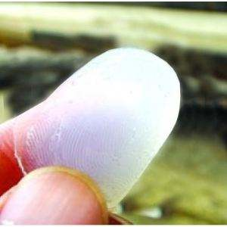
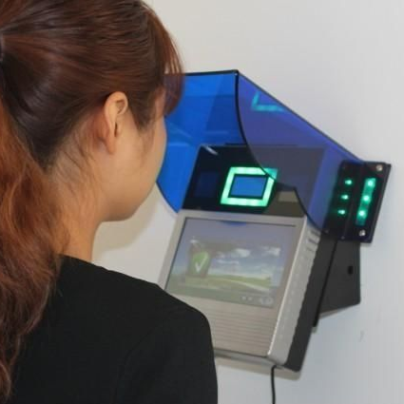
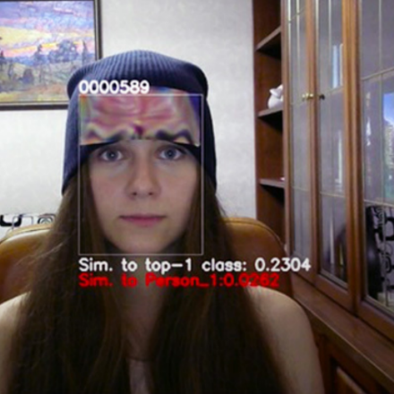
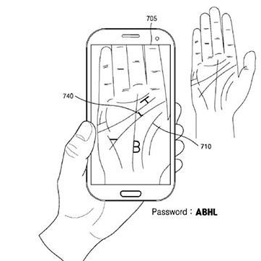
3 Palmprint vs. Others
Fingerprint
Fake fingerprint
Water sensitivity
Iris
Large device
Expensive
Face
Not secure
Not robust
Palmprint
Convenient
Quick
Precise
Cheap

Slide 7
Literature Review
PART II

Slide 8
Timeline of Palmprint Recognition
2003
2004
2006
2011
2014
D. Zhang, IEEE Trans. PAMI ^{[1]}
ROI: coordinate system
Feature: 2D Gabor phase encoding
W.-K. Kong
,ICPR ^{[2]}
Feature: Compatitive Code
A. Kong,PR ^{[3]}
Feature: Fusion Code
J. Dai, IEEE Trans. PAMI ^{[4]}
High resolution
Feature: multipe feature
X. Wu,PR ^{[5]}
contactless
Feature: SIFT

Slide 9
Timeline of Palmprint Recognition
2015
2016
2017
2018
D. Zhao, Proc. ICWMMN ^{[6]}
contactless
Feature: deep learning
L. Fei,PR ^{[7]}
contactless
Feature: Double-orientation code
Matching: nonlinear matching
W. Jia, IEEE Trans. IP ^{[8]}
contactless
Feature: complete direction representation
Yang Liu,arXiv ^{[9]}
contactless
Feature: deep learning

Slide 10
Inadequacy of predecessors
ROI
Sensitive to luminance, rotation
Dependent on palm segmentation
Feature basing on local texture descriptors
Handcrafted feature extraction, with manual optimal parameters
No standard data acquiring device
Deep CNN
Supervised training, require training data
Use general-purpose filters (e.g., filters pretrained on general image classification databases)
Lack experiment across databases
Lack comparisons with recent local texture descriptors based methods
Not generalized enough for identifying new unseen classes

Slide 11
Research Method
PART III

Slide 12
Process of palmprint recognition
STEP 1
STEP 2
STEP 3
STEP 4
Preprocess
ROI alignment
Feature extraction
Matching & recognize

Slide 13
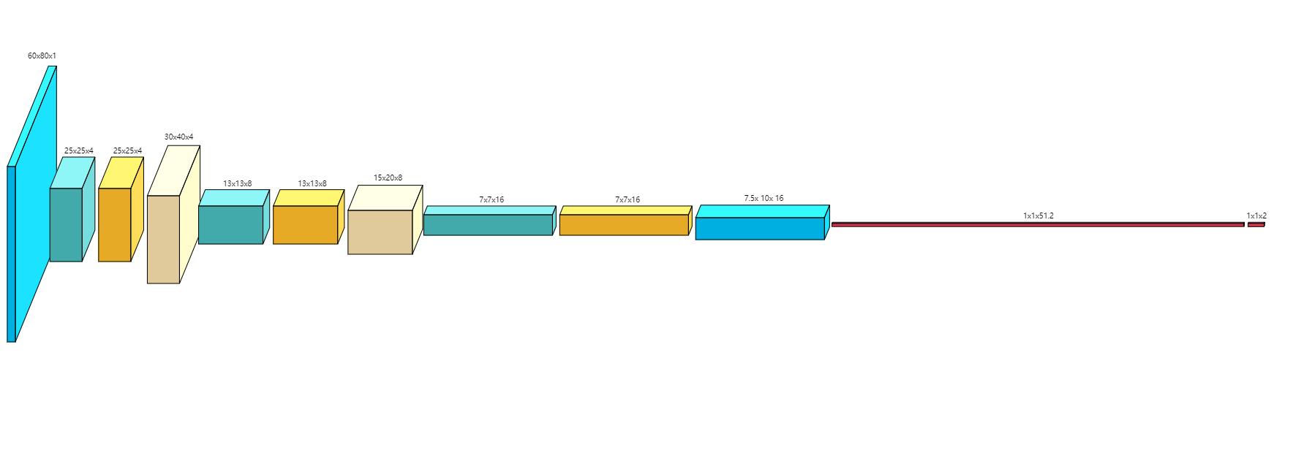
Preprocess
Left and Right Hand classify
Traditional method: Haar features
Dataset tells it

Slide 14

Preprocess
Palm segmentation
OTSU threshold segmentation performs not good
Fixed threshold is not adapt to changing environment
We propose a CNN based threshold regressing method

Slide 15
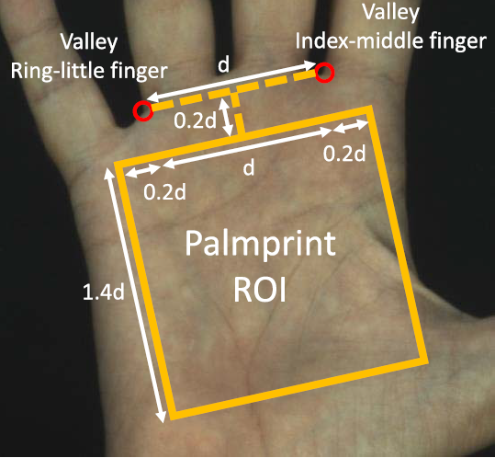
ROI alignment
Zhang’s ROI method
Advantage:
Not sensitive to scale and translation
Drawback:
Not easy to find two valley (line scanning based, curvature based, fixed region based, corner detection based)

Slide 16
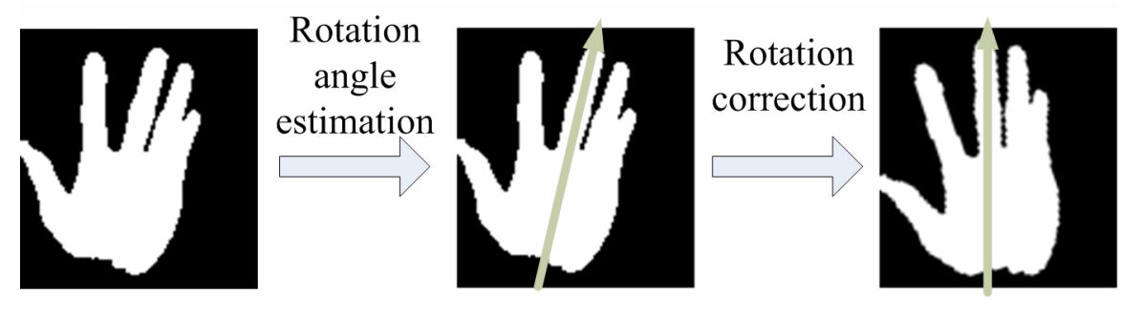
ROI alignment
Improved Zhang’s ROI method
Estimate and adjust rotation + line scanning
Followed by Zhang’s method

Slide 17
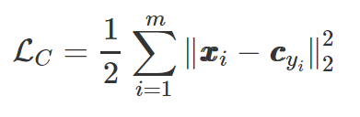
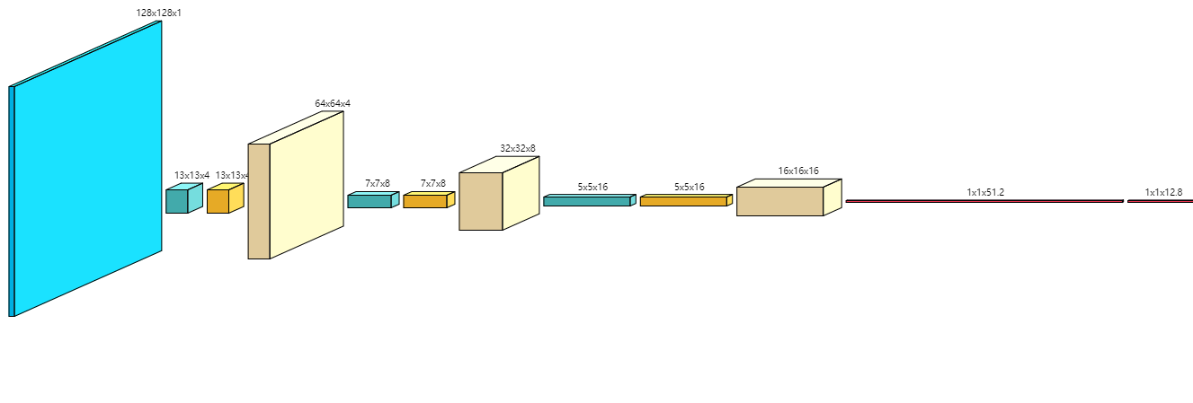
Feature extraction
Discriminative feature learning ^{[10]}
Center loss

Slide 18
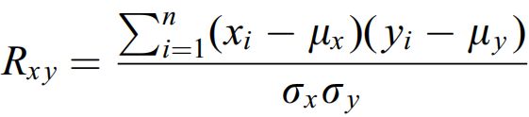
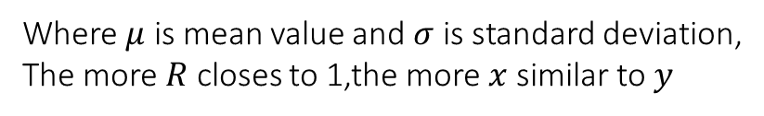
Matching
Matching using the correlation function
correlation function :
Where $μ$ is mean value and $σ$ is standard deviation,
The more $R$ closes to 1,the more $x$ similar to $y$

Slide 19
PART IV
Conclusion

Slide 20
Major jobs
Palmprint images taken from less constraint environment are hard to separate form complex background, we propose a CNN to adaptively find out palmprint segmentation parameter
Propose a CNN to estimate rotation of palmprint image, which is re-useable by left and right hand classification and palmprint segmentation
Put forward another CNN with center loss to extract palmprint feature from ROI image, expecting a better result than popular orientation and texture based feature extracting method
Apply correlation function rather than Hamming distance in palmprint matching, which may earns a bit of performance

Slide 21
Dataset
NAME | SUBJECTS | TOTAL IMG | CONTACTLESS
PolyU ^{[11]} | 193 | 7752 | ✗
CASIA ^{[12]} | 312 | 5500 | ✓
IITD ^{[13]} | 230 | 2600 | ✓
GPDS ^{[14]} | 100 | 100 | ✓
Tongji ^{[15]} | 300 | 6000 | ✓
HITsz | 346 | 1336 | ✓

Slide 22
References
[1] Zhang, D., Kong, W.K., You, J., Wong, M.: Online Palmprint Identification. IEEE Trans on PAMI 25(9), (2003)
[2] A. W.-K. Kong and D. Zhang, “Competitive coding scheme for palmprint verifification,” in Proc. Int. Conf. Pattern Recognit. (ICPR), 2004
[3] A. Kong, D. Zhang, and M. Kamel, “Palmprint identifification using feature-level fusion,” Pattern Recognit., vol. 39, no. 3,2006.
[4] J. Dai and J. Zhou, “Multifeature-based high-resolution palmprint recognition,” IEEE Trans. Pattern Anal. Mach. Intell., vol. 33, no. 5, May 2011.
[5] X. Wu, Q. Zhao, and W. Bu, “A SIFT-based contactless palmprint verifification approach using iterative RANSAC and local palmprint descriptors,” Pattern Recognit., vol. 47, no. 10, 2014.
[6] D. Zhao, X. Pan, X. Luo, and X. Gao, “Palmprint recognition based on deep learning,” in Proc. ICWMMN, 2015.
[7] L. Fei, Y. Xu, W. Tang, and D. Zhang, “Double-orientation code and nonlinear matching scheme for palmprint recognition,” Pattern Recognit., vol. 49, Jan. 2016.
[8] W. Jia et al., “Palmprint recognition based on complete direction representation,” IEEE Trans. Image Process., vol. 26, no. 9,Sep. 2017.

Slide 23
References
[9] Yang Liu and Ajay Kumar, “A Deep Learning based Framework to Detect and Recognize Humans using Contactless Palmprints in the Wild”, arXiv preprint arXiv:1812.11319, 2018.
[10] Wen, Y.; Zhang, K.; Li, Z.; Qiao, Y. A discriminative feature learning approach for deep face recognition.In Proceedings of the European Conference on Computer Vision, Amsterdam, The Netherlands, 11–14 October 2016
[11] (2010). PolyU Palmprint Database (Version 2.0), Multispectral Palmprint Database. [Online]. Available:http://www.comp.polyu.edu.hk/biometrics/
[12] (2005). CASIA Palmprint Image Database. [Online]. Available:http://biometrics.idealtest.org/
[13] (2006). IITD Touchless Palmprint Database (Version1.0).[Online]. Available:http://www4.comp.polyu.edu.hk/csajaykr/IITD/ Database_Palm.htm
[14] (2011). GPDS Palmprint Image Database. [Online]. Available:http://www.gpds.ulpgc.es
[15] (2017). Tongji Palmprint Image Database. [Online]. Available:http://sse.tongji.edu.cn/linzhang/contactlesspalm/index.htm

Slide 24
Thank you for Your Attention!
Question and Answer
Reporter: Jinyang Yang Tutor: Guangming Lu

