Slide 1
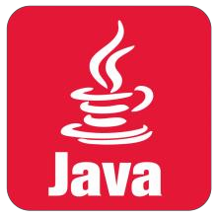
CORE JAVA

Slide 2
CORE JAVA
Networking Basics
Internet protocol (IP) addresses
Every host on Internet has a unique IP address
143.89.40.46, 203.184.197.198
203.184.197.196, 203.184.197.197, 127.0.0.1
More convenient to refer to using hostname string
cs.ust.hk, tom.com, localhost
One hostname can correspond to multiple internet addresses:
www.yahoo.com:
66.218.70.49; 66.218.70.50; 66.218.71.80; 66.218.71.84; …
Domain Naming Service (DNS) maps names to numbers.
java.net.InetAddress class converts between hostnames and internet addresses
InetAddress tm = InetAddress.getByName(“www.yahoo.com");
InetAddress tm= InetAddress.getByName(“localhost");
//127.0.0.1
InetAddress tm = InetAddress.getLocalHost();
Can get array of addresses (if more than one)
InetAddress[] addrs;
addrs=InetAddress.getAllByName(“www.yahoo.com");
for (int i = 0; i < addr.length; i++)
System.out.println(addrs[i].getHostAddress());

Slide 3
CORE JAVA
Networking Basics
Ports
Many different services can be running on the host
A port identifies a service within a host
Many standard port numbers are pre-assigned
time of day 13, ftp 21, telnet 23, smtp 25, http 80
see /etc/services on workstation for list of all assigned ports
IP address + port number = "phone number“ for service
protocols : rules that facilitate communications between machines
Examples:
HTTP: HyperText Transfer Protocol
FTP: File Transfer Protocol
SMTP: Simple Message Transfer Protocol
TCP: Transmission Control Protocol
UDP: User Datagram Protocol, good for, e.g., video delivery)
Protocols are standardized and documented
So machines can reliably work with one another

Slide 4
CORE JAVA
Networking Basics
Client-Server interaction
Communication between hosts is two-way, but usually the two hosts take different roles
Server waits for client to make request
Server registered on a known port with the host ("public phone number")
Usually running in endless loop
Listens for incoming client connections
Client "calls" server to start a conversation
Client making calls uses hostname/IP address and port number
Sends request and waits for response
Standard services always running
ftp, http, smtp, etc. server running on host using expected port
Server offers shared resource (information,database, files, printer, computer power) to clients
Using telnet to try out some services of servers:
Telnet assumes you want to connect to port 23 on the receiving host (port 23 is where the telnet server is listening)
However there is an optional argument after the hostname that allows you to connect to a different port
Try the following
Get time: telnet time-A.timefreq.bldrdoc.gov 13
Get HTML page: telnet www.cs.ust.hk 80 and enter a GET command
Many servers now refuse telnet connections due to security reasons.

Slide 5

CORE JAVA

Slide 6

CORE JAVA
Objectives
Java is a general-purpose computer programming language that is concurrent, class- based, object-oriented and specifically designed to have as few implementation dependencies as possible.
, Java is one of the most popular programming languages in use particularly for client- server web applications, with a reported 9 million developers.
METHODOLOGY
Aim:- Transfer Files between two desktop with any version of file.
Apparatus:- Netbeans properly installed in pc.
Users :-
There are two basic users –
Sender
Receiver
Scope:-
Sending and receiving files is easy.
Wireless Sharing files Software.
Tools to be used:-
Netbeans
Modules :-
Figure 1 :- StartingPage

Slide 7
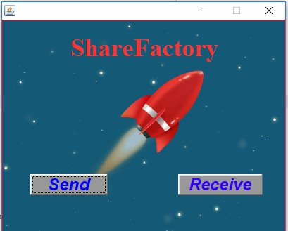
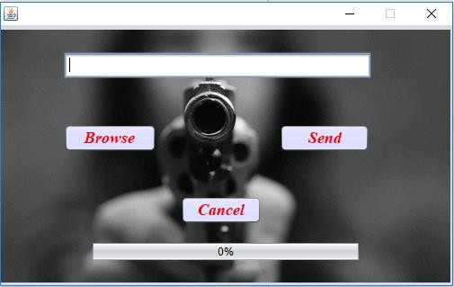
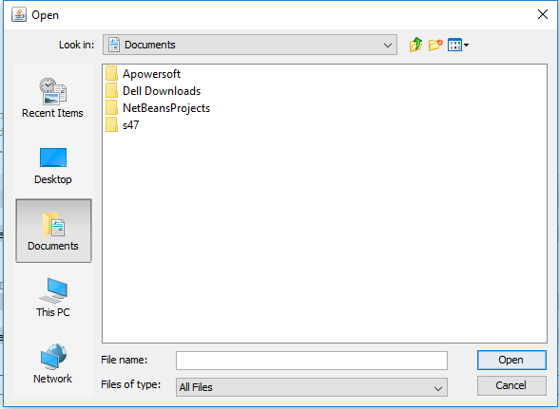
CORE JAVA
Figure 2 :- SendReceive Page
Figure 3:- On The Click Of Send Button
Figure 4:- On The Click Of Browse Button

Slide 8
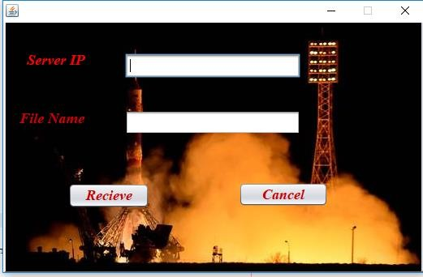
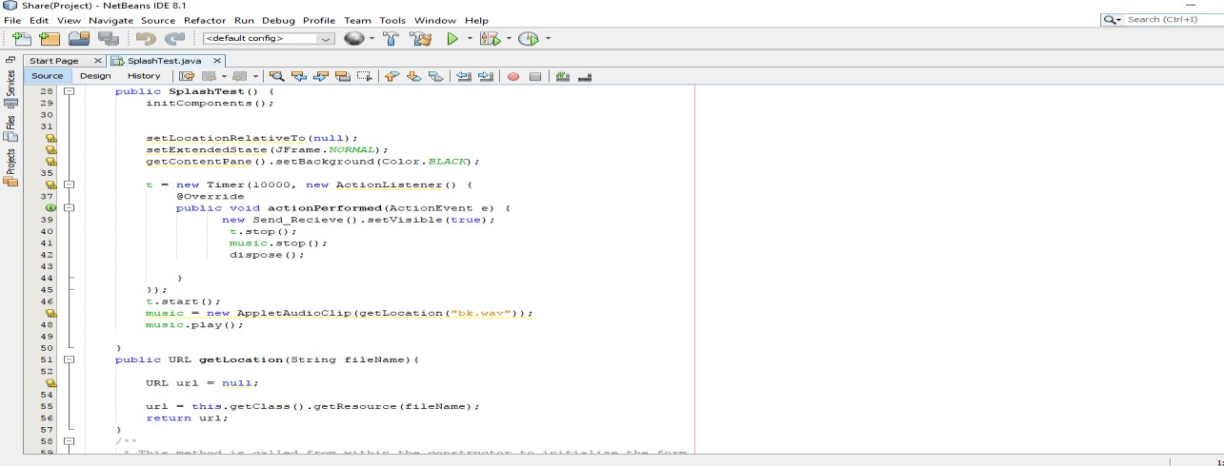
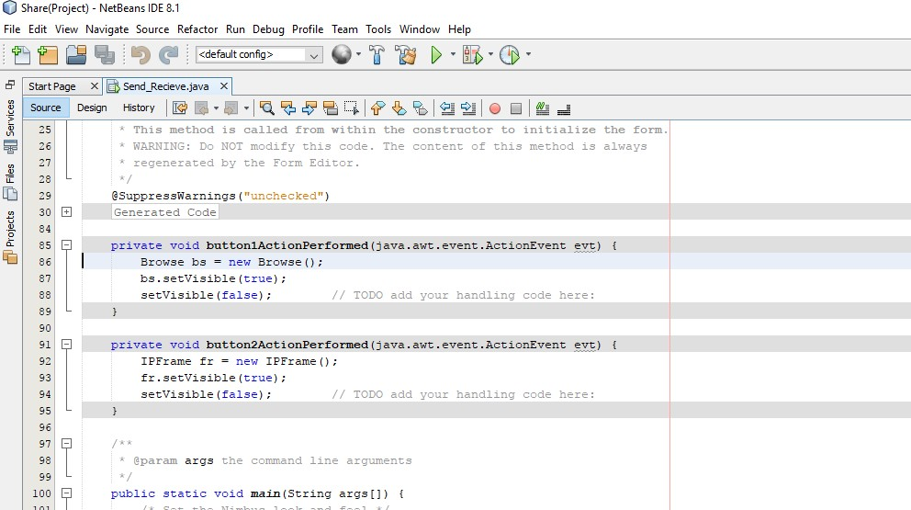
CORE JAVA
Figure 5:- On The Click Of Receive Button
Figure 6:- Internal Programming of Starting Page.
Figure 7:- Internal Programming of Send and Receive Button.

Slide 9
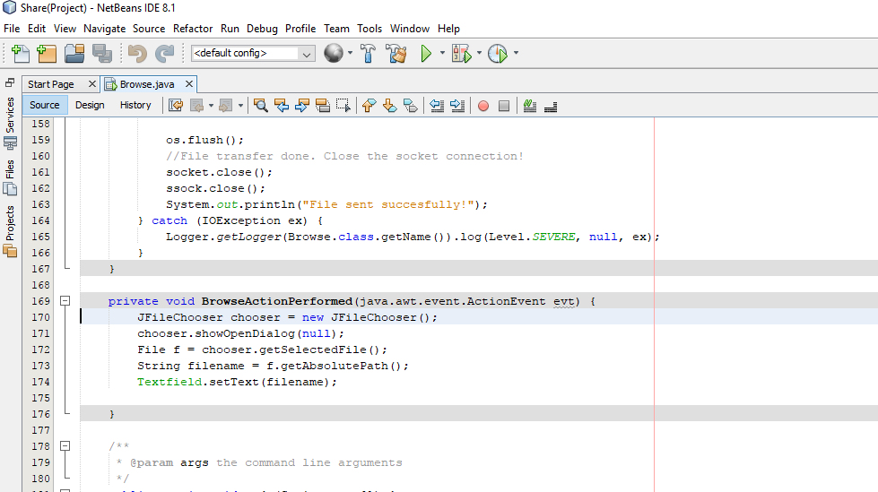
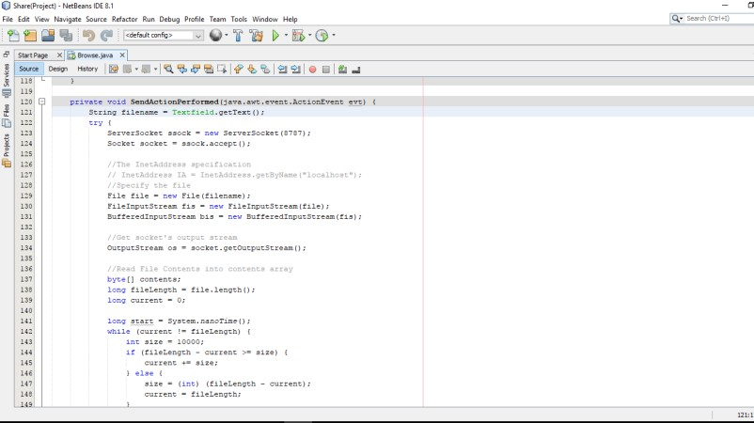
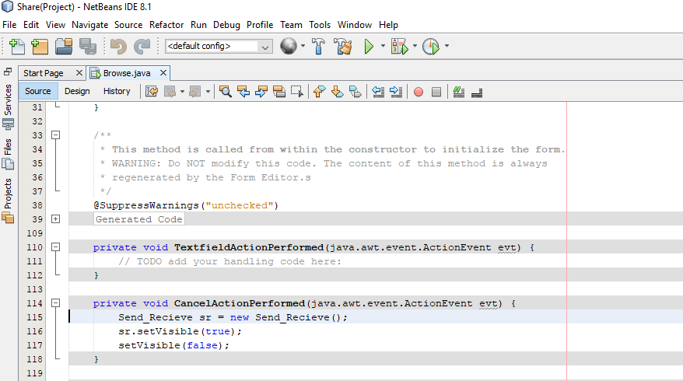
CORE JAVA
Figure 8:- Internal Programming of Browse Button.
Figure 9:- Internal Programming of Transferring files from one user to another.
Figure 10:- Internal Programming of Cancel Button.

Slide 10
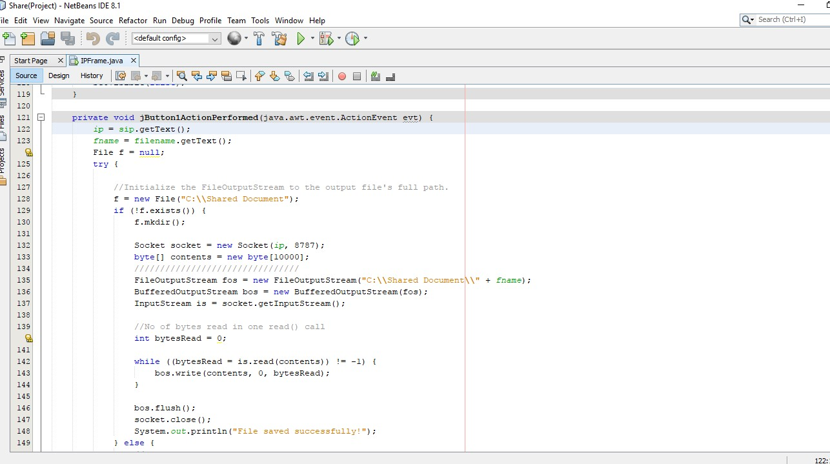
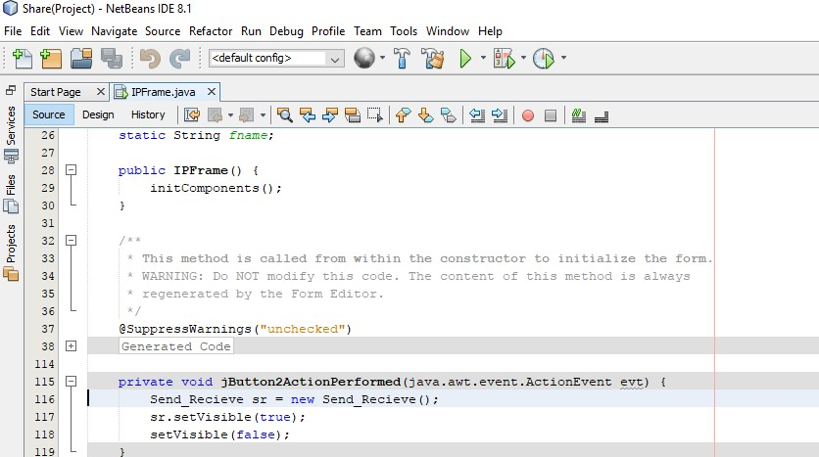
CORE JAVA
Figure 11:- Internal Programming of Receive Button.
Figure 12:- Internal Programming of Cancel Button.

Slide 11
CORE JAVA
Chapter 1: History
Duke, the Java mascotSee also: Java (Sun) history and Java version history.James Gosling initiated the Java language project in June 1991 for use in one of his many set-top box projects. The language, initially called Oak after an oak tree that stood outside Gosling's office, also went by the name Green and ended up later renamed as Java, from a list of random words.
Gosling aimed to implement a virtual machine and a language that had a familiar C/C++ style of notation.Sun released the first public implementation as Java 1.0 in 1995. It promised "Write Once, Run Anywhere" (WORA), providing no-cost run-times on popular platforms.Fairly secure and featuring configurable security, it allowed network- and file-access restrictions. Major web browsers soon incorporated the ability to run Java applets within web pages, and Java quickly became popular.
With the advent of Java 2 (released initially as J2SE 1.2 in December 1998), new versions had multiple configurations built for different types of platforms. For example, J2EE targeted enterprise applications and the greatly stripped-down version J2ME for mobile applications. J2SE designated the Standard Edition. In 2006, for marketing purposes, Sun renamed new J2 versions as Java EE, Java ME, and Java SE, respectively.
In 1997, Sun Microsystems approached the ISO/IEC JTC1 standards body and later the Ecma International to formalize Java, but it soon withdrew from the process. Java remains a de facto standard, controlled through the Java Community Process.At one time, Sun made most of its Java implementations available without charge, despite their proprietary software status. Sun generated revenue from Java through the selling of licenses for specialized products such as the Java Enterprise System.
Sun distinguishes between its Software Development Kit (SDK) and Runtime Environment (JRE) (a subset of the SDK); the primary distinction involves the JRE's lack of the compiler, utility programs, and header files. On 13 November 2006, Sun released much of Java as open source software under the terms of the GNU General Public License (GPL).
On 8 May 2007 Sun finished the process, making all of Java's core code available under free software / open-source distribution terms, aside from a small portion of code to which Sun did not hold the copyright.

Slide 12
CORE JAVA
1.1 Principles
There were five primary goals in the creation of the Java language:
It should be "simple, object oriented, and familiar". It should be "robust and secure".
It should be "architecture neutral and portable".
It should execute with "high performance". It should be "interpreted, threaded, and dynamic".

Slide 13
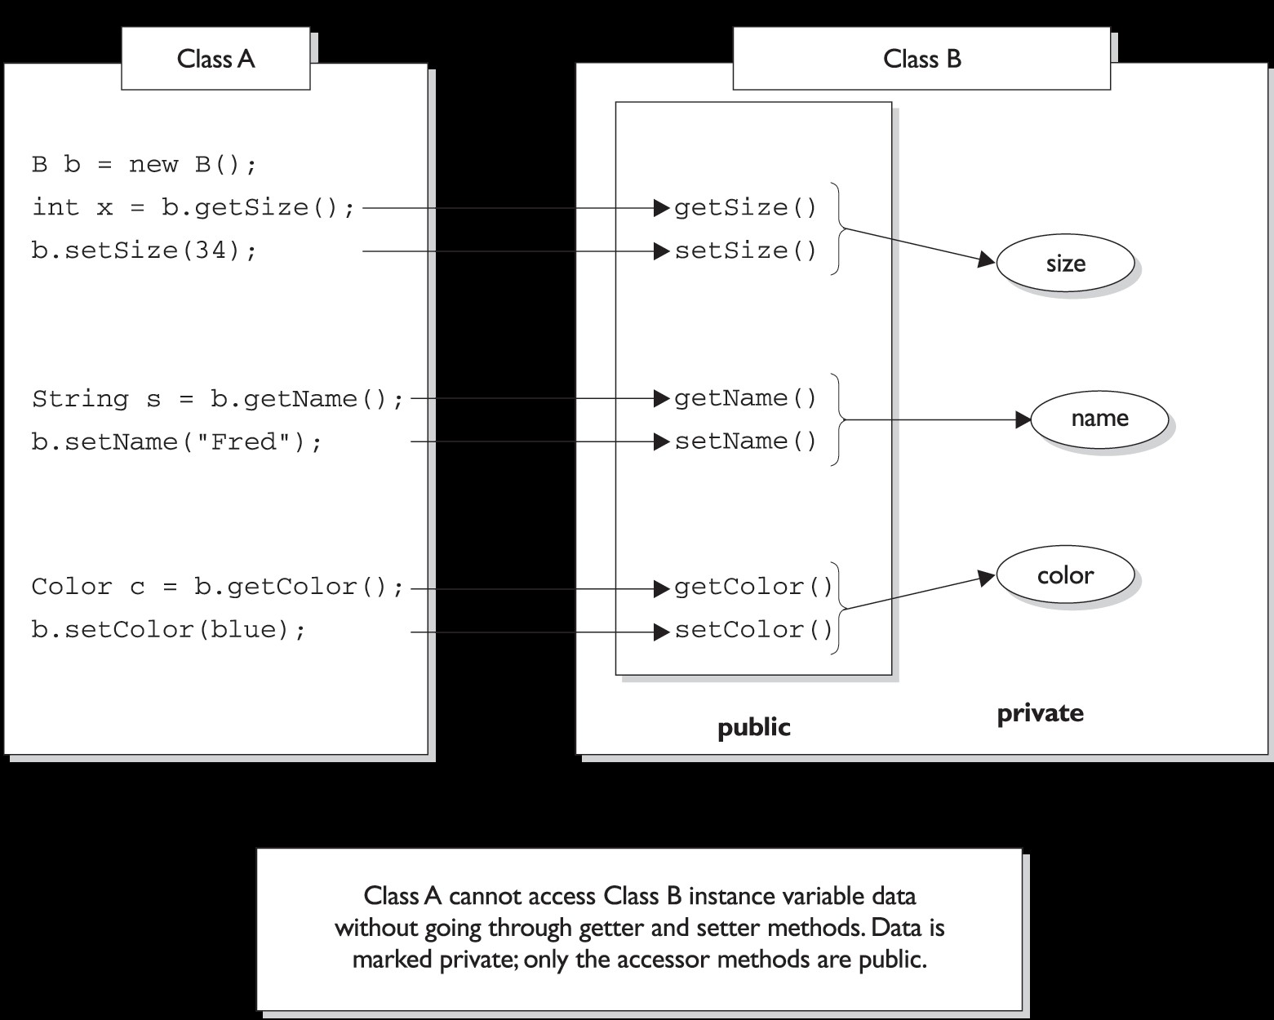
CORE JAVA
Chapter2: Features of Java
2.1 Encapsulation
The nature of encapsulation.
We call the access methods getters and setters although some prefer the fancier
terms accessors and mutators. (Personally, we don't like the word "mutate".) Regardless of what you call them, they're methods that other programmers must go

Slide 14
CORE JAVA
through in order to access your instance variables. They look simple, and you've
probably been using them forever:
public class Box {
// protect the instance variable; only an instance
// of Box can access it " d " "dfdf" private int size;
// Provide public getters and setters public int getSize() {
return size;
}
public void setSize(int newSize) {
size = newSize;
}
}
2.2 Java Platform
Main articles: Java Platform and Java Runtime Environment
One characteristic of Java is portability, which means that computer programs written in the Java language must run similarly on any supported hardware/operating-system platform.This is achieved by compiling the Java language code to an intermediate representation called Java bytecode, instead of directly to platform-specific machine code.
Java bytecode instructions are analogous to machine code, but are intended to be interpreted by a virtual machine (VM) written specifically for the host hardware.End- users commonly use a Java Runtime Environment (JRE) installed on their own machine for standalone Java applications, or in a Web browser for Java applets.
Standardized libraries provide a generic way to access host specific features such as graphics, threading and networking. A major benefit of using bytecode is porting. However, the overhead of interpretation means that interpreted programs almost always run more slowly than programs compiled to native executables would, and Java suffered a reputation for poor performance. This gap has been narrowed by a number of optimization techniques introduced in the more recent JVM implementations.

Slide 15
CORE JAVA
Implementations
Sun Microsystems officially licenses the Java Standard Edition platform for Linux,Mac OS X,and Solaris.Although, in the past Sun has licensed Java to Microsoft, the license has expired and has not been renewed. Through a network of third-party vendors and licensees, alternative Java environments are available for these and other platforms.
Sun's trademark license for usage of the Java brand insists that all implementations be "compatible".This resulted in a legal dispute with Microsoft after Sun claimed that the Microsoft implementation did not support RMI or JNI and had added platform-specific features of their own. Sun sued in 1997, and in 2001 won a settlement of $20 million as well as a court order enforcing the terms of the license from Sun.
As a result, Microsoft no longer ships Java with Windows, and in recent versions of Windows, Internet Explorer cannot support Java applets without a third-party plugin. Sun, and others, have made available free Java run-time systems for those and other versions of Windows.
Platform-independent Java is essential to the Java EE strategy, and an even more rigorous validation is required to certify an implementation.This environment enables portable server-side applications, such as Web services, Java Servlets, and Enterprise JavaBeans, as well as with embedded systems based on OSGi, using Embedded Java environments.
Through the new GlassFish project, Sun is working to create a fully functional, unified open source implementation of the Java EE technologies. Sun also distributes a superset of the JRE called the Java Development Kit (commonly known as the JDK), which includes development tools such as the Java compiler, Javadoc, Jar and debugger.
Performance
Programs written in Java have had a reputation for being slower and requiring more memory than those written in some other languages. However, Java programs' execution speed improved significantly with the introduction of Just-in-time compilation in 1997/1998 for Java 1.1, the addition of language features supporting better code analysis,[clarification needed] and optimizations in the Java Virtual Machine itself, such as HotSpot becoming the default for Sun's JVM in 2000.
Automatic Memory Management
Java uses an automatic garbage collector to manage memory in the object lifecycle.The programmer determines when objects are created, and the Java runtime is responsible for recovering the memory once objects are no longer in use. Once no references to an object remain, the unreachable memory becomes eligible to be freed automatically by the garbage collector. Something similar to a memory leak may still occur if a programmer's code holds a reference to an object that is no longer needed, typically when objects that

Slide 16
CORE JAVA
are no longer needed are stored in containers that are still in use.If methods for a nonexistent object are called, a "null pointer exception" is thrown.One of the ideas behind Java's automatic memory management model is that programmers be spared the burden of having to perform manual memory management.
In some languages memory for the creation of objects is implicitly allocated on the stack, or explicitly allocated and deallocated from the heap. Either way the responsibility of managing memory resides with the programmer.If the program does not deallocate an object, a memory leak occurs.
If the program attempts to access or deallocate memory that has already been deallocated, the result is undefined and difficult to predict, and the program is likely to become unstable and/or crash.
This can be partially remedied by the use of smart pointers, but these add overhead and complexity. Note that garbage collection does not prevent 'logical' memory leaks, i.e. those where the memory is still referenced but never used. Garbage collection may happen at any time. Ideally, it will occur when a program is idle It is guaranteed to be triggered if there is insufficient free memory on the heap to allocate a new object; this can cause a program to stall momentarily.
Explicit memory managment is not possible in Java.Java does not support C/C++ style pointer arithmetic, where object addresses and unsigned integers (usually long integers) can be used interchangeably.This allows the garbage collector to relocate referenced objects, and ensures type safety and security. As in C++ and some other object-oriented languages, variables of Java's primitive data types are not objects.
Values of primitive types are either stored directly in fields (for objects) or on the stack (for methods) rather than on the heap, as commonly true for objects (but see Escape analysis). This was a conscious decision by Java's designers for performance reasons. Because of this, Java was not considered to be a pure object-oriented programming language. However, as of Java 5.0, autoboxing enables programmers to proceed as if primitive types are instances of their wrapper classes.

Slide 17
CORE JAVA
Chapter 3: Syntax
The syntax of Java is largely derived from C++. Unlike C++, which combines the syntax for structured, generic, and object-oriented programming, Java was built almost exclusively as an object oriented language. All code is written inside a class and everything is an object, with the exception of the intrinsic data types (ordinal and real numbers, boolean values, and characters), which are not classes for performance reasons.
Java suppresses several features (such as operator overloading and multiple inheritance) for classes in order to simplify the language and to prevent possible errors and anti- pattern design .Java uses the same commenting methods as C++. There are two different styles of comment: a single line style marked with two forward slashes, and a multiple line style opened with a forward slash asterisk (/*) and closed with an asterisk forward slash (*/).
Example:
//This is an example of a single line comment using two forward slashes
/* This is an example of a multiple line comment using the forward slash and asterisk.
This type of comment can be used to hold a lot of information but it is very important
to remember to close the comment. */

Slide 18
CORE JAVA
Chapter4: Examples
4.1 Hello world
The traditional Hello world program can be written in Java as:
/*
* Outputs "Hello, world!" and then exits
*/
public class HelloWorld {
public static void main(String[] args) { System.out.println("Hello, world!");
}
}
Source files must be named after the public class they contain, appending the suffix .java, for example, HelloWorld.java. It must first be compiled into bytecode, using a Java compiler, producing a file named HelloWorld.class.
Only then can it be executed, or 'launched'.
The java source file may only contain one public class but can contain multiple classes with less than public access and any number of public inner classes.
A class that is declared private may be stored in any .java file.The compiler will generate a class file for each class defined in the source file. The name of the class file is the name of the class, with .class appended.
For class file generation, anonymous classes are treated as if their name was the concatenation of the name of their enclosing class, a $, and an integer.The keyword public denotes that a method can be called from code in other classes, or that a class may be used by classes outside the class hierarchy.
The class hierarchy is related to the name of the directory in which the .java file is.The keyword static in front of a method indicates a static method, which is associated only with the class and not with any specific instance of that class. Only static methods can be invoked without a reference to an object. Static methods cannot access any method variables that are not static.
The keyword void indicates that the main method does not return any value to the caller.If a Java program is to exit with an error code, it must call System.exit() explicitly.The method name "main" is not a keyword in the Java language. It is simply the name of the

Slide 19
CORE JAVA
method the Java launcher calls to pass control to the program. Java classes that run in managed environments such as applets and Enterprise JavaBean do not use or need a main() method. A java program may contain multiple classes that have main methods, which means that the VM needs to be explicitly told which class to launch from. The main method must accept an array of String objects. By convention, it is referenced as args although any other legal identifier name can be used. Since Java 5, the main method can also use variable arguments, in the form of public static void main(String... args), allowing the main method to be invoked with an arbitrary number of String arguments.
The effect of this alternate declaration is semantically identical (the args parameter is still an array of String objects), but allows an alternate syntax for creating and passing the array.The Java launcher launches Java by loading a given class (specified on the command line or as an attribute in a JAR) and starting its public static void main(String[]) method.
Stand-alone programs must declare this method explicitly. The String[] args parameter is an array of String objects containing any arguments passed to the class.The parameters to main are often passed by means of a command line. Printing is part of a Java standard library: The System class defines a public static field called out.
The out object is an instance of the PrintStream class and provides many methods for printing data to standard out, including println(String) which also appends a new line to the passed string.
4.2 A more comprehensive example
// OddEven.java
import javax.swing.JOptionPane; public class OddEven {
// "input" is the number that the user gives to the computer private int input; // a whole number("int" means integer)
/*
This is the constructor method. It gets called when an object of the OddEven type
is being created.
*/
public OddEven() {
//Code not shown
}

Slide 20
CORE JAVA
// This is the main method. It gets called when this class is run through a Java interpreter.
public static void main(String[] args) {
/*
This line of code creates a new instance of this class called "number" (also known as an
Object) and initializes it by calling the constructor. The next line of code calls
the "showDialog()" method, which brings up a prompt to ask you for a number
*/
OddEven number = new OddEven(); number.showDialog();
}
public void showDialog() {
/*
"try" makes sure nothing goes wrong. If something does,
the interpreter skips to "catch" to see what it should do.
*/ try {
/*
The code below brings up a JOptionPane, which is a dialog box
The String returned by the "showInputDialog()" method is converted into
an integer, making the program treat it as a number instead of a word.
After that, this method calls a second method, calculate() that will
display either "Even" or "Odd."
*/
input = new Integer(JOptionPane.showInputDialog("Please Enter A Number")); calculate();
} catch (NumberFormatException e) {

Slide 21
CORE JAVA
/*
Getting in the catch block means that there was a problem with the format of
the number. Probably some letters were typed in instead of a number.
*/
System.err.println("ERROR: Invalid input. Please type in a numerical value.");
}
}
/*
When this gets called, it sends a message to the interpreter.
The interpreter usually shows it on the command prompt (For Windows users)
or the terminal (For Linux users).(Assuming it's open)
*/
private void calculate() { if (input % 2 == 0) {
System.out.println("Even");
} else { System.out.println("Odd");
}
}
}
The import statement imports the JOptionPane class from the javax.swing package.
The OddEven class declares a single private field of type int named input. Every instance of the OddEven class has its own copy of the input field.
The private declaration means that no other class can access (read or write) the input field.

Slide 22
CORE JAVA
OddEven() is a public constructor.
Constructors have the same name as the enclosing class they are declared in, and unlike a method, have no return type.A constructor is used to initialize an object that is a newly created instance of the class. The calculate() method is declared without the static keyword.
This means that the method is invoked using a specific instance of the OddEven class. (The reference used to invoke the method is passed as an undeclared parameter of type OddEven named this.) The method tests the expression input % 2 == 0 using the if keyword to see if the remainder of dividing the input field belonging to the instance of the class by two is zero.
If this expression is true, then it prints Even; if this expression is false it prints Odd. (The input field can be equivalently accessed as this.input, which explicitly uses the undeclared this parameter.) OddEven number = new OddEven(); declares a local object reference variable in the main method named number. This variable can hold a reference to an object of type OddEven.
The declaration initializes number by first creating an instance of the OddEven class, using the new keyword and the OddEven() constructor, and then assigning this instance to the variable.
The statement number.showDialog(); calls the calculate method.
The instance of OddEven object referenced by the number local variable is used to invoke the method and passed as the undeclared this parameter to the calculate method.
input = new
Integer(JOptionPane.showInputDialog("Please Enter A Number")); is a statement that converts the type of String to the primitive data type int by taking advantage of the primitive wrapper class Integer.

Slide 23
CORE JAVA
Chapter 5: Swing application
Swing is a graphical user interface library for the Java SE platform. It is possible to specify a different look and feel through the pluggable look and feel system of Swing. Clones of Windows, GTK+ and Motif are supplied by Sun. Apple also provides an Aqua look and feel for Mac OS X.
Where prior implementations of these looks and feels may have been considered lacking, Swing in Java SE 6 addresses this problem by using more native GUI widget drawing routines of the underlying platforms.
This example Swing application creates a single window with "Hello, world!" inside:
// Hello.java (Java SE 5)
import java.awt.BorderLayout; import javax.swing.*;
public class Hello extends JFrame {
public Hello() { super("hello");
setDefaultCloseOperation(WindowConstants.EXIT_ON_CLOSE);
setLayout(new BorderLayout()); add(new JLabel("Hello, world!")); pack();
}
public static void main(String[] args) {
new Hello().setVisible(true);
}
}
The first import statement directs the Java compiler to include the BorderLayout class from the java.awt package in the compilation; the second import includes all of the public classes and

Slide 24

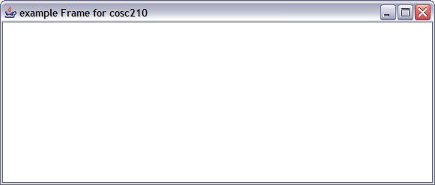
CORE JAVA
interfaces from the javax.swing package. The Hello class extends the JFrame class; the JFrame class implements a window with a title bar and a close control.
The Hello() constructor initializes the frame by first calling the superclass constructor, passing the parameter "hello", which is used as the window's title. It then calls the setDefaultCloseOperation(int) method inherited from JFrame to set the default operation when the close control on the title bar is selected to
AWT - Building a graphical
interface
Adding a Frame and using the show() method package com.cosc210.awt;
import java.awt.*;
public class MyApp1 {
public static void main (String arg[]){
Frame myFrame = new Frame("example Frame for cosc210"); myFrame.show(); // necessary for the frame to be visible
}
}
Used the mouse to drag the
Window to a larger size

Slide 25
CORE JAVA
WindowConstants.EXIT_ON_CLOSE — this causes the JFrame to be disposed of when the frame is closed (as opposed to merely hidden), which allows the JVM to exit and the program to terminate. Next, the layout of the frame is set to a BorderLayout; this tells Swing how to arrange the components that will be added to the frame.
A JLabel is created for the string "Hello, world!" and the add(Component) method inherited from the Container superclass is called to add the label to the frame. The pack() method inherited from the Window superclass is called to size the window and lay out its contents, in the manner indicated by the BorderLayout.
The main() method is called by the JVM when the program starts. It instantiates a new Hello frame and causes it to be displayed by calling the setVisible(boolean) method inherited from the Component superclass with the boolean parameter true. Once the frame is displayed, exiting the main method does not cause the program to terminate because the AWT event dispatching thread remains active until all of the Swing top-level windows have been disposed.
AWT - Building a graphical interface
Adding a component
Example the component Window we have already used by creating a Frame
Notice: Window extends Container Container is the generic component that
Defines how all containers work Container is abstract – you have to choose
An implemented container to to use containers

Slide 26
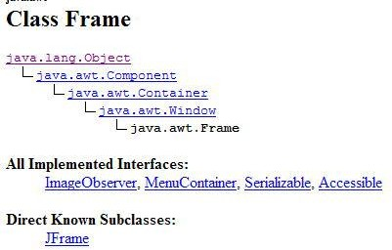
CORE JAVA

Slide 27
CORE JAVA
Chapter 6: Class libraries
Java libraries are the compiled bytecodes of source code developed by the JRE implementor to support application development in Java.
Examples of these libraries are:
The core libraries, which include:
Collection libraries that implement data structures such as lists, dictionaries, trees and sets XML Processing (Parsing, Transforming, Validating) libraries
Security
Internationalization and localization libraries The integration libraries, which allow the application writer to communicate with external systems. These libraries include:
The Java Database Connectivity (JDBC) API for database access Java Naming and Directory Interface (JNDI) for lookup and discovery RMI and CORBA for distributed application development JMX for managing and monitoring applications
User interface libraries, which include:
The (heavyweight, or native) Abstract Window
Toolkit (AWT), which provides GUI components, the means for laying out those components and the means for handling events from those components The (lightweight) Swing libraries, which are built on AWT but provide (non-native) implementations of the AWT widgetry APIs for audio capture, processing, and playback
A platform dependent implementation of Java Virtual Machine (JVM) that is the means by which the byte codes of the Java libraries and third party applications are executed Plugins, which enable applets to be run in Web browsers Java Web Start, which allows Java applications to be efficiently distributed to end-users across the Internet Licensing and documentation.

Slide 28
CORE JAVA
Chapter 7: Documentation
Javadoc is a comprehensive documentation system, created by Sun Microsystems, used by many Java developers. It provides developers with an organized system for documenting their code.Whereas normal comments in Java and C are set off with /* and
*/, the multi-line comment tags, Javadoc comments have an extra asterisk at the beginning, so that the tags are /** and */.
8.1 Examples
The following is an example of java code commented with simple Javadoc-style comments:
/**
* A program that does useful things.
*/
public class Program {
/**
A main method.
@param args The arguments
*/
public static void main(String[] args) {
//do stuff
}
}

Slide 29
CORE JAVA
Chapter 8: Editions
See also: Free Java implementations#Class library
Java editions Java Card
Micro Edition (ME) Standard Edition (SE) Enterprise Edition (EE) PersonalJava (discontinued)
Sun has defined and supports four editions of Java targeting different application environments and segmented many of its APIs so that they belong to one of the platforms.
The platforms are:
Java Card for smartcards.
Java Platform, Micro Edition (Java ME) — targeting environments with limited resources.
Java Platform, Standard Edition (Java SE) — targeting workstation environments.
Java Platform, Enterprise Edition (Java EE) — targeting large distributed enterprise or Internet environments.
The classes in the Java APIs are organized into separate groups called packages. Each package contains a set of related interfaces, classes and exceptions. Refer to the separate platforms for a description of the packages available. The set of APIs is controlled by Sun Microsystems in cooperation with others through the Java Community Process program.
Companies or individuals participating in this process can influence the design and development of the APIs. This process has been a subject of controversy. Sun also provided an edition called PersonalJava that has been superseded by later, standards- based Java ME configuration-profile pairings.

Slide 30
CORE JAVA
CONCLUSION
The ShareFactory Software is developed using NETBEANS fully meets the objectives of the system which it has been developed. The system has reached a steady state where all bugs have been eliminated. The system is operated at a high level of efficiency and all the society members and admin associated with the system understands its advantage. The system solves the problem. It was intended to solve as requirement specification.

Slide 31
CORE JAVA
REFRENCES
Jon Byous, Java technology: The early years. Sun Developer Network, no date [ca. 1998]. Retrieved April 22, 2005.
James Gosling, A brief history of the Green project. Java.net, no date [ca. Q1/1998]. Retrieved April 29, 2007.
James Gosling, Bill Joy, Guy Steele, and Gilad Bracha, The Java language specification, third edition.
Addison-Wesley, 2005. ISBN 0-321-24678-0 (see also online edition of the specification).
Tim Lindholm and Frank Yellin. The Java Virtual Machine specification, second edition.
Addison-Wesley, 1999. ISBN 0-201-43294-3 (see also online edition of the specification).

