Slide 1
SHARE FACTORY
Prepared by:
Gagandeep Singh

Slide 2
Need to know about Socket Programming
Socket-level programming
Writing a client
Writing a server

Slide 3
Socket-Level Programming
Socket is an abstraction of one type of bi-directional communication channel between hosts
Send and receive data using streams
OutputStream
InputStream
Client
Server
InputStream
OutputStream
Next:
How to write a client
How to write a server

Slide 4
Writing Clients
To write a client socket using java.net.Socket
Create a new Socket with hostname and port number of the connection
Socket s = New Socket(String hostName,int portNumber);
Call s.getOutputStream() and s.getInputStream() to get streams for sending and receiving infomation
Need to learn protocol used to communicate
Know how to properly form requests to send to server
Know how to interpret the server’s responses

Slide 5
Writing Clients
SocketTest:
Makes a socket connection to the atomic clock in Boulder, Colorado,
and prints the time that the server sends.
try
{ Socket s = new Socket("time-A.timefreq.bldrdoc.gov", 13);
BufferedReader in = new BufferedReader
(new InputStreamReader( s.getInputStream() ));
// read from in
}
catch (IOException e)
{ e.printStackTrace();
}

Slide 6
Writing Servers
To write a server using java.net.ServerSocket
Create a new ServerSocket with a port number to listen on the port
ServerSocket s = New ServerSocket( portNumber);
Use accept() to listen on the port.
accept() returns a socket incoming when a client calls
Socket incoming = s.accept();
Call incoming.getOutputStream() and incoming.getInputStream() to get streams for sending and receiving information

Slide 7
Writing Servers
Example: Echo server
ServerSocket s = new ServerSocket(8189);
Socket incoming = s.accept( );
BufferedReader in = new BufferedReader
(new InputStreamReader(incoming.getInputStream()));
PrintWriter out = new PrintWriter
(incoming.getOutputStream(), true /* autoFlush */ );
out.println( "Hello! Enter BYE to exit." );
…

Slide 8
Servers & Client
A more interesting example
ICQServer.java
A simple server that listens on port 7777.
Connect two clients so that they can talk to each other.
Can handle more than one pairs.
ICQClient.java
Allows user to connect to ICQServer and have one-to-one conversation with partner

Slide 9

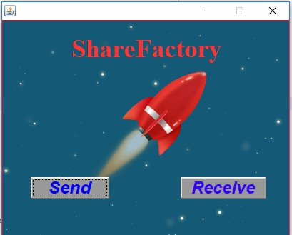
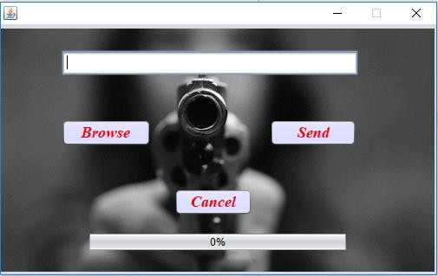
HOW IT WORKS (1)
Figure 1 :- StartingPage
Figure 2 :- SendReceive Page
Figure 3:- On The Click Of Send Button.
Browse item and send .... ...
But First check the receive window functioning

Slide 10
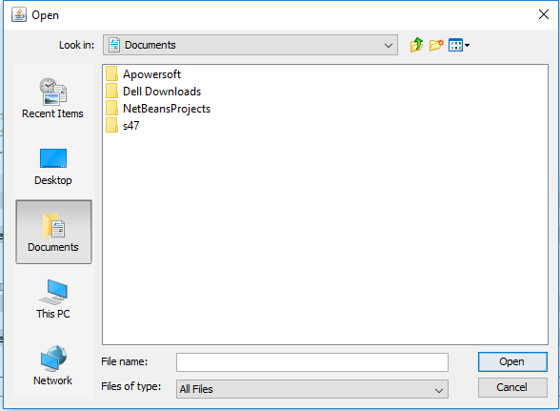
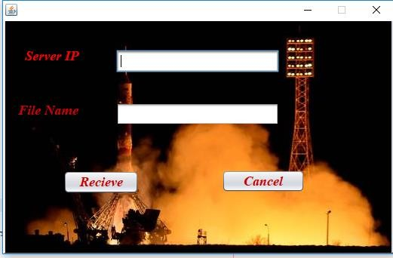
HOW IT WORKS (2)
Figure 4:- On The Click Of Browse Button
Figure 5:- On The Click Of Receive Button ... Add server Ip address and file name with same format as the sending file name

Slide 11
Conclusion :
The ShareFactory Software is developed using NETBEANS fully meets the objectives of the system which it has been developed. The system has reached a steady state where all bugs have been eliminated. The system is operated at a high level of efficiency and all the society members and admin associated with the system understands its advantage. The system solves the problem. It was intended to solve as requirement specification.

Slide 12
Thank You

