Slide 1

Network-Based Applications in Behavioral Evolution, Outbreak Prediction, and Citation Inference
George Dewey, MPH
April 28, 2022

Slide 2
Agenda
Objectives
Specific Aims
Background
Approach
Analytic Plan
Public Health Implications

Slide 3
Objectives
Demonstrate applications of network science to problems relevant to epidemiology and public health
Three areas of interest:
Evolution of behavioral strategies in social experiments
Dynamics of infectious disease outbreaks
Citation behavior in academic literature

Slide 4
Specific Aims
Aim 1: Examine the mechanisms behind aggressive and peaceful states in network-based social experiments
Aim 2: Evaluate early warning signals (EWS) and network-based derivatives as predictive tools for infectious disease outbreaks
Aim 3: Develop and test a text inference model for detecting gender bias in academic citations
Notes:
Plan to complete these projects in the order presented

Slide 5
Aim 1
Aim 1: Examine the mechanisms behind aggressive and peaceful states in network-based social experiments
Subobjectives
Determine if aggressive behavior can be categorized based on the local network environment
Trace behavioral patterns leading up to cascades of non-peaceful behavior

Slide 6
Approach
Understanding the dynamics between cooperation and punishment using laboratory experiments has corollaries with many public health scenarios
People prefer an equal distribution of wealth, but most societies are economically imbalanced
Is it beneficial for actors to penalize themselves to promote good behavior in others? Or should they always act amicably even if harmed?
How do behavioral decisions like choosing to go against a group dynamic or follow it influence people’s well-being?
Notes:
Can aggression be advantageous to move neighbors away from defection or punishment

Slide 7
An Evolutionary Dilemma
C
D
C
P
? (C)
?
C
C
P
C
Notes:
Left: in scenarios where the local network is fully cooperative, it is easy to conclude that in evolutionary terms, the best choice for the index person is to also cooperate (everyone gets richer)
Right: it gets more complicated when the breakdown of behaviors is complex. Is it right to punish the punishers to ”correct” their behavior (but also penalize the defector and the cooperator), or should you cooperate and hope the punishers and defector stop? What is the personal benefit for the index individual for each of these behaviors?

Slide 8
Background
Punishment has been theorized to have several influences
To promote cooperation from non-cooperators
Competitive drive (Raihani and Bshary 2019, Evol. Human Sci.)
Prior work has explored factors that influence the decision-making process in similar laboratory games
Wealth inequality and visibility (Nishi et al. 2015, Nature)
Local environment and decision time (Nishi et al. 2016, Scientific Reports)
Length of games and weakening effects of punishment (Gachter et al. 2008, Science)
Notes:
Visibility: Visibility leads to propagation of inequality compared to invisible wealth differences. Making wealth visible results in lower cooperation and fewer connections
Local environment: cooperation is faster choice in cooperative environments, defection faster in non-cooperative environments
Repetitive behaviors are faster than changing behaviors due to decision conflicts
Gachter: punishment increases cooperation and makes the group outcome better in the long run because the costs of punishment are outweighted by increased gains from cooperation

Slide 9
Hypotheses
Hypothesis 1: Punishment in the experimental games arises as a response to neither a desire to convert non-cooperators nor inequality aversion, but to increase subjective well-being
Hypothesis 2: The decision conflict caused by choosing to punish in a generally cooperative environment will lengthen decision-making time.
Hypothesis 3: Game scenarios with more instances of punishment will end with a lower average wealth among participants.
Notes:
Can aggression be advantageous to move neighbors away from defection or punishment

Slide 10
Experiment Details
745 players recruited using Amazon mTurk from 26 countries
Played 50 games of 15 rounds each, totaling 10727 individual decisions
Initial score (wealth) and initial network structure are randomly allocated
After making behavioral choice, players are asked to keep/cut ties and given a subjective well-being survey
Notes:
Majority of players from US and India
Some players dropped after initial network creation
Initial wealth is binary (either low: 200 or high: 1150)
Small world: most nodes are not neighbors, but neighbors of any given node are likely to be neighbors of each other

Slide 11
Player View
700
Round 5
If you choose A, you pay 50 points for each other player you are connected to and each of them gains 100 points.
If you choose B, you don’t pay any points and other players connected to you don’t lose or gain any points.
If you choose C, you pay 50 points for each other player you are connected to and each of them loses 100 points.
Each player you are connected to has the same choice. Regardless of which of these you choose, for each of them that chooses A, you will gain 100 points.
450
A
300
B
C
550
1000
A: -200
B: 0
C: -200
Notes:
Games are randomized to wealth invisible/wealth visible settings (here wealth is visible)
Colors reflect the choice each player made in the last round (Blue – C, orange – P, green – D)
Middle (large) circle is the active player

Slide 12
Behavior Choices
Behavior | Outcome
Cooperation (C) | Pay 50 to give 100 to all neighbors
Defection (D) | Pay 0 to give 0 to all neighbors
Punishment (P) | Pay 50 to take 100 from all neighbors
Notes:
Games are randomized to wealth invisible/wealth visible settings

Slide 13
Restructuring the Network
After making decisions, players are asked if they want to stay connected to their neighbors
They can choose to break ties (only one member of the pair needs to choose this)
Can also make new pairs (both members must agree)
Round t-1
A
C
B
Round t
A
C
B
Notes:
After making the C/D/P decision, results of the game round are calculated (increased/decreased score), and players can choose to cut ties with their neighbors or make new ties
In the example, player B chooses to punish both players A and C (who are initially not connected). After this, player A may choose to break their tie to B while player C does not; meanwhile players A and C both choose to create new ties with cooperators (since both A and C cooperated in the previous round)

Slide 14
Preliminary Results
We want to determine why people choose to punish at different points in the games and if there are trends that link choosing the “punish” option and other factors
Preliminary results suggest that:
Indian subjects are more likely to choose punishment compared to subjects from the US (replicating findings of Nishi 2017 PLoS One)
Choosing punishment takes longer than choosing either cooperation or defection
Notes:
Other factors: visibility of wealth (probably not), happiness (maybe choosing punish may lead to small increase in happiness), initial score (no)
Knowing what influences peaceful rounds also will let us know what lead to unpeaceful/aggressive rounds
Also, punishment is strongly associated with increased rate of punishment in the previous round – implies retaliatory behavior)
Triggered punishment: aka justified punishment/aggression
Random: unjustified

Slide 15
Preliminary Results
 |  | Ever Punisher
 |  | Yes | No
Country | US | 82 | 362
 | India | 95 | 162
 | Other | 8 | 40
X² = 25.65, p < 0.001
Notes:
82/362 = 22.6%
95/162 = 58.6%
8/40 = 20%
Comparing proportions of ever choosing punish by country of origin

Slide 16
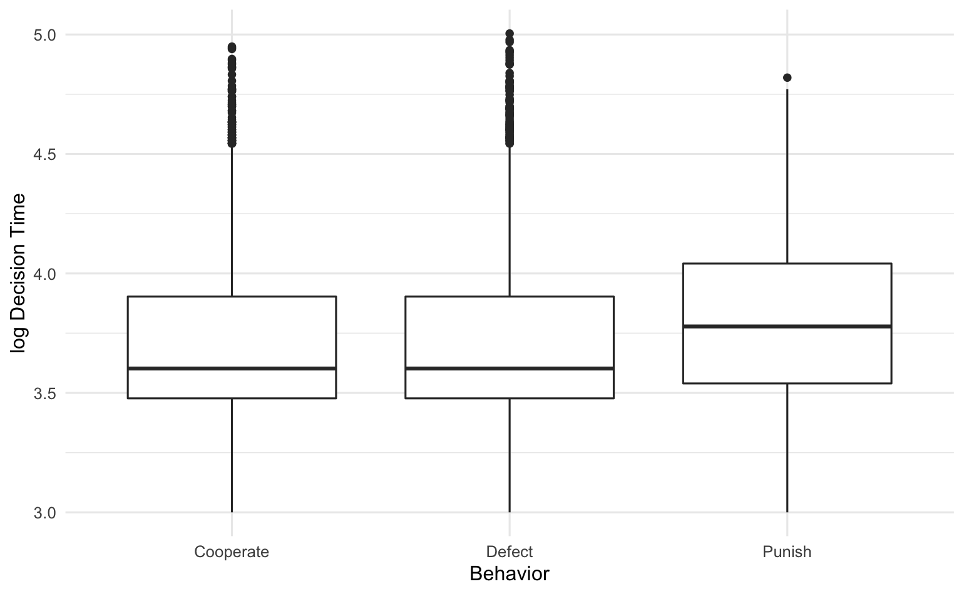
Preliminary Results
Notes:
Behavior choice vs. log decision time – can see that the median time for punishment is higher than either cooperation or defection.

Slide 17
Analytic Strategy
Contingency tables and descriptive statistics to evaluate trends
Generalized mixed logistic regressions for behaviors (glmer package in R)
Outcome: choosing the punishing behavior
Random effects/clustering variables: game, round, player ID
Sociodemographic covariates: country, age, gender
Behavioral variables: subjective well-being
Include variables about the prior round’s decisions: choice, decision time, local rate of behaviors
Network analysis using igraph package in R
Visualization of behavioral trends using animations
Notes:
Choosing punishing behavior instead of either coop/defect
Local rate of behaviors: the proportion of those in the local network choosing a specific behavior: changes based on rewiring choices leading to changes in degree

Slide 18
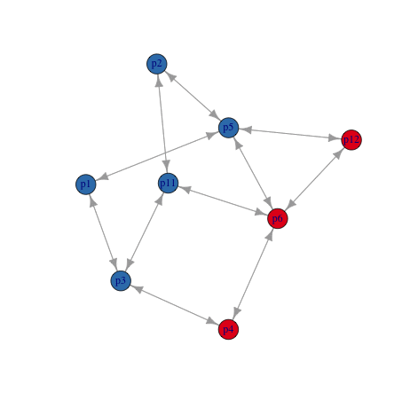
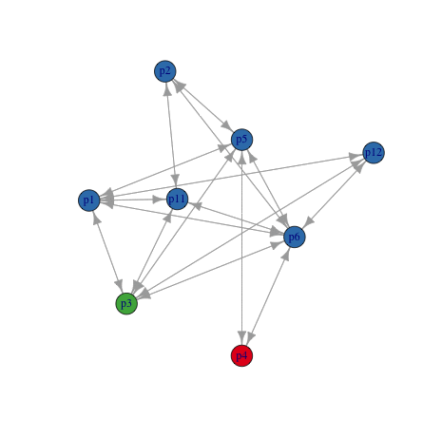
Network Analysis
Game 49 Round 1
Game 49 Round 5
Notes:
Example of actual game dynamics – can see changing behaviors and rewiring

Slide 19
Public Health Implications
Understanding how individuals act in response to stimuli in local networks can improve our understanding of behavioral change
Can be applied to behaviors related to addiction, care-seeking, etc.
Since human relationships are inherently exchanges, using social network experiments allow us to model conflict and resolution in scenarios where ”harming” can be chosen without real-life consequences

Slide 20
Aim 2
Aim 2: Evaluate early warning signals (EWS) and network-based derivatives as predictive tools for infectious disease outbreaks
Subobjectives
Evaluate the performance of network-based EWS in relation to traditional EWS like variance, autocorrelation, and skewness
Determine the ability of EWS to highlight health inequalities when applied across geographic regions that have differing socioeconomic characteristics

Slide 21
Concept
Outbreak detection/prediction is a difficult and complex problem
Transmission is a stochastic process once a pathogen is in a population
In the early stages of an outbreak, basic parameters of the disease that we usually use to quantify it are unknown
Reproductive number, serial interval, infectious period, etc.
Data quality is often poor (if the data is even present)
As a result, hard to predict if interventions will work until we know more about the disease
Notes:
Reproduction number: expected number of cases directly generated by one case in a population where all individuals are susceptible to infection
Serial interval:
Time between successive cases in a chain of transmission
Incubation period:
Number of days between infection and rise of symptoms
Infectious period:
Time that the index subject can transmit infection

Slide 22
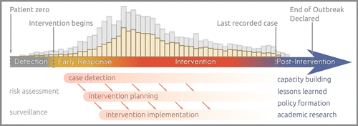
Outbreak Detection is Complex
Polonsky et al. 2019, Phil Trans R. Soc. B
Notes:
Reproduction number: expected number of cases directly generated by one case in a population where all individuals are susceptible to infection
Serial interval:
Time between successive cases in a chain of transmission
Incubation period:
Number of days between infection and rise of symptoms
Infectious period:
Time that the index subject can transmit infection

Slide 23
Approach
Develop a widely applicable method for outbreak detection that remains robust while using limited amounts of data
Can augment current syndromic surveillance tools
Main syndromic surveillance approaches in practice
Automated data collection and comparison to expected values
Regular reporting and comparison to historical data/expected values
Our approach aims to be self-sustaining: the goal is that internal comparison can confirm detection of an outbreak
Notes:
EWS can be automated and be calculated regularly
Commonly used SyS metrics evaluate if disease/case specimen counts are greater than the mean + multiple SD using NB or pseudo-Poisson regression (Noufaily 2019 Bioinformatics)

Slide 24
Critical Slowing Down Theory
Most complex systems have thresholds/tipping points where the system transitions from one state to another
Critical transitions are those that result in fundamental shifts in the system when they pass the tipping point
In the outbreak of an infectious disease, we can think of this as a change from the pre-outbreak state to the outbreak state
We want to identify the statistical signals which best predict the onset of this critical transition in our population of interest

Slide 25
Early Warning Signals
We should be able to identify a set of early warning signals (EWSs) that can precede the transition from pre-outbreak to outbreak conditions regardless of the disease of concern
There is evidence for signals that exhibit characteristic changes before critical transitions in many disciplines
Medicine – epileptic seizures, asthma attacks, depression
Environmental sciences – climate transitions

Slide 26
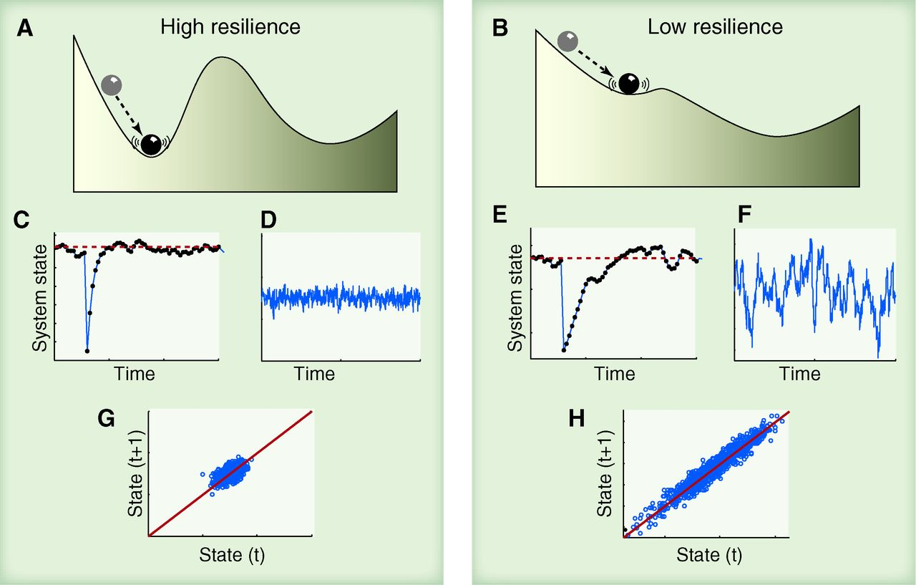
Critical Slowing Down Theory
Scheffer et al. 2012, Science
Notes:
In this figure, we can focus on panels C-H. C and E show reduction in recovery as the system reaches a critical transition.
Panels D and F show increased variance (larger spread of the wave). Panels G and H show increased autocorrelation.

Slide 27
Main Early Warning Signals
Indicator | Direction
Recovery from perturbation | Reduced
Variance | Increased
Autocorrelation | Increased
Skewness | Increased
Notes:
Others include presence of flickering (a combination of..

Slide 28
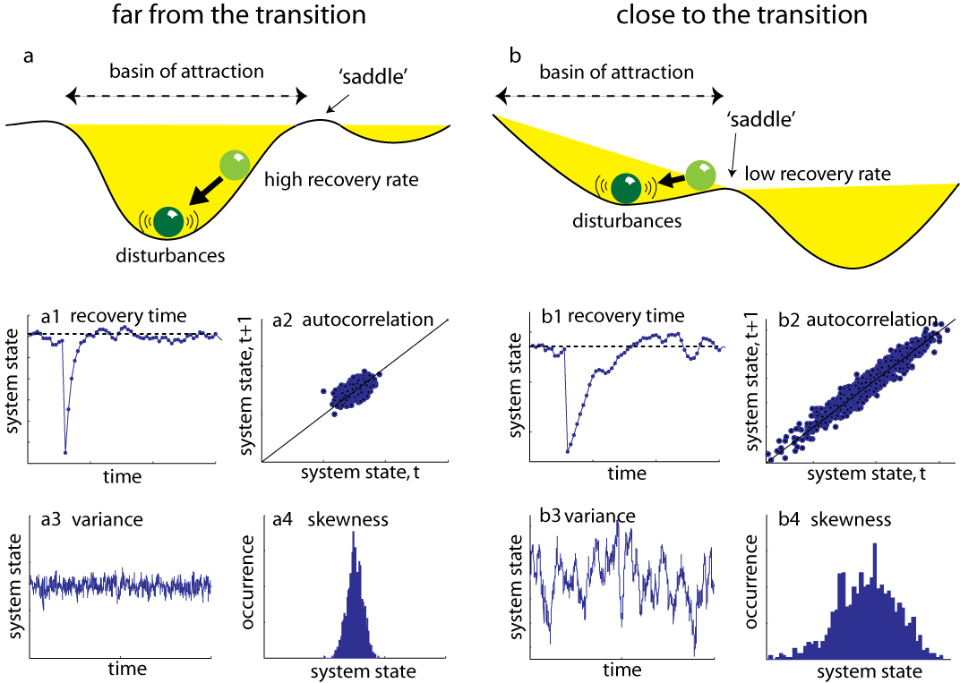
Early Warning Signals
http://www.early-warning-signals.org/?page_id=480
Notes:
http://www.early-warning-signals.org/?page_id=480: the early warning signals toolbox

Slide 29
EWSs for Infectious Diseases
Prior to the COVID-19 pandemic, EWS were not strongly considered as tools for outbreak prediction
However, the suddenness of the pandemic as well as the model-free nature and ability to provide meaningful signals with limited data led researchers to identify EWS as a field of tremendous potential
Recent work (O’Brien 2021 Biology Letters, Proverbio 2022 PLOS Comp. Bio.) has focused on evaluating the predictive ability of EWS in nonlinear time series and understanding what factors inhibit prediction
Notes:
Goal is to determine how robust EWSs are in different states of complex systems
Challenges: pattern recognition, data quality, mandating certain thresholds for statistical accuracy
OBrien: using composite EWS combining variance, skew, and autocorrelation
Proverbio: EWS performance is sensitive to the underlying dynamics of infection, need a slow-moving transition and non-fat-tailed noise
Southall 2020: potential to use incidence rate as an EWS as it demonstrates similar properties as variance and autocorrelation

Slide 30
EWSs as Indicators of Health Inequality
The model-free and adaptable nature of EWS suggests they may be able to identify vulnerable populations based on differences in early outbreak data
Responses to COVID-19 have highlighted inequality worldwide
In the US, Hispanic Americans had 1.9 times the risk of infection and 2.8 times the risk of hospitalization as White Americans. Black Americans had 1.1 times the risk of infection and 2.8 times the risk of hospitalization
Quantin et al. (Lancet Public Health, 2022) found that NPIs had differential impacts depending on social deprivation and population density in France
Notes:
US info: CDC data portal
Goal is to determine how robust EWSs are in different states of complex systems
Challenges: pattern recognition, data quality, mandating certain thresholds for statistical accuracy
Zelner et al. in PLOS Comp Bio (2022): include inequity in models to improve modeling frameworks

Slide 31
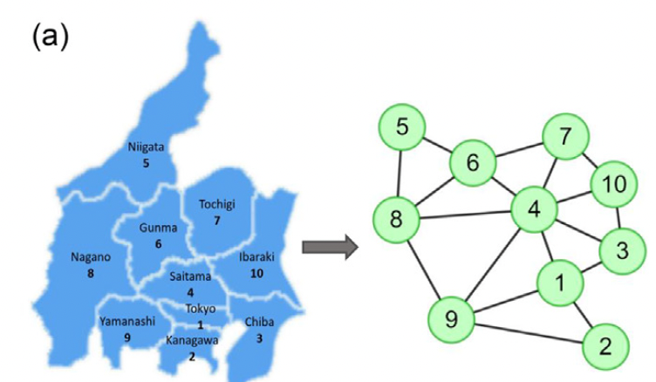
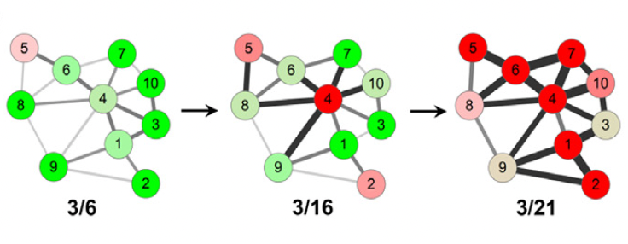
Network-Based EWS: Landscape Network Entropy
Liu et al. Science Bulletin, 2021 describes landscape network entropy (LNE): a high-dimensional dynamic method to collect network-wide information
Combines the structure of the “district network” (the geographic relationships between regions) with case data from individual districts

Slide 32
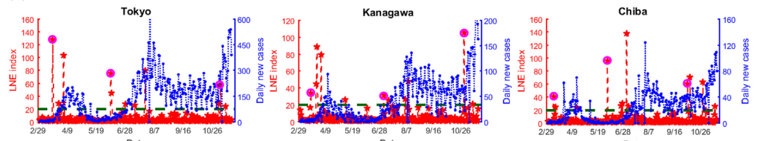
Foundational Work - LNE
Core idea of the paper: to capture both local spread of infection (within district) and coordinated spread in neighboring districts (across districts)
Tested using prefectures in Japan, US states, countries in Europe
Connections between districts are based on a transportation link between the two zones
Notes:
Limitations: regions with many inlets/outlets could be problematic for modeling – hard to assume that travel from region A -> region B is the saem as from region B -> region C without considering geography, points of interest, etc.

Slide 33
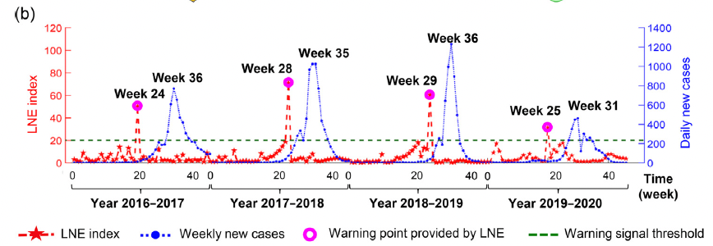
Foundational Work - LNE
Bottom line of LNE: can serve as another early warning signal that can catch outbreaks prior to the critical transition

Slide 34
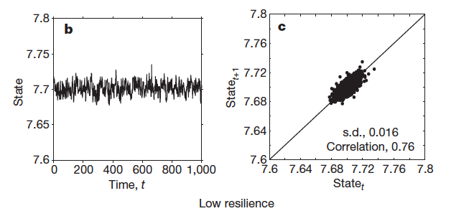
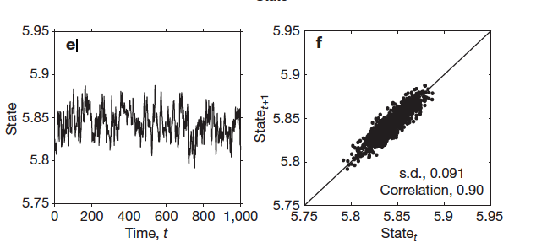
Early Warning Signals
Scheffer et. al. (Nature 2009) details the main symptoms of “critical slowing down”/approaching a critical transition
In the figures, panels b/c represent the pre-transition state while e/f represent the system moving toward transition

Slide 35
Early Warning Signals
Skewness of the distribution of states increases as the system approaches the critical transition point
In addition to the previously mentioned signals, flickering of the time series can also be present
Characterized by increased variance, increased skewness, and bimodality
Notes:
Show a figure for this one
In a system mapped as a network, the infectious status of individuals will be affected by the status of their neighbors
Potential to identify early warning signals based on distribution of infection throughout the network

Slide 36
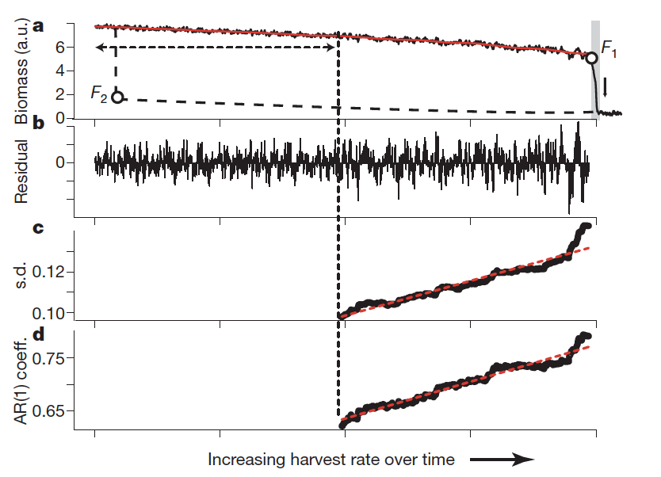
Critical Slowing Down Theory
Figure shows a simulated population moving towards a critical transition (marked F₁)
The magnitude of residuals, standard deviation, and autocorrelation all increase as the transition is approached
Scheffer et. al (Nature, 2009)
Notes:
Trim this figure

Slide 37
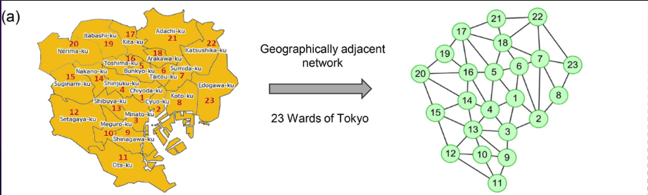
Network Interface with EWS
We model geographic relationships using a network framework under the assumption that physical boundaries represent ways people (and thus diseases) can move between regions
Liu, R., et al. (2021). "Predicting local COVID-19 outbreaks and infectious disease epidemics based on landscape network entropy." Science Bulletin 66(22): 2265-2270.

Slide 38
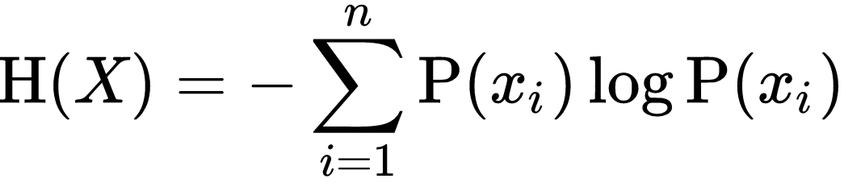
Network Entropy
There is a certain amount of “information” contained in each node (member) of a network
Can be properties of a node, relationships to other nodes, membership in a community of nodes, etc.
Entropy is the average level of “information” given by each node characteristic’s possible outcomes

Slide 39
Hypotheses
Hypothesis 1: The EWS framework can achieve at least 80% accuracy when detecting a doubling of case counts within a 14-day period
Hypothesis 2: Surges in network-based EWS will precede case increases in not only an index region but also in neighboring geographic regions
Hypothesis 3: Surges of EWS can be detected in more affluent communities and those with greater White populations before they are detected in communities with a large proportion of racial and ethnic minority residents

Slide 40
Data Sources
COVID-19 case series from the UC/CDPH COVID-19 consortium
COVID-19 cases stratified by age/gender/race/ethnicity as reported to CDPH
Public COVID-19 case trends from NY Times and CDC database for non-California states
Community/county-level sociodemographic data from official State databases and American Community Survey
Historical outbreak data from Project Tycho from University of Pittsburgh
Notes:
Consortium data has both reported and actual date – can do sensitivity analysis on this
Can also test for EWS for hospitalizations? But link between hosp. rate and cases implies an extra layer of complexity (need to convert medical records into disease-specific point of interest)
NYT: https://github.com/nytimes/covid-19-data
CDC: https://covid.cdc.gov/covid-data-tracker/#datatracker-home
Project Tycho: (https://www.tycho.pitt.edu/)

Slide 41
Analytic Plan
Step 1: Calculate both traditional and network EWS
Step 2: Evaluate predictive accuracy to detect a doubling in cases in 14 days
Step 3: Evaluate ability of EWS to detect health inequalities using data stratified by proportion of racial/ethnic minority populations
Step 0: Translate network-based EWS code into R
Notes:
Step 0 (Done!): Replicate and convert landscape network entropy (LNE), a network-based EWS developed by Liu et. Al, from MATLAB into R
Step 1 (In progress): Estimate both traditional and network-based EWS (both LNE and alternatives) for COVID-19 in US States
Step 2: Evaluate accuracy of calculated EWS to detect a doubling in cases over a 14-day period using ROC curves and AUC
Step 3: Stratify county-level COVID-19 data from California by proportion of race/ethnic minority populations and calculate EWS for each county to determine ability of EWS to detect health inequalities

Slide 42
Step 0
Requested the code to construct LNE from the original authors (Liu et al.)
Rewrote the code in R and verified the results obtained in the original article
Have run trial simulations using the network-based infectious disease simulation (used in Nishi 2020 PNAS)
Confirm if LNE can identify surges in networks generated with random community structures instead of geographic networks

Slide 43
Step 1
Confirm that established EWS are valid using COVID-19 case series from different US states
Variance
Lag-1 autocorrelation
Skewness
Repeat for network-based EWS (both LNE and modified versions)
Verify correlations of EWS surges and case surges using historical outbreak data
Notes:
Test EWS calculation with and without detrending
Describe the modified LNE versions
Change the rolling window
Different combinations/variations of traditional EWS in conjunction with network term

Slide 44
Calculating EWS
Increased variance
Calculate the rolling standard deviation of the case time series
Increased autocorrelation
Calculate the lag-1 (AR 1) autocorrelation of the case time series
Increased skewness
Calculate rolling skewness of the case time series
Reduced recovery from perturbations
Measured by the rolling difference after an increase in cases

Slide 45
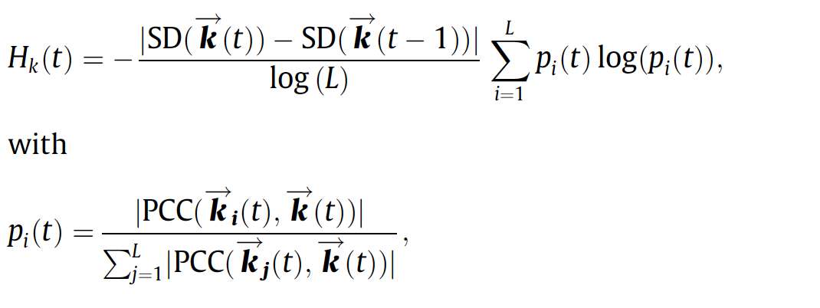
Calculating Network-based EWS (LNE)
Liu et al. 2021 Science Bulletin
Notes:
LNE is the product of deviation and Shannon’s entropy, where the vector k(t) is a moving vector of case totals reported in district k up to time point t and the vector k(t-1) is a vector of the same length up to the day prior to day t.
L is the the number of directly connected neighbors.
PCC(k_{i}(t), k(t) is the Pearson correlation between the case trend in district k and its direct neighbor k_{i} at time t (so the denominator of p(t) is the sum of the PC for k and all neighboring districts)

Slide 46
Rolling Window Determination
The rolling window should be adjusted based on how the case data was collected
For COVID-19 data, range of 7-14 days (but 9 days is optimal to account for reporting delays on weekends)
For historical data, 7 days may be sufficient if data is recorded for each consecutive day
Notes:
Generally, disease data is reported weekly, but databases may vary in their completeness on weekends

Slide 47
Step 2
Generate ROC curves for each calculated EWS and calculate accuracy and AUC
Main metric: does surge in each EWS precede a doubling of cases within the next 14 days
Notes:
Threshold of days can be adjusted in sensitivity analyses
COVID-19 infectious period is about 2-14 days

Slide 48
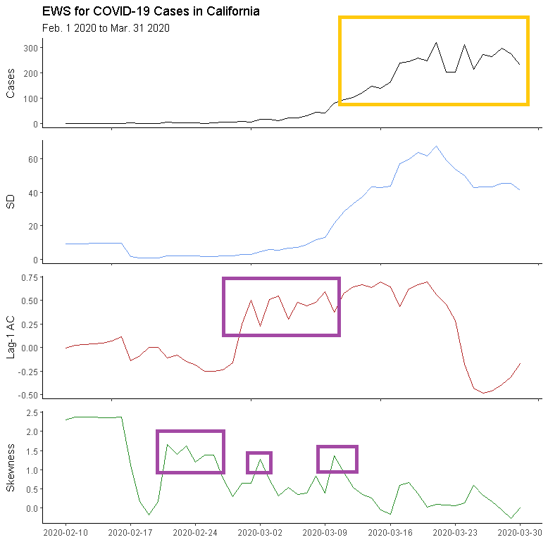
Preliminary Findings
Notes:
Shows COVID-19 cases from 2/1/2020 to 3/31/2020 using CA state data
Surges in Lag-1 autocorrelation and skewness (purple, lower) precede actual COVID-19 case surges (gold) by 2-4 weeks
Next things to consider: to use a static or dynamic threshold that indicates a “spike”

Slide 49
Step 3
Focus on minority communities in California
Use ACS data to create a geographic distribution of socioeconomic factors that could lead to health inequality – use county as unit of analysis
Calculate EWS (both traditional and network-based) for each unit
Stratify the counties by factors associated with inequality (% minority population, socioeconomic status, etc.) and compare time difference between EWS surge and case surge
Notes:
Factors: % population who is minority
Can do % population of specific minority groups
Median income (or can do % below federal poverty level)

Slide 50
Public Health Implications
If EWS can potentially identify upcoming surges in infectious disease cases, public health officials can use them complement existing syndromic surveillance systems
Since estimating EWS does not require specific disease characteristics to be calculated, systems using EWS can be deployed in the earliest stages of a novel outbreak
EWS may be able to accurately distinguish case trends in vulnerable populations from trends in the greater population, allowing for targeted interventions to be rapidly deployed

Slide 51
Aim 3
Aim 3: Develop and test a text inference model for detecting gender bias in academic citations
Subobjectives
Construct a network model of citation behavior for articles published to PubMed Central in the last 2 calendar years to complement the text inference model

Slide 52
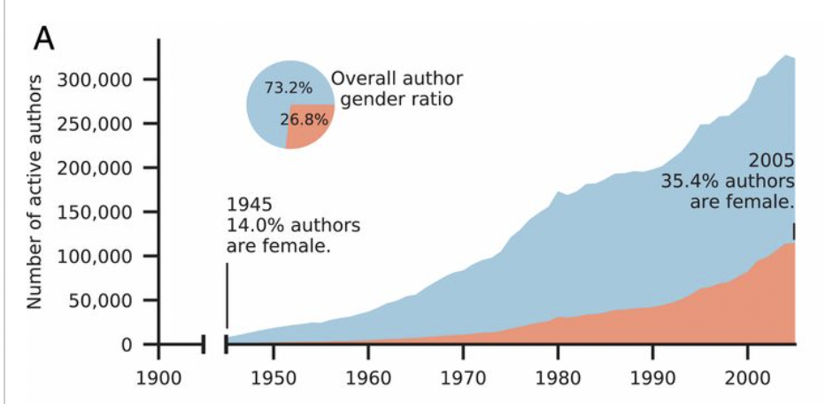
Gender Gaps in Scientific Academia
There is evidence of significant gender gaps in STEM fields in almost all aspects: compensation, recognition, opportunities for promotion, etc.
A recent study (Dworkin et al. 2020, Nature Neuroscience) found that papers with a first or last author who was a woman are cited between 12-14% less than expected in certain fields
Huang et. al. 2020 PNAS
Notes:
A downward spiral: men publish more than women and as a result men have more citations
Citation practices do not follow the increased representation of women in STEM (and are in fact getting worse)
Rate below expectation increased by 0.4% every year

Slide 53
Concept
Since citations are frequently used in decision making situations in academia especially when it comes to hiring and promotion practices, it would be valuable to characterize researchers’ citation behavior
One idea: calculate an “imbalance” score comparing the genders of cited authors and genders of authors that could have been cited
Such a score could be used by academics to ”self-evaluate” their own citation patterns and explore work by other researchers that may be obscured by existing norms or sorting algorithms
Ideally, we want an ethical, fair way to evaluate scientists that also encourages equality among colleagues

Slide 54
What does this require?
Broadly speaking, evaluating bias in academic text will require two major components:
AI systems that can identify imbalances in citation behavior by understanding the text and semantics of scientific literature
A way to quantify implicit bias in written sentences and associated metadata like citations using natural language understanding
This project will focus on the second bullet (but include some of the first)
Notes:
AI systems should function with or without human input

Slide 55
Natural Language Understanding
Key to solving most problems in natural language processing
Main approach: text inference
Take a model and present it with a pair of sentences (premise/hypothesis pair) and ask it to classify their relationship from a small set of options
Word meanings
NLU
Input text
Output text
Notes:
NLU options:
Entailment: the hypothesis has a similar meaning to the premise
Contradiction: hypothesis and premise have opposite meanings
Neutral: similar items but different meaning

Slide 56
Using BERT for Text Inference
Use the state-of-the-art BERT (Bidirectional Encoder Representations from Transformer) model
Key concept: transfer learning
Train a neural network on a known task
Use the trained neural network for a new task-specific model
BERT as a text learning model
Learns contextual relationships between words – non-directional
Reads all words of a sentence at once
Notes:
Positional encoding: re-representation of the values of a word and its position in a sentence (given that is not the same to be at the beginning that at the end or middle).

Slide 57
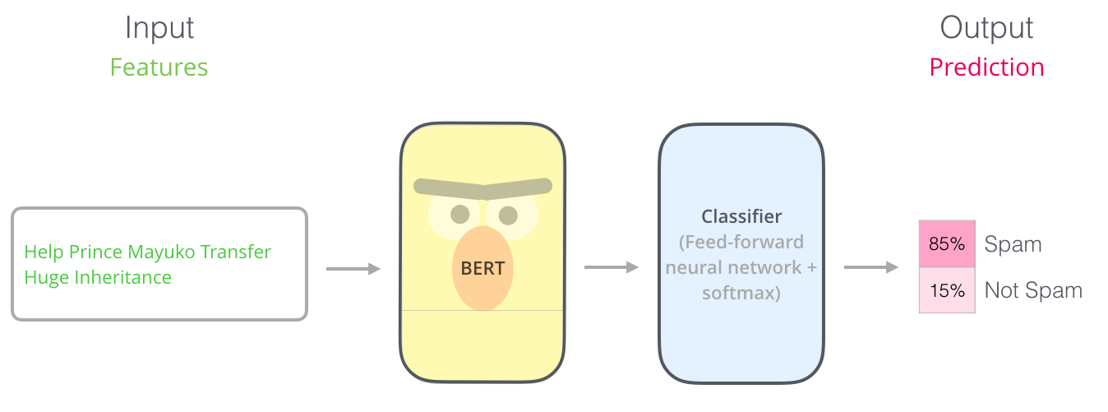
A BERT overview
https://jalammar.github.io/illustrated-bert/
Bidirectional model: reads all elements of a sequence of words simultaneously
2 main training strategies: Masked Language Modeling (MLM) and Next Sentence Prediction (NSP)
Goal is to minimize the combined loss function of the two strategies
Notes:
Jay Alammar
Loss function: function that maps values to a “cost” – here: we want to reduce the costs of predicting the wrong word
Feed-forward: no cycles in NN (vs. recurrent)

Slide 58
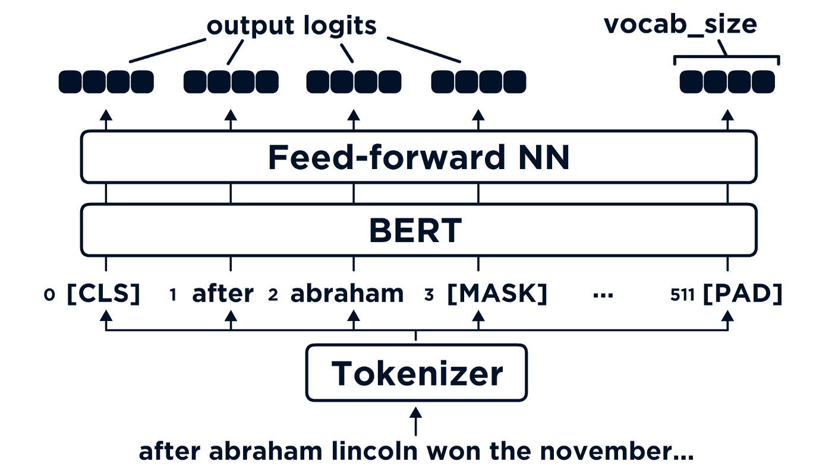
Masked Language Modeling
Give BERT an input sentence and ask it to output the same sentence
Mask a few words (in the example: ”Lincoln” is masked) before input so the model learns context and linguistic patterns
https://towardsdatascience.com/masked-language-modelling-with-bert-7d49793e5d2c
Notes:
Masked LM: Mask t

Slide 59
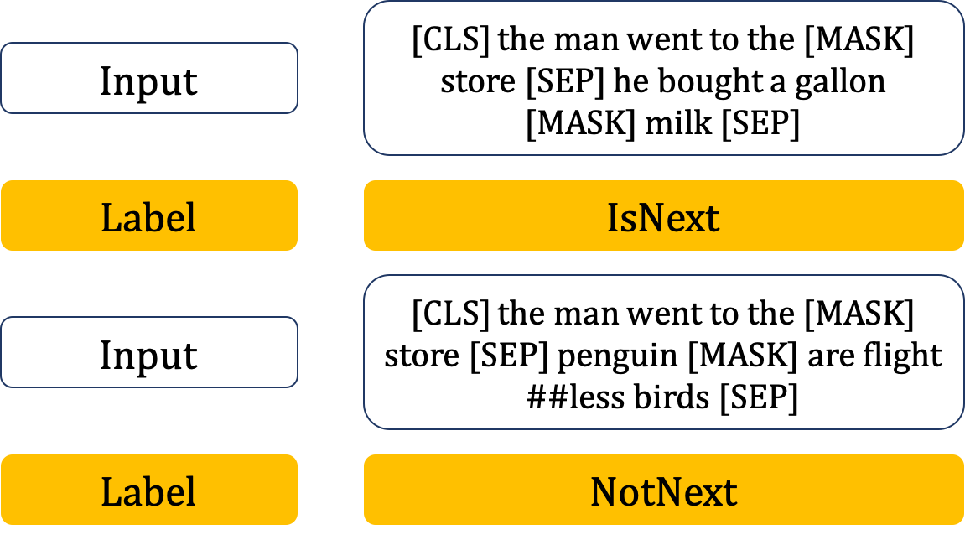
Next Sentence Prediction
Ask BERT if one sentence occurs after the other
Tokens are used to tag different parts of the document: [CLS] token for the beginning of a sentence, [SEP] tokens for subsequent sentences
In addition to token embeddings, sentence and positional embeddings are added
https://humboldt-wi.github.io/blog/research/information_systems_1920/bert_blog_post/
Notes:
[CLS] classification
[SEP] separator
Sentence embeddings: sentence A vs. sentence B
Positional: nth word of a sequence

Slide 60
Citation Behavior as Networks
Use network science to improve our understanding of relationships between researchers that influence citation behavior
We can treat the connections of researchers through references of each others’ papers as ties in a citation network
Characteristics of local citation networks can be evaluated using community detection algorithms
Allows us to separate groups of papers by discipline and semantic argument
Notes:
Community membership can be a component of the neural network?

Slide 61
Hypotheses
Hypothesis 1: Authors from scientific disciplines with closer to a 1:1 gender ratio will have on average lower imbalance scores (controlling for position/seniority and geographic region)
Hypothesis 2: The gender gap in citation behavior will be more pronounced in younger fields (i.e., fields where the proportion of publications in the last 20 years is higher compared to the proportion pre-2000) compared to the same gap in more established fields

Slide 62
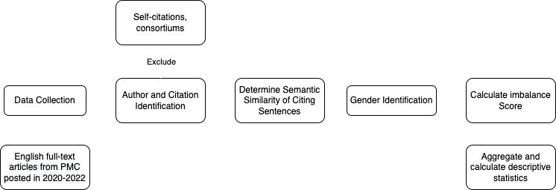
Analytic Plan
Notes:
Download articles published in the last 2 calendar years (for example June 2020 to June 2022) from the PubMed Central database
Identify sentences in the downloaded articles with citations and find other articles (+ their authors) within the database citing the same sources
Fine-tune BERT to determine semantic similarity of the citing sentences (a la sentiment analysis)
Perform gender prediction on author names
Calculate the imbalance score on the sentence and author levels
Present descriptive statistics of imbalance score across disciplines, author position, region of origin

Slide 63
Data Collection
Use the past 2 years of papers hosted on the PMC database (the “index” articles)
English full-text articles
Include all fields to allow for subanalyses
Some articles were previously downloaded on a server in Dr. Chang’s lab
Database will need to be updated to capture recent articles – most recent capture was before the start of the COVID-19 pandemic
Notes:
Fields will be aggregated into buckets (i.e. biology/chemistry/physics if applicable)
# of years can be adjusted if we think the networks will not be dense enough

Slide 64
Author and Citation Identification
Full text articles downloaded from the PMC database comes with author information (name, institution, etc.) included in metadata
Python code to identify sentences with citations and ID papers in the database citing the same papers in progress
Exclude self-citations and citations of consortiums
Cited articles:
T. W. Valente, Network interventions. Science 337,49–53 (2012).
Index article:
Nishi A, et al., Network interventions for managing the COVID-19 pandemic and sustaining economy, PNAS 117 (48) 30285-30294 (2020).
Other citing articles:
Nunner, H., van de Rijt, A. & Buskens, V. Prioritizing high-contact occupations raises effectiveness of vaccination campaigns. Sci Rep 12, 737 (2022).

Slide 65
Calculate Semantic Similarity
SS > 0.5
The differences between sets of citations used by authors across multiple papers may not be a result of bias but due to a difference in meaning
Calculate semantic similarity between sentences citing the same source to determine if the meaning of the sentences are the same
Fine-tune BERT/SciBERT based on the PMC dataset’s parameters
Use the Huggingface APIs with PyTorch
Notes:
Sentences are similar but are not semantically similar. Sentence 1 identifies one element of Valente’s framework, while sentence 2 indicates interventions based on Valente’s framework to reduce spread of COVID-19.
0.5 is the threshold for having some similarity

Slide 66
Gender Identification
Identify the gender of the authors of the index articles and cited articles
Using the GenderAPI proprietary database
Better performance on Asian names compared to Genderize.io which has been used by other groups
Can use manual annotation for ambiguous/unisex names if reasonable
Potential for subanalysis of gender imbalance stratifying by source of author name
Akihiro
George
Akira
GenderAPI
Male (100%)
Male (97%)
Male (57%)
Notes:
% represents APIs confidence
Compare anglophone vs. not anglophone names

Slide 67
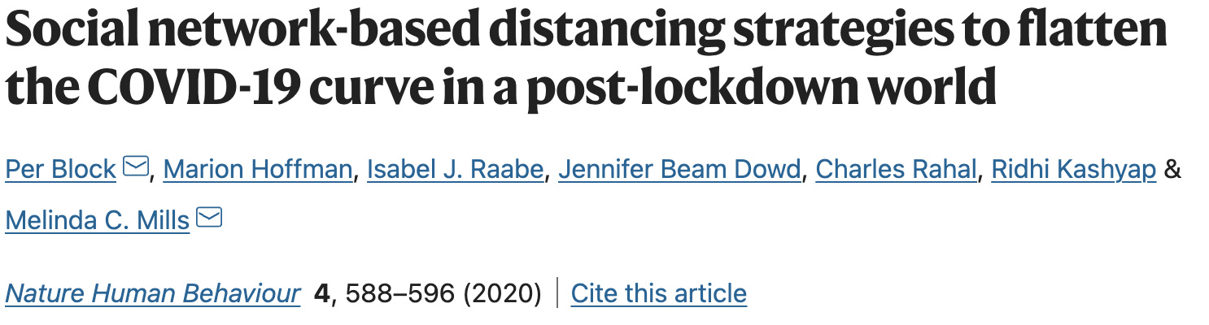

Calculating the Imbalance Score: Sentence-level
Per: M
Marion: F
Isabel: F
Jennifer: F
Charles: M
Ridhi: F
Melinda: F
$$\frac{1+0.14}{1+0.5+5(0.14)}=0.52$$
Use the first-last author emphasis as a basis for the contribution of each author: first author gets weight 1, last author receives weight 0.5, other authors get equal credit to calculate the “male proportion” (MP)
Calculate the median MP for other sentences citing the same paper that rank highly in semantic similarity
The sentence-level imbalance score is the ratio of the MP of the sentence in question to the median MP
Notes:
MP = 1 is parity
MP <1 female preference
MP >1 male preferent
Can test other norms: first author norm, equal contribution norm, etc.

Slide 68
Calculating the Imbalance Score: Author-level
Aggregate the sentence-level imbalance scores for sentences written by the author and calculate the median imbalance score and 95% CI using bootstrapping
If the null imbalance score (1) is included in the CI, then no imbalance by the author is indicated
Scores <1 are female-preferent while scores >1 are male-preferent
Notes:
10,000-time bootstrap sampling from gender imbalance scores obtained from different sentence sections over different papers
Bootstrapping – sample with replacement the gender imbalance scores to generate a new bootstrap sample to calculate a median imbalance score
Attribute sentences to the first author of the paper from which it was extracted

Slide 69
Wrap-up
Aggregate individual-level imbalance scores for all citing authors in the database (authors must have at least one paper to be scored and to be eligible)
Calculate descriptive statistics (mean, median, range)
Perform stratified descriptive analysis for subfields (medicine, life sciences, social sciences, etc.) and compare to gender proportions as calculated by scientific associations/academic institutions

Slide 70
Public Health Implications
Assessment of citation behavior can be widely deployed in making hiring/promotion decisions or to allow researchers to expand their research circles and improve collaborative efforts
Promotion of equality in academia will support growth of young researchers of diverse backgrounds
Identifying and reducing gender biases will allow female researchers and female-led research teams to penetrate fields that are traditionally male-dominated

Slide 71
Thank you!
Notes:
Some figures for Aim 2?

Slide 72
References
Raihani NJ, Bshary R. Punishment: one tool, many uses. Evolutionary Human Sciences. 2019;1doi:10.1017/ehs.2019.12
Nishi A, Christakis NA, Evans AM, O'Malley AJ, Rand DG. Social Environment Shapes the Speed of Cooperation. Sci Rep. Jul 20 2016;6:29622. doi:10.1038/srep29622
Nishi A, Shirado H, Rand DG, Christakis NA. Inequality and visibility of wealth in experimental social networks. Nature. 2015/10/01 2015;526(7573):426-429. doi:10.1038/nature15392
Gächter S, Renner E, Sefton M. The Long-Run Benefits of Punishment. Science. 2008/12/05 2008;322(5907):1510-1510. doi:10.1126/science.1164744
Nishi A, Christakis NA, Rand DG. Cooperation, decision time, and culture: Online experiments with American and Indian participants. PLOS ONE. 2017;12(2):e0171252. doi:10.1371/journal.pone.0171252
Polonsky JA, Baidjoe A, Kamvar ZN, et al. Outbreak analytics: a developing data science for informing the response to emerging pathogens. Philos Trans R Soc Lond B Biol Sci. Jul 8 2019;374(1776):20180276. doi:10.1098/rstb.2018.0276
Scheffer M, Carpenter Stephen R, Lenton Timothy M, et al. Anticipating Critical Transitions. Science. 2012/10/19 2012;338(6105):344-348. doi:10.1126/science.1225244
Scheffer M, Bascompte J, Brock WA, et al. Early-warning signals for critical transitions. Nature. Sep 3 2009;461(7260):53-9. doi:10.1038/nature08227
Notes:
Some figures for Aim 2?

Slide 73
References
O'Brien DA, Clements CF. Early warning signal reliability varies with COVID-19 waves. Biology Letters. 17(12):20210487. doi:10.1098/rsbl.2021.0487
Proverbio D, Kemp F, Magni S, Gonçalves J. Performance of early warning signals for disease re-emergence: A case study on COVID-19 data. PLOS Computational Biology. 2022;18(3):e1009958. doi:10.1371/journal.pcbi.1009958
Nishi A, Dewey G, Endo A, et al. Network interventions for managing the COVID-19 pandemic and sustaining economy. Proceedings of the National Academy of Sciences. 2020/12/01 2020;117(48):30285-30294. doi:10.1073/pnas.2014297117
Liu R, Zhong J, Hong R, et al. Predicting local COVID-19 outbreaks and infectious disease epidemics based on landscape network entropy. Science Bulletin. 2021;66(22):2265-2270. doi:10.1016/j.scib.2021.03.022
Centers for Disease Control and Prevention. Disparities in COVID-19-Associated Hospitalizations. Accessed April 1, 2022. https://www.cdc.gov/coronavirus/2019-ncov/community/health-equity/racial-ethnic-disparities/disparities-hospitalization.html
Centers for Disease Control and Prevention. Disparities in Deaths from COVID-19. Accessed April 2, 2022. https://www.cdc.gov/coronavirus/2019-ncov/community/health-equity/racial-ethnic-disparities/disparities-deaths.html
Quantin C, Tubert-Bitter P. COVID-19 and social inequalities: a complex and dynamic interaction. The Lancet Public Health. 2022;7(3):e204-e205. doi:10.1016/S2468-2667(22)00033-0
New York Times. NYTimes COVID-19 Data. Accessed April 24, 2022. https://github.com/nytimes/covid-19-data
Notes:
Some figures for Aim 2?

Slide 74
References
University of Pittsburgh. Project Tycho. Accessed March 30, 2022. https://www.tycho.pitt.edu/
US Census. American Community Survey Data. Accessed April 15, 2022. https://www.census.gov/programs-surveys/acs/data.html
Huang J, Gates AJ, Sinatra R, Barabasi AL. Historical comparison of gender inequality in scientific careers across countries and disciplines. Proc Natl Acad Sci U S A. Mar 3 2020;117(9):4609-4616. doi:10.1073/pnas.1914221117
Dworkin JD, Linn KA, Teich EG, Zurn P, Shinohara RT, Bassett DS. The extent and drivers of gender imbalance in neuroscience reference lists. Nat Neurosci. Aug 2020;23(8):918-926. doi:10.1038/s41593-020-0658-y
Devlin J, Chang M-W, Lee K, Toutanova K. BERT: Pre-training of Deep Bidirectional Transformers for Language Understanding. 2018:arXiv:1810.04805. Accessed October 01, 2018. https://ui.adsabs.harvard.edu/abs/2018arXiv181004805D
Nunner H, van de Rijt A, Buskens V. Prioritizing high-contact occupations raises effectiveness of vaccination campaigns. Scientific Reports. 2022/01/14 2022;12(1):737. doi:10.1038/s41598-021-04428-9
Block P, Hoffman M, Raabe IJ, et al. Social network-based distancing strategies to flatten the COVID-19 curve in a post-lockdown world. Nature Human Behaviour. 2020/06/01 2020;4(6):588-596. doi:10.1038/s41562-020-0898-6
gender-api.com. Gender API. Accessed April 20, 2022. https://gender-api.com/
Notes:
Some figures for Aim 2?

