Slide 1

UNIVERSITÀ DI PISA
Intelligent Systems For Pattern Recognition
Midterm 2 | Assignment 4
This assignment involves implementing a Bayesian network from scratch.
The network was implemented using 3 classes:
1) BayesianNetwork - to handle operations on the entire underlying graph.
2) BayesianNode - to manage the single node.
3) CPT_Item - an auxiliary class to manage Conditional Probabilities Tables.
Gennaro Daniele Acciaro
MAT. 635009

Slide 2
My process
My problem is the path to passing this exam through the midterms.
The random variable are: {studying_m1, studying_m2, studying_m3, studying_m4, studying_oral,
midterm1, midterm2, midterm3, midterm4, oral, happy_gennaro_daniele}
Each intermediate exam requires the student to have passed the previous midterm and to have studied for that particular midterm. The domain of each midterm exam is boolean.
Each "studying" node indicates how much a student has studied for a midterm or final oral. The domain of these nodes is [ "Hard", "Sufficient", "Not so much" ]
The domain for the oral variable indicates 4 possible grades : ["Honorary", "Remarkable", "Pass", "Fail"]
The random variable happy_gennaro_daniele indicates my own happiness based on the grade on this exam.

Slide 3
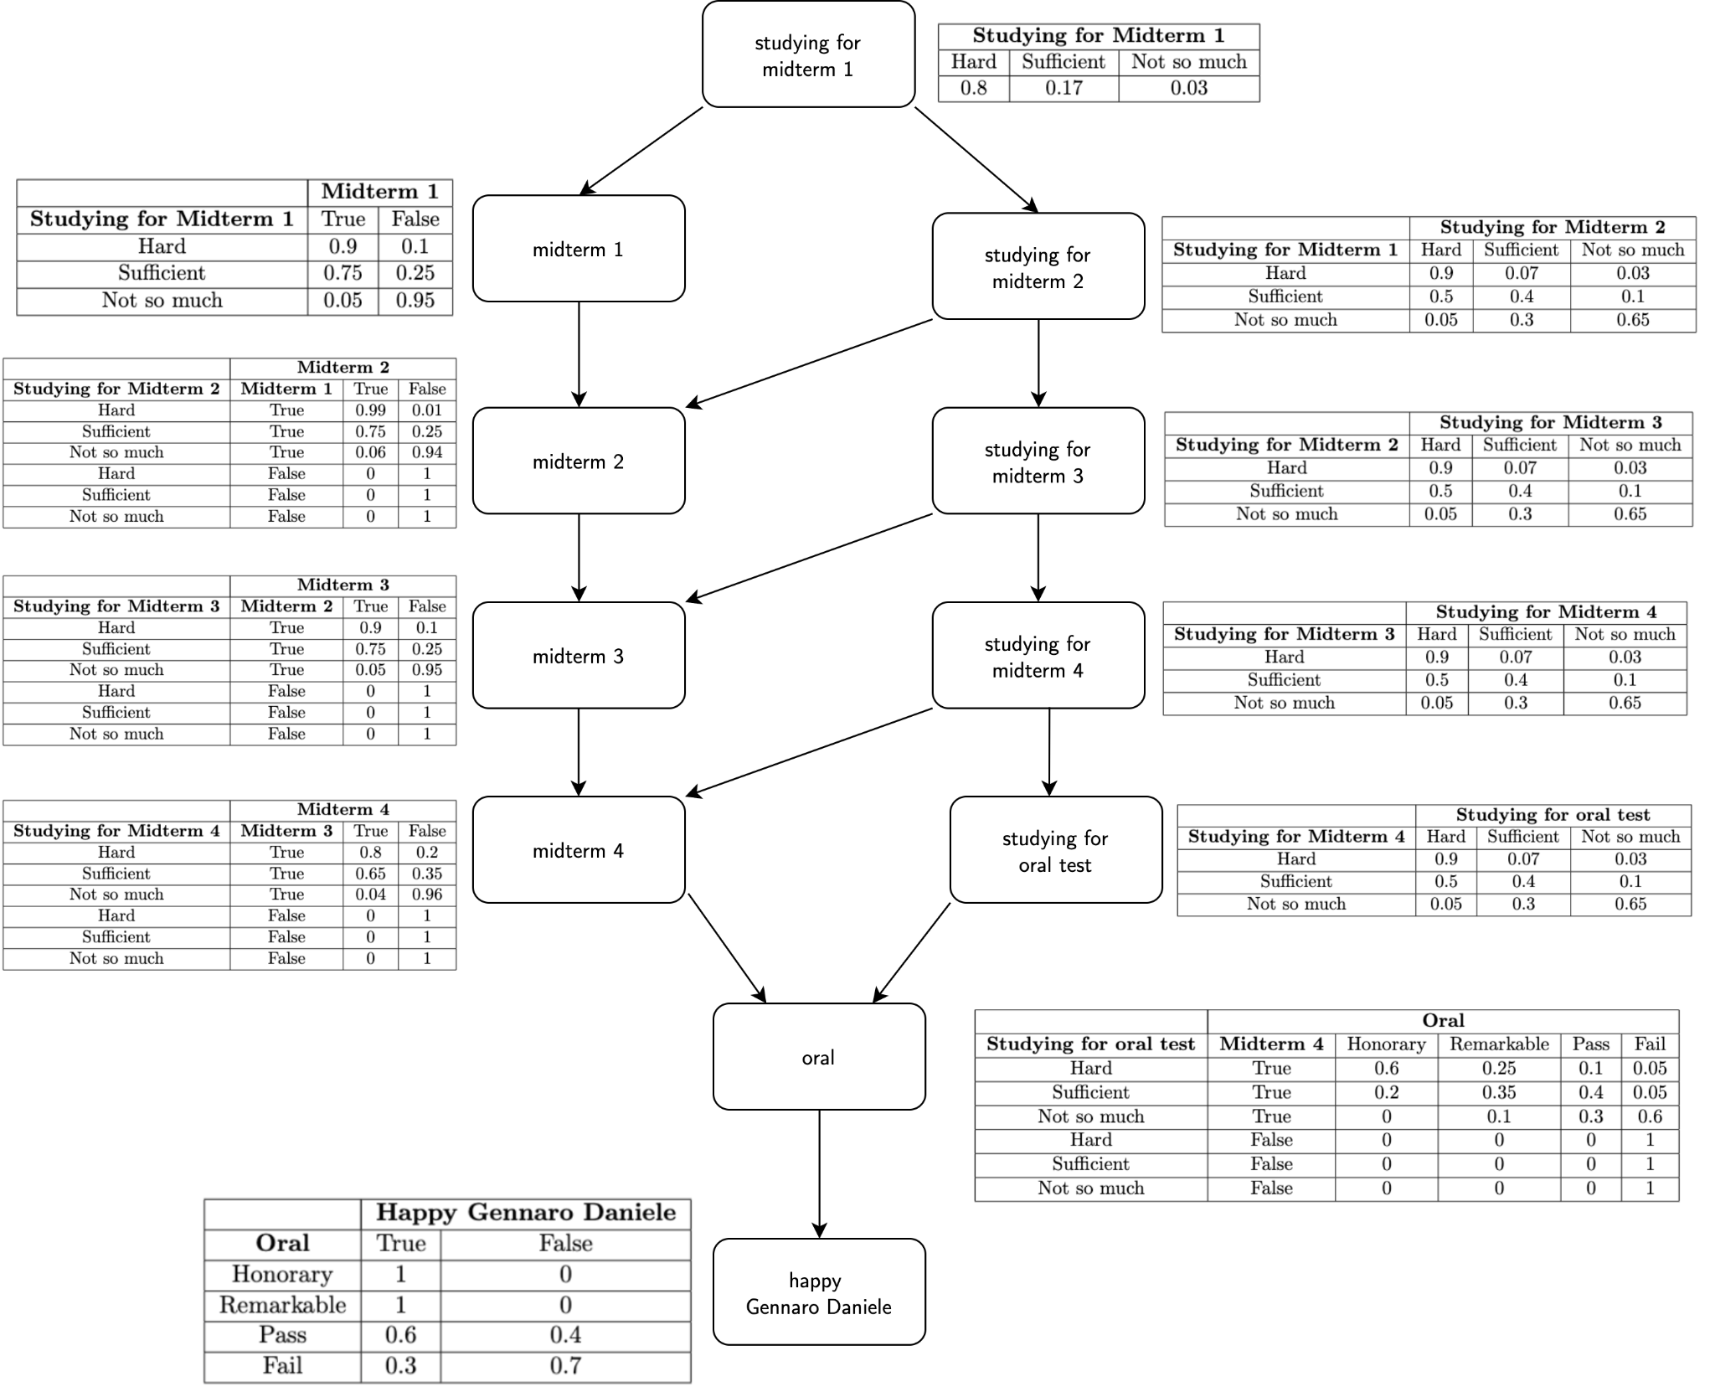

Slide 4
How I represented CPTs
Each node has a Conditional Probability Table that is implemented as a set of CPT_Items, a pair (cause, probability).
Causes are defined by means of a list, and each element in this list contains the cause object and a domain value of this object.
Passing the object directly may not be the most efficient way, computationally speaking, to create CPTs, but I decided to do it this way to make more user-friendly the insertion of values in CPTs. In fact libraries like pomegranate, allow to create CPTs considering using only the domain values.
Personally I think this can create confusion and errors if this activity is done manually, even more so if we have to describe a very large CPT.
On the next slide there is a comparison between my version and pomegranate.
Finally, probabilities are handled via a simple list of values. This list follows the order of the domain values of the node itself.

Slide 5
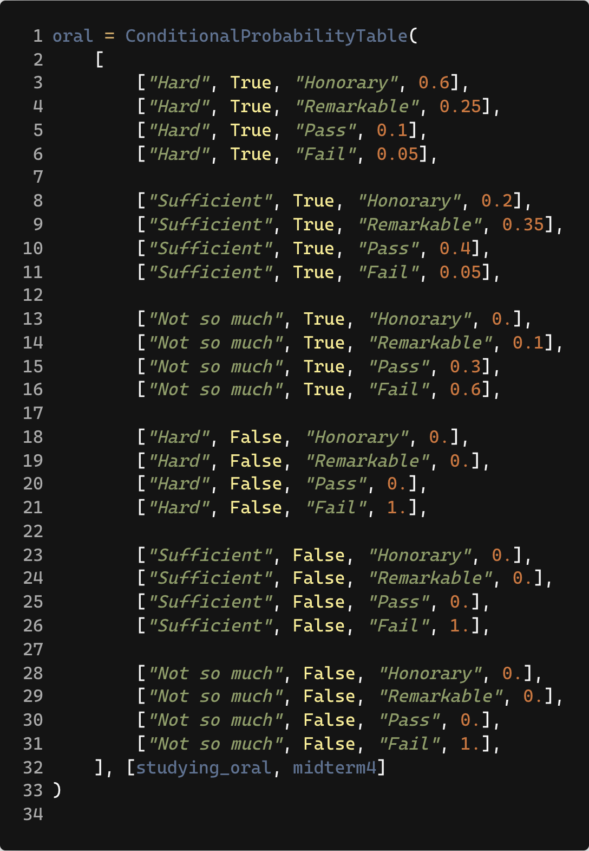
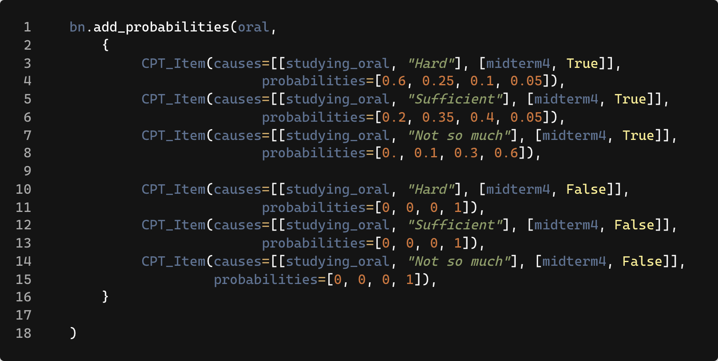
How I represented CPTs
My CPT
Pomegranate’s CPT

Slide 6
How I calculate probabilities
Given a sequence of random variables, we can calculate the probability of the joint distribution of those variables using BN.
In this project, this computation was performed by visiting the graph through the BFS graph visitation algorithm. The BFS starts with the independent nodes and adds to the queue all the children of the current node that have not yet been visited.
For each node then, one probability must be selected from its CPT.
If the node is independent, it will have only one probability in the CPT and then I will use that.
If the node is dependent, I choose the probability whose causes are present in the causes passed as input to the algorithm.

Slide 7
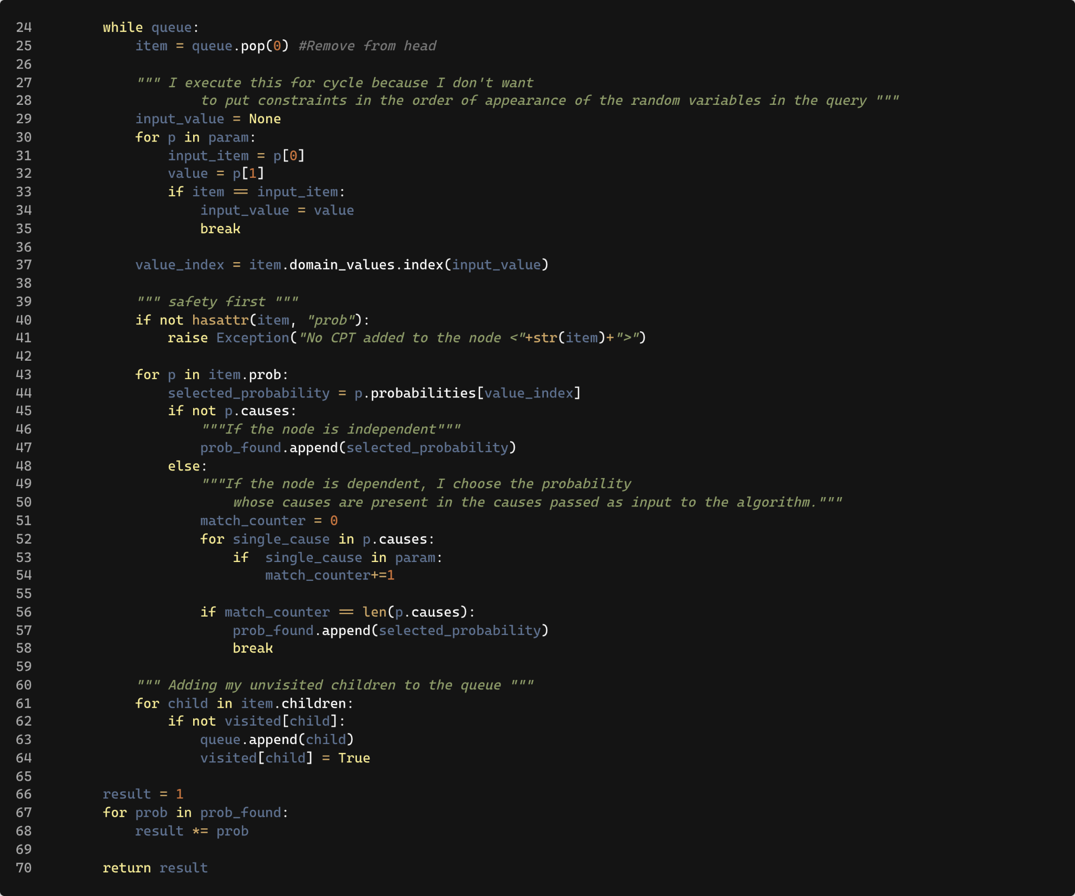
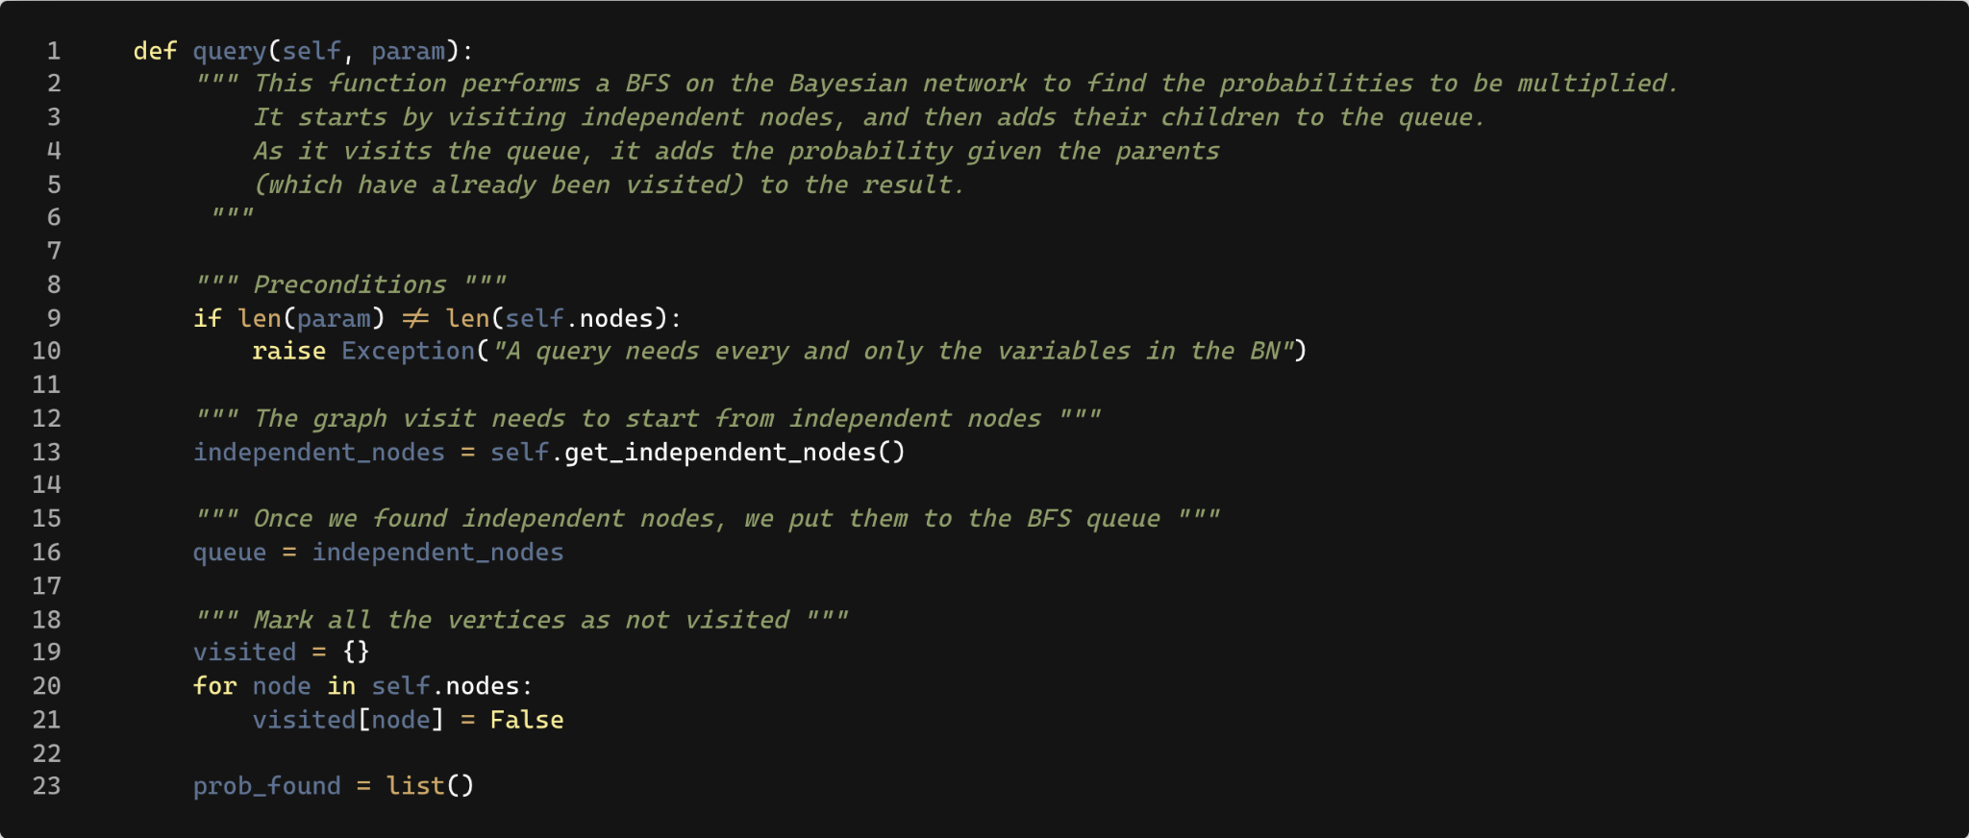
How I calculate probabilities

Slide 8
Ancestral Sampling
Ancestral Sampling is a sampling process that involves sampling nodes without parents, and then sampling their children, conditioned by the probability of the parents, and so on.
I implemented this sampling technique through the BFS visitation algorithm.
For each node in the graph I call the .sample() function which, given a cause, generates a sample for that node given the probability described in the node's CPT for that particular cause.
(For independent nodes, the cause is left blank).
Once the probability is found, I use Numpy's np.random.choice() method to generate the node’s sample (which is a random value from its domain given the probability).

Slide 9
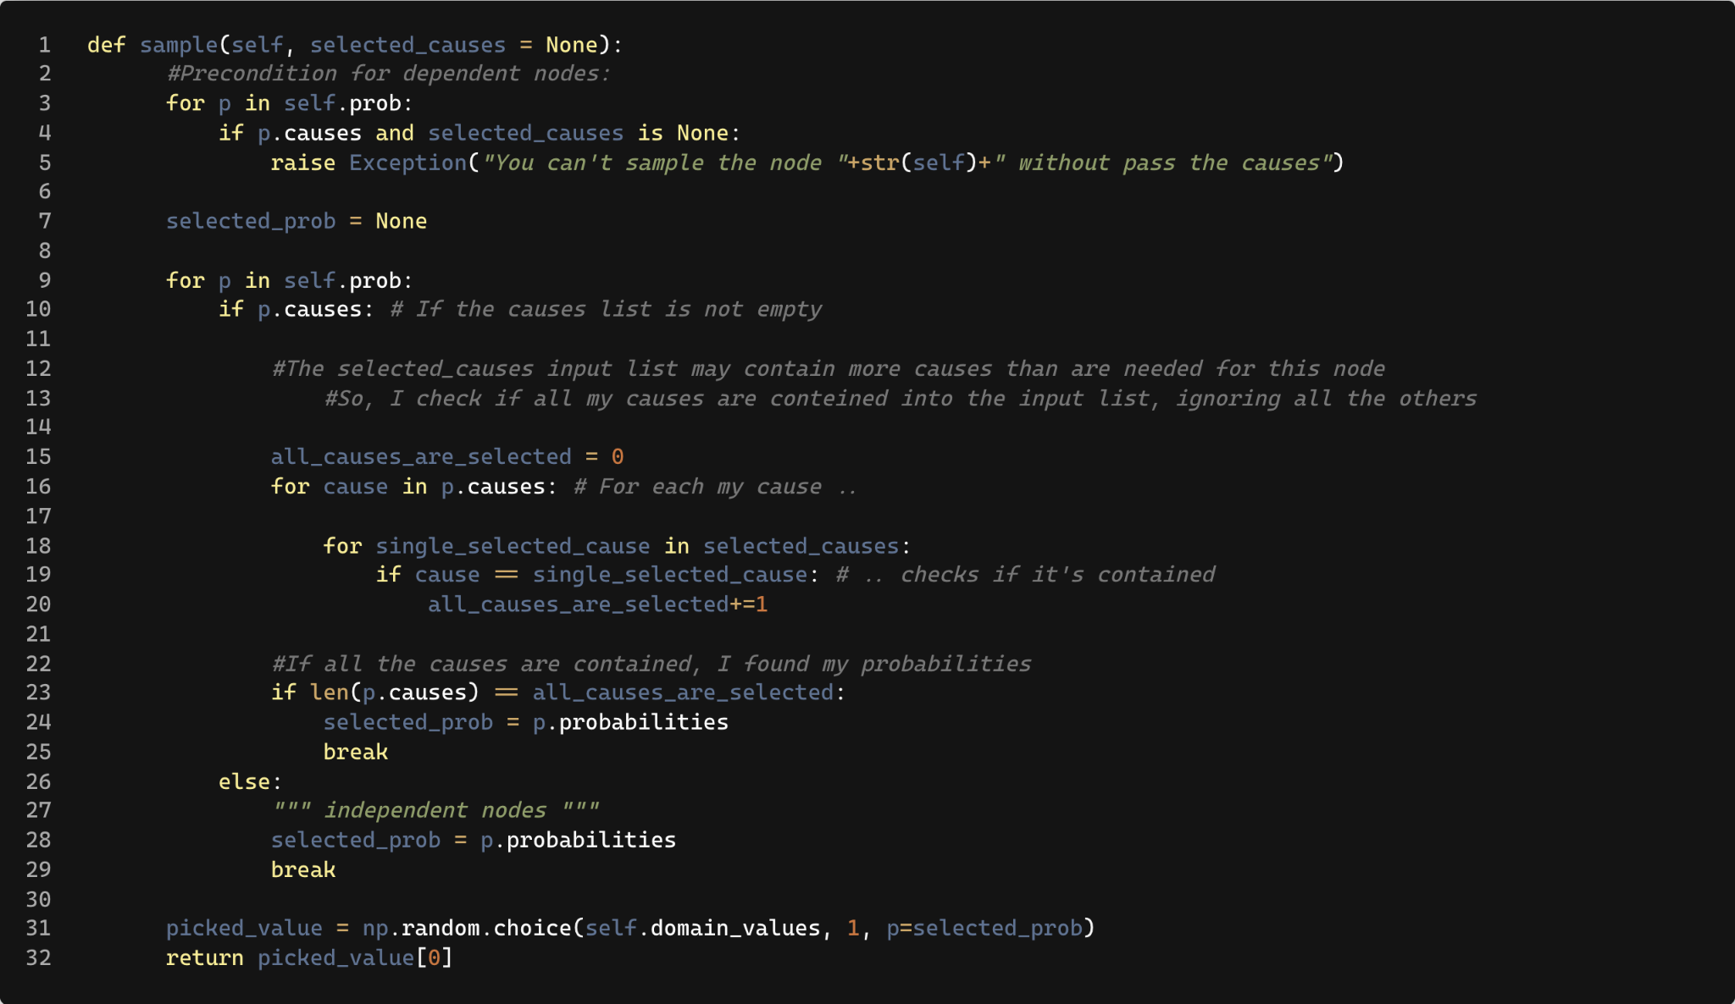
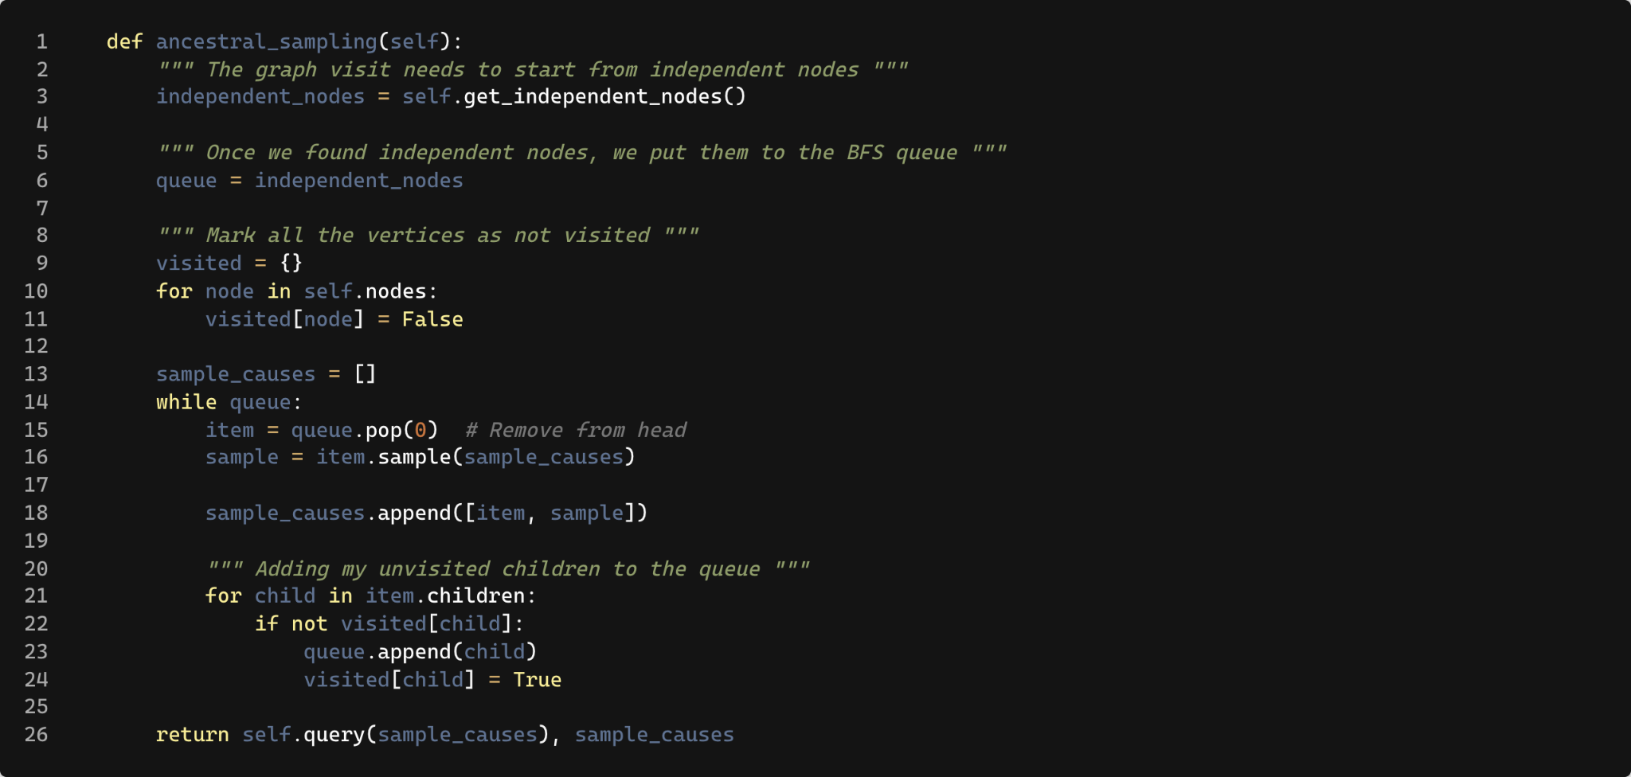
Ancestral Sampling
Bayesian Node’s method
Bayesian Network’s method

Slide 10
Sampling Results
As we can see from the graphs on the next slide, a fair trade-off between the number of samples (and execution time) and the quality of the distribution is about 100 samples.
In fact the distribution of results with 100 samples is very similar to that with 5000 samples, although the time required for the first run is 0.084 secs while the execution of 2000 samples takes 4.172 secs.
Another interesting observation might be that the distribution follows the idea that, unfortunately, it is much easier to fail this exam (about 70% of total cases) than to pass it with an honors grade (about 15% of total cases).
This was an expected result.

Slide 11
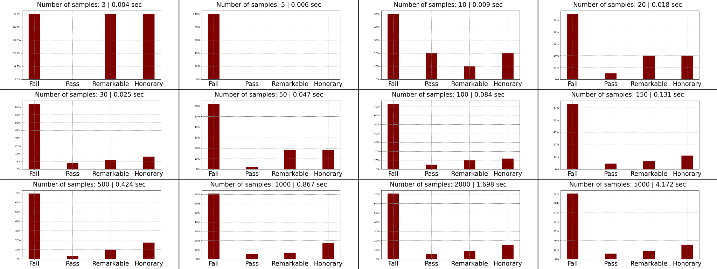
Sampling Results

Slide 12
Finals observations
Building a Bayesian network from scratch was quite a challenge.
Computationally, performing a BFS for each query is expensive, it may be possible to improve the complexity of the project by performing a single visit to the graph after adding all the edges and save this topological order in a data structure and reuse it, whenever it is necessary to visit the graph.
Lessions learned:
Experience with Bayesian Network
Experience with Pomegranate (to compare my BN with this library)
First experience with sampling approaches

