Slide 1
Analyzing the Ordering of MLB Lineups
By George Daher and Dan Mariani

Slide 2
Background
In baseball one of the key decisions a manager has to make is how to order the lineup
It is generally overlooked in importance as a manager’s decision in terms of pitching substitutions and strategy is usually considered more important
However the order of the lineup has an effect on the game, as you want your better hitters early in the lineup so they can hit more times and contribute more to your team.
In our background research, we discovered that beyond just placing better hitters earlier in the common conventional wisdom is:
  Place highest OBP batters 1st and 2nd
  This sets them up for the best hitter, in the 3rd spot.
  Then, the 4th and 5th spots would be the best power hitters
  Finally, batters 6-9 would be ordered best to worst.

Slide 3
Project Overview
Our initial plan was to create a model to optimize MLB batting lineups.
We realized that this question might be too complex with adjustments and multiple tests needed
With limited time and trouble with the raw data, our plan evolved to investigating the conventional wisdom in batting lineups.
To investigate the validity of this, we looked at statistics from websites Baseball Reference and FanGraphs, such as on-base percentage, OPS,, slugging percentage, batting average, and more.
We chose to look at the time period 2012-2019, cutting out the shortened 2020 season, as well as universal DH season, and any seasons pre-sabermetric era.

Slide 4
Research Question & Relevance
Final Question: Is conventional wisdom, with on-base batters 1st and 2nd, the best hitter 3rd, and power hitters 4th and 5th still used by MLB managers to construct their lineups today?
Investigating our initial question would have had relevance to MLB front offices, managers, and fans, showing them how to best manage their teams for optimal performance.
This new question has relevance to similar audiences.
This question can be investigated throughout time to see whether the conventional wisdom about lineup construction is still used by MLB front offices or whether there is more optimal way to construct lineups.

Slide 5
Hypotheses
Our hypotheses for our analysis are as follows:
  MLB batting orders will have a strong relationship with hitting statistics
  Conventional lineup wisdom is still used in the MLB
This will be investigated with multiple paired hypothesis tests comparing the batting statistics of multiple different lineup positions.
ANOVA tests will also be used for comparing the means of different batting statistics across lineup positions.

Slide 6
Baseball Statistic Dictionary
Before we continue, it is important to understand the following baseball statistics
Batting Average (AVG or BA) - The percentage of At-bats where a player gets a hit
  AVG = hits/at-bats
  All hits are weighted the same
  At-bats are used instead of plate appearances, which excludes walks, hit by pitches, etc.
  Good stat for picking out the best on-base hitters
On-Base Percentage (OBP) - the percentage of time a player gets on-base
  OBP = (hits+walks+hit by pitches)/plate appearances
  Accounting for how much a player gets hit and walked, while still emphasizing hits
  Good stat for picking out the best on-base hitters
Slugging Percentage (SLG) - the average amount of bases a player gets per at-bat
  SLG = (singles+2*doubles+3*triples+4*homeruns)/at-bats
  Weights hits differently, so that more impactful hits give higher values, contrary to batting average
  Still doesn't account for walks or hit by pitches
  Good stat for picking out the best power hitters
On-Base Percentage + Slugging Percentage (OPS)
  OPS = on-base percentage +slugging percentage
  Accounts for how often a player gets on base and how impactful their hits are
  Good stat for picking out the best overall hitters
Notes:
Low priority

Slide 7
Sourcing our Data
All of the data was collected from MLB games and MLB player performances, and we used two sources to access the data:
Retrosheet had game logs for all past MLB games.
  From these game logs, we used the lineup order and result for every game.
Baseball Reference had hitting splits over specifiable periods of time.
  From these hitting splits, we used hitting statistics from the past season
Merging the data from these two sources gave us a dataset that we could analyze in order to answer our research questions

Slide 8
Scope of the Data
We decided Sabermetric Era in baseball which is from 2012 to the present.
Additionally, the pandemic significantly distorted the MLB season and caused a number of rule changes so we decided to not include the pandemic year (2020) or post pandemic years in our analysis.
Consequently, our data would be over a time frame ranging from 2012 to 2019.
We eliminated non qualified hitters from the dataset because they would present outliers in many rate statistics (AVG, OBP, etc.) due the small sample size of their play over the hitting split.
For the hitting statistics, we decided to focus on hitting “rate statistics” such as AVG, OBP, SLG and OPS, because they are less susceptible to outliers than counting statistics.

Slide 9
Resulting Data & Data Dictionary
The resulting data set would include 155,280 data points, where each data point was a hitter with some lineup position on a particular date with their hitting splits from the previous year.
This meant there was some repetition in the data because some teams keep their lineups mostly the same, but the size of the dataset meant this repetition would not be largely impactful on results
All of the data points included the following statistics relevant to the analysis:
  Lineup Position - Response Variable, position that the player batted in the lineup on that day
  BA (or AVG) - Explanatory Variable, the batting average the player had in the previous year
  OBP - Explanatory Variable, the on base percentage the player had in the previous year
  SLG - Explanatory Variable, the slugging percentage the player had in the previous year
  OPS - Explanatory Variable, the on-base plus slugging percentage the player had in the previous year

Slide 10
Analysis
First step in the analysis is to determine whether each of the explanatory variables (AVG, OBP, SLG, OPS) have a relationship with the response variable of lineup position.
To do this we conducted multiple one way ANOVA tests and linear regression between lineup position and each of the explanatory variables separately
However to do this, certain assumptions must be checked.
  The independence assumption satisfied because the dataset includes the entire population over the time frame and scope we are considering.
  The equal variance assumption is satisfied because the variance among the explanatory variable all come from the same hitting splits dataset before being divided into groups based on lineup positions.
  The normality assumption can be checked using histograms and Q-Q plots.

Slide 11
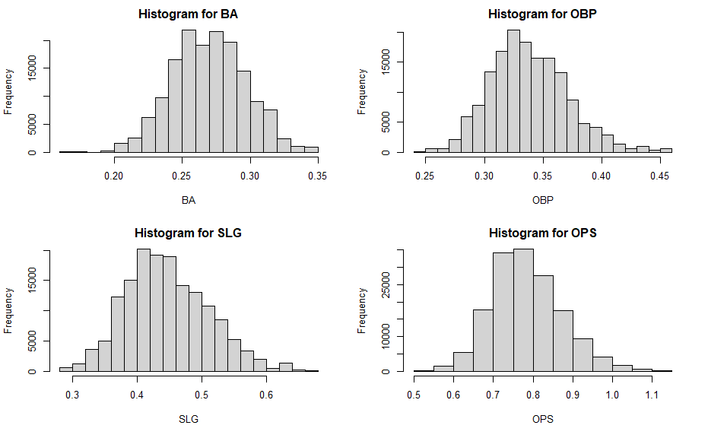
Checking Normality
The assumption of normality seems mostly sound, however there is slight skew visible in the histograms for BA, OBP and SLG.

Slide 12
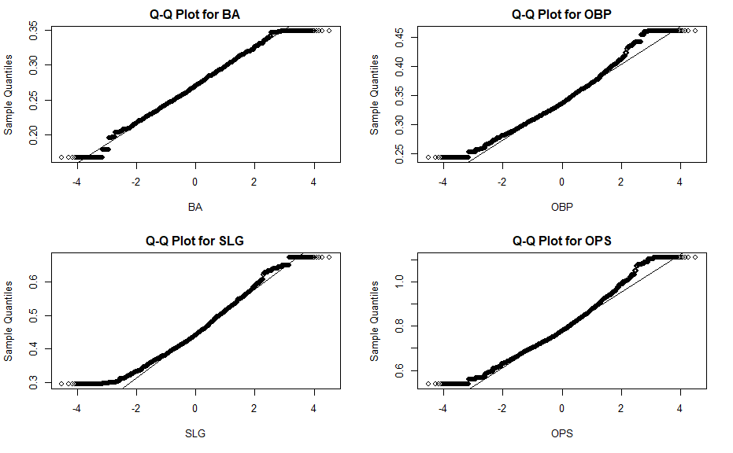
Checking Normality
The assumption of normality seems however there is visible deviation from a straight line on all the Q-Q plots.

Slide 13
Analysis
However, ANOVA is robust against slight departures from normality if the size of the groups are the same.
So despite the slight departure from normality, the assumptions for ANOVA and simple linear regression
ANOVA Null Hypothesis = the true mean of the batting statistic is equal for each lineup position (for batting statistics: avg, obp, slg, ops)
ANOVA Alternative Hypothesis = the true mean of the batting statistic is not equal for each lineup position (for batting statistics: avg, obp, slg, ops)

Slide 14
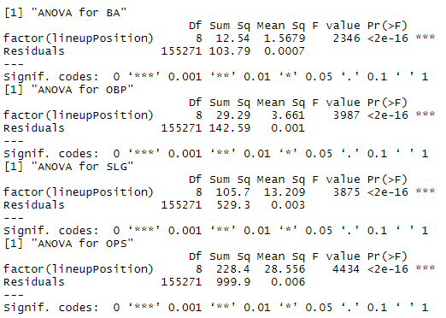
ANOVA Tests
All of the ANOVA tests show very high F test statistics and very low p-values. Hence we can reject the null hypothesis and conclude that BA, OBP, SLG and OPS differ by lineup position.

Slide 15
ANOVA Results
Using ANOVA we determined that there is difference in BA, OBP, SLG and OPS by lineup position
Each of the tests yielded a p-value that would reject the null hypothesis for equal means for each of the statistics at all the lineup positions.
We conclude that there is statistical evidence was found that BA, OBP, SLG and OPS are not independent of lineup position.
The next step is determine what type of relationship this is based on a simple linear regression with each of the explanatory variables used to predict lineup position
For the linear regression the null hypothesis is that each of the coefficients are 0, and the p-values are then calculated from this for each of the coefficients in each regression model

Slide 16
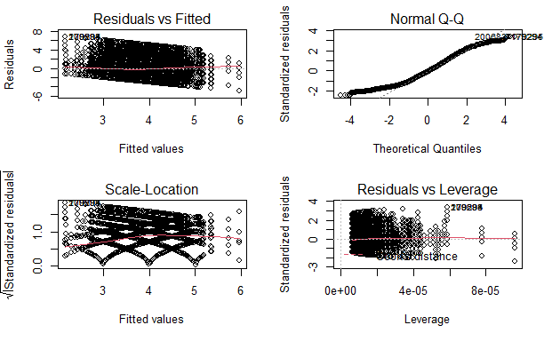
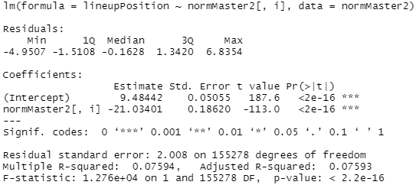
Linear Regression for BA
From the results of the regression we can conclude that the BA has a negative relationship with lineup position because the p-value for that coefficient is very small (meaning that as BA increases, lineup position decreases). However, the regression is very weak and only account for ~8% of the error in the data and meaning it is not an adequate model to predict lineup position.

Slide 17
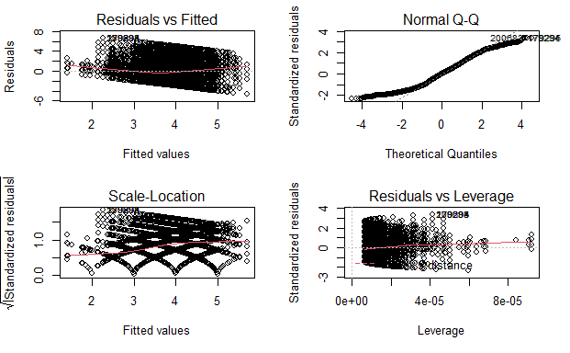
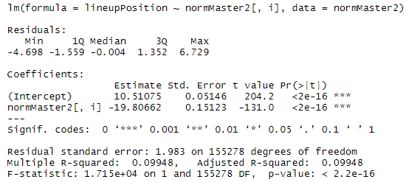
Linear Regression for OBP
From the results of the regression we can conclude that the OBP has a negative relationship with lineup position because the p-value for that coefficient is very small (meaning that as OBP increases, lineup position decreases). However, the regression is very weak and only account for ~9% of the error in the data and meaning it is not an adequate model to predict lineup position. However it can be noted that this is a better linear predictor for lineup position than BA.

Slide 18
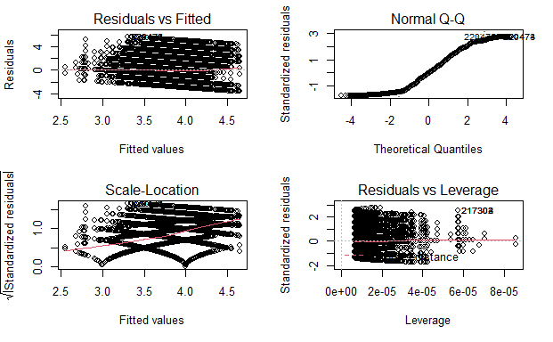
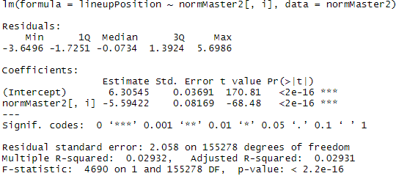
Linear Regression for SLG
From the results of the regression we can conclude that the SLG has a negative relationship with lineup position because the p-value for that coefficient is very small (meaning that as SLG increases, lineup position decreases). However, the regression is very weak and only account for ~3% of the error in the data and meaning it is not an adequate model to predict lineup position. However it can be noted that this is a worse linear predictor than both BA and OBP for lineup position.

Slide 19
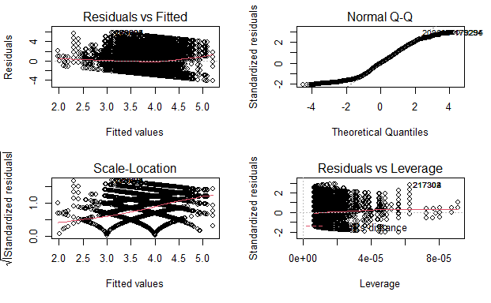
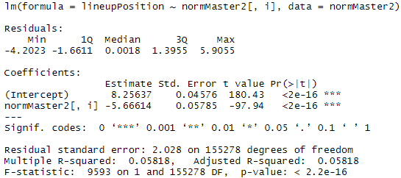
Linear Regression for OPS
From the results of the regression we can conclude that the OPS has a negative relationship with lineup position because the p-value for that coefficient is very small (meaning that as OPS increases, lineup position decreases). However, the regression is very weak and only account for ~3% of the error in the data and meaning it is not an adequate model to predict lineup position. However it can be noted that this is a worse linear predictor than both BA and OBP for lineup position but a better linear predictor than SLG.

Slide 20
Linear Regression Conclusions
None of the variables have a strong linear relationship
  Relationship takes some other shape, not completely linear which is also observable on the residual plots for each of the linear regressions that show a pattern meaning the linear model is not sound.
All of the variables have a negative relationship with lineup position.
  Intuitively, this makes sense as better hitters will generally have higher rates across all these statistics meaning it would make sense according to basic conventional wisdom that these hitters would be placed earlier in the lineup.
OBP has the strongest linear relationship with lineup position out of the variables examined.
  This is an interesting result because OPS is generally considered to be the better overall measure of a hitter.
  However, this still makes intuitive sense as favoring players with higher OBP earlier in the lineup means that your hitters will generally get to hit more as higher OBP means a lower chance to get out in any plate appearance.

Slide 21
Multiple Regression
While looking at multiple regression models we need to consider interaction effects due to the strong covariance/collinearity between variables in the dataset
This means that for any multiple regression that is calculated, the p-values for each of the coefficients will not correctly indicate statistical significance due to the level of collinearity
This means that the primary way to evaluate the model is on the overall value for r-squared.

Slide 22
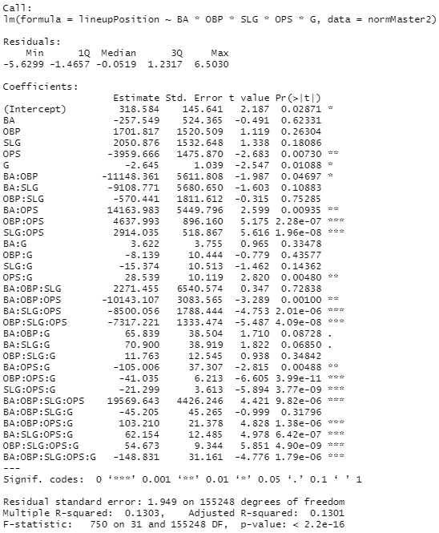
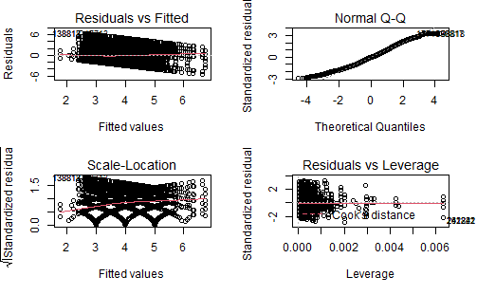
Multiple Regression Results
NOTE: The p-values for the coefficients and overall model need to be evalued with scrutiny due to collinearity in the data

Slide 23
Multiple Regression Conclusions
Even when accounting for the interaction effects a linear regression model does not work
  The residual plot shows a pattern meaning the model is not sound.
The multiple r-squared value indicates that this model only accounts for 12% of the variation in the data.
  This means that even though the p-values indicates significance, which may also be inaccurate due to collinearity in the data, the model is not good because it only accounts for a small portion of the overall variation meaning it does not predict or explain the data well.
More advanced regression techniques could lead to a sound model,
By an ordinary least square regression method, even when accounting for interaction, a regression model to predict lineup position based on hitting statistics does not work.

Slide 24
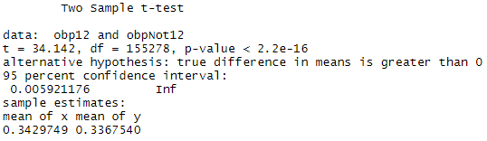
T-Test 1
Comparing the OBP of the 1st and 2nd batters to the rest to investigate the claim that the 1st and 2nd batters should be the team’s high on-base batters
Null Hypothesis: The true mean OBP of the 1st and 2nd batters is the same as the OBP of the rest of the lineup.
Alternative Hypothesis: The true mean of OBP for the 1st and 2nd batters is greater than the OBP of the rest of the lineup.
With an extremely low p-value, we reject the null hypothesis and conclude that the true mean of OBP for the 1st and 2nd batters is greater than the OBP of the rest of the lineup showing that these are a team’s best on base batters
Notes:
Explain null vs alternative for just this one
Why T vs Z, functionally same in the same in this case due to very high df

Slide 25
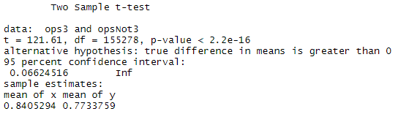
T-Test 2
Comparing the OPS of the 3rd batter to the rest to investigate the claim that the 3rd batter should be the best overall batter
Null Hypothesis: The true mean OPS of the 3rd batter is the same as the OPS of the rest of the lineup.
Alternative Hypothesis: The true mean of OPS of the 3rd batter is greater than the OPS of the rest of the lineup.
With an extremely low p-value, we reject the null hypothesis and conclude that the true mean of OPS of the 3rd batter is greater than the OPS of the rest of the lineup showing that this is a team’s best overall batter

Slide 26
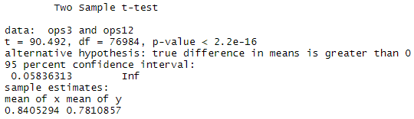
T-Test 3
Comparing the OPS of the 3rd batter to the 1st and 2nd batters to investigate the claim that the 3rd batter should be the best overall batter, while accounting for the fact that the 4 through 9 hitters will be probably be worse overall (negative relationship for lineup position with OPS) compared to the first half of the lineup.
Null Hypothesis: The true mean OPS of the 1st and 2nd batters is the same as the OPS of the 3rd batter.
Alternative Hypothesis: The true mean of OPS for the 1st and 2nd batters is less than the OPS of the 3rd batter.
With an extremely low p-value, we reject the null hypothesis and conclude that the true mean of OPS for the 1st and 2nd batters is less than the OPS of the 3rd batter showing that this is a team’s best overall batter

Slide 27
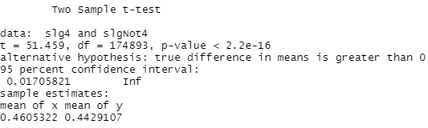
T-Test 4
Comparing the SLG of the 4th and 5th batters to the rest to investigate the claim that the 4th and 5th batters should be the team’s best power hitters
Null Hypothesis: The true mean SLG of the 4th and 5th batters is the same as the SLG of the rest of the lineup.
Alternative Hypothesis: The true mean of SLG for the 4th and 5th batters is greater than the SLG of the rest of the lineup.
With an extremely low p-value, we reject the null hypothesis and conclude that the true mean of SLG for the 4th and 5th batters is greater than the SLG of the rest of the lineup showing that these are a team’s best power batters

Slide 28
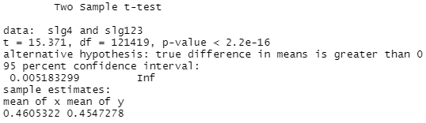
T-Test 5
T-test 5: Comparing the SLG of the 4th and 5th batters to the 1st, 2nd, and 3rd batters to investigate the claim that the 4st and 5th batters should be the team’s best power hitters, while accounting for the fact that the 6 through 9 hitters will be worse overall (negative relationship for lineup position with SLG) compared to the first half of the lineup.
Null Hypothesis: The true mean SLG of the 4th and 5th batters is the same as the OPS of the 1,2, and 3 batters.
Alternative Hypothesis: The true mean of SLG for the 4th and 5th batters is greater than the OPS of the 1st,2nd, and 3rd batters.
With an extremely low p-value, we reject the null hypothesis and conclude that the true mean of SLG for the 4th and 5th batters is greater than the SLG of the 1st,2nd, and 3rd batters showing that these are a team’s best power batters

Slide 29
Conclusions
Data was not completely normal but sound enough for ANOVA and regression
ANOVA showed that lineup position was not independent from batting statistics
Simple Linear Regression for each of the explanatory variables showed a negative relationship but not a strongly linear relationship
Simple linear and multiple regression did not create models that were good at predicting lineup position based on the statistics
  Best Subsets and Stepwise regression techniques did not improve this even when accounting for all interaction effects
Used t-tests to investigate each of the claims about conventional wisdom for baseball lineups
All t-tests yielded results that indicated the conventional wisdom was still being used in the MLB

Slide 30
Final Conclusions
Going back to our initial question, from our ANOVA, t-tests, and regression analysis, we can conclude that that conventional wisdom, with on-base batters 1st and 2nd, the best hitter 3rd, and power hitters 4th and 5th is still used by MLB managers to construct their lineups today.
Our ANOVA revealed that there are differences in batting statistics between the lineup positions, while the simple linear regression, along with the 5 t-tests revealed the direction of the differences.
Since the OBP of the 1 and 2 batters is greater than the rest, we can conclude they are the on-base batters. Since the OPS of the 3 batter is greater than the rest, we can conclude that they are the best overall batter. Finally, since the SLG of the 4 and 5 batters is greater than the rest, we can conclude that they are the power batters.

Slide 31
Limitations
There were a lot of technical limitations in our project
  Calculating splits for a specified time frame before each game would require a lot of compute power even if only one year were considered
  Merging the two datasets for the data about hitting splits and game logs caused some amount of loss of data.
  There are a number of difficulties in calculating a regression model while accounting for a lot of interaction effects especially over such a large dataset
  We initially wanted to look at composite statistics like WAR and OPS+ but computing these for each of the splits posed technical problems
Sampling from the data could be used to get around some of these problems but could cause problems due to the limited normality the dataset and number of outliers
Querying data in a better from the databases could also have helped by making the data cleaning process simpler

Slide 32
Future Work
We could investigate how hitting splits for 1 or 2 weeks before a game impact lineup construction, instead of the whole season before
  This would give more accurate results accounting for what hitters are hot and cold
  Might give even more significant results
We could investigate the same relationship using composite stats, such as OPS+, WRC+, or ISO, that have complex formulas and where league average is 100
  This could give us more normal data and more accurate results, because of the accurate formulas
We could see how lineup construction has changed over time using different eras instead of just 2012-2019
  Use t-tests to compare the statistics of different lineup positions over different eras
The use of more complex or advanced regression models could help us reach our final goal of truly optimizing a lineup
  Classification or regression tree models
  Markov Chains

Slide 33
References
Data Sources:
Baseball Reference - MLB Stats, Scores, History, & Records | Baseball-Reference.com
Fangraphs - FanGraphs Baseball | Baseball Statistics and Analysis
Baseball R - Acquiring and Analyzing Baseball Data • baseballr (billpetti.github.io)
Background Sources:
https://bleacherreport.com/articles/1619689-the-anatomy-of-a-perfect-major-league-lineup
https://www.beyondtheboxscore.com/2009/3/17/795946/optimizing-your-lineup-by
https://www.drivelinebaseball.com/2020/02/seqnzr-simulation-lineup-optimizaton/
https://www2.isye.gatech.edu/~jsokol/boouu.pdf
https://www.overtimeheroics.net/2022/05/31/the-mathematically-optimal-batting-order/
https://digitalrepository.unm.edu/cgi/viewcontent.cgi?article=1082&context=educ_hess_etds

