Slide 1
UR SUSS
Carter, Cheryl, Chloe, George, Miles

Slide 2
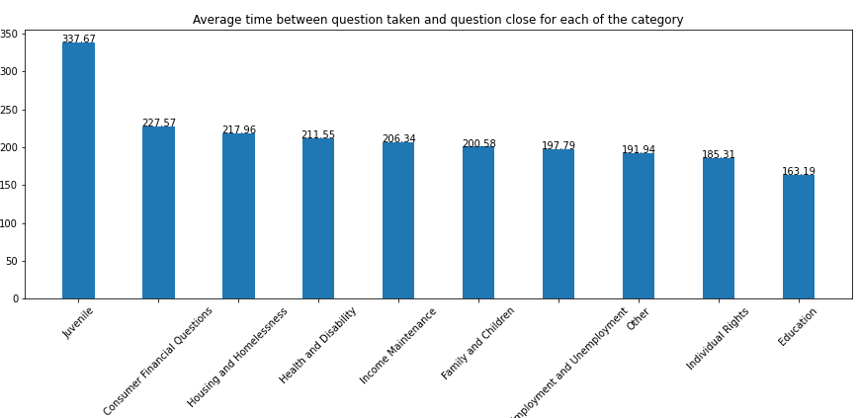
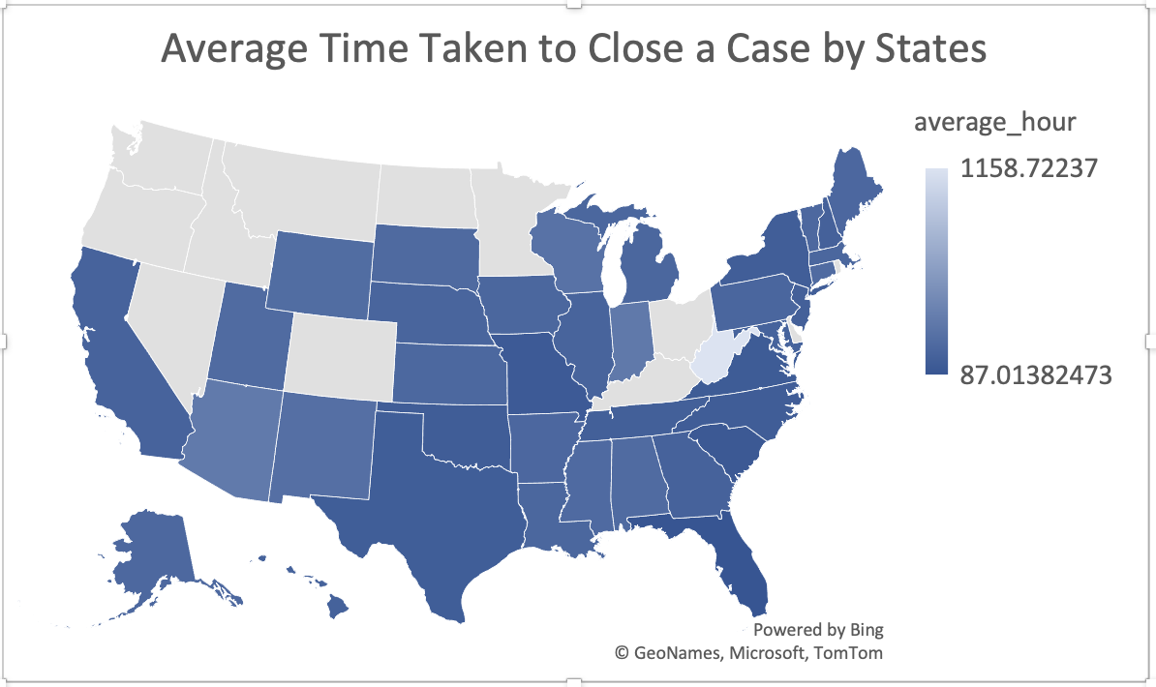
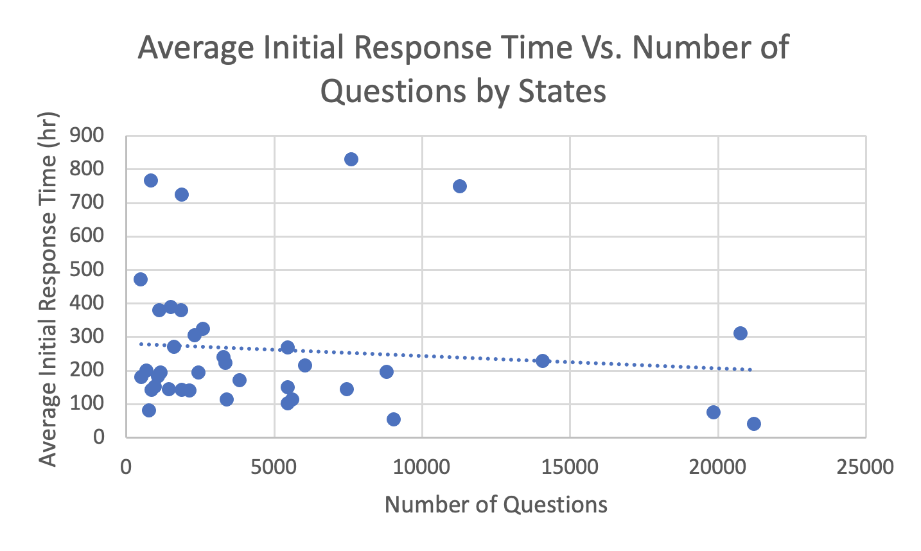
EDA
Comparison of efficiency between states and identifying areas for improvement
Analyzed response times by category to prioritize cases and allocate resources effectively
More efficiency with increased number of questions since there is a slightly downward trend

Slide 3
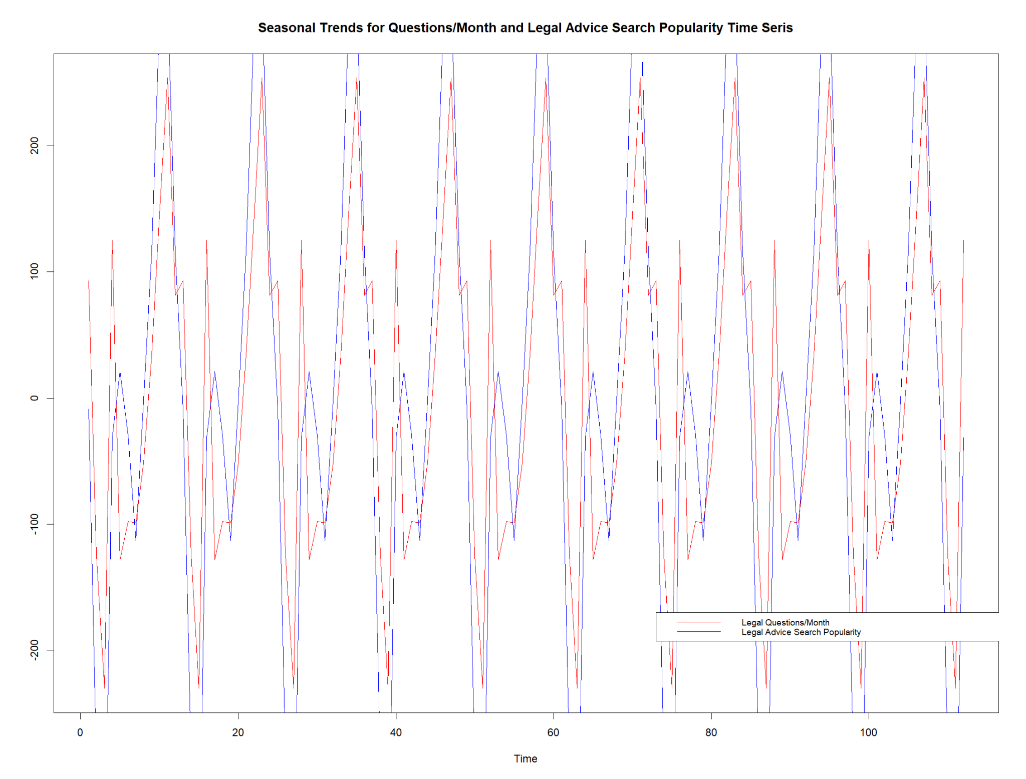
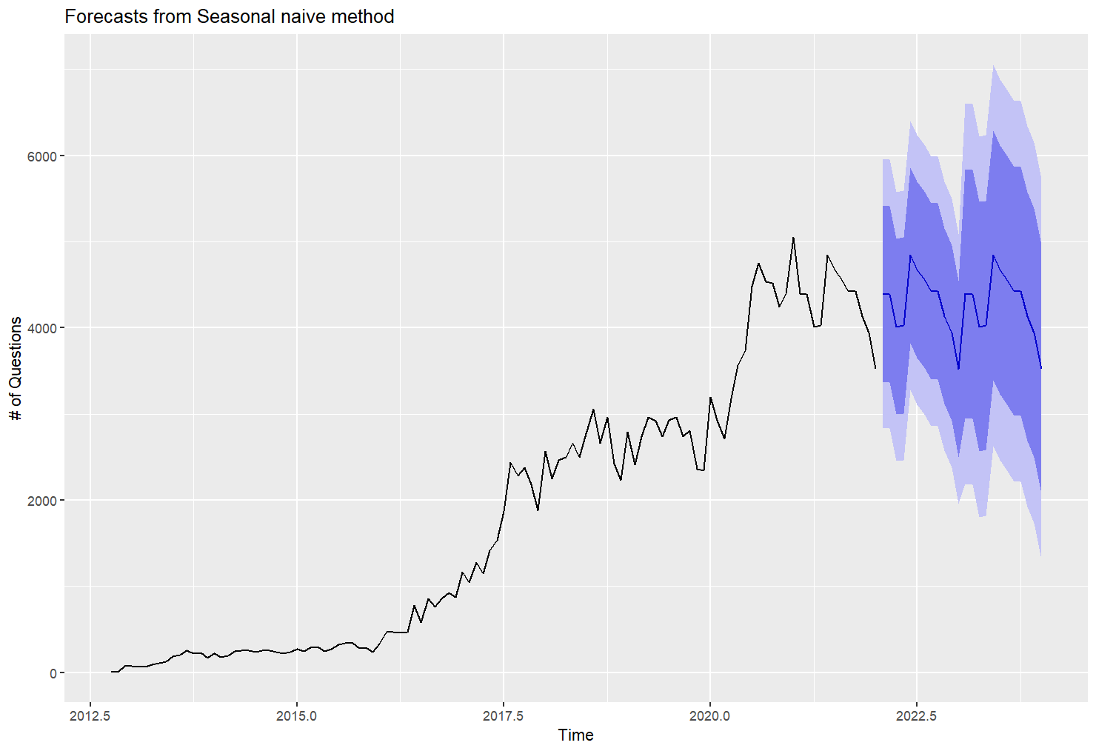
Time Series Analysis - Seasonal Trends & Forecast
Monthly Questions align with Legal Advice Search Seasonal Trends
Statistically Significant Forecasting Model - mostly sound

Slide 4
Findings
Exploratory Data Analysis
identifies areas for improvement in ensuring timely and effective legal assistance for clients.
Measuring the efficiency of free lawyer consulting services across different states and identifying areas for improvements is important to reduce response times and increase case resolution speed.
Average initial response time and time taken to close a case are important metrics to compare the efficiency of free lawyer consulting services in each state.
Analyzing response times by category helps identify areas where more resources may be needed or certain cases need prioritizing.
Time Series Analysis
Analyzing data as a time series is important to predict the growth of the platform and plan for logistical and staffing needs.
Time series analysis demonstrates the importance of analyzing trends in the volume of questions asked over time.
Data-driven approach is important to better understand and address the legal needs of underserved communities.

