Slide 1
Simulation Study of MWW Rank Sum Test
George Daher

Slide 2
Testing Center: Welch t-test
Many ways to test center between 2 data sets
Parametric Method: Welch’s t test
Assumptions:
  Identically Independently Distributed
  Equal Variance
  Approximately Normal
Parametric Assumption = Approximate Normality
Can be difficult to uphold

Slide 3
Testing Center: MWW test
Nonparametric Method: Wilcoxon Rank Sum Test
Assumptions:
  Identically Independently Distributed Data
  Equal Variance
Equal variance assumption easier to satisfy & check then normality
Can “enforce” equal variance through data transformation
However equal variance still must be checked
Test for Dispersion
  Ansari-Bradley Test
  Miller’s Jackknife
  Lepage *

Slide 4
Goal: Check Wilcoxon Test Performance when Equal Variance Assumption Violated
Subtitle

Slide 5
Simulation Setup: Distributions
Only small number parametric methods to choose from,
Use normal distribution as baseline
Many non-parametric distributions to choose from, need to choose diverse group
Look at Kurtosis and Symmetry
Specific shapes can vary but kurtosis and symmetry most important values t conservative
Chose Normal, Uniform - lower kurtosis, laplace – high kurtosis as symmetric distributions
Chose Chi-Square (df =1) - skewed and high kurtosis, Exponential (rate =1) - skewed and moderate high kurtosis, Lognormal – highly skewed and very high kurtosis

Slide 6
Simulation Setup: Variables
Many variables could have effect on result
Most notably, true shift in center, standard deviation ratio (SDR), sample size ratio
Need to decide levels to vary this at
  Did some small preliminary simulations
Decide to vary SDR from 1, 1.25, 1.5 to 2
Vary true shift in center from 0, 0.5, 1 standard deviations
Sample ratio, ½ , 1, 2 (ratio of sample size of smaller var sample to larger)
Also need to decide how iteration each simulation should be run

Slide 7
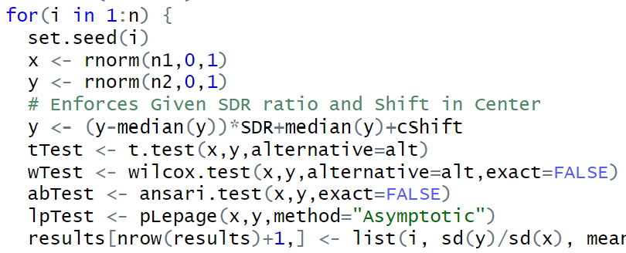
Simulation Method
Draw 2 samples from the same distribution
Enforce specified standard deviation ratio and shift in the center
  This is the same as if the distribution was adjusted before the sample was taken, but this is easier to implement
Run Tests and store test results
Repeat

Slide 8
Analysis Methods
Examine p-value distribution for each simulation under null condition
Expect uniform distribution because should have probability p that test yields p-value
Type 1 error distribution
Any deviation from this uniform distribution will mean a change in type 1 error rate
Implies change in Power Rate

Slide 9
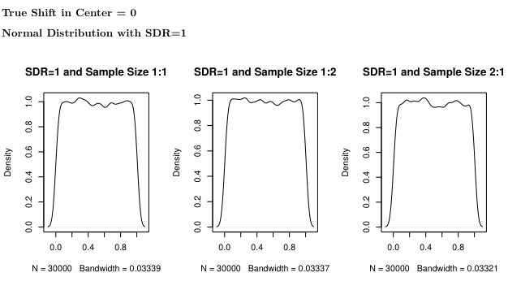

Slide 10
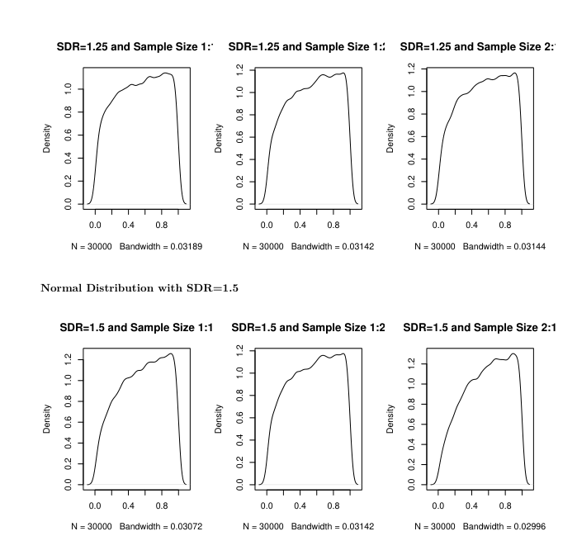

Slide 11
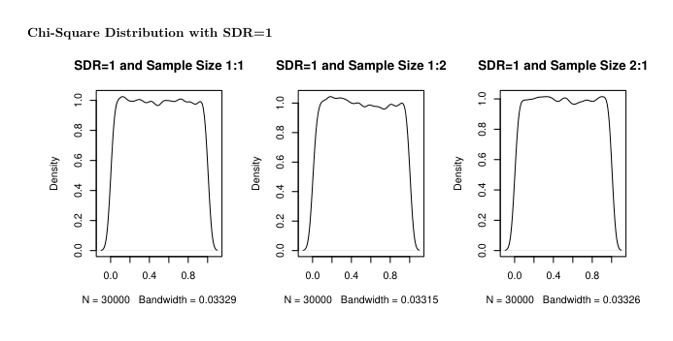

Slide 12
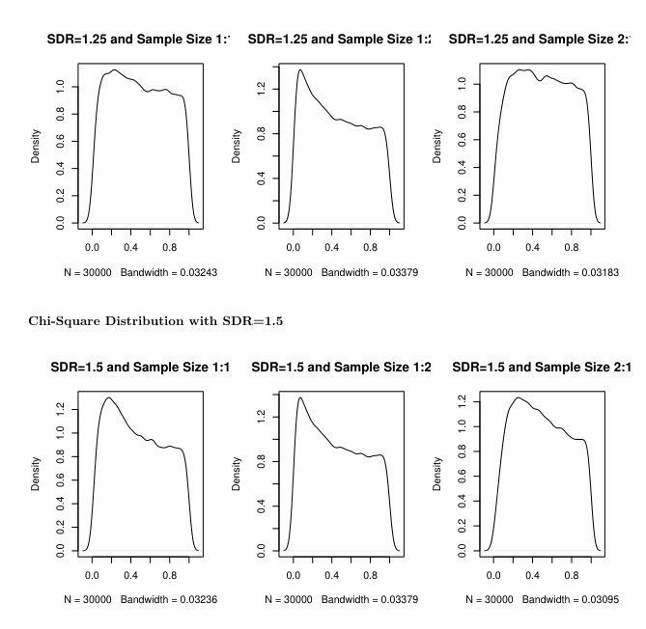

Slide 13
Results
The distribution of the p-value becomes non-uniform
Implies the test is behaving “weirdly”
From observation: symmetric distributions have left-skewed p-values
Asymmetric distributions have right-skewed p-values
Left-skewed : implies that observed p-value are higher than actual p-value
Right-skewed: implies observed p-values are lower than actual p-value
Need to consider p-values to observe behavior more clearly

Slide 14
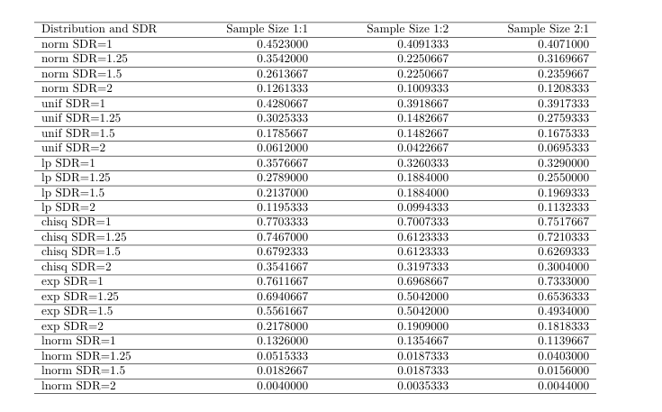
Power Calculations
Can calculated simulated power of teset by counting number of observations for which null hypothesis was correctly rejected for various levels of location shift
Results show that power of the test decreases as SDR increases from 1 to 1.25, 1.5, 2
We can also see that the sample size ratio has a minimal affect on the power of the test

Slide 15
Comparing t-test and Wilcoxon test

Slide 16
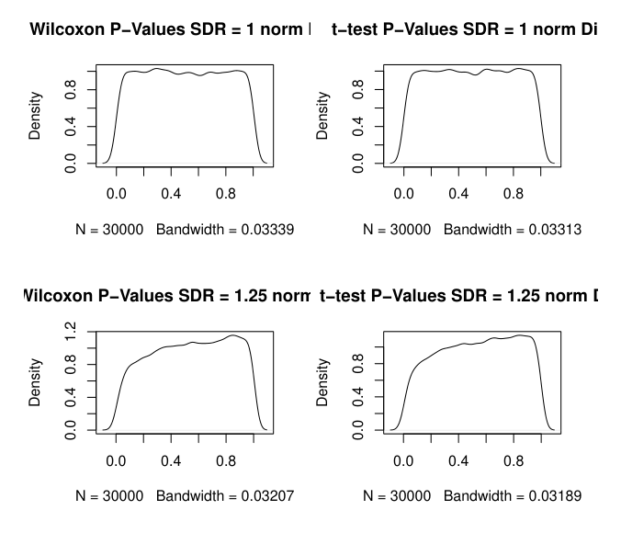
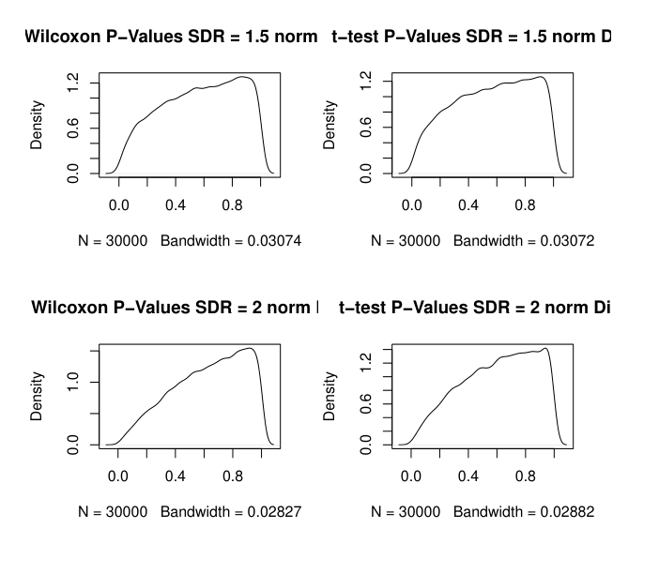
Comparing t-Test vs Wilcoxon – Normal Distribution

Slide 17
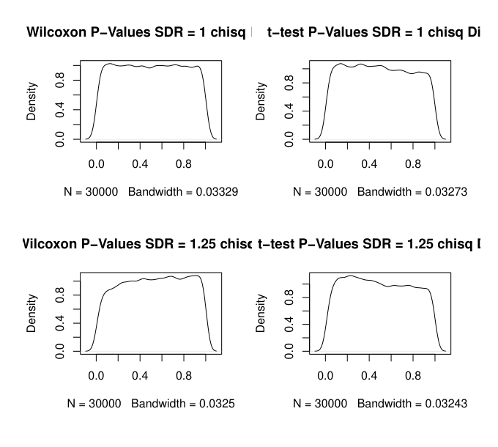
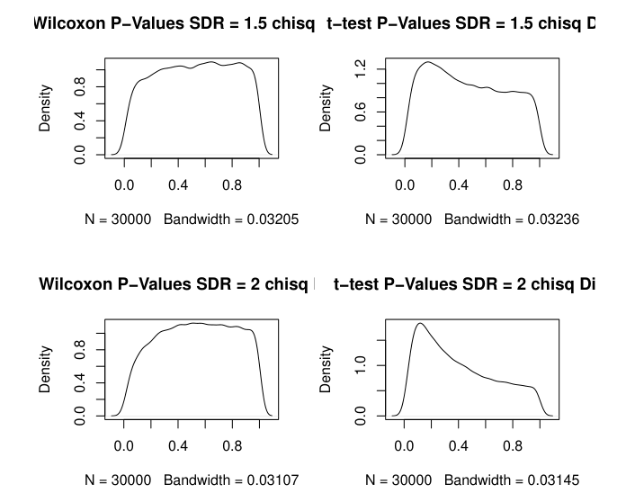
Comparing t-Test vs Wilcoxon – Chi-Square Distribution

Slide 18
Remarks on t-test vs Wilcoxon
In the symmetric case, the performance of tests is very similar
Intuition makes sense because tests of the center using mean and median respectively
In symmetric distributions mean = median
Even for the non-normal symmetric distributions used, t-test works decently well because sample sizes not too small

Slide 19
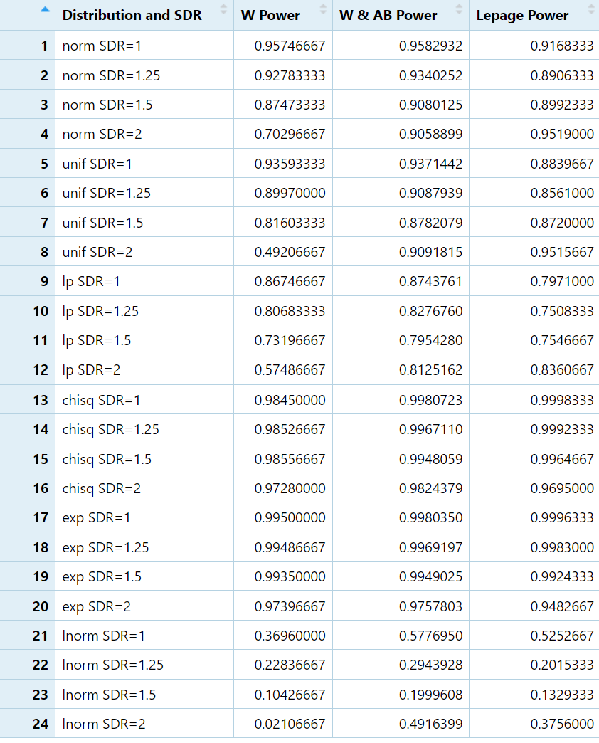
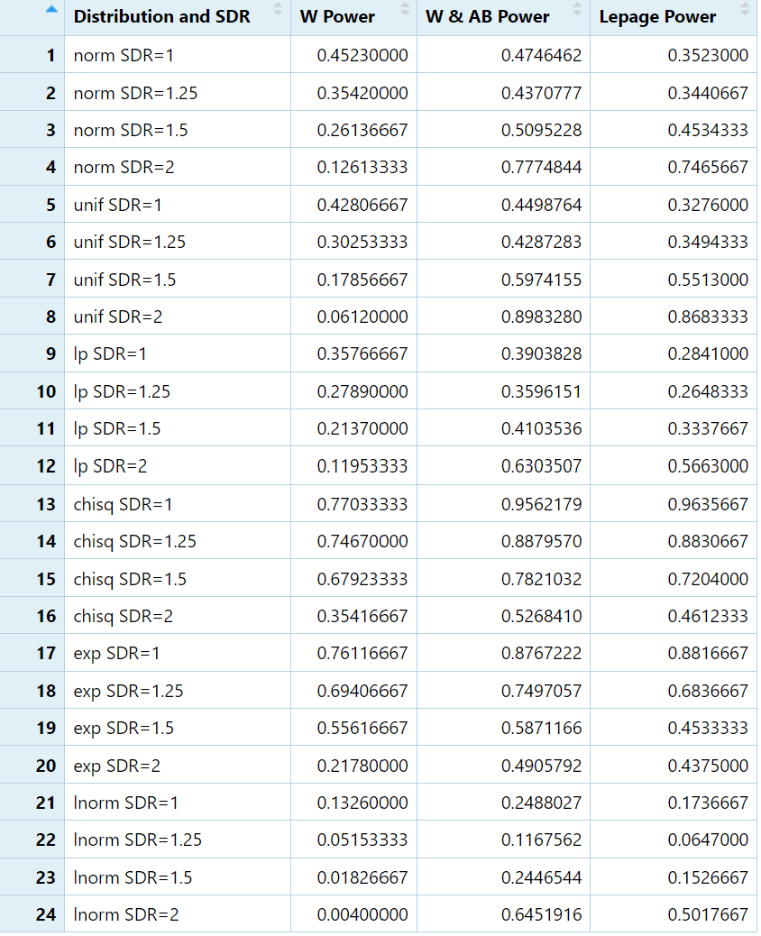
Power of Procedures Compared
LHS is true shift in center equal to 0.5, RHS is true shift in center equal to 1

Slide 20
Conclusions
Wilcoxon Rank Sum test power is mostly preserved for SDR up to 1.25
Distribution of p-values is right/left skewed depending on the behavior of the underlying distribution
  Cannot predict/correct this without underlying knowledge
Under the true null hypothesis, the performance of p-values for the t-test and Wilcoxon test are very similar for symmetric distributions
For asymmetric distributions, the Wilcoxon test is more robust
As the variance between the data sets becomes more unequal, Wilcoxon loses power
  The comparative performance between Ansari Bradley and Wilcoxon vs Lepage

Slide 21
Thank You

