Slide 1
Mixed Models and Imputation: Tackling the DataFest Dataset
George Daher, Daniel Illera and Isabella Wang

Slide 2
Introduction
Data for DataFest was from CourseKata - an online textbook service
Data collected included page views, media views, pre-chapter self-assessments and post-chapter review questions
Data ranged across chapters from a number of textbooks for students at various institutions

Slide 3

“Our longer-term agenda is to make research on teaching and learning more relevant and more effective for improving important learning outcomes for all students.”

Slide 4
Goal
Evaluate CourseKata success at “improving learning outcomes”
Need metric of success to evaluate
Potential Metrics within the Data:
  Engagement Time with Textbook Chapter
  End of Chapter Assessment (EOC) proportion of questions correct
  Self-Reported “Pulse Metrics” - Expectancy (Self-Confidence in Material) and others

Slide 5
Choosing a Metric of Success
No context given for use of textbook within classes or institutions
Engagement:
  Low Engagement could mean understanding or apathy
  Time varied by pacing of course - better predictor than response
EOC:
  Negative Relationship with Chapter Number - Possible indicator of difficulty
  Prior studies show assessments are good predictors of success
Notes:
Engagement - May be predictor of performance
Context Missing on role of Textbook in Course
Idle time measurement flawed - closing page vs idling
Low Engagement could mean understood or apathy
EOC - Flawed by construction, trends indicate confounding effects present
Unlimited attempts, so need to account for number of attempts
Questions differ from chapter to chapter, EOC negative relationship with chapter #
# of attempts mostly consistent across chapters - EOC more of difficulty metric
Want consistent scale across chapters to be able to compare
Pulse Metrics left be looked at - cost and expectancy
Expectancy - Self-Confidence in Information Learned
Cost - “I did not have enough time to be able to understand the material well”
Cost vs Expectancy - Preferred Expectancy
Ambiguity in question of cost
Dependency Structure with all Pulse metrics - related
Expectancy is self-reported confidence in material learned
Analysis was to look at trends, missingness, imputation and modeling for expectancy

Slide 6
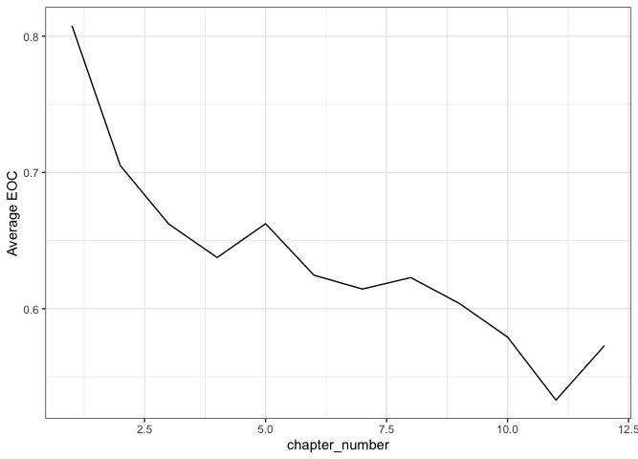

Slide 7
Choosing a Metric of Success
No context given for use of textbook within classes or institutions
Engagement:
  Low Engagement could mean understanding or apathy
  Time varied by pacing of course - better predictor than response
EOC:
  Negative Relationship with Chapter Number - Possible indicator of difficulty
  Prior studies show assessments are good predictors of success
  With unlimited attempts this is different, strength as predictor not sure
Decide to use as predictors rather than success metrics
Notes:
Engagement - May be predictor of performance
Context Missing on role of Textbook in Course
Idle time measurement flawed - closing page vs idling
Low Engagement could mean understood or apathy
EOC - Flawed by construction, trends indicate confounding effects present
Unlimited attempts, so need to account for number of attempts
Questions differ from chapter to chapter, EOC negative relationship with chapter #
# of attempts mostly consistent across chapters - EOC more of difficulty metric
Want consistent scale across chapters to be able to compare
Pulse Metrics left be looked at - cost and expectancy
Expectancy - Self-Confidence in Information Learned
Cost - “I did not have enough time to be able to understand the material well”
Cost vs Expectancy - Preferred Expectancy
Ambiguity in question of cost
Dependency Structure with all Pulse metrics - related
Expectancy is self-reported confidence in material learned
Analysis was to look at trends, missingness, imputation and modeling for expectancy

Slide 8
Selected Metric: Expectancy
Expectancy (Self-Confidence in Material) - reported by students at start of each next chapter
Outside sources show self-prediction is a good predictor for academic success
  ”significantly related to their semester-wide GPA” (Gadzella et al, 1976)
  ”better predictor than standardized test or high school GPA” (Keefer, 1969)
Focused our analysis using Expectancy as a Response

Slide 9
Sources of Variation
Institution Level
Classroom Level
Heterogeneity from students

Slide 10
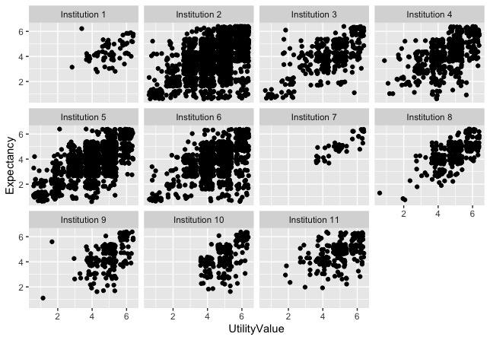

Slide 11
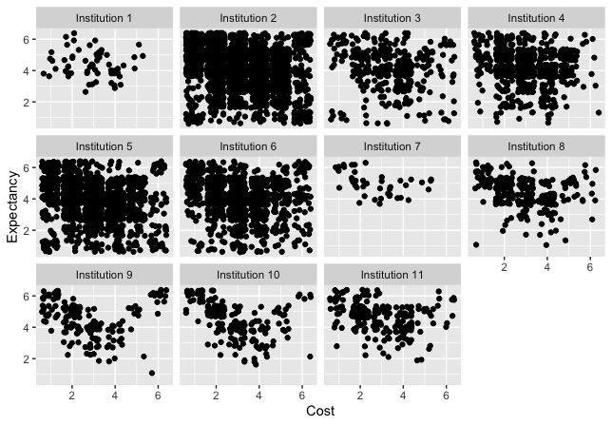

Slide 12
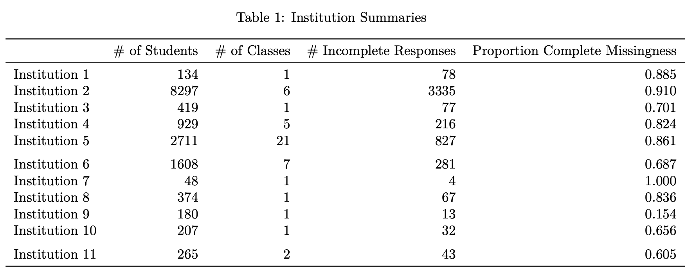

Slide 13
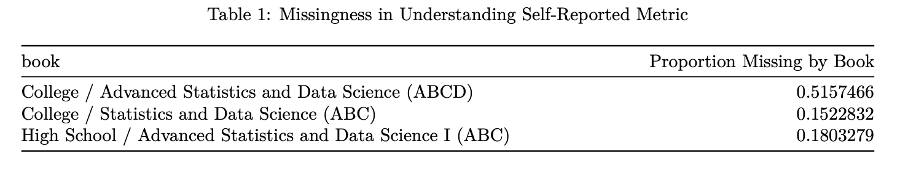
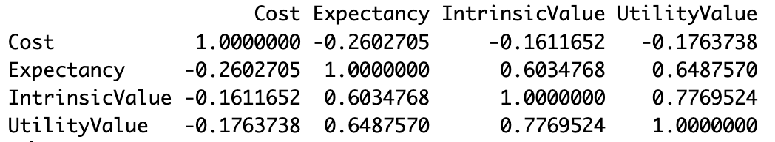
The Missingness
Missingness could be associated with multilevel structure indicating MAR.
Even if the missingness is in fact MCAR, the correlation we observe would make it easy to impute.
Table : Imputed Correlations of the Entire Dataset

Slide 14
Methods
Cumulative Logit Mixed Model:
  Response: Expectancy
  Covariates: Utility Value, Cost, EOC, and Minutes Engaged.
  Chapter Number used as “time”
  Coefficients show multiplicative increase of Odds with a one unit increase.
  Models clustering dependency structure.
Multiple Imputation
  Predictive Mean Matching:
    Works for multinomial data
    Preserves Multilevel Structure
Done by Institution

Slide 15
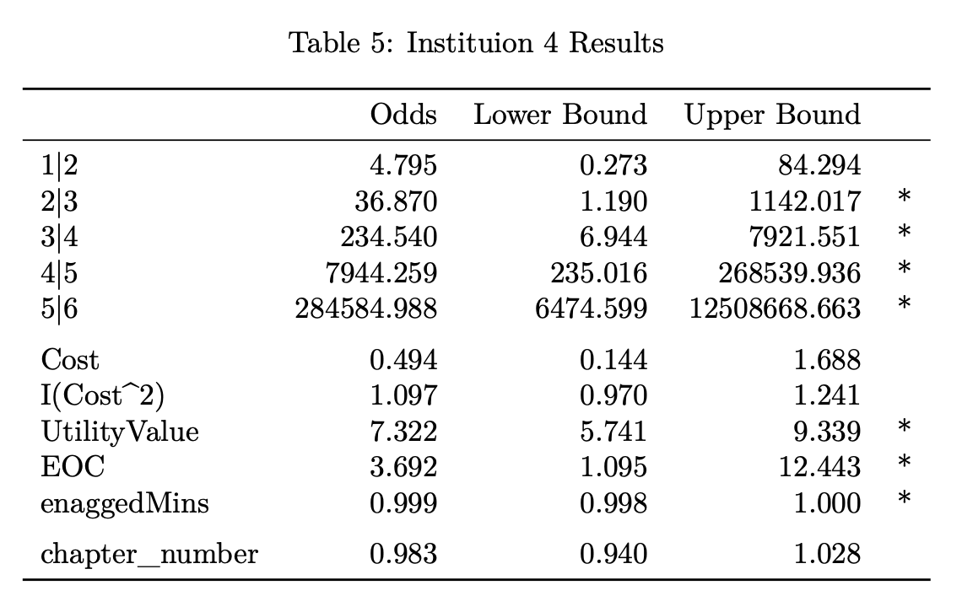
Findings
Future Work
Total Minutes Engaged per Chapter was not significant for any of the Institutions.
Effect of an increase in Chapter Number is tiny.
An increase in Cost decreases Odds of understanding the material better. Although not always significant.
EOC was significant for some but not all institutions.
Utility Value was significant for all of them.
Better Handling of Censored Data
Factor Analysis of the four survey variables

Slide 16
References
Gadzella, B. M., Cochran, S. W., Parham, L., & Fournet, G. P. (1976). Accuracy and
Differences among Students in Their Predictions of Semester Achievement. The
Journal of Educational Research, 70(2), 75–81. http://www.jstor.org/stable/27536965
Keefer, K. E. (1969). Self-Prediction of Academic Achievement by College Students.
The Journal of Educational Research, 63(2), 53–56.
http://www.jstor.org/stable/27535912
Vink, G., Lazendic, G., & van Buuren, S. (n.d.). Partitioned predictive mean matching as
a multilevel imputation technique. Stefvanbuuren.Name. Retrieved March 24,
2024, from
https://stefvanbuuren.name/publications/2015%20Partitioned%20PMM%20-%20PTAM.pdf

