Slide 1
Capstone Project - The Battle of the Neighborhoods
Applied Data Science Capstone by IBM/Coursera
Made By:Gayatri Dalvi

Slide 2
Introduction: Business Problem
The main aim of this project is to ease peoples choice making of a neighborhood in North York,Toronto.
For ease of accessing to Cafe, School, Colleges, Grocery Shops,Theatre, Hospital etc.
This Project aim to create an analysis of features for a people migrating to North York to search a best neighborhood as a comparative analysis between neighborhoods.
It will help people to get awareness of the area and neighborhood before moving to a city.

Slide 3
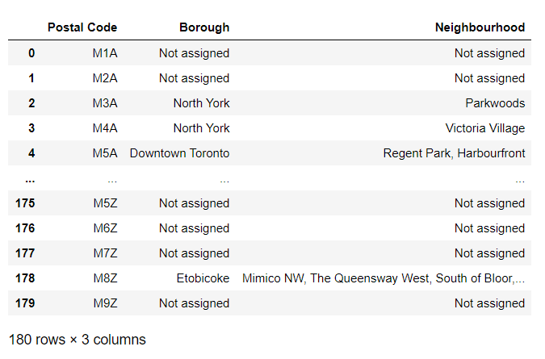
Data Description:
Data Link: https://en.wikipedia.org/wiki/List_of_postal_codes_of_Canada:_M
Web Scraping this data will get PostalCode,Borough,Neighbourhood of North York,Toronto.

Slide 4
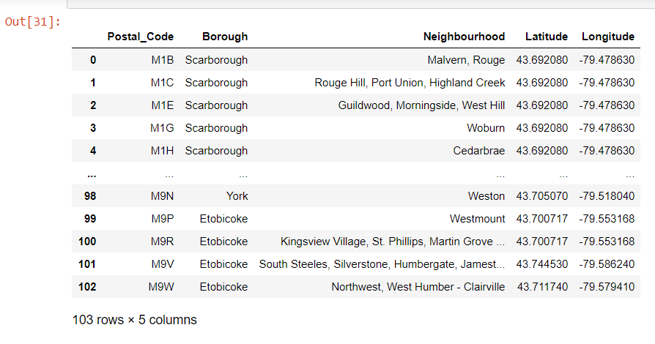
Geocoder
Used Geocoder to retrieve Location Data.

Slide 5
Foursquare API Data:
Foursquare is a location data provider with information about all manner of venues and events within an area of interest.
The data retrieved from
Foursquare contained :
Neighbourhood
Neighbourhood Latitude
Neighbourhood Longitude
Venue
Venue Latitude
Venue Longitude
Venue Category

Slide 6
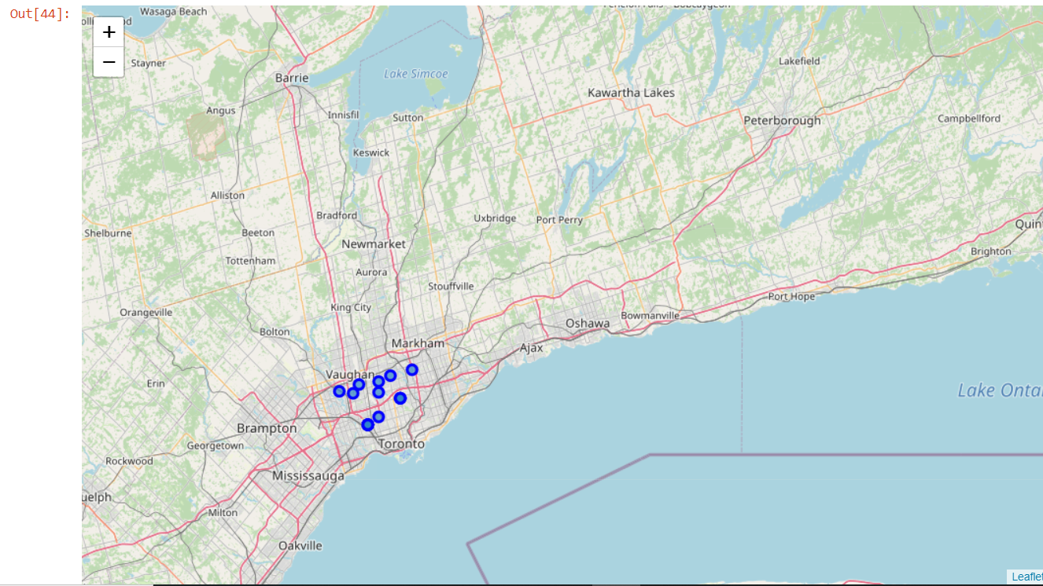
Map of North York,Toronto

Slide 7
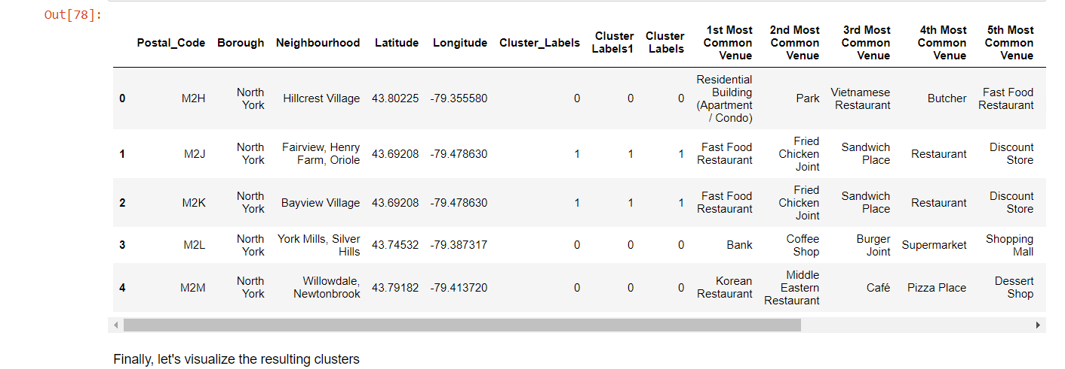
Methodology
Clustering Approach:
Used unsupervised machine learning: k-means clustering algorithm for clustering the data.
Using K-Means Clustering Approach

Slide 8
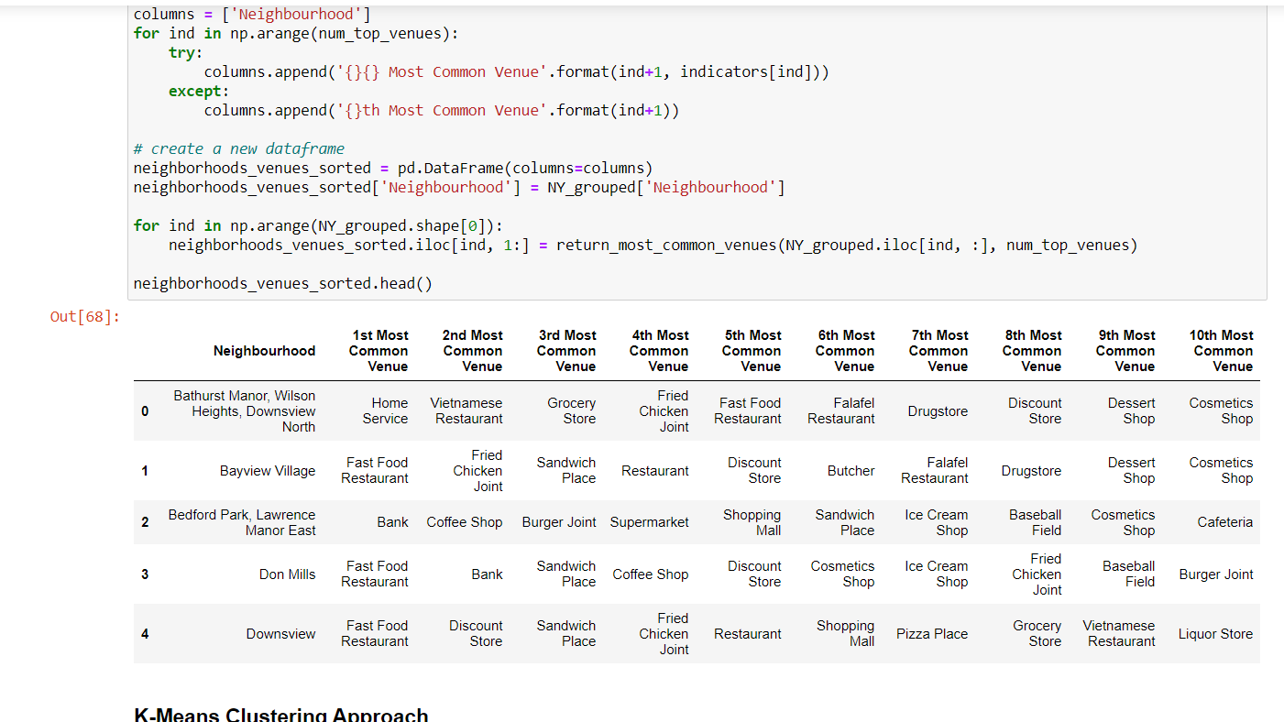

Slide 9
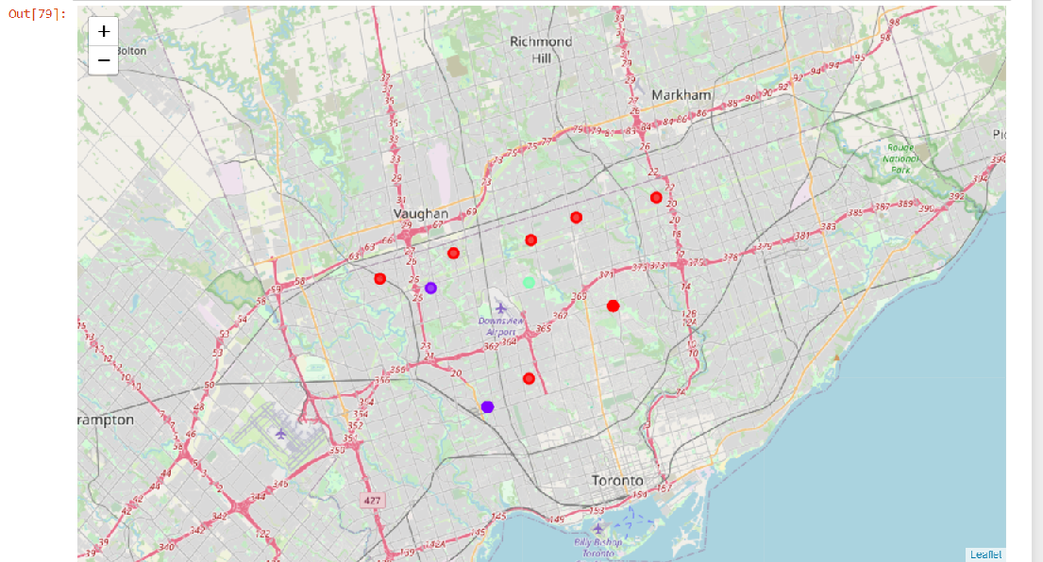
Results
Map of Clusters in North York

Slide 10
Problems Tried to solve:
The challenge to resolve is being able to find better neighborhood in a new city for the person who are shiffting there.
Close acessibility to Markets, School, Airport, like minded people in the neighborhood.

Slide 11
Libraries Which are Used to Develope the Project:
Pandas: For creating and manipulating dataframes.
Folium: Python visualization library would be used to visualize the neighborhoods cluster distribution of using interactive leaflet map.
Scikit Learn: For importing k-means clustering.
JSON: Library to handle JSON files.
XML: To separate data from presentation and XML stores data in plain text format.
Geocoder: To retrieve Location Data.
Beautiful Soup and Requests: To scrap and library to handle http requests.
Matplotlib: Python Plotting Module.

Slide 12
Conclusion
Purpose of the project was to identify best neighborhood in North York,Toronto.I narrowed down the search for optimal location for hotel,school,malls etc.I used Foursquare data for searching nearby venues.Using K-means clustring algorithm I separated the neighborhood into different clusters and top 10 venues for each neighborhood.Used geocoder to get the latitude and longitude coordinates of a given postal code.Got 103 different lattitude and logitude for the dataset.

