Slide 1
Hidden Markov Models
Garrett M. Dancik, PhD

Slide 2
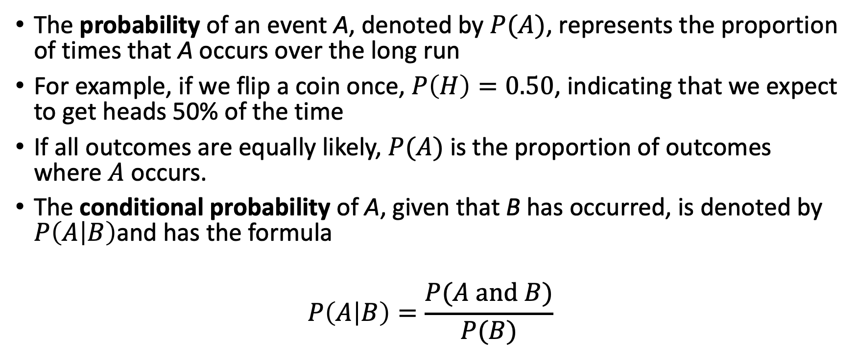
Some definitions
The probability of an event A, denoted by $P(A)$, represents the proportion of times that A occurs over the long run
For example, if we flip a coin once, $P\left(H\right)=0.50$, indicating that we expect to get heads 50% of the time
If all outcomes are equally likely, $P(A)$ is the proportion of outcomes where $A$ occurs.
The conditional probability of A, given that B has occurred, is denoted by $P\left(A | B\right)$and has the formula
$$P\left(A | B\right)=\frac{P(A \text{and} B)}{P(B)}$$

Slide 3
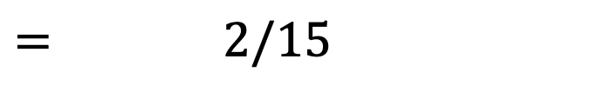
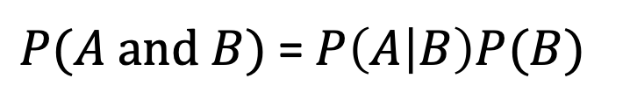
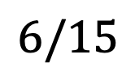

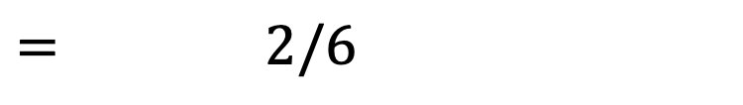
Conditional probability
Class status | M | F | Total
Soph | 4 | 2 | 6
Junior | 3 | 2 | 5
Senior | 3 | 1 | 4
Total | 10 | 5 | 15
From the conditional probability formula, it is true that
Example:
$P(A \text{and} B)$= $P\left(A | B\right)P(B)$
$P\left(Female \text{and} Soph\right)=$ $P\left(Female | Soph\right)P(Soph)$
$= 2/6$
$$×$$
$6/15$
$= 2/15$
This should make sense, as there are 2 female sophomores and 15 total students

Slide 4
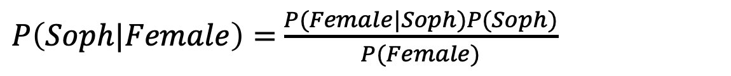
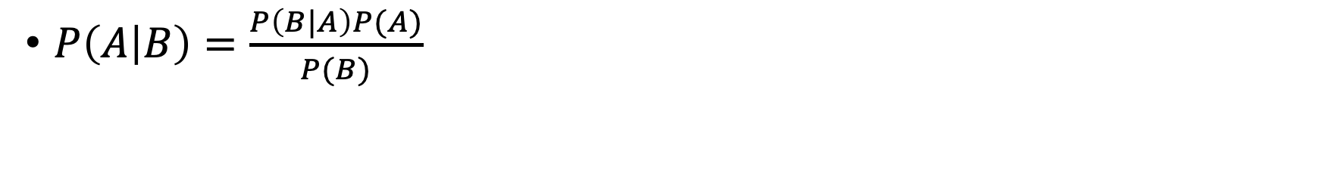
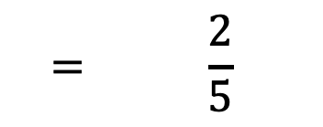
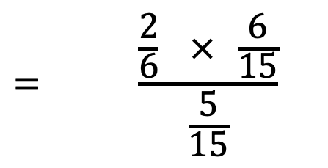
Bayes' Theorem
Class status | M | F | Total
Soph | 4 | 2 | 6
Junior | 3 | 2 | 5
Senior | 3 | 1 | 4
Total | 10 | 5 | 15
$P\left(A | B\right)=\frac{P\left(B|A\right)P(A)}{P(B)}$
$P\left(Soph|Female\right)=$ $\frac{P(Female|Soph)P(Soph)}{P(Female)}$
$$= \frac{\frac{2}{6} × \frac{6}{15}}{\frac{5}{15}}$$
This should make sense, as there are 2 female sophomores and 5 total females
(given the person is female – and there are 5 females – there are 2 sophomores)
$$= \frac{2}{5}$$

Slide 5
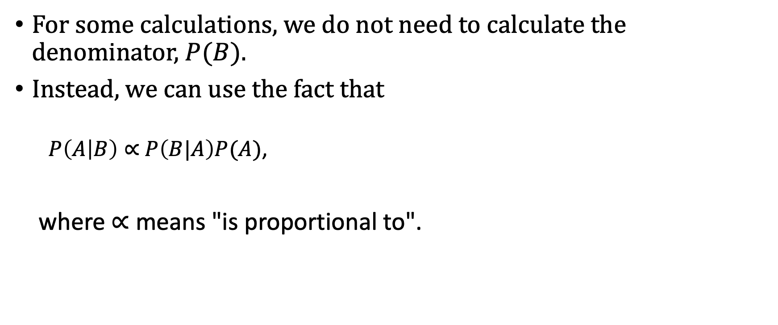
Bayes' Theorem
For some calculations, we do not need to calculate the denominator, $P(B)$.
Instead, we can use the fact that
$P\left(A | B\right)∝$ $P\left(B|A\right)P(A)$,
where $∝$ means "is proportional to".

Slide 6
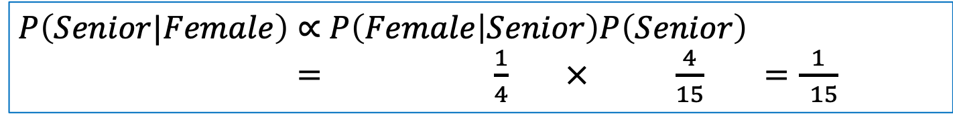
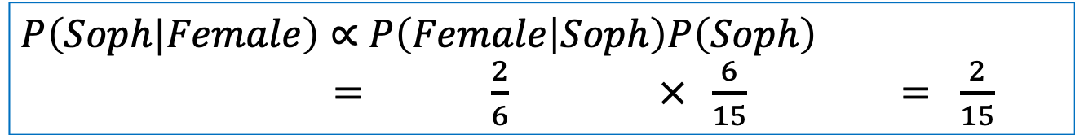
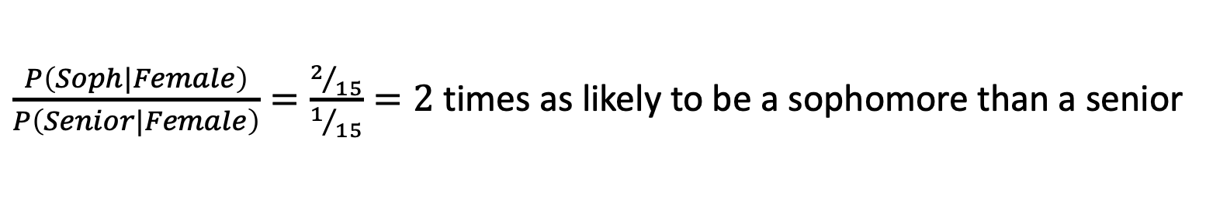
Bayes' Theorem
Class status | M | F | Total
Soph | 4 | 2 | 6
Junior | 3 | 2 | 5
Senior | 3 | 1 | 4
Total | 10 | 5 | 15
A female student is selected. Is the student more likely to be a sophomore or a senior?
$P\left(Soph|Female\right)∝$ $P\left(Female | Soph\right)P\left(Soph\right)$
$=$ $\frac{2}{6} × \frac{6}{15} = \frac{2}{15}$
$P\left(Senior|Female\right)∝$ $P\left(Female | Senior\right)P\left(Senior\right)$
$=$ $\frac{1}{4} × \frac{4}{15} =\frac{1}{ 15}$
Since $P\left(Soph|Female\right)∝\frac{2}{15}$ and $P\left(Senior|Female\right)∝ \frac{1}{15}$ the selected individual is
$\frac{P\left(Soph|Female\right)}{P\left(Senior|Female\right)}=\frac{2/{15}}{1/{15}}=2$ times as likely to be a sophomore than a senior

Slide 7
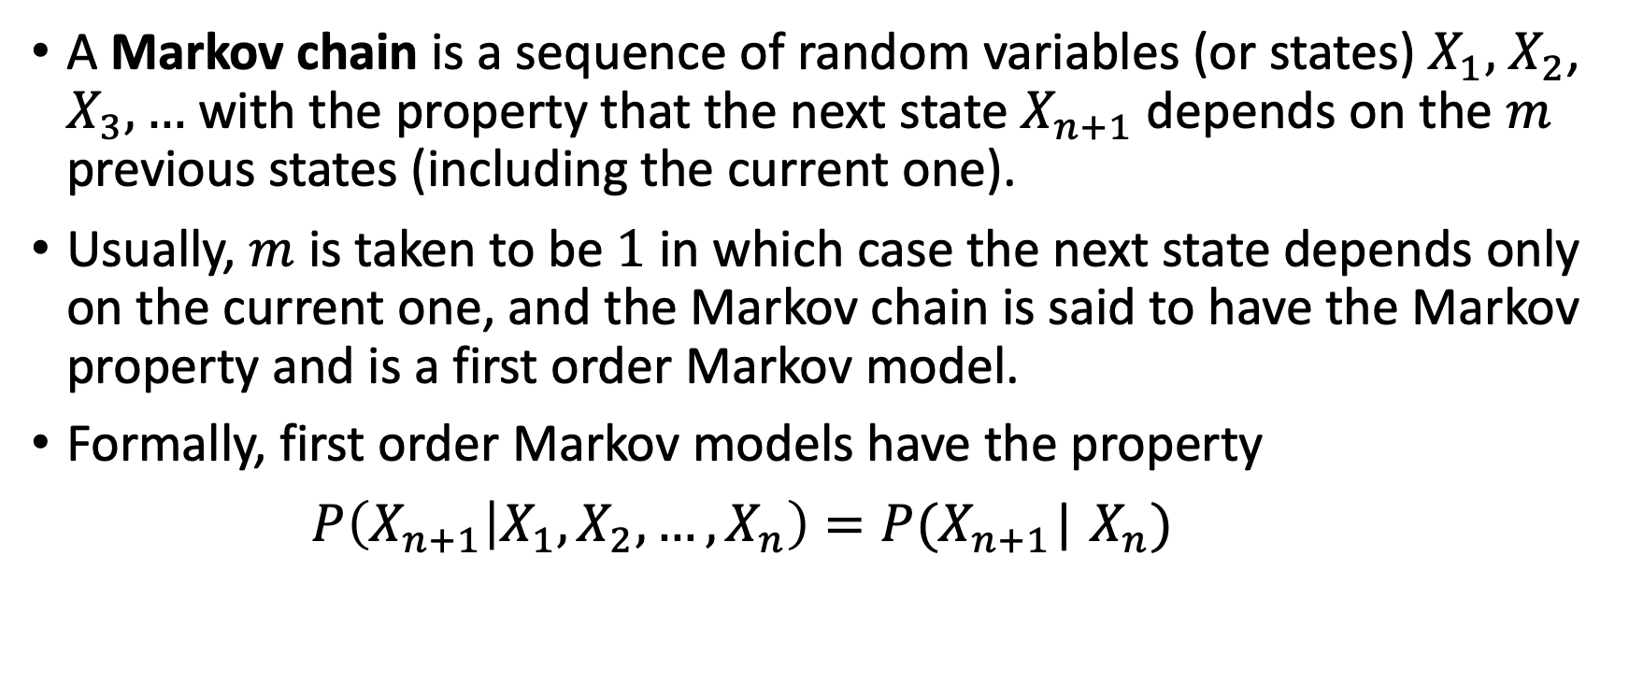
Markov chains
A Markov chain is a sequence of random variables (or states) $X_{1},$ $X_{2}$, $X_{3},…$ with the property that the next state $X_{n+1}$ depends on the $m$ previous states (including the current one).
Usually, $m$ is taken to be $1$ in which case the next state depends only on the current one, and the Markov chain is said to have the Markov property and is a first order Markov model.
Formally, first order Markov models have the property
$P\left(X_{n+1} | X_{1},X_{2},…,X_{n}\right)=P(X_{n+1}$| $X_{n})$

Slide 8
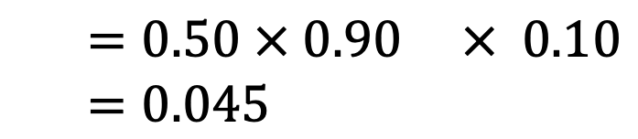
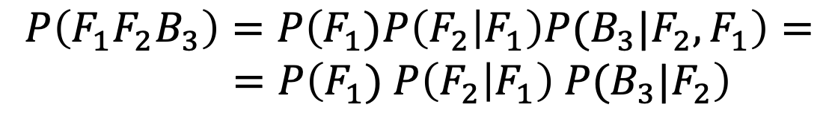
0.9
Example:
An individual has two coins, a fair (F) coin and a biased (B)coin.
Before each coin toss, there is a 10% chance that the individual will switch coins.
Initially, there is a 50% chance the individual selects the fair (or biased) coin.
Find the probability that the selected coins are FFB.
Note that this is a 1st order Markov Chain. The subscript i will be used for the i^{th} selected coin
F
0.50
Start
0.10
0.10
0.50
B
$$P\left(F_{1}F_{2}B_{3}\right)=P\left(F_{1})P\left(F_{2} | F_{1}\right)P(B_{3}|F_{2},F_{1}\right)=$$
$=P\left(F_{1}) P\left(F_{2} | F_{1}\right) P(B_{3}|F_{2}\right)$
(Markov assumption)
$=0.50 × 0.90 × 0.10$
$=0.045$
0.90

Slide 9
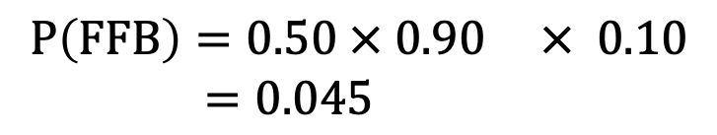
0.9
Find the probability that the selected coins are FFB.
We don't need the fancy notation. Just follow the arrows through the Markov Model and write the corresponding probabilities
F
0.50
State | Start | → F | → F | →B
Prob | -
Start
0.10
0.10
0.50
0.90
0.10
0.50
B
Now multiply the probabilities together to get the probability of the state (e.g., FFB)
$$P\left(FFB\right)=0.50 × 0.90 × 0.10$$
$=0.045$
0.90

Slide 10

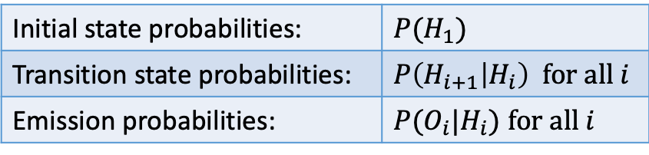

Hidden Markov models
A Hidden Markov model (HMM) is a Markov chain where the states are hidden (unobserved)
Hidden states emit observed values with certain probabilities.
The hidden states can then be deduced based on the observed values.
General HMM notation:
0.9
F
H 0.50
T 0.50
0.50
Start
0.10
0.10
$$\text{Observed} \text{states}\text{:} O_{1},O_{2}, …O_{n}$$
0.50
B
$$\text{Hidden} \text{states}\text{:} H_{1},H_{2}, …H_{n}$$
H 0.80
T 0.20
Initial state probabilities: | $$P(H_{1})$$
Transition state probabilities: | $$P\left(H_{i+1} | H_{i}\right) \text{for} \text{all} i$$
Emission probabilities: | $P(O_{i}|H_{i})$ $\text{for} \text{all} i$
0.90

Slide 11

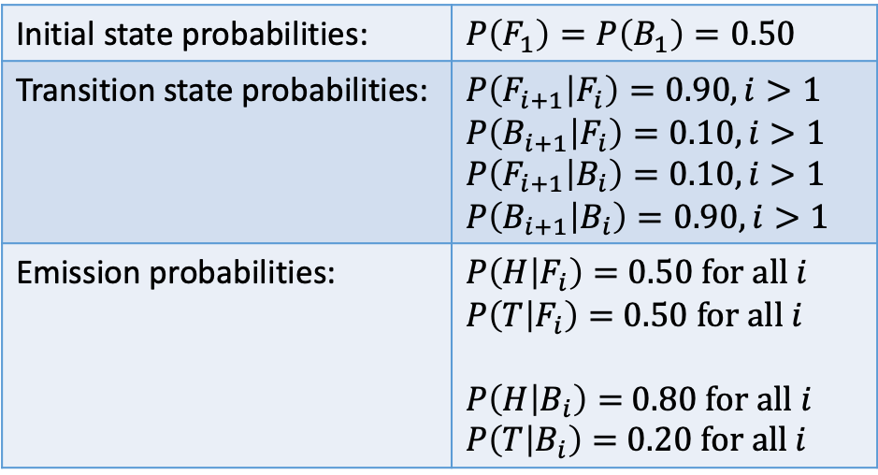
Hidden Markov models
0.9
We can specify a HMM graphically or by specifying the relevant probabilities:
F
H 0.50
T 0.50
Initial state probabilities: | $$P\left(F_{1}\right)=P\left(B_{1}\right)=0.50$$
Transition state probabilities: | $$P\left(F_{i+1} | F_{i}\right)=0.90, i>1$$ $$P\left(B_{i+1} | F_{i}\right)=0.10, i>1$$ $$P\left(F_{i+1} | B_{i}\right)=0.10, i>1$$ $$P\left(B_{i+1} | B_{i}\right)=0.90, i>1$$
Emission probabilities: | $P\left(H | F_{i}\right)=$ $0.50 \text{for} \text{all} i$ $P\left(T | F_{i}\right)=$ $0.50 \text{for} \text{all} i$ $P\left(H | B_{i}\right)=$ $0.80 \text{for} \text{all} i$ $P\left(T | B_{i}\right)=$ $0.20 \text{for} \text{all} i$
0.50
Start
0.10
0.10
$$\text{Hidden} \text{states}\text{:} H_{1},H_{2}, …H_{n}$$
0.50
B
H 0.80
T 0.20
0.90

Slide 12

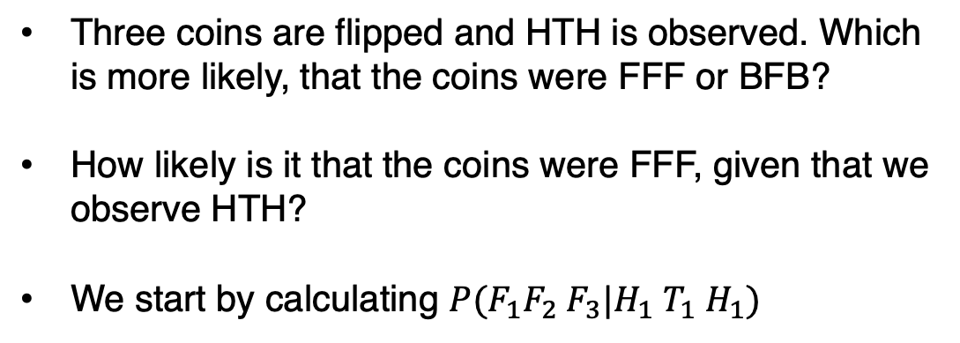



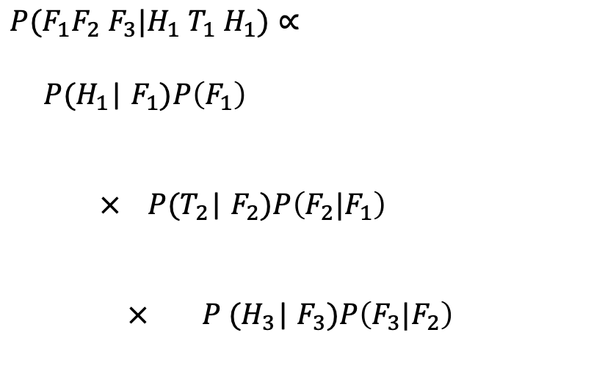
Hidden Markov models
Three coins are flipped and HTH is observed. Which is more likely, that the coins were FFF or BFB?
How likely is it that the coins were FFF, given that we observe HTH?
We start by calculating $P(F_{1}F_{2}$ $F_{3}|H_{1}$ $T_{1}$ $H_{1})$
0.9
F
H 0.50
T 0.50
0.50
$P(F_{1}F_{2}$ $F_{3}|H_{1}$ $T_{1}$ $H_{1})∝$
${ P(H}_{1}$| $F_{1})P\left(F_{1}\right)$
$× P{(T}_{2}$| $F_{2})P\left(F_{2}|F_{1}\right)$
$× P {(H}_{3}$| $F_{3})P\left(F_{3}|F_{2}\right)$
Start
Start with fair coin, flip it, get heads
0.10
0.10
$$(0.50×0.50)$$
0.50
B
Keep fair coin, flip it, get tails
H 0.80
T 0.20
$$(0.50×0.90)$$
Keep fair coin, flip it, get heads
$$(0.50×0.90)$$
0.90
$$=0.050625$$

Slide 13
Hidden Markov models – P(FFF | HTH)
How likely is it that the coins were FFF, given that we observe HTH?
0.9
F
Prob (state)
State | Start | → F | → F | →F
Emission (observation) |  | H | T | H
Prob (observed) | -
H 0.50
T 0.50
0.50
Start
0.10
0.10
0.50
B
H 0.80
T 0.20
0.90

Slide 14
Hidden Markov models – P(FFF | HTH)
How likely is it that the coins were FFF, given that we observe HTH?
0.9
F
Prob (state)
State | Start | → F | → F | →F
Emission (observation) |  | H | T | H
Prob (observed) | -
0.50
H 0.50
T 0.50
0.50
Start
0.10
0.10
0.50
B
H 0.80
T 0.20
0.90

Slide 15
Hidden Markov models – P(FFF | HTH)
How likely is it that the coins were FFF, given that we observe HTH?
0.9
F
Prob (state)
State | Start | → F | → F | →F
Emission (observation) |  | H | T | H
Prob (observed) | -
0.50
H 0.50
T 0.50
0.50
Start
0.10
0.10
0.50
0.50
B
H 0.80
T 0.20
0.90

Slide 16
Hidden Markov models – P(FFF | HTH)
How likely is it that the coins were FFF, given that we observe HTH?
0.9
F
0.90
Prob (state)
State | Start | → F | → F | →F
Emission (observation) |  | H | T | H
Prob (observed) | -
0.50
H 0.50
T 0.50
0.50
Start
0.10
0.10
0.50
0.50
B
H 0.80
T 0.20
0.90

Slide 17
Hidden Markov models – P(FFF | HTH)
How likely is it that the coins were FFF, given that we observe HTH?
0.9
F
0.90
Prob (state)
State | Start | → F | → F | →F
Emission (observation) |  | H | T | H
Prob (observed) | -
0.50
H 0.50
T 0.50
0.50
Start
0.10
0.10
0.50
0.50
0.50
B
H 0.80
T 0.20
0.90

Slide 18
Hidden Markov models – P(FFF | HTH)
How likely is it that the coins were FFF, given that we observe HTH?
0.9
F
0.90
0.90
Prob (state)
State | Start | → F | → F | →F
Emission (observation) |  | H | T | H
Prob (observed) | -
0.50
H 0.50
T 0.50
0.50
Start
0.10
0.10
0.50
0.50
0.50
B
H 0.80
T 0.20
0.90

Slide 19
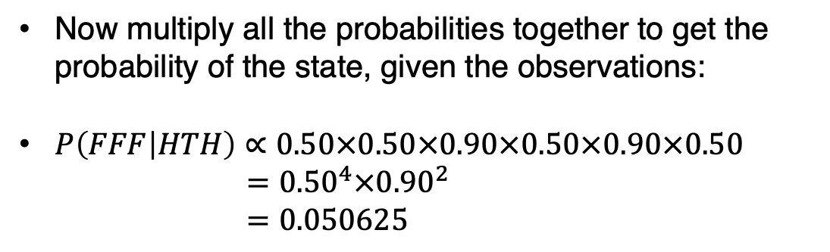
Hidden Markov models – P(FFF | HTH)
How likely is it that the coins were FFF, given that we observe HTH?
0.9
F
0.90
0.90
Prob (state)
State | Start | → F | → F | →F
Emission (observation) |  | H | T | H
Prob (observed) | -
0.50
H 0.50
T 0.50
0.50
Start
0.10
0.10
0.50
0.50
0.50
0.50
B
H 0.80
T 0.20
Now multiply all the probabilities together to get the probability of the state, given the observations:
$P\left(FFF | HTH\right)∝0.50×0.50×0.90×0.50×0.90×0.50$
$={0.50}^{4}×{0.90}^{2}$
$=0.050625$
0.90

Slide 20
Hidden Markov models – P(BFB | HTH)
How likely is it that the coins were BFB, given that we observe HTH?
0.9
F
Prob (state)
State | Start | → B | → F | →B
Emission (observation) |  | H | T | H
Prob (observed) | -
H 0.50
T 0.50
0.50
Start
0.10
0.10
0.50
B
H 0.80
T 0.20
0.90

Slide 21
Hidden Markov models – P(BFB | HTH)
How likely is it that the coins were BFB, given that we observe HTH?
0.9
F
Prob (state)
State | Start | → B | → F | →B
Emission (observation) |  | H | T | H
Prob (observed) | -
0.50
H 0.50
T 0.50
0.50
Start
0.10
0.10
0.50
B
H 0.80
T 0.20
0.90

Slide 22
Hidden Markov models – P(BFB | HTH)
How likely is it that the coins were BFB, given that we observe HTH?
0.9
F
Prob (state)
State | Start | → B | → F | →B
Emission (observation) |  | H | T | H
Prob (observed) | -
0.50
H 0.50
T 0.50
0.50
Start
0.10
0.10
0.80
0.50
B
H 0.80
T 0.20
0.90

Slide 23
Hidden Markov models – P(BFB | HTH)
How likely is it that the coins were BFB, given that we observe HTH?
0.9
F
0.10
Prob (state)
State | Start | → B | → F | →B
Emission (observation) |  | H | T | H
Prob (observed) | -
0.50
H 0.50
T 0.50
0.50
Start
0.10
0.10
0.80
0.50
B
H 0.80
T 0.20
0.90

Slide 24
Hidden Markov models – P(BFB | HTH)
How likely is it that the coins were BFB, given that we observe HTH?
0.9
F
0.10
Prob (state)
State | Start | → B | → F | →B
Emission (observation) |  | H | T | H
Prob (observed) | -
0.50
H 0.50
T 0.50
0.50
Start
0.10
0.10
0.80
0.50
0.50
B
H 0.80
T 0.20
0.90

Slide 25
Hidden Markov models – P(BFB | HTH)
How likely is it that the coins were BFB, given that we observe HTH?
0.9
F
0.10
0.10
Prob (state)
State | Start | → B | → F | →B
Emission (observation) |  | H | T | H
Prob (observed) | -
0.50
H 0.50
T 0.50
0.50
Start
0.10
0.10
0.80
0.50
0.50
B
H 0.80
T 0.20
0.90

Slide 26
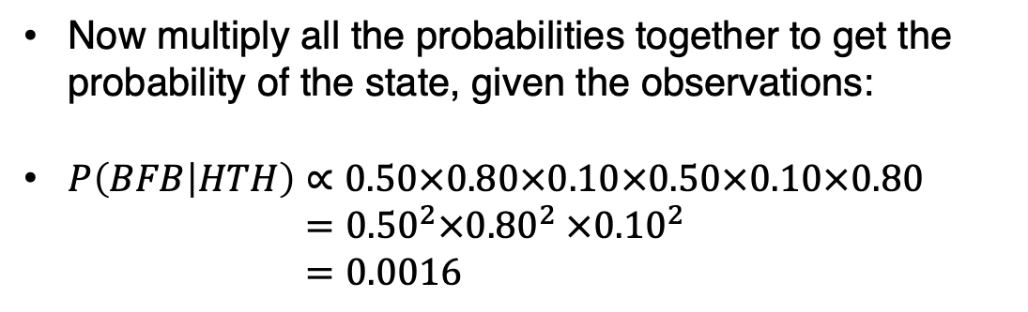
Hidden Markov models – P(BFB | HTH)
How likely is it that the coins were BFB, given that we observe HTH?
0.9
F
0.10
0.10
Prob (state)
State | Start | → B | → F | →B
Emission (observation) |  | H | T | H
Prob (observed) | -
0.50
H 0.50
T 0.50
0.50
Start
0.10
0.10
0.80
0.50
0.80
0.50
B
H 0.80
T 0.20
Now multiply all the probabilities together to get the probability of the state, given the observations:
$P\left(BFB | HTH\right)∝0.50×0.80×0.10×0.50×0.10×0.80$
$={0.50}^{2}×{0.80}^{2}$ $×{0.10}^{2}$
$=0.0016$
0.90

Slide 27
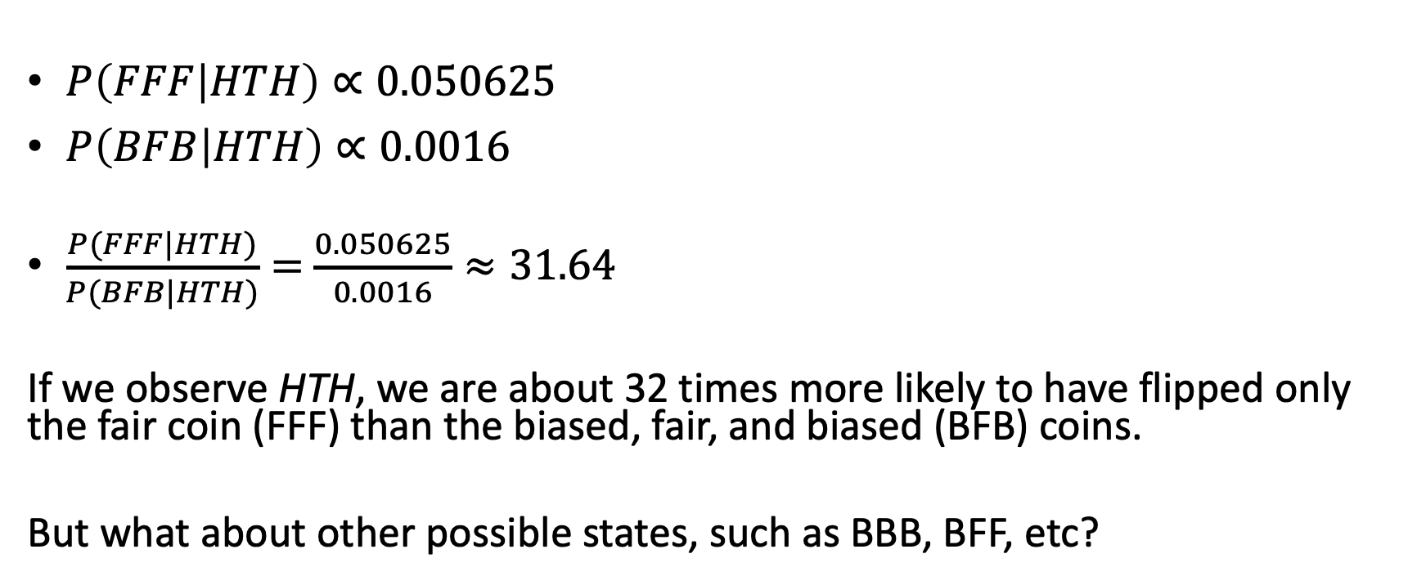
Which is more likely?
$P\left(FFF | HTH\right)∝0.050625$
$P\left(BFB | HTH\right)∝0.0016$
$\frac{P(FFF|HTH)}{P(BFB|HTH)}=$ $\frac{0.050625}{0.0016}≈31.64$
If we observe HTH, we are about 32 times more likely to have flipped only the fair coin (FFF) than the biased, fair, and biased (BFB) coins.
But what about other possible states, such as BBB, BFF, etc?

Slide 28
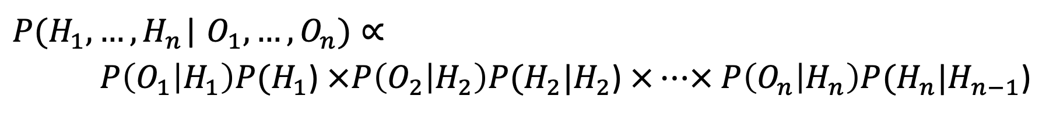
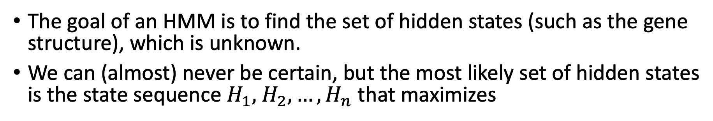
Hidden Markov Models
The goal of an HMM is to find the set of hidden states (such as the gene structure), which is unknown.
We can (almost) never be certain, but the most likely set of hidden states is the state sequence $H_{1},$ $H_{2}, …,H_{n}$ that maximizes
${P(H}_{1}, …,H_{n}$| $O_{1}, …,O_{n})∝$
$P\left(O_{1} | H_{1}\right)P(H_{1}$) $× P\left(O_{2} | H_{2}\right)P(H_{2}|H_{2}\text{)}$ $×…× P\left(O_{n} | H_{n}\right)P(H_{n}|H_{n−1}\text{)}$
Most of the time, we work with probabilities on the log scale, where the log of a product is equal to the sum of the logs.

Slide 29
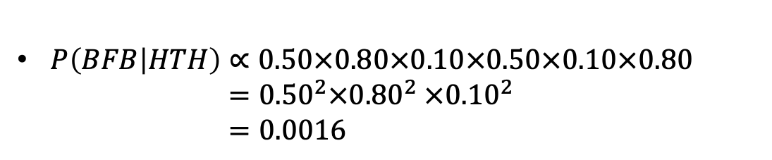
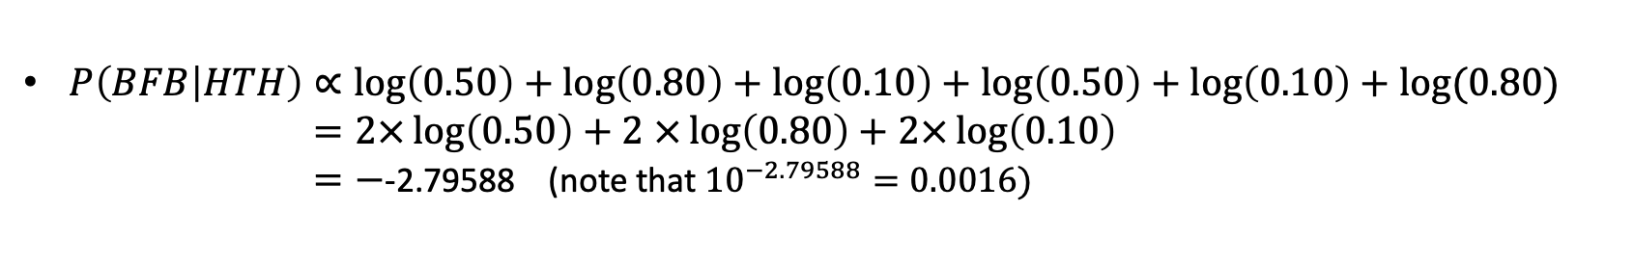
Prob (state) |  | 0.50 | 0.10 | 0.10
State | Start | → B | → F | →B
Emission (observation) |  | H | T | H
Prob (observed) | - | 0.80 | 0.50 | 0.80
$P\left(BFB | HTH\right)∝0.50×0.80×0.10×0.50×0.10×0.80$
$={0.50}^{2}×{0.80}^{2}$ $×{0.10}^{2}$
$=0.0016$
Prob (state) (log scale) |  | log(0.50) | log(0.10) | log(0.10)
State | Start | → B | → F | →B
Emission (observation) |  | H | T | H
Prob (observed) (log scale) | - | log(0.80) | log(0.50) | log(0.80)
$P\left(BFB | HTH\right)∝\log\left(0.50\right)+\log\left(0.80\right)+\log\left(0.10\right)+\log\left(0.50\right)+\log\left(0.10\right)+log⁡(0.80)$
$=2×\log\left(0.50\right)+2$ $×\log\left(0.80\right)+2×\log\left(0.10\right)$
$=−\text{-2.79588}$ (note that ${10}^{−2.79588}=0.0016)$

Slide 30
Viterbi algorithm
How do we determine the optimal sequence of hidden states?
Let's continue with our coin tossing example, where the hidden state sequence ends with either F or B.
Suppose we know the optimal hidden states for the first two observations, ending with F or B. Then there are 4 possibilities for the next hidden state:
F → F
B → F
F → B
B → B
This lends itself to a dynamic programming solution, known as the Viterbi algorithm.

Slide 31
Hidden Markov models
Find the optimal state that would generate HTH.
0.9
F
H 0.50
T 0.50
 | H | T | H
F | 0.50(0.50)=0.25
B | 0.50(0.80)=0.40
0.50
Start
0.10
0.10
0.50
B
H 0.80
T 0.20
0.90

Slide 32
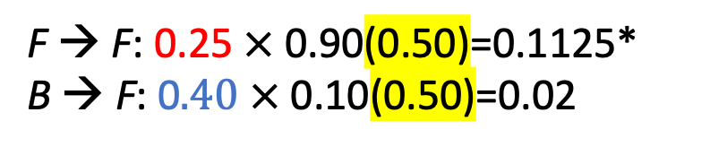
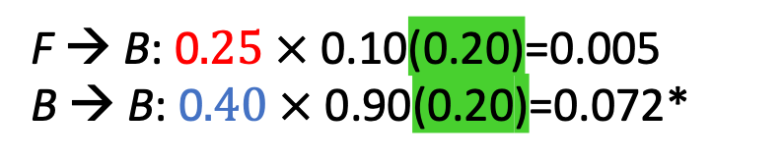
Hidden Markov models
Find the optimal state that would generate HTH.
0.9
F
H 0.50
T 0.50
 | H | T | H
F | 0.50(0.50)=0.25
B | 0.50(0.80)=0.40
0.50
0.1125*
Start
0.072*
0.10
0.10
0.50
B
F → F: 0.25$×$ 0.90(0.50)=0.1125*
B → F: 0$.40 ×$ 0.10(0.50)=0.02
H 0.80
T 0.20
F → B: 0$.25 ×$ 0.10(0.20)=0.005
B → B: 0$.40 ×$ 0.90(0.20)=0.072*
0.90

Slide 33
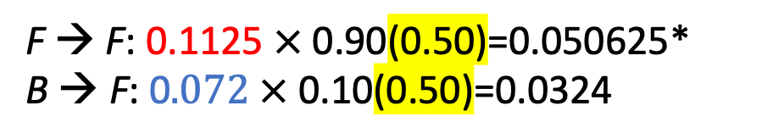
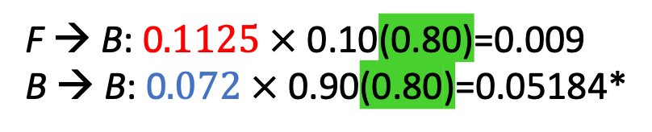
Hidden Markov models
Find the optimal state that would generate HTH.
0.9
F
H 0.50
T 0.50
 | H | T | H
F | 0.50(0.50)=0.25
B | 0.50(0.80)=0.40
0.50
0.1125
0.050625
Start
0.072
0.05184
0.10
0.10
0.50
B
F → F: 0.1125$×$ 0.90(0.50)=0.050625*
B → F: 0$.072 ×$ 0.10(0.50)=0.0324
H 0.80
T 0.20
F → B: 0$.1125 ×$ 0.10(0.80)=0.009
B → B: 0$.072 ×$ 0.90(0.80)=0.05184*
0.90

Slide 34
Hidden Markov models
Find the optimal state that would generate HTH.
0.9
F
H 0.50
T 0.50
 | H | T | H
F | 0.50(0.50)=0.25
B | 0.50(0.80)=0.40
0.50
0.1125
0.050625
Start
0.072
0.05184
0.10
0.10
The optimal final state ends in B, since
0.05184 > 0.050625.
We then use traceback to find the optimal path, in this case yielding B → B → B.
The optimal state sequence is BBB
0.50
B
H 0.80
T 0.20
0.90

Slide 35
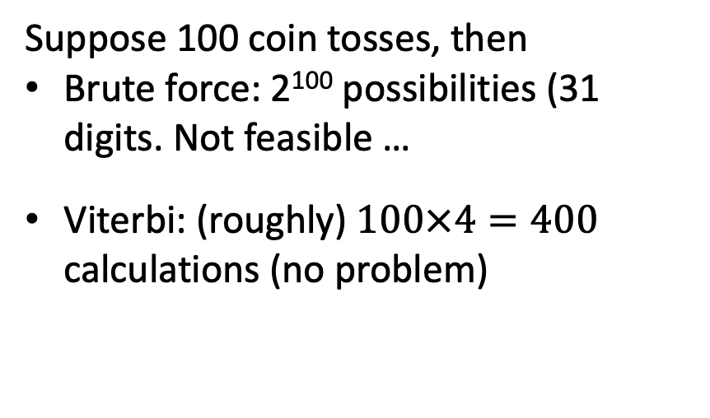
Hidden Markov models
Viterbi algorithm eliminates non-optimal paths
 | H | T | H
F | 0.25 | 0.1125 | 0.050625
B | 0.40 | 0.072 | 0.05184
F
B
Suppose 100 coin tosses, then
Brute force: 2¹⁰⁰ possibilities (31 digits. Not feasible …
Viterbi: (roughly) $100×4=400$ calculations (no problem)
F
B
F
B
F
B
F
B
F
B
F
B

Slide 36
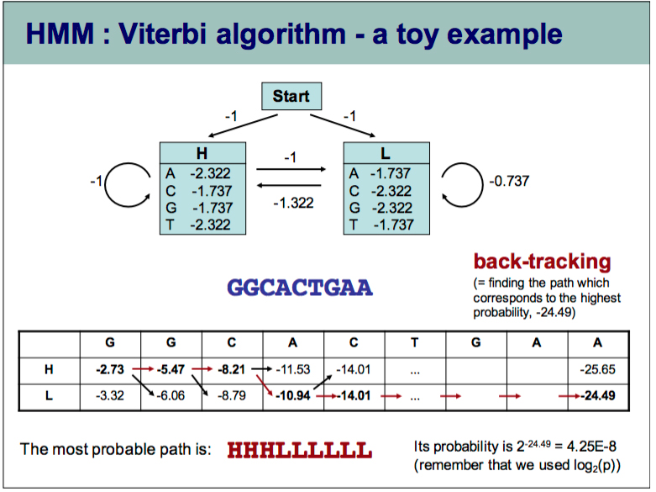
"Simple" model:
https://bmcbioinformatics.biomedcentral.com/articles/10.1186/1471-2105-5-59
Augustus Model:
https://academic.oup.com/bioinformatics/article/19/suppl_2/ii215/180603
Note: probabilities are on the log2 scale.
Source (no longer available), http://homepages.ulb.ac.be/%7Edgonze/TEACHING/viterbi.pdf

