Slide 1

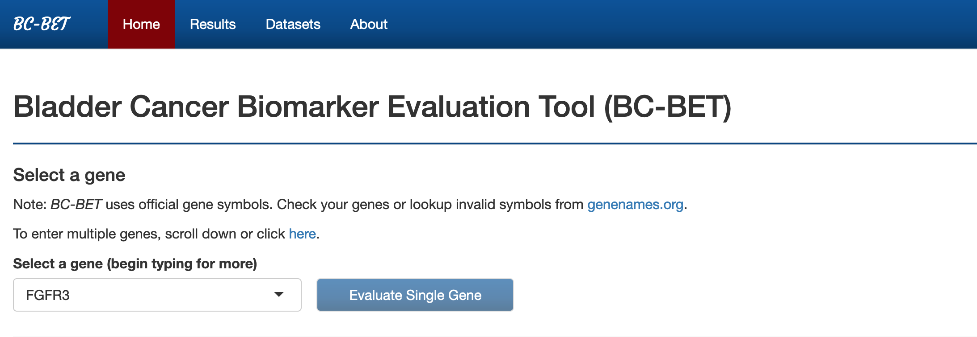
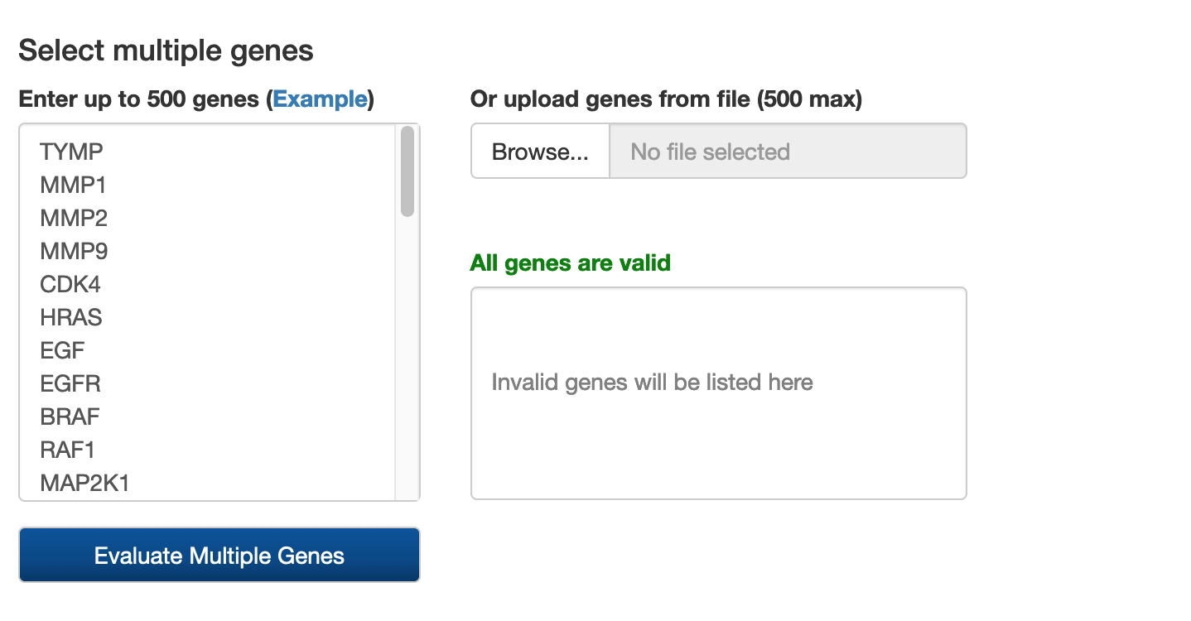
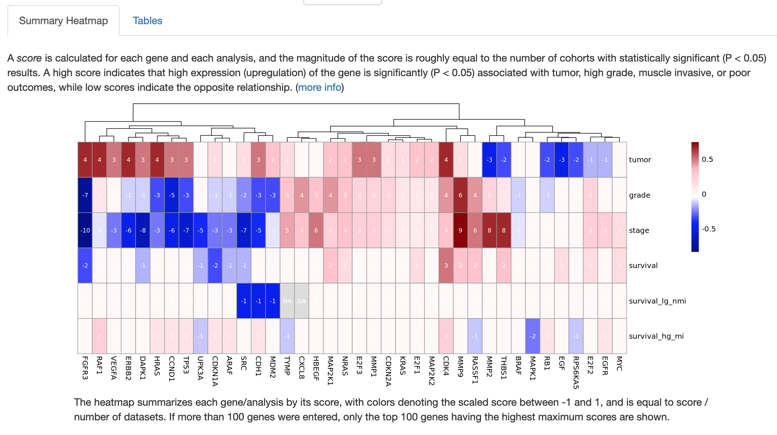
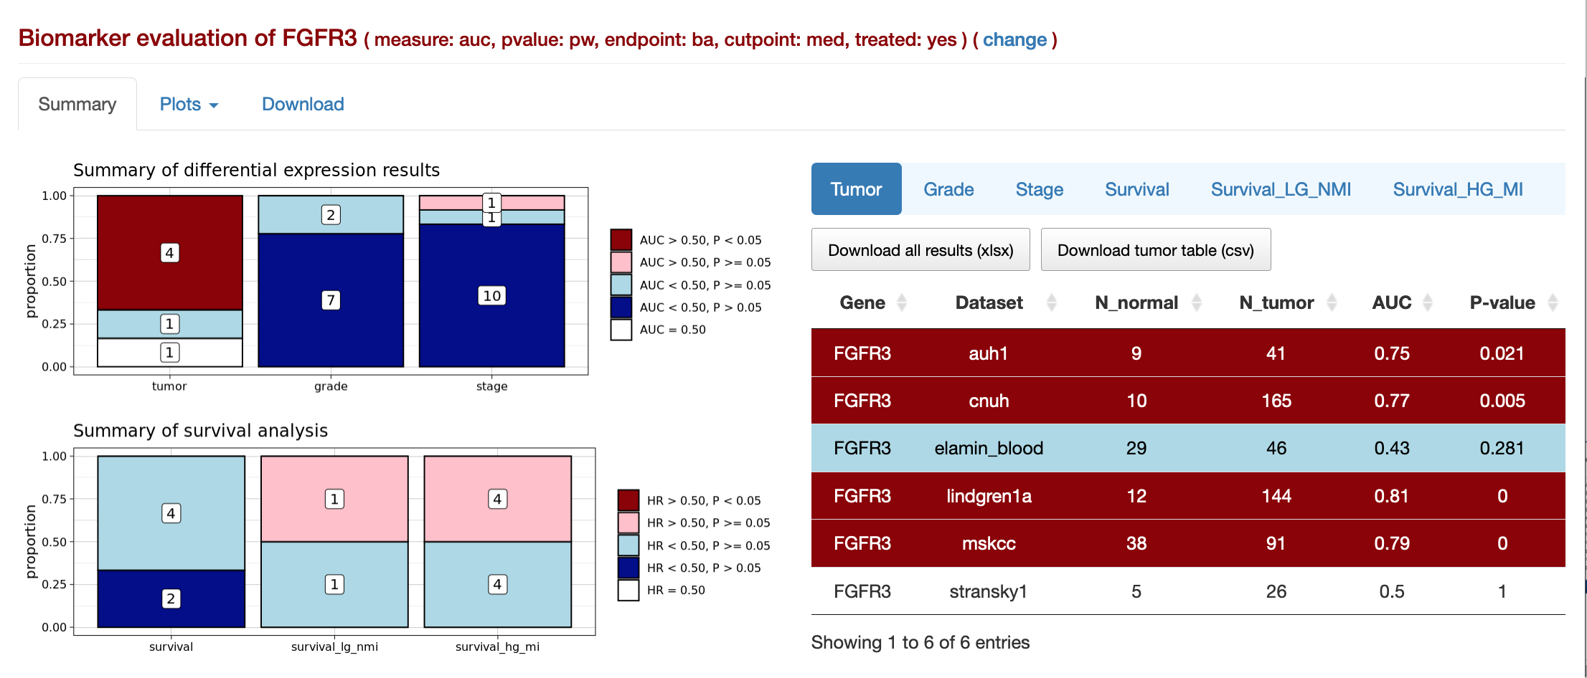
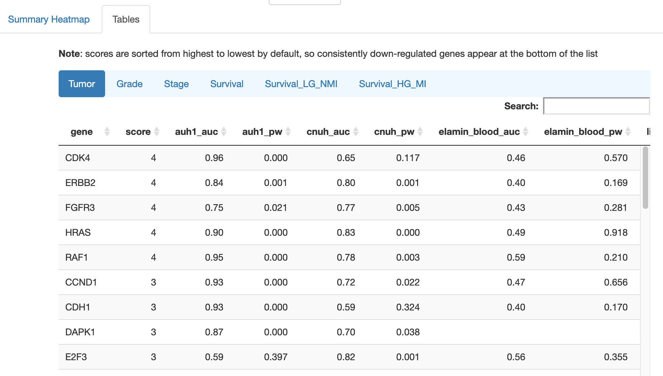
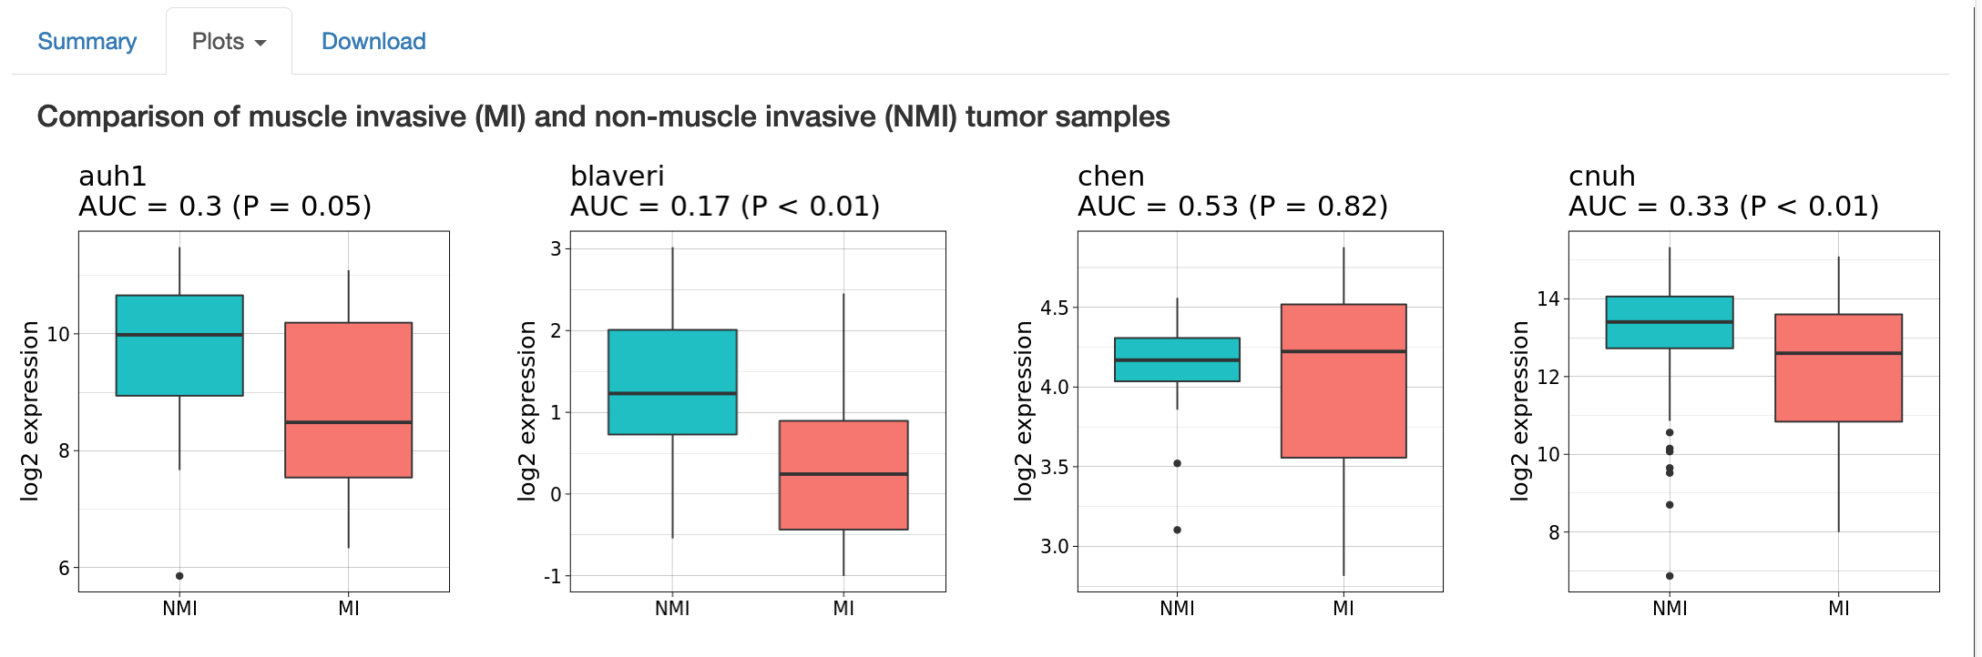
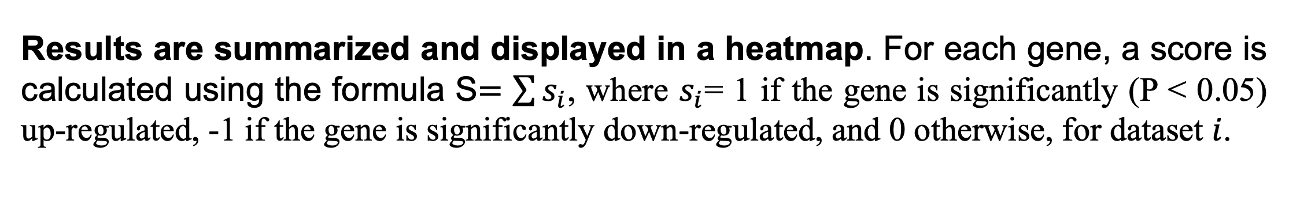
BC-BET v2.0: updates to an online Bladder Cancer Biomarker Evaluation Tool Garrett M. Dancik Department of Computer Science, Eastern Connecticut State University, Willimantic, Connecticut, USA
Abstract #1195
Introduction
Results
The Bladder Cancer Biomarker Evaluation Tool (BC-BET) is a web application for quickly evaluating candidate diagnostic and prognostic biomarkers in bladder cancer, based on publicly available gene expression datasets [Dancik, G. M. BMC Urol. 15, 59 (2015)]. Specifically, BC-BET evaluates whether a selected gene is differentially expressed between normal cells and tumor samples; between low- and high- grade tumors; and between non-muscle invasive and muscle-invasive tumors. BC-BET also evaluates whether a selected gene is significantly associated with survival, and whether the gene is associated with survival in two clinically important patient subsets: patients with low-grade, non-muscle invasive tumors; and patients with high-grade, muscle invasive tumors.
Availability: http://bioinformatics.easternct.edu/BCBET
Example Single Gene Analysis (FGFR3)
Example Multi- Gene Analysis (Cell Cycle Gene Set)
Screenshot of BC-BET multi-gene analysis. Users can enter genes or upload genes from a file.
Screenshot of BC-BET single gene analysis of FGFR3. First, the user selects a gene and sets statistical parameters (not shown), and clicks the Evaluate button
New datasets: BC-BET contains 15 patient cohorts (N = 1559).
Improved performance (~2x faster)
Visualization of differential expression (boxplots) and survival analyses (KM curves)
Support for multi-gene queries
Data export (results + expression and clinical data)
Database updates
Results are presented using summary bar graphs and tables. Bar graphs summarize the results for differential expression testing differential expression between tumor vs. normal samples, high grade vs. low grade samples, and non-muscle invasive vs muscle-invasive samples; and for survival analysis of all samples, and in subsets of patients with low-grade (lg), non-muscle invasive (nmi) tumors; and high-grade (hg), muscle invasive (mi) tumors. Tables on the right report the results from each dataset.
Results are summarized and displayed in a heatmap. For each gene, a score is calculated using the formula S$=\sum{s_{i}}$, where $s_{i}$= 1 if the gene is significantly (P < 0.05) up-regulated, -1 if the gene is significantly down-regulated, and 0 otherwise, for dataset $i$.
R is used for data processing
MongoDB is used for data storage
The web application is developed in R/Shiny
Technical details
Visualizations are provided for each analysis for each dataset. The "Plots" tab provides visualizations of all analyses (the first row of NMI vs MI comparisons for FGFR3 are shown). Users can also download a spreadsheet of the results or data from individual cohorts (not shown)
Dataset specific results are provided in a table. Results can also be exported to an Excel spreadsheet (not shown).
Acknowledgements: This work was supported, in part, by grants from the American Association of University Professors and Connecticut State University Board of Regents (DANR14 and YRDA01).

