Slide 1
Refactoring - Team D
Gareth Daunton, Quang Vu, Daniel Roberts, Mitchell Derby
Notes:
Introduction: Gareth

Slide 2
Targeted Refactoring Hot Spots
AppointmentTemplate Class
Model Pattern Package/AppointmentUtility
Listener Package - Added inheritance
Notes:
Introduction: Gareth

Slide 3
Duplicate Methods
AppointmentTemplate class
Metric Evidence: Weighted Methods by Class
Notes:
Quang

Slide 4
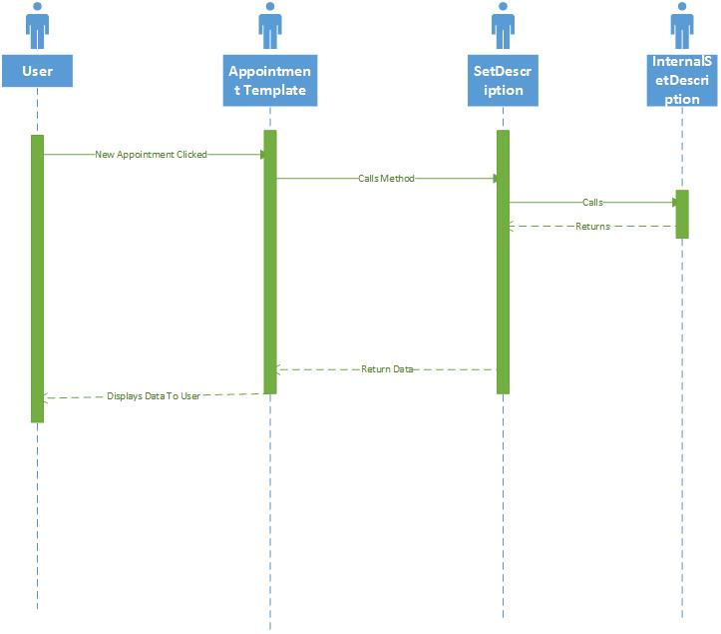
Before
Notes:
Quang

Slide 5
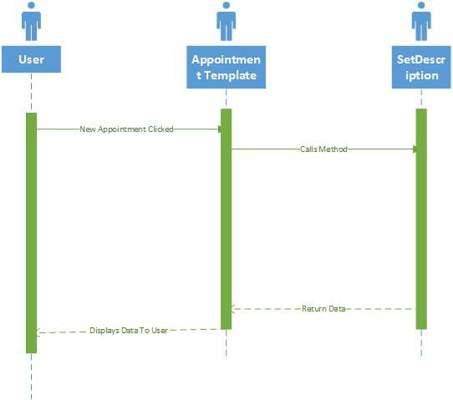
After
Notes:
Quang

Slide 6
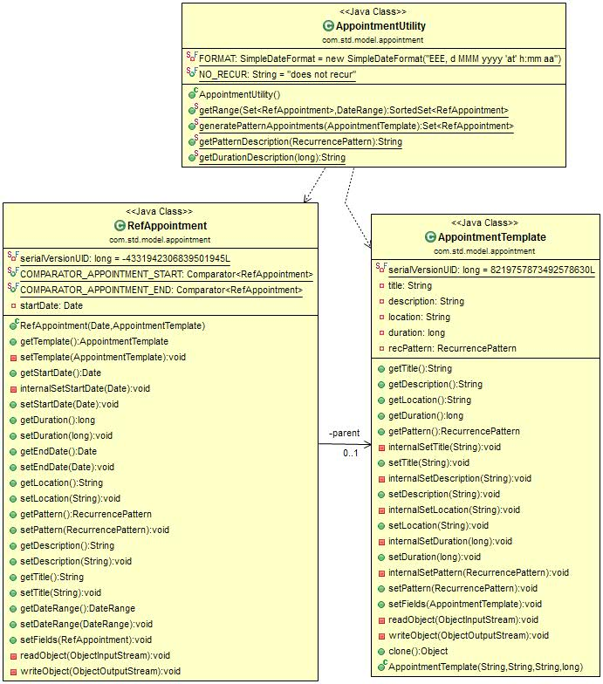
Class Diagram Before
Notes:
Mitchell

Slide 7
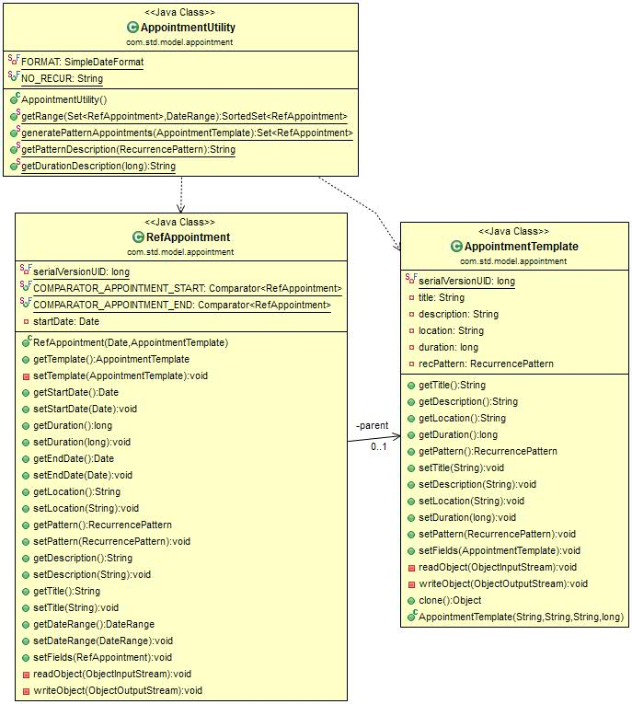
Class Diagram After
Notes:
Mitchell

Slide 8
Model Pattern Package
Refactoring Pattern: Replace Conditional with Polymorphism
Metric Evidence: Cyclomatic Complexity
Notes:
Mitchell

Slide 9
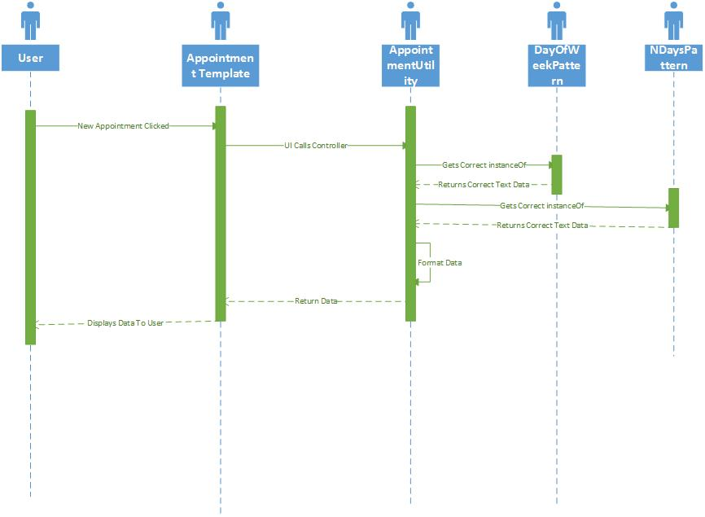
Before
Notes:
Daniel

Slide 10
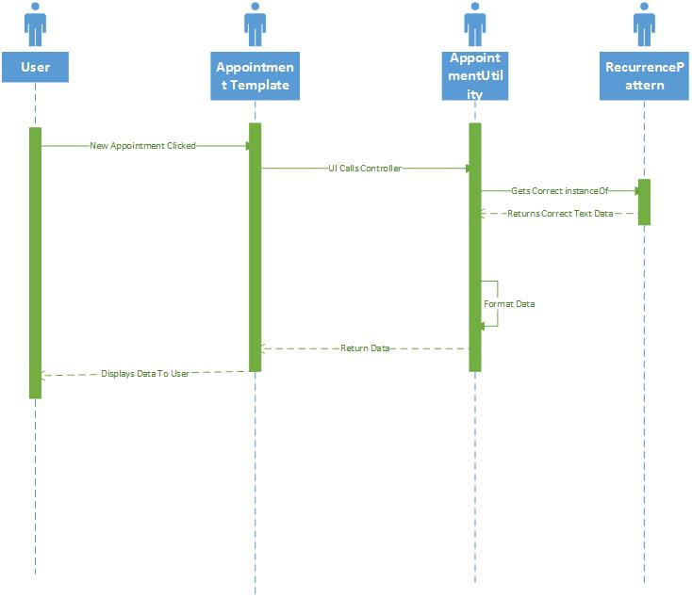
After
Notes:
Daniel

Slide 11
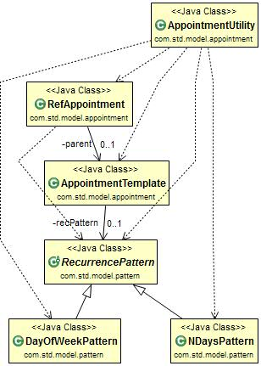
Class Diagram Before
Notes:
Gareth

Slide 12
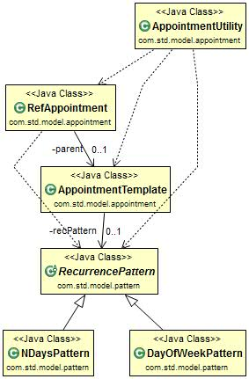
Class Diagram After
Notes:
Gareth

Slide 13
Listener Package
Duplicate code in all listener classes
Created a ControllerListener superclass
All listener classes extend the superclass
Notes:
Quang

Slide 14
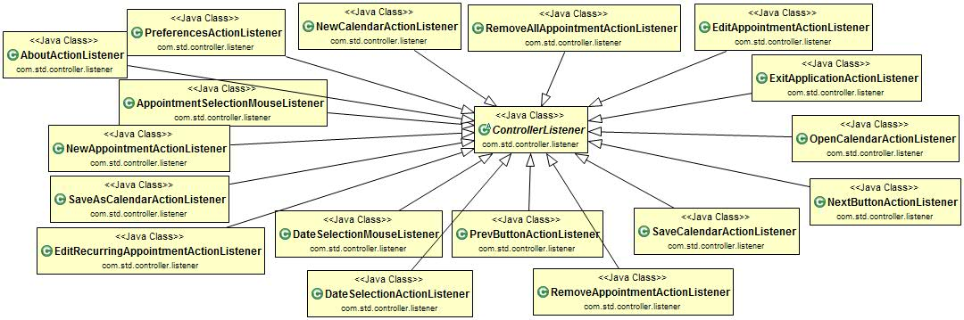
Class Diagram
Notes:
Quang

Slide 15
Design Patterns
Observer
Strategy
Notes:
Daniel

Slide 16
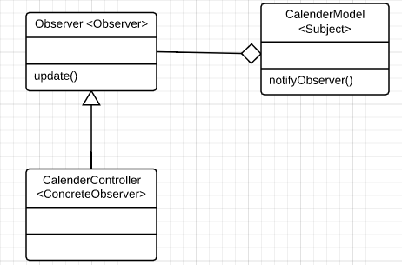
Observer
In original design
Notes:
Daniel

Slide 17
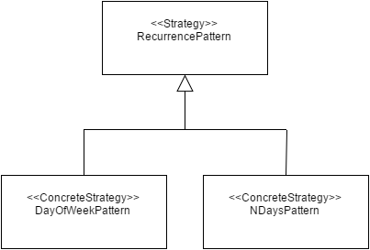
Strategy

Slide 18
Questions?

