Slide 1
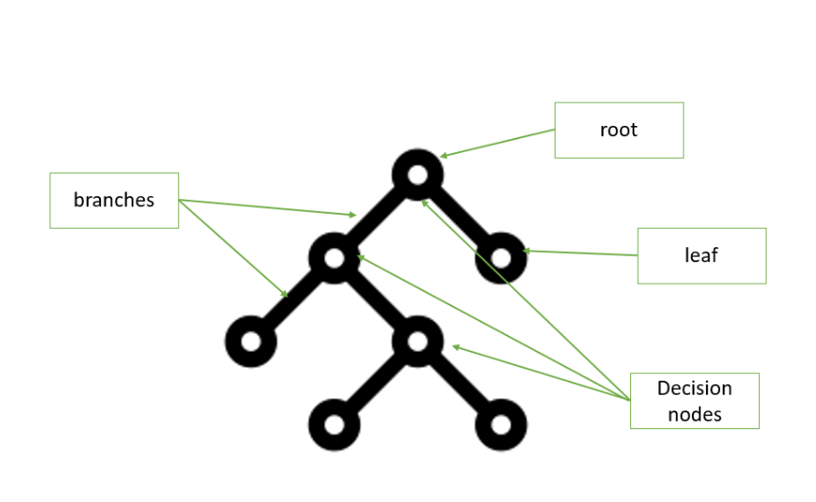
COMP 6210 BIG DATA : GROUP WORK
ASSIGNMENT 2 : SEMESTER 1 , 2025
Submitted ON 6th June 2025

Slide 2
Group Members
Name | Student ID | Email | Assigned Task
Anuj Adhikari | 48547743 | anuj.adhikari@students.mq.edu.au | Task 2
Bharat Poudel |  | bharat.poudel@students.mq.edu.au | Report
Gopal Bhatt |  | gopal.bhatt@students.mq.edu.au | Task 1

Slide 3

DISCUSSION TOPICS
Table of contents
Task 1 : Nearest Neighbour Search Presented By Gopal Bhat
Task 2 : Skyline Search Presented By Anuj Adhikari
Discussion on Assignment Report involving construction of R-trees Presented By Bharat Poudel

Slide 4
Task 2 Skyline Search
USING Sequential Scan, BBS, and Divide-and- Conquer Approaches
Presented By : Anuj Adhikari( 48547743)
Notes:
Good morning/afternoon and evening guys. I’m here to present my analysis
of skyline search algorithms which is a part of of our group assignment. The algorithms are applied to real estate dataset which I as selected cityy1. I implemented three different algorithms to find optimal houses based on cost and size criteria.

Slide 5
Skyline Problem
What is Skyline?
Contextual Problem Definition: To find the best houses to buy from a large property selection pool
Criteria: Cost (lower is better)
AND
Size (higher is better)
Logic for Domination: House A dominates House B if A is cheaper AND larger
Skyline Points: Houses not dominated by any other house
Notes:
Let me start by explaining what we mean by the skyline
problem. I want to give an example here where we are looking to buy a house and we mainly focus about two things: we want the house to be
as cheap as possible and as large as possible.
It’s a real fact that some houses are clearly better
than others. House A costs $150k for 100 square meters, and House B costs
$200k for 90 square meters, then House A dominates House B because it's both cheaper and
larger.
The skyline consists of all houses that aren't dominated by any other house - these
represent your best options. In my dataset of 300,000 houses,
I found 8 skyline points that represent the optimal trade-offs between cost and size. Which ill discuss further in upcoming slides

Slide 6
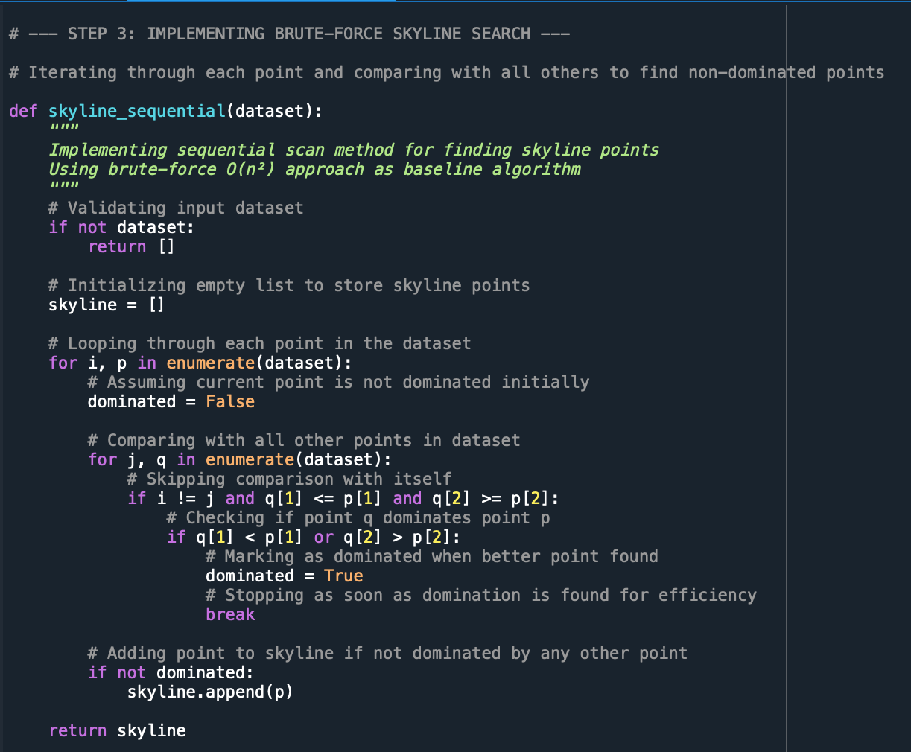
Algorithm 1 : Sequential Scan
BRUTE– FORCE APPROACH
In this approach we compare every house against every other house.
It is very slow for this particular “city1” dataset which has more than 300,000 data points.
For each house, we are using the pre-established domination logic to check if any other house dominates it.
It is very inefficient, hence has the highest execution time among the three algorithms used for skyline search.
Image
Notes:
The first algorithm I implemented is Sequential Scan, which
is the brute force approach. For every house in the dataset, I compare it against every other
house to see if it's dominated. This means for 300,000 houses, I'm doing 90 billioncomparisons! The algorithm is straightforward - for each house, I loop through all others and
check if any house has both lower cost and higher size. If I find such a house, the current
house is eliminated from the skyline. While this approach is simple to understand and
implement, it's extremely slow with O(n²) time complexity. In my testing, this took over 0.9
seconds, which serves as our baseline for comparison."

Slide 7
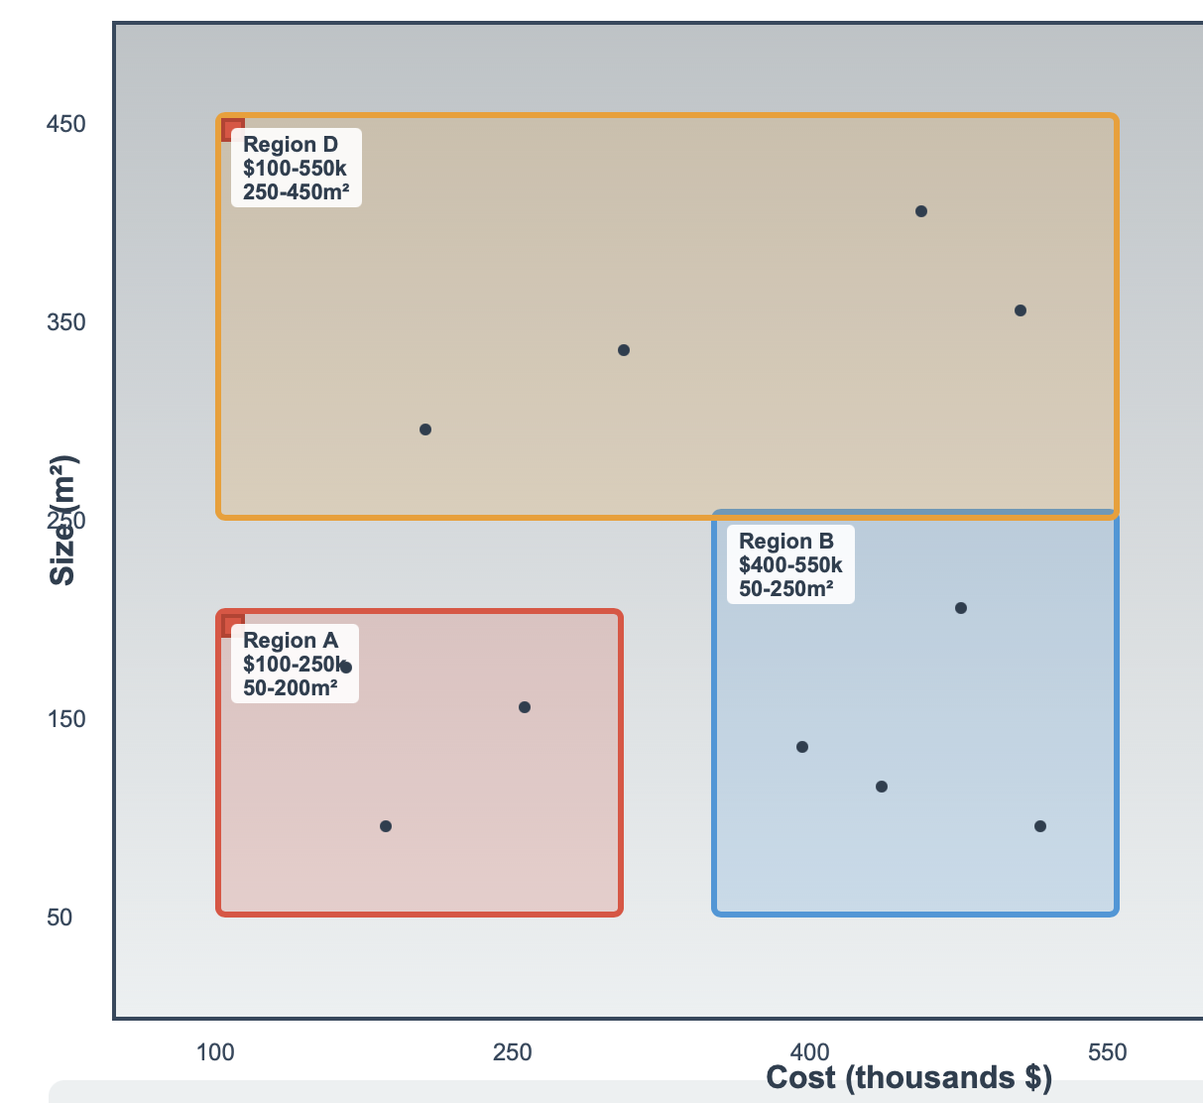
Algorithm 2 : Branch and Bound Skyline
Smart APPROACH : BBS with R-tree
R-tree spatial indexing for efficient pruning where 300,000 houses are organized into hierarchical spatial groups instead of checking individually like algorithm 1
For MBR, we group the houses into spatial regions with boundaries. Each folder contains houses with cost range $150k-$200k, size range 80-120m²
For pruning, we skip entire regions dominated by skyline points. If skyline has $100k/150m² house, skipping all folders labeled "$200k+ houses"
Faster compared to Sequential Scan due to the pruning efficiency
Image

Slide 8
Algorithm 2 : Branch and Bound Skyline
Process of BBS
Build tree
Sort by cost
traverse with priority queue
prune aggressively
chunk into groups
build levels
search most promising regions first

Slide 9
Algorithm 3 : Divide and Conquer BBS
Split THEM , SOLVE THEM AND MERGE THEM
Sorting
Splitting at the median
Applying BBS to each half
Merging
BBS but with extra steps involving division and merging
Dividing dataset by cost, solving each half separately
For the final filtering step , which is merging both skylines, we apply our standard skyline checking to the merged candidates to obtain only non-dominated points.

Slide 10
Implementation of Key Program Properties
Technical Implementations in the CODE
Data Structure: Tuples in the structure of (ID, cost, size)
R-tree Construction: Bulk loading has been used with 100 entries per node
Priority Queue: Heapq() has been used for node processing
Error Handling: Data Validation is present along with error handling for file I/O operations.
No External Dependencies: No external library has been used which requires manual installation

Slide 11
Evaluation of Results
Comparison between the algorithms

Slide 12
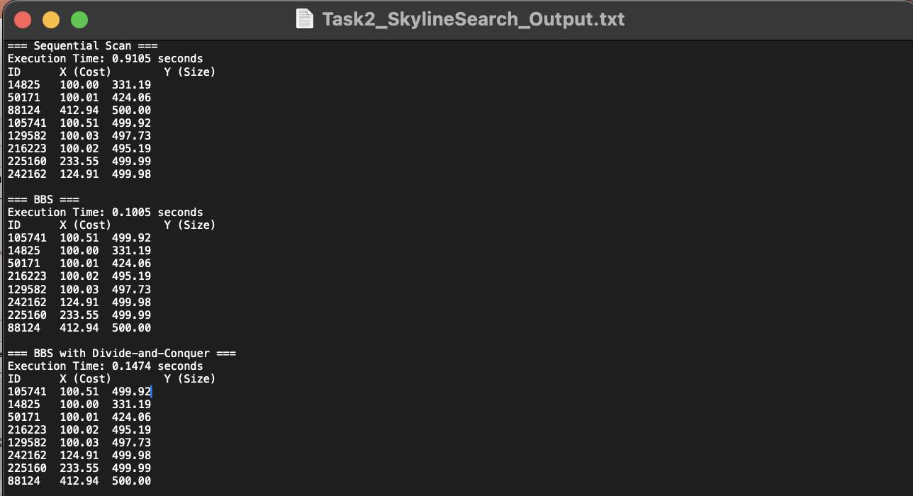
Skyline Points
SOLUTION TO THE HOUSE SELECTION PROBLEM
All 3 algorithms output the same 8 skyline points.
The cheapest house is 14825: $100k, 331m²
The house with the balanced values as per the two criteria is 50171: $100k, 424m²
The largest house is 88124: $413k, 500m²
The best house in the entire dataset is 105741: $100k, 500m²
There are also 4 other points with optimal trade-offs.

Slide 13
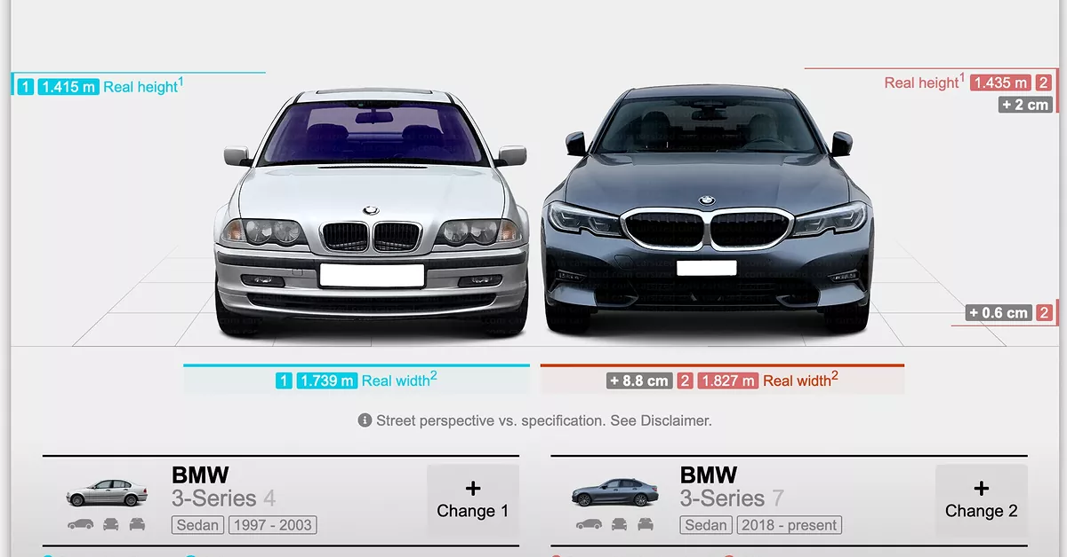
Other Real World Examples
APPLICATIONS OF THIS PROGRAM IN OTHER SECTORS
Job Selection: Salary vs work-life balance vs career growth potential
Restaurant Selection: Cost vs rating vs distance from home
University Selection: Tuition cost vs academic ranking vs location preference
Car Shopping: Price vs fuel efficiency vs safety rating
Image

Slide 14
Conclusion
Takeaways from task 1
Spatial indexing improves performance significantly
R-trees enable effective pruning for such complex and large data problems
Algorithm choice matters based on dataset characteristics
Implementation simplicity can be more valuable than complexity
Skyline algorithms solve real optimization problems

