Slide 1
PubHub
“Serious trivia for serious pubs”
Developers:
Blair Gentry, Geoffrey Blech, Linh Tran, Travis Cox
Notes:
Geoff

Slide 2
Progress...

Slide 3
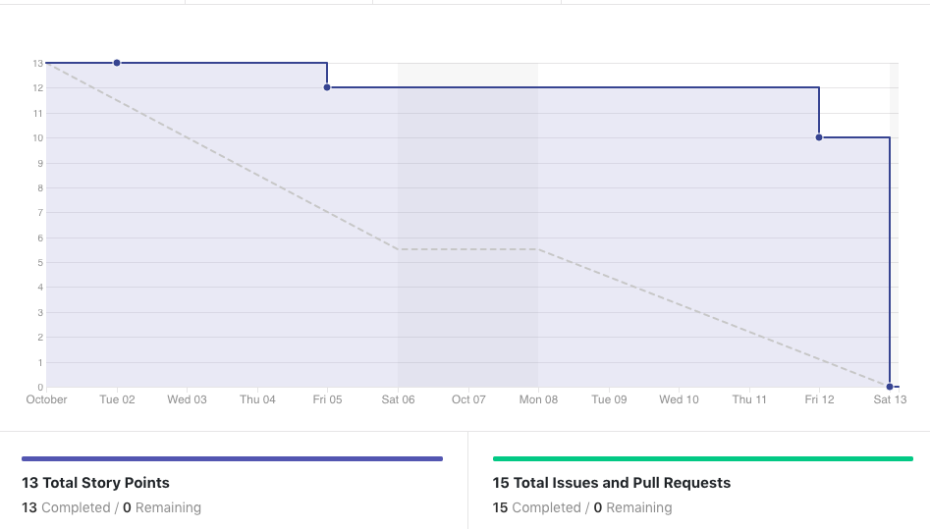
Sprint γ

Slide 4
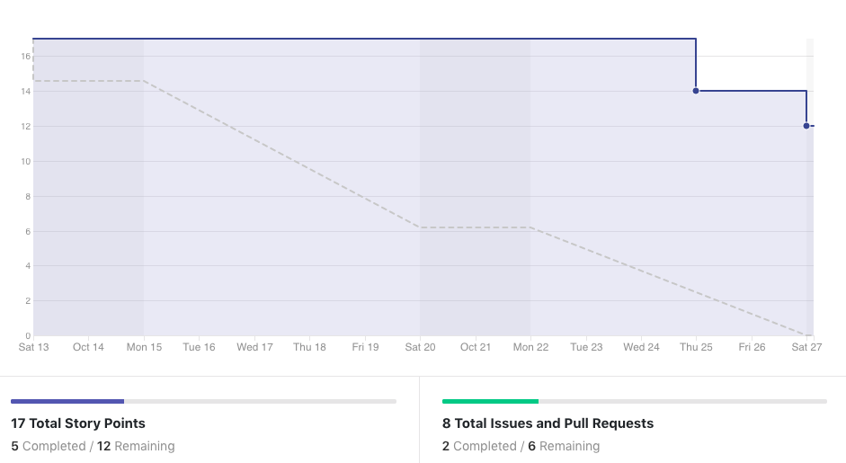
Sprint δ

Slide 5
Implementation
And Changes

Slide 6
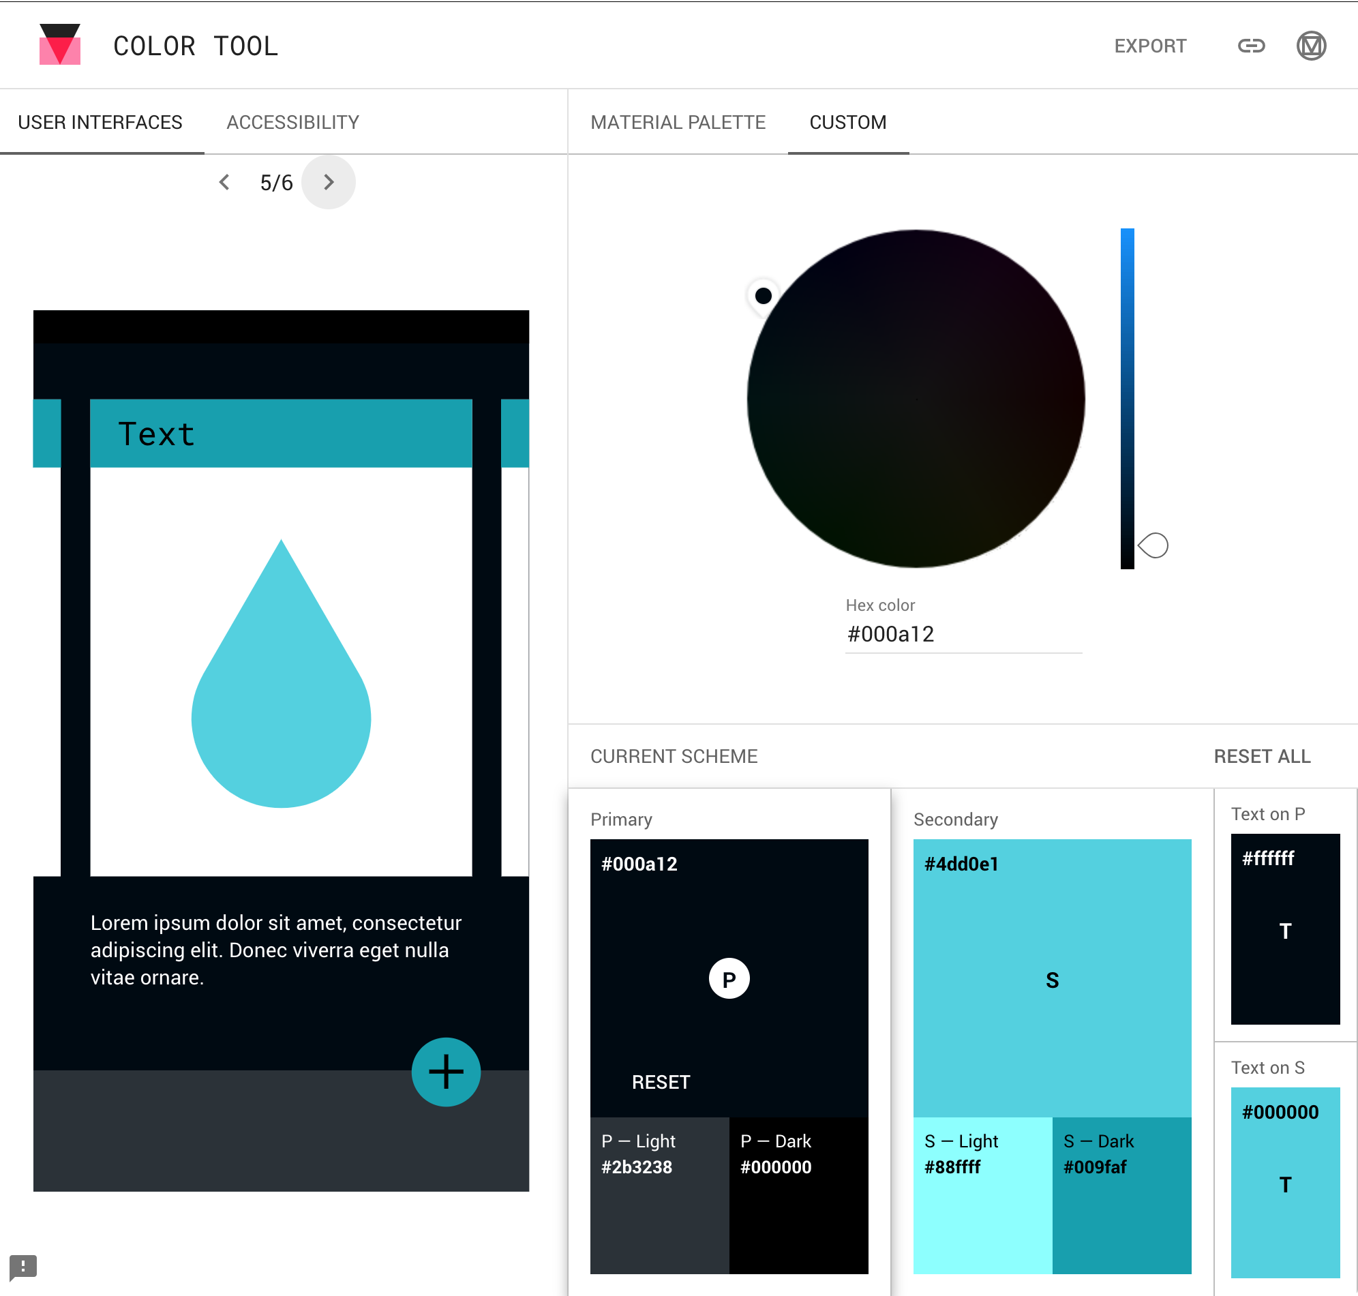
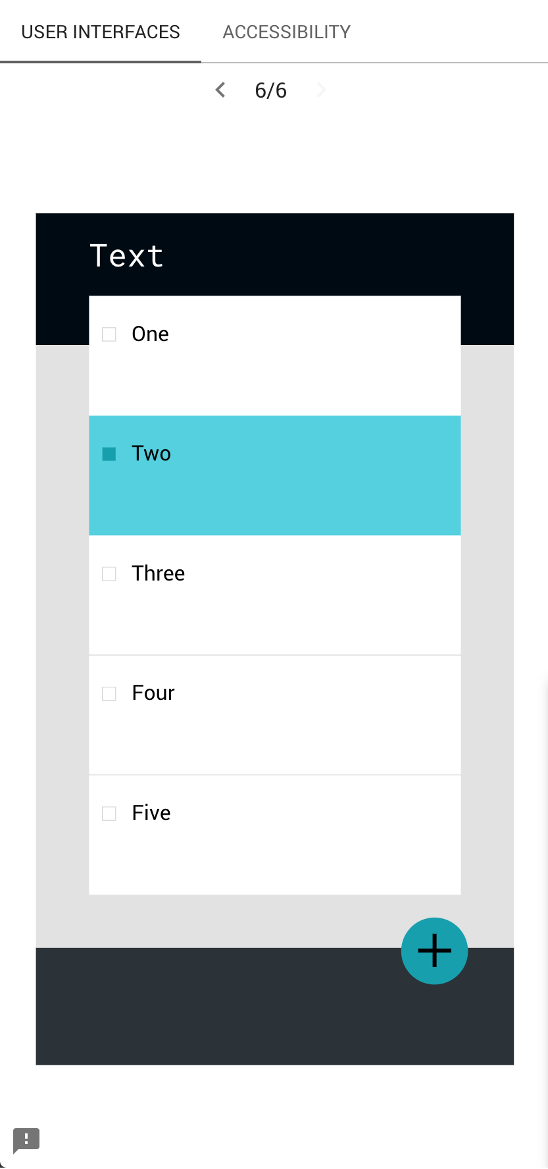
Design Decision: Color Palette

Slide 7
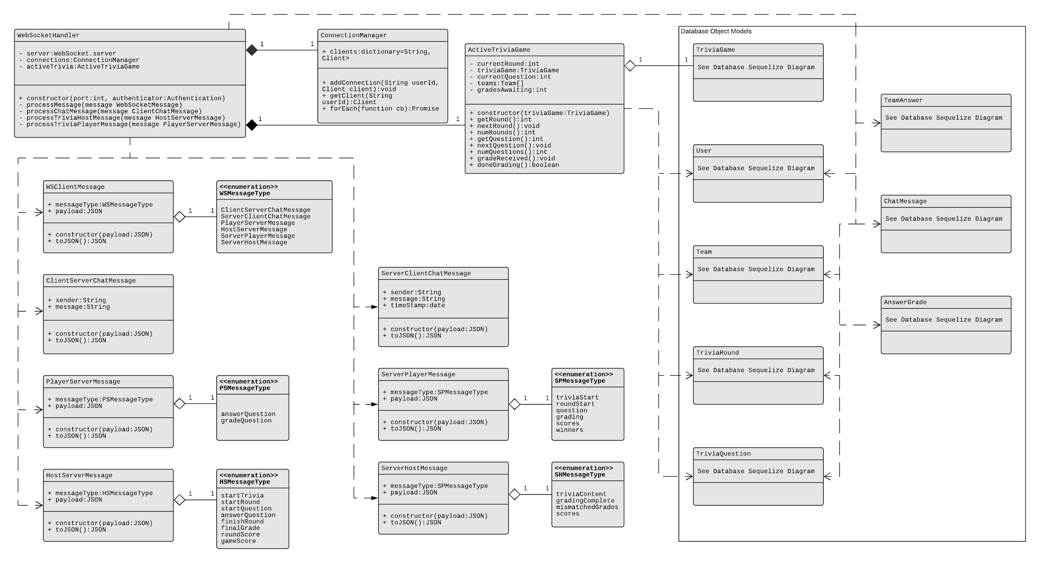
Websocket server (planned)

Slide 8
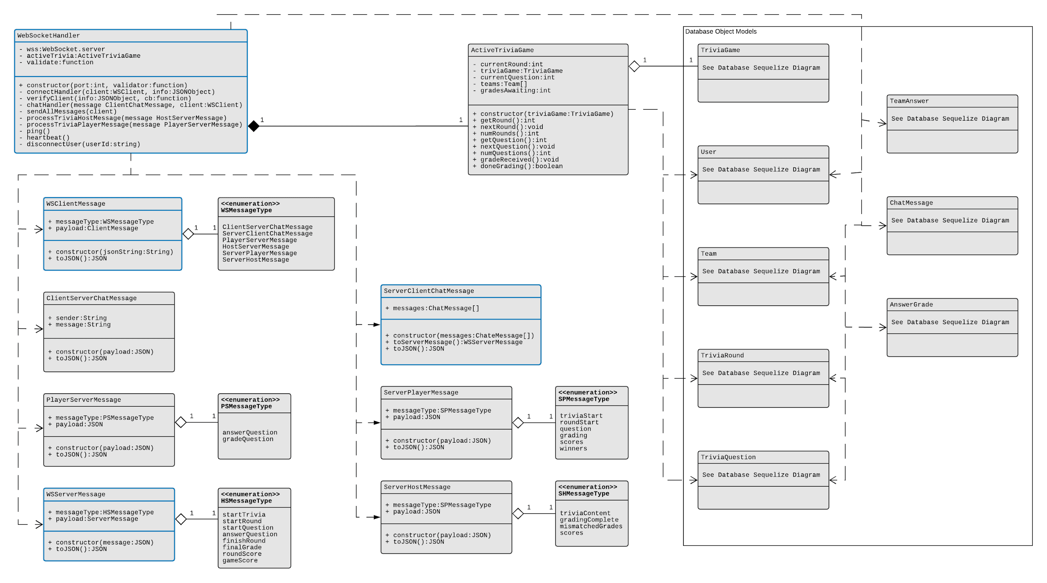
Websocket server (current)

Slide 9
Testing

Slide 10
Node.js Unit Testing
Mocha: Javascript testing framework. Define preconditions and postconditions.
Chai: Javascript assertion library. Adds additional and more powerful asserts.
NYC: code coverage tool. Gives output report of code test coverage.
Sinon: Stub and mock framework. Allows mocking and stubbing of functionality to isolate the code under test.
wsmock: Websocket specific mocking tools

Slide 11
Node.js Integration Testing
Bash script to execute tasks for testing
Start docker db container
Load sample data with sequelize seeder
Execute tests (utilize mocha and chai)
Supertest for testing rest api
Clean up environment

Slide 12
Demo

