Slide 1
PubHub
“Serious trivia for serious pubs”
Developers:
Blair Gentry, Geoffrey Blech, Linh Tran, Travis Cox
Notes:
Geoff

Slide 2
The Great Shakeup 2018
Flutter
Java
Dynamo (NoSQL)
RDS (MySQL)

Slide 3
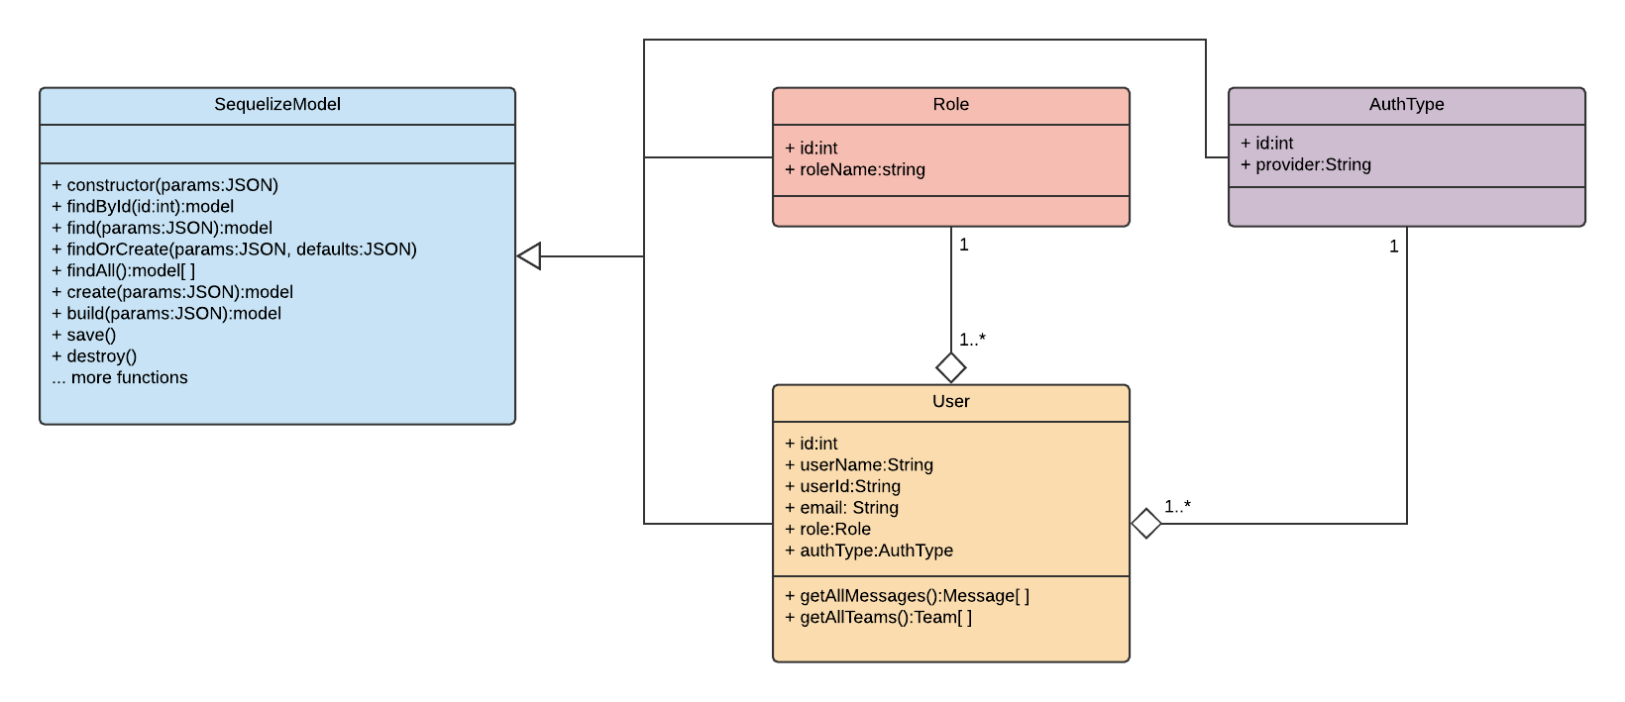
Why Sequelize?

Slide 4
PubHub System Design
Split between frontend and backend

Slide 5
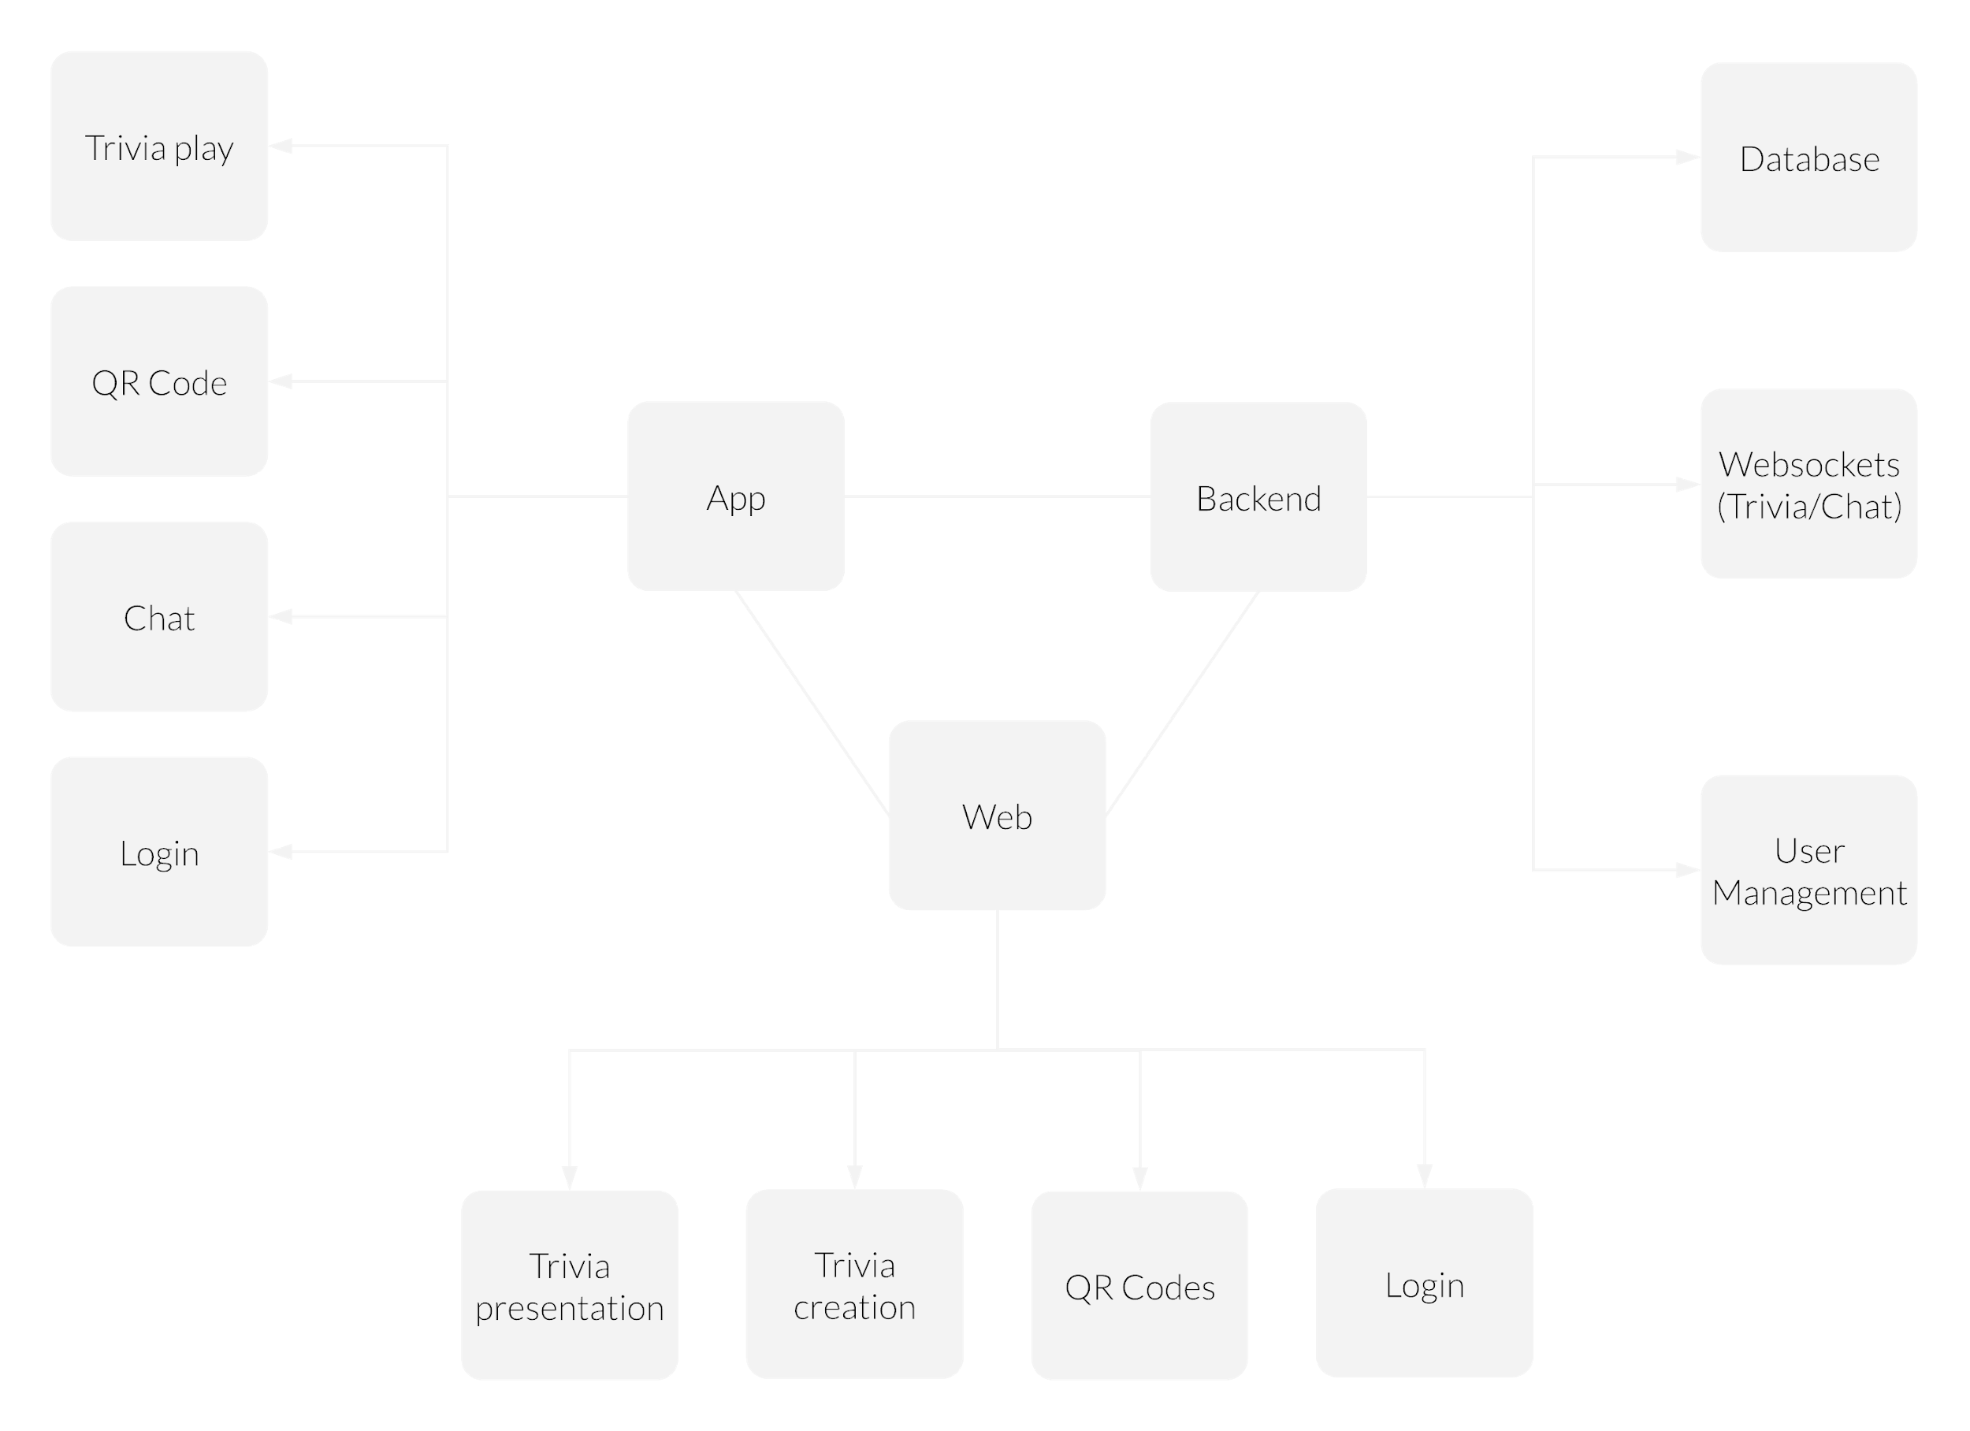
PubHub Overview - Model 1
Notes:
Geoff

Slide 6
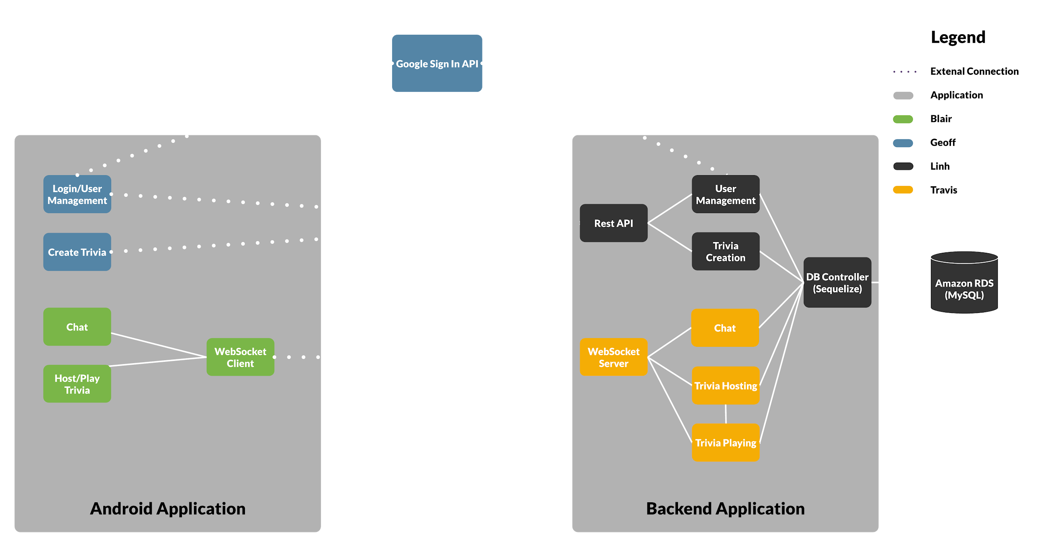
PubHub Overview - Model 2

Slide 7
PubHub Subsystems Overview
Subsystem 1 [G Frontend] Login, User Management, Trivia Creation
Subsystem 2 [L Backend ] User Management, Trivia Creation, DB
Subsystem 3 [B Frontend] Chat, Host Trivia, Play Trivia, Websocket Client
Subsystem 4 [T Backend ] Websocket Server, Chat, Host Trivia, Play Trivia

Slide 8
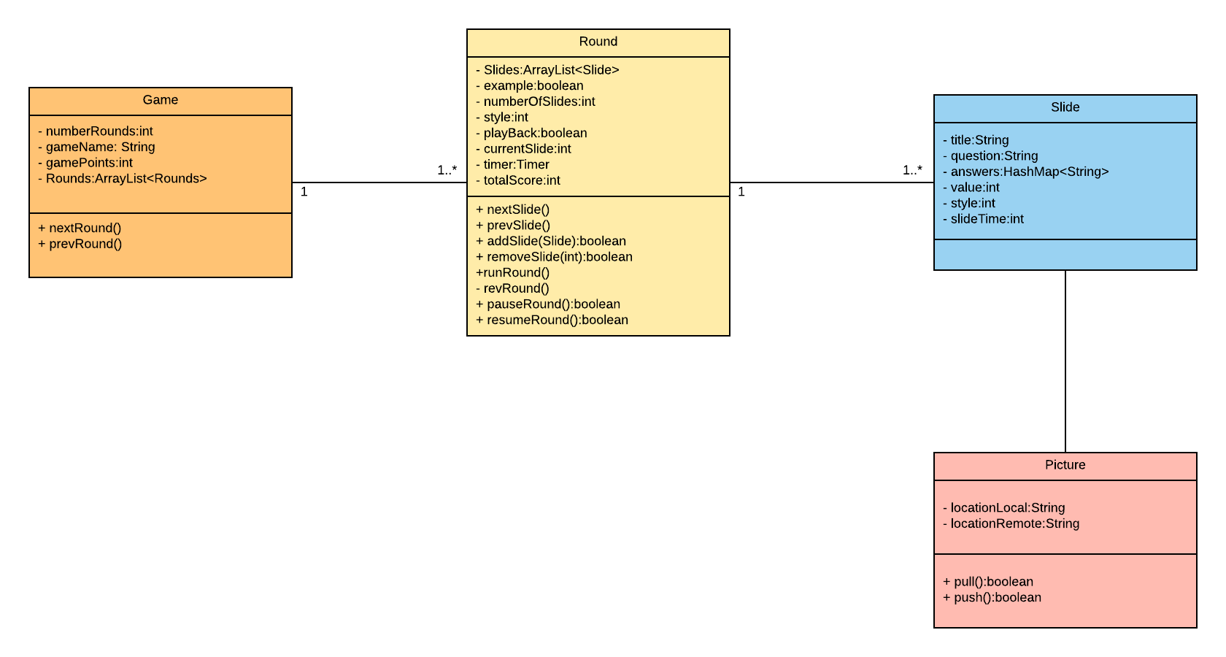
Subsystem 1: Trivia Creation

Slide 9
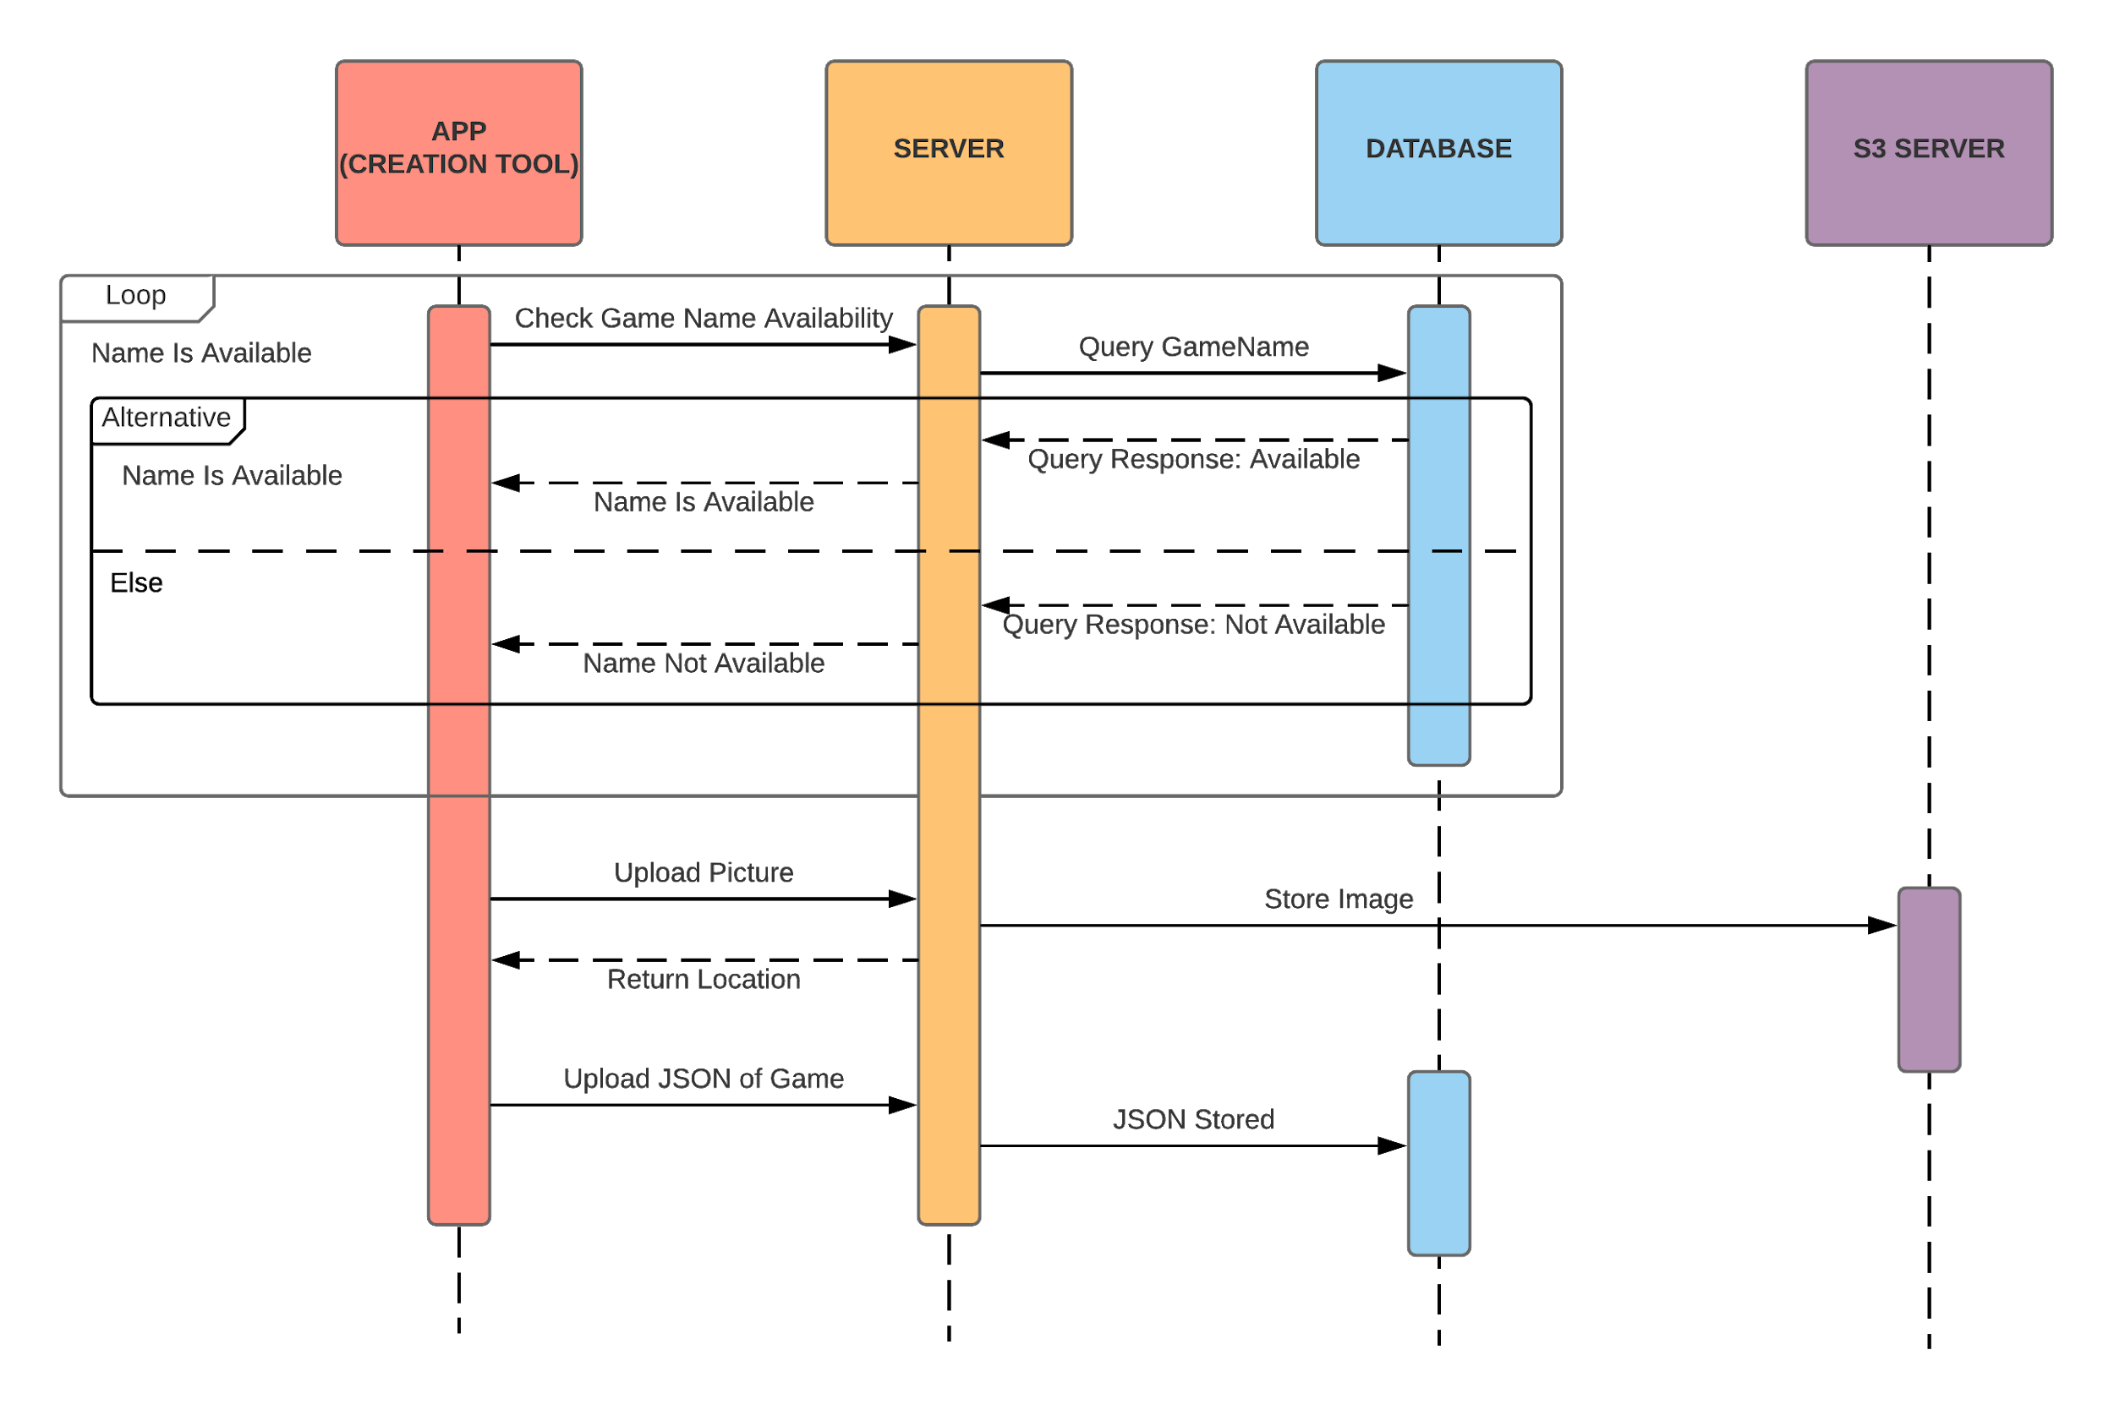
Subsystem 1: Trivia Creation
Notes:
Subsystem 2: Querrrrrrrrrrrrrry

Slide 10
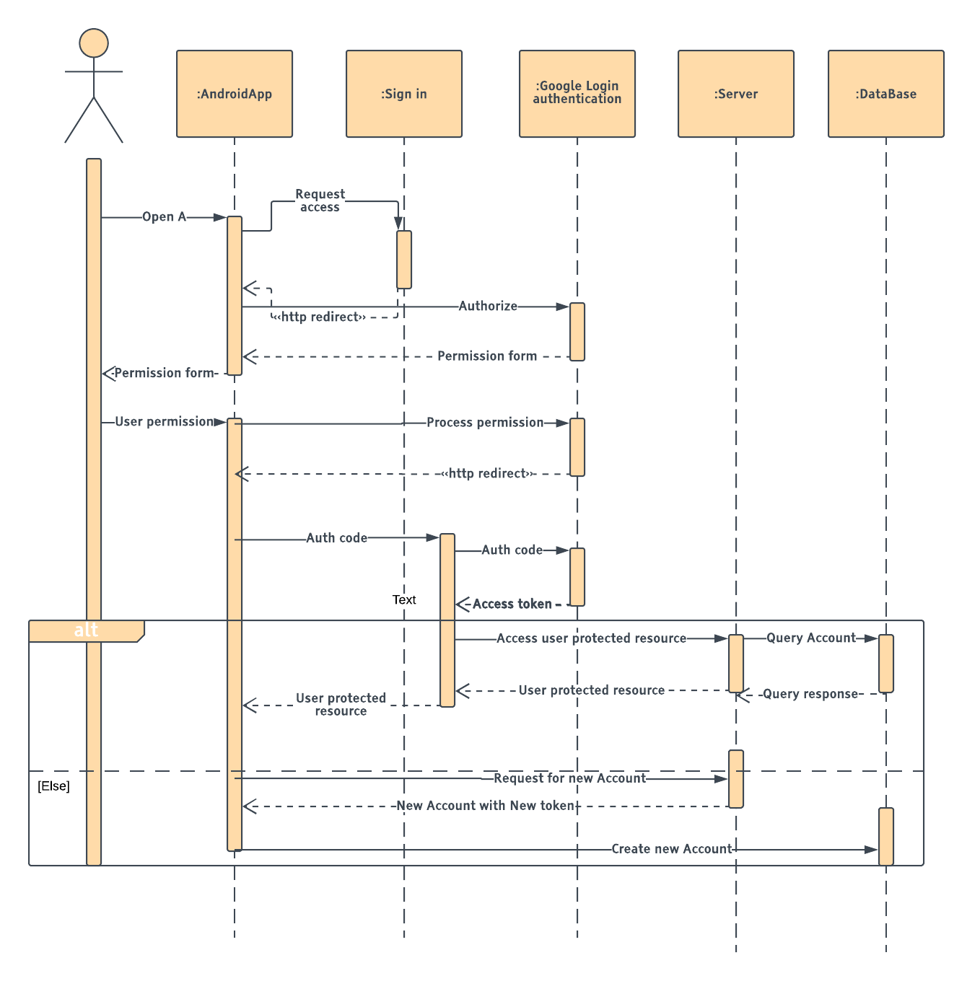
Subsystem 2: User Management

Slide 11
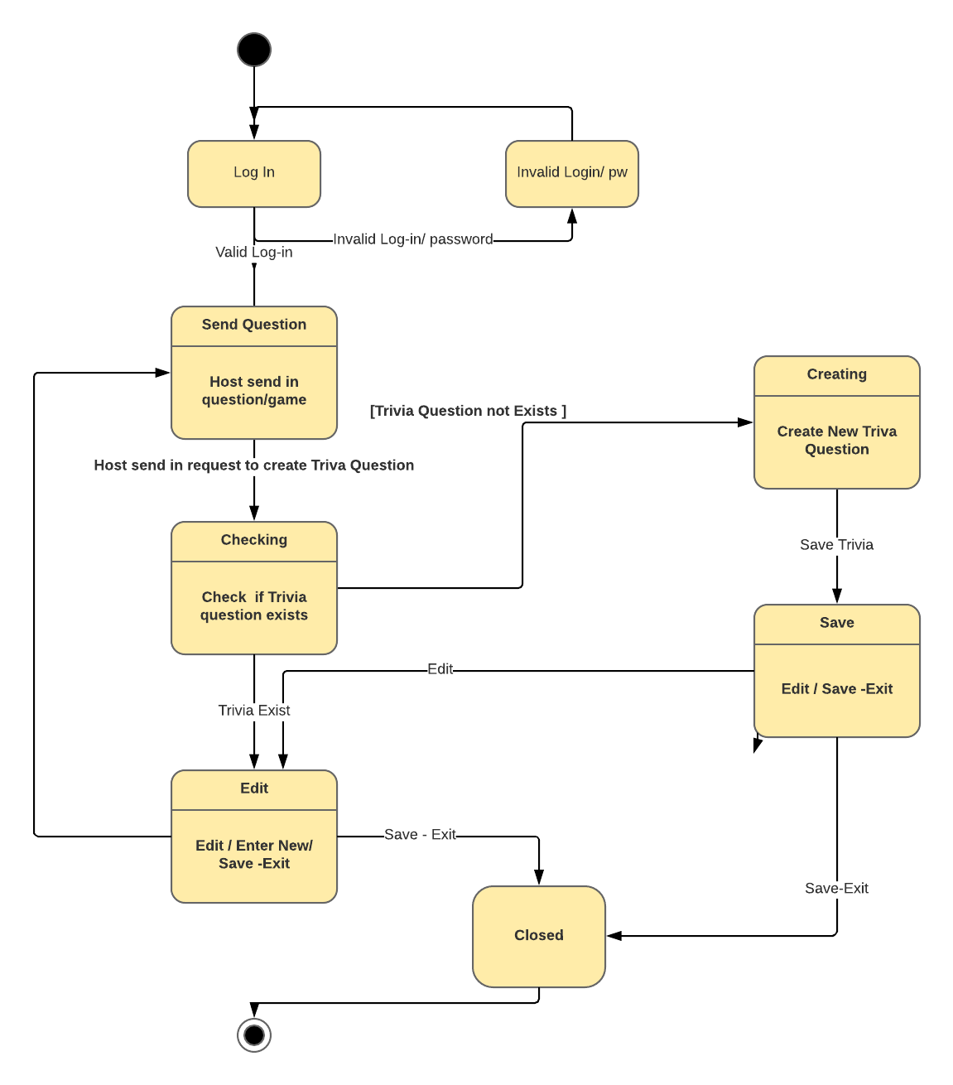
Subsystem 2: Trivia Creation

Slide 12
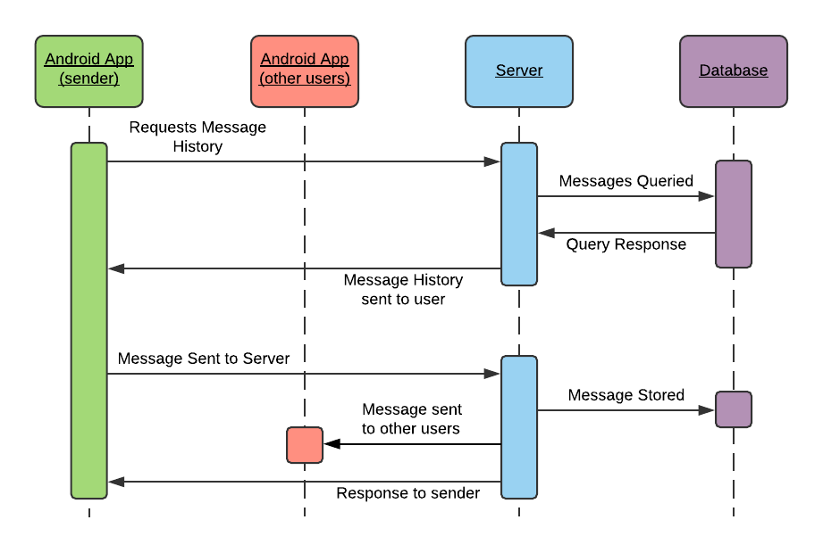
Subsystem 3: Chat Sequence
Notes:
Interaction with websockets between chat FE and BE
Server: Node.js application
DB: Relational DB/MySQL

Slide 13
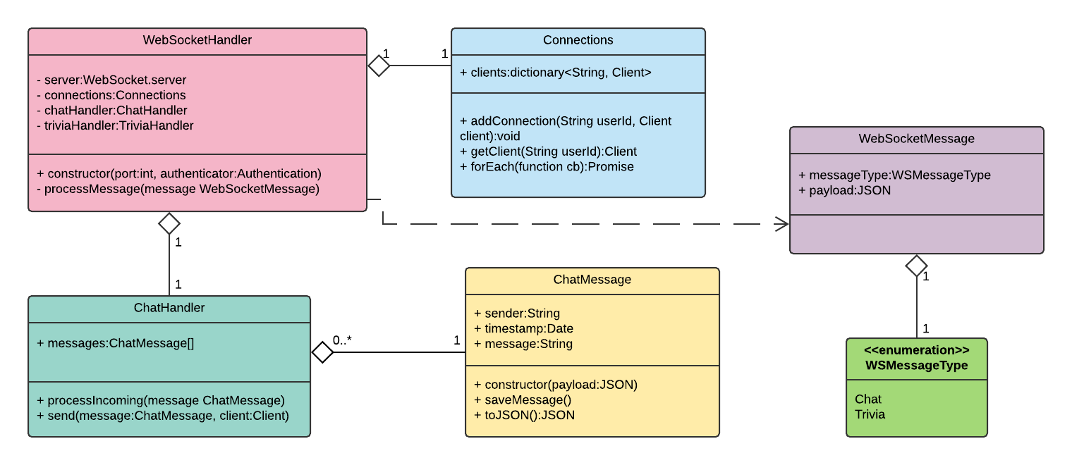
Subsystem 4: Websockets (Chat UML)

Slide 14
Q & A
Questions?
Constructive Commentary?

