Slide 1

Vivere
a personal health assistant for everyone

Slide 2
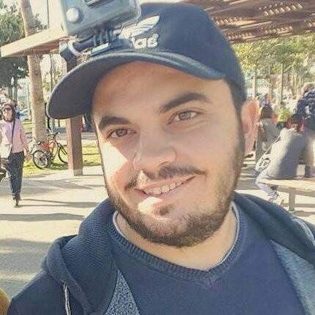

Vivere™
Giorgos Demosthenous Co-Founder
Kyriakos Kyriakou Co-Founder

Slide 3
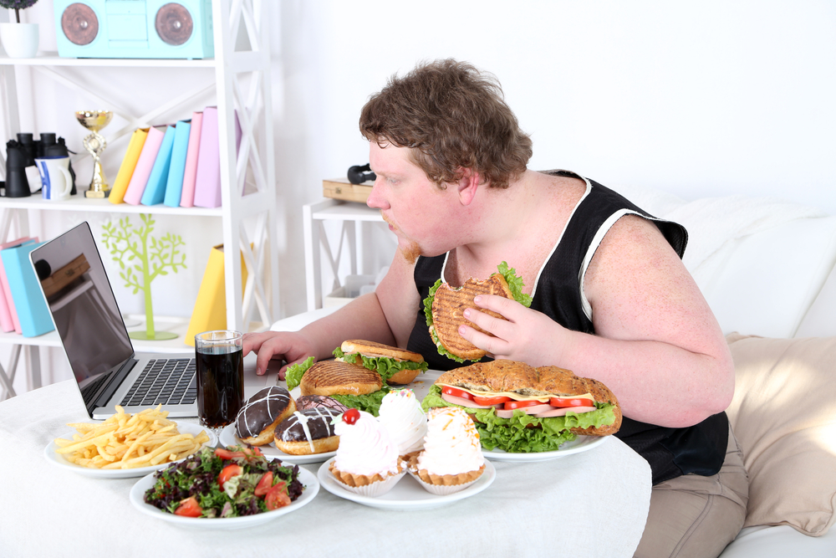

Slide 4


Slide 5
The modern lifestyle
You
Unhealthy eating
Bad Habits
Negligence
Lack of sleep
Health Problems

Slide 6
BAD HABITS + LACK OF TIME = BAD HEALTH
Can you solve this?
Vivere can!
BAD HABITS
+
LACK OF TIME
=
BAD HEALTH

Slide 7
Vivere is your personal health assistant. It knows what your health needs. With Vivere you can manage your visits to the doctor, keep track of your medication and improve your lifestyle.
It motivates you to do rather than don’t!

Slide 8





An ecosystem full of great features

Slide 10
Manage Appointments
Find available date and time to make an appointment to a doctor or a chemist
Keep record of your appointments

Slide 12
Doctor’s Advice
Display of patient’s appointment history.
Contains past doctor’s advice for each visit.

Slide 14
Medication
Remind the user to take his medication using classic and original methods.
Both user and doctor can change the medication within their permission range.

Slide 16
Exams
Periodical reminders regarding medical examinations.
Depending on the age and health situation of the user, Vivere knows how and when to inform him accordingly.

Slide 18
Combating Negligence
Stay notified for everything with user-friendly notifications that pop-up during the day.
Do you have a predisposition to something?
Vivere will notify you right on time to take an examination or arrange an appointment with a doctor to find it out!

Slide 19
Did you know that it only takes 66 days on average to break or gain a bad or good habit?

Slide 20
Behavioral Psychologists claim that rewarding people, subconsciously pushes them towards repeating the task that has originally rewarded them.

Slide 21


Slide 22

Habits
We took advantage of the 66 day rule and made something new.
With the habit feature you can choose to break a bad habit or gain a good one.
It keeps you alert and motivated.

Slide 23
Not convinced yet?
Vivere knows what experts should advice you, right on time.
It will motivate you with the most right and creative way to stay on the track of your health.
It’s the responsible assistant to get you up-to-date, while you have many other things to do and remember during the day.

Slide 24

Neglecting your health is the equivalent to spitting in the face for everyone fighting to stay alive and of those who have lost their fight.
-Ingrid Weir-

Slide 25


Thank you

