Slide 1
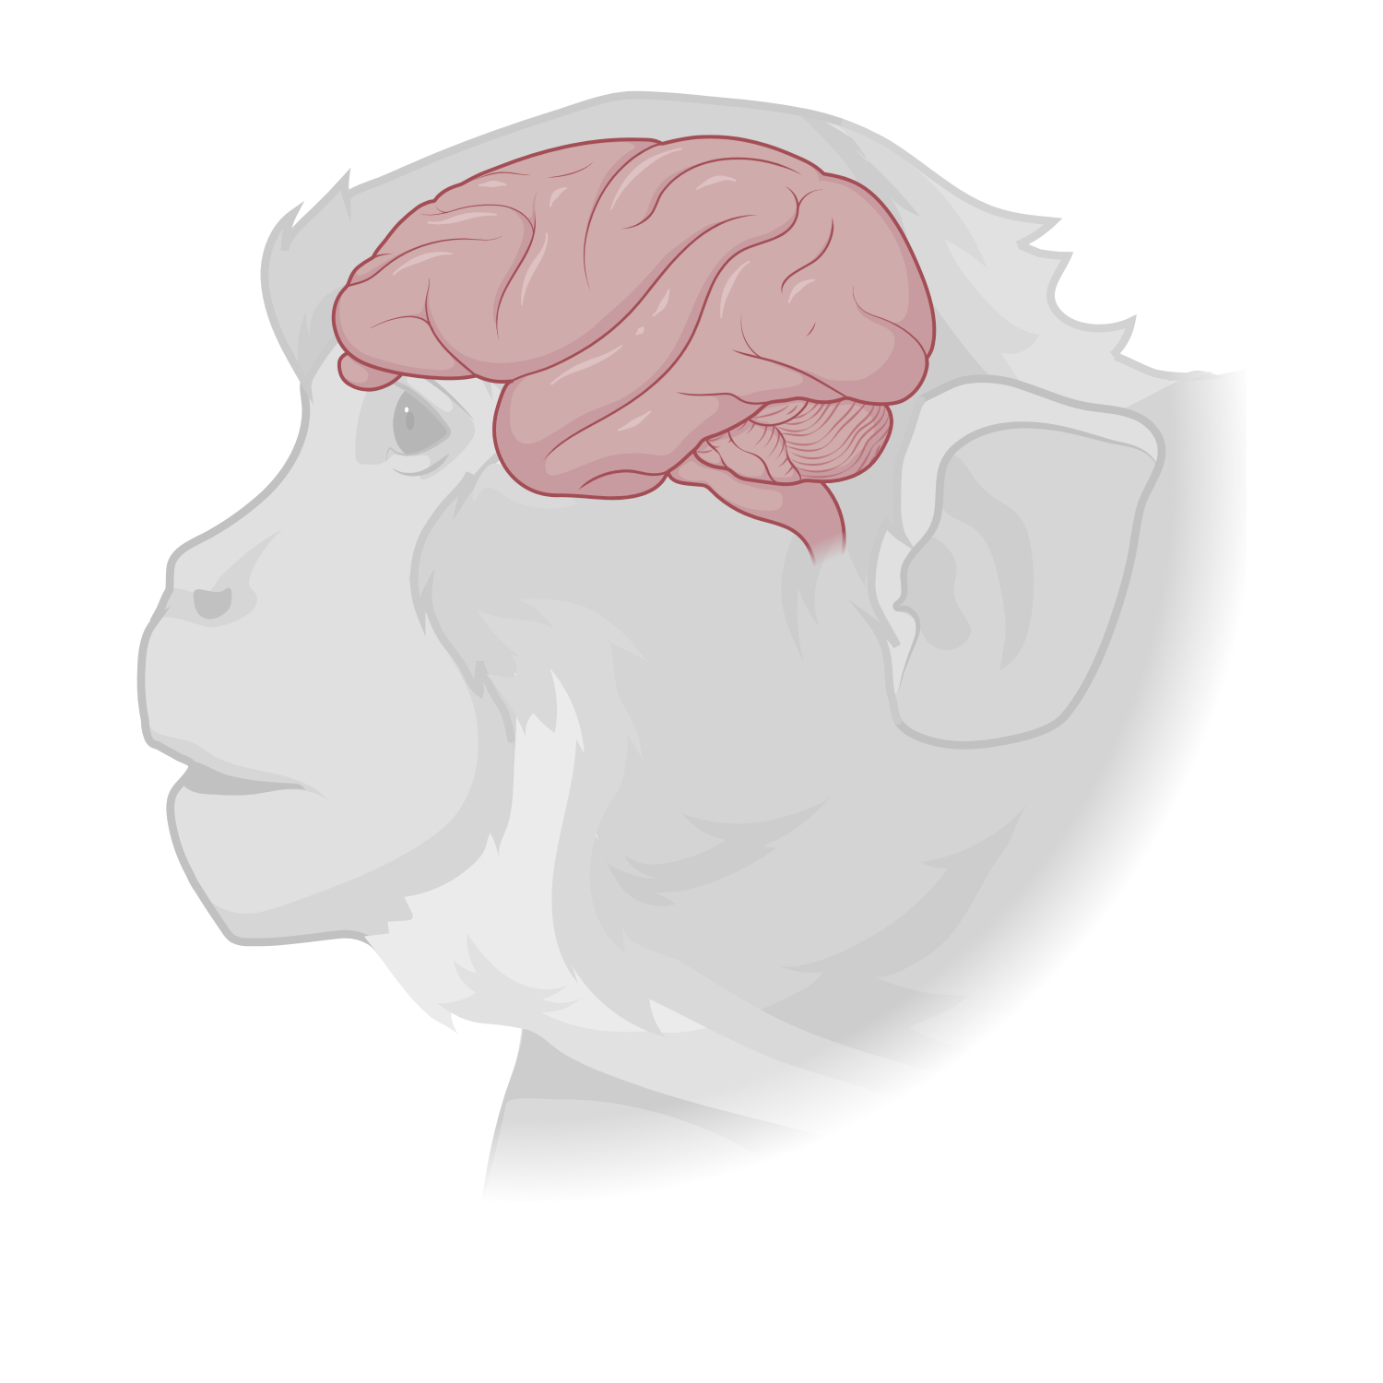
















$$s_{2}$$
high
shattering-dimensionality (SD)
Detail-based
behavioral adjustments
$$s_{7}$$
$$s_{1}$$
$$s_{4}$$
dorsolateral prefrontal cortex
$$s_{5}$$
$$s_{6}$$
neruon 3
neruon 2
$$s_{3}$$
$$s_{8}$$
hippocampus
neruon 1
$$s_{2}$$
$$s_{7}$$
high
cross-condition generalization performance (CCGP)
$$s_{1}$$
$$s_{5}$$
Generalization
in novel conditions
$$s_{4}$$
$$s_{6}$$
neruon 3
$$s_{3}$$
$$s_{8}$$
neruon 2
neruon 1

Slide 2
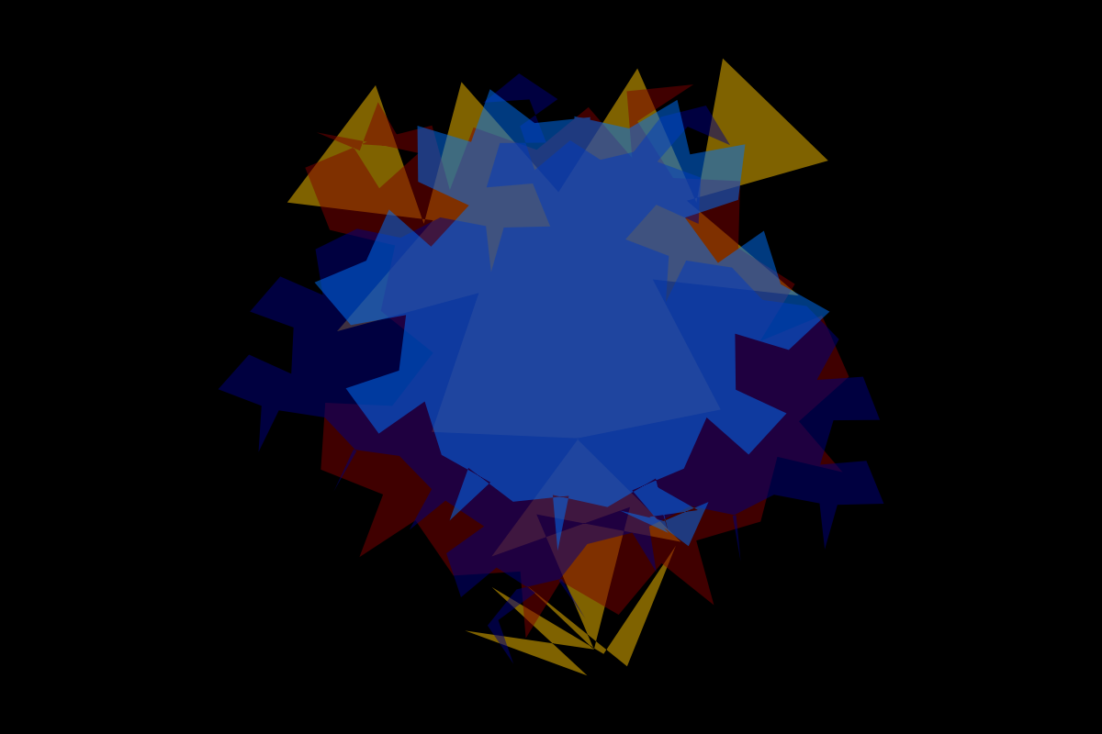

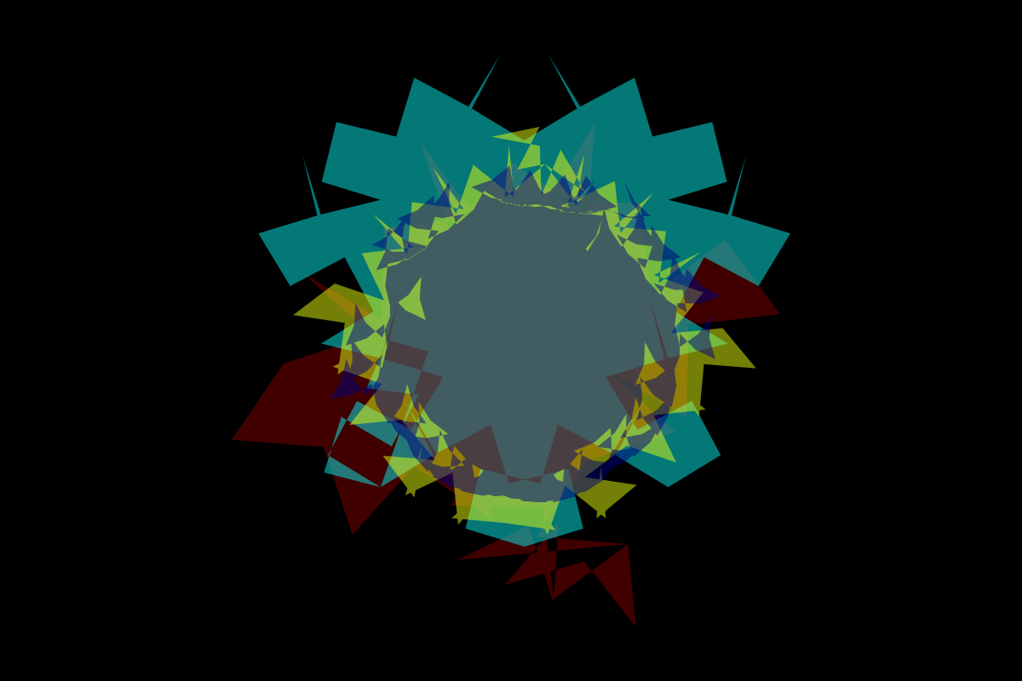
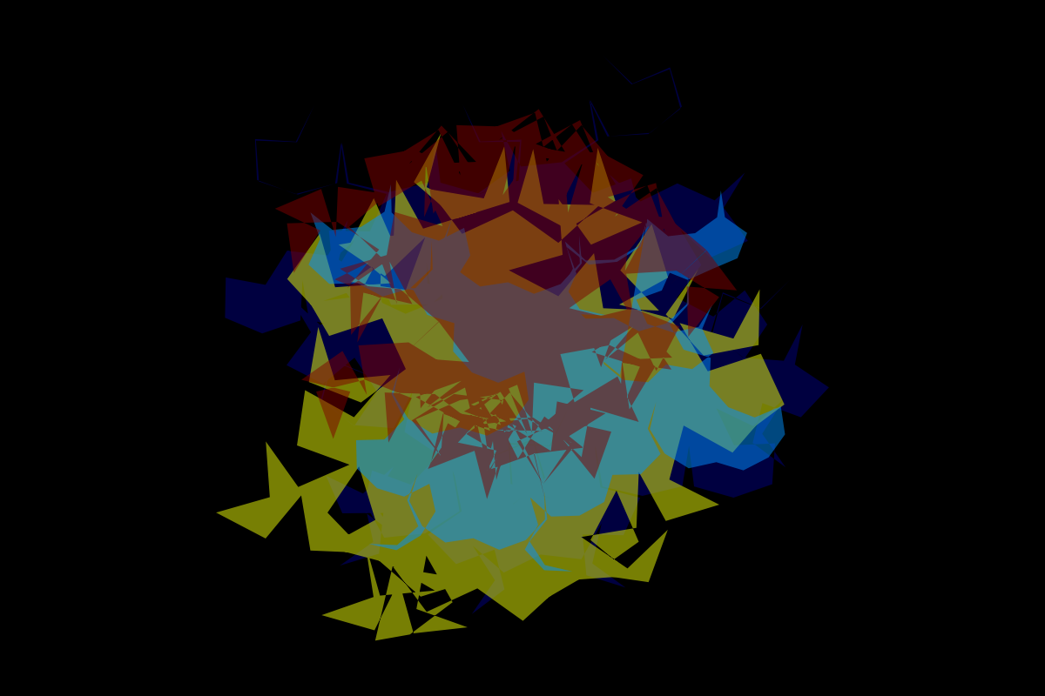
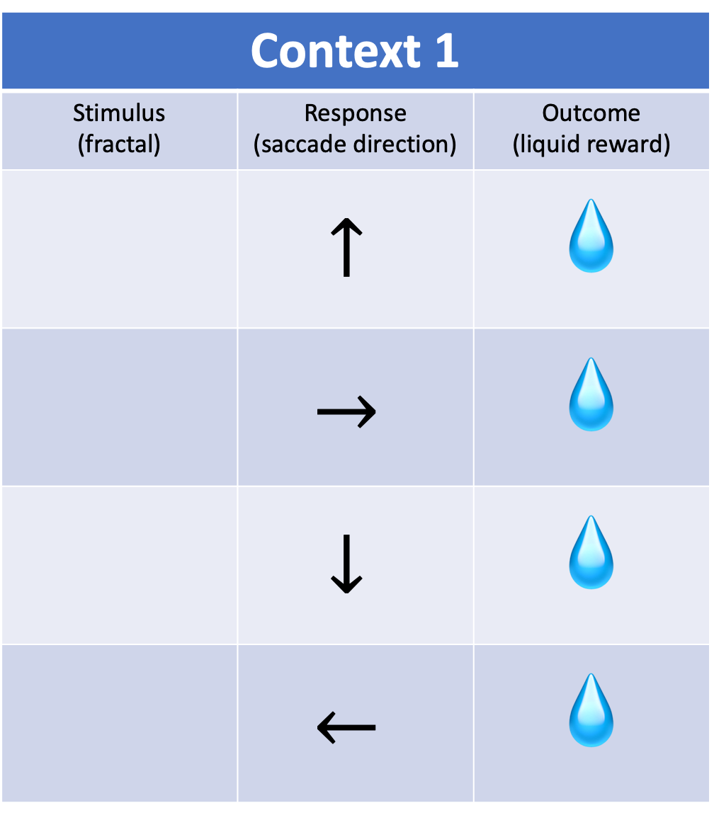
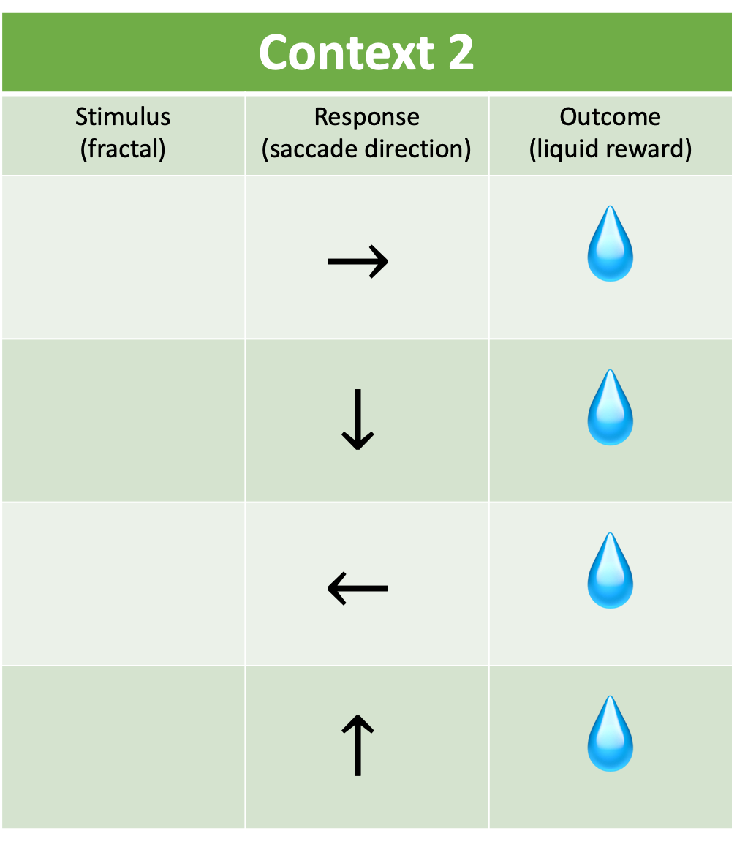
Context 1
Stimulus (fractal) | Response (saccade direction) | Outcome (liquid reward)
 | $$↑$$ | 💧
 | $$→$$ | 💧
 | $$↓$$ | 💧
 | $$←$$ | 💧
Context 2
Stimulus (fractal) | Response (saccade direction) | Outcome (liquid reward)
 | $$→$$ | 💧
 | $$↓$$ | 💧
 | $$←$$ | 💧
 | $$↑$$ | 💧
A
A
B
B
C
C
D
D

Slide 3

ctx 1
fixation (500 ms)
A
stimulus (300 ms)
delay (1000 ms)
analysis of SD and CCGP
switch
context/ none/ switch cue (300 ms)
delay, targets on (1000 ms)
fixation off, choice

Slide 4
context 1
+ context cue
(8 trials)
context 1
w/o context cue
(40-60 trials)
context 1
+ switch cue
(1 trial)
context 2
+ context cue
(8 trials)
context 2
w/o context cue
(40-60 trials)
context 2
+ switch cue
(1 trial)
context 1
+ context cue
(8 trials)
p = 0.5
p = 0.5

Slide 5
new context cues introduced
new context cues introduced
Ctx 1 (A,B,C,D)
Ctx 2 (A,B,C,D)
Ctx 1 (A,B,C,D)
Ctx 2 (A,B,C)
Ctx 1 (A,B,C)
Ctx 2 (A,B,C)
Ctx 2 (D)
Ctx 1 (B,C,D)
Ctx 2 (B,C,D)
…
…
…
analysis of CCGP

Slide 6
























a
b
c
d
$$s_{2}$$
$$s_{2}$$
$$s_{2}$$
$$s_{2}$$
$$s_{1}$$
$$s_{4}$$
$$s_{1}$$
$$s_{4}$$
$$s_{1}$$
$$s_{4}$$
$$s_{1}$$
$$s_{4}$$
decoding boundary
neruon 2
$$s_{3}$$
neruon 2
$$s_{3}$$
neruon 2
$$s_{3}$$
neruon 2
$$s_{3}$$
neruon 1
neruon 1
neruon 1
neruon 1
e
f
g
$$s_{2}$$
$$s_{2}$$
$$s_{2}$$
$$s_{1}$$
$$s_{4}$$
$$s_{1}$$
$$s_{4}$$
$$s_{1}$$
$$s_{4}$$
neruon 2
$$s_{3}$$
neruon 2
$$s_{3}$$
neruon 2
$$s_{3}$$
neruon 1
neruon 1
neruon 1

Slide 7


















a
$$s_{2}$$
$$s_{2}$$
$$s_{2}$$
$$s_{2}$$
test
train
train
test
$$s_{1}$$
$$s_{4}$$
$$s_{1}$$
$$s_{4}$$
$$s_{1}$$
$$s_{4}$$
$$s_{1}$$
$$s_{4}$$
test
test
train
train
neruon 2
$$s_{3}$$
CCGP: 1
neruon 2
$$s_{3}$$
CCGP: 1
neruon 2
$$s_{3}$$
CCGP: 0.5
neruon 2
$$s_{3}$$
CCGP: 0.5
neruon 1
neruon 1
neruon 1
neruon 1
b
$$s_{2}$$
$$s_{2}$$
$$s_{2}$$
train
$$s_{2}$$
train
test
test
$$s_{1}$$
$$s_{4}$$
$$s_{1}$$
$$s_{4}$$
$$s_{1}$$
$$s_{4}$$
$$s_{1}$$
$$s_{4}$$
train
test
train
test
neruon 2
$$s_{3}$$
neruon 2
$$s_{3}$$
neruon 2
$$s_{3}$$
CCGP: 0
neruon 2
$$s_{3}$$
CCGP: 0
CCGP: 0
CCGP: 0
neruon 1
neruon 1
neruon 1
neruon 1

Slide 8























a
$$s_{1}$$
$$s_{2}$$
$$s_{1}$$
$$s_{2}$$
$$s_{1}$$
$$s_{2}$$
$$s_{1}$$
$$s_{2}$$
decoding boundary
train
test
train
train
test
test
train
test
$$s_{3}$$
$$s_{4}$$
$$s_{3}$$
$$s_{4}$$
$$s_{3}$$
$$s_{4}$$
$$s_{3}$$
$$s_{4}$$
neruon 2
CCGP: 1
neruon 2
CCGP: 1
neruon 2
CCGP: 0.5
neruon 2
CCGP: 0.5
neruon 1
neruon 1
neruon 1
neruon 1
b
train
test
$$s_{1}$$
$$s_{2}$$
$$s_{1}$$
$$s_{2}$$
$$s_{1}$$
$$s_{2}$$
$$s_{1}$$
$$s_{2}$$
train
test
test
train
$$s_{3}$$
$$s_{4}$$
$$s_{3}$$
$$s_{4}$$
$$s_{3}$$
$$s_{4}$$
$$s_{3}$$
$$s_{4}$$
test
neruon 2
train
neruon 2
CCGP: 0
neruon 2
CCGP: 0
neruon 2
CCGP: 0
CCGP: 0
neruon 1
neruon 1
neruon 1
neruon 1

