Slide 1
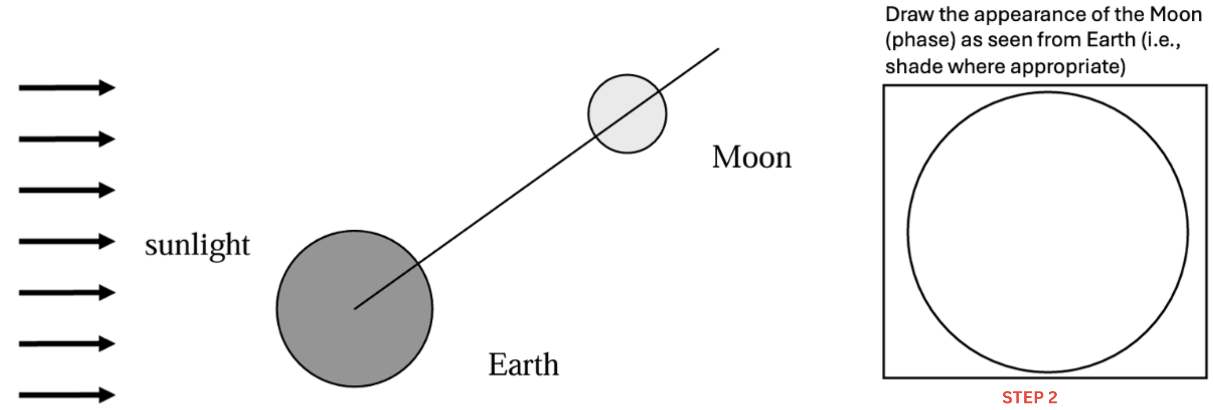
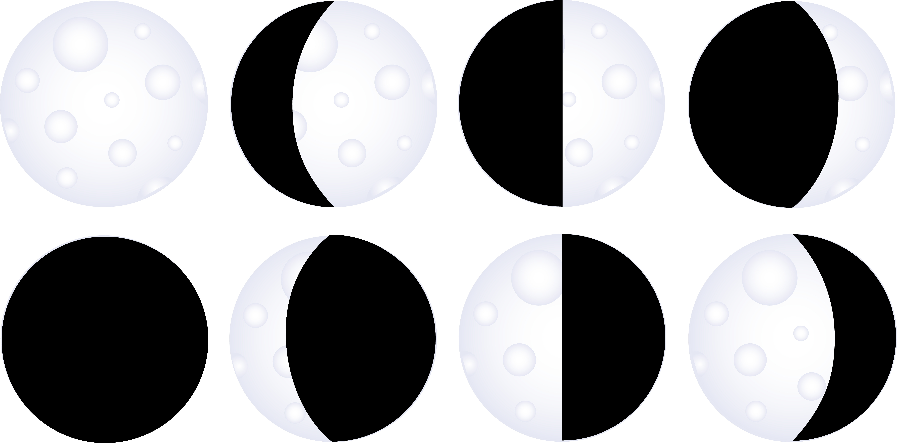
STEP 1
Use these lines as bisectors for the Moon
and Earth, just as in the simulation.
Drag and rotate them to their correct
positions in the drawing below.
This will be the appearance of the Moon (phase) as seen from Earth, corresponding to the drawing on the left.
STEP 2
Choose the phase from the options below.
Drag one of the images to the location above and enlarge it to cover the circle above.

