Slide 1
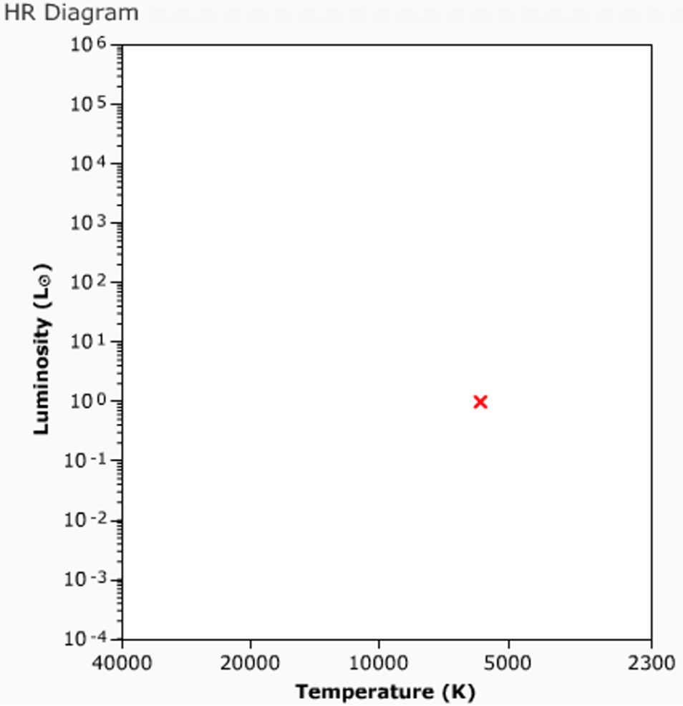



A
B
E
C
F
D
G
H
$${1 R}_{⨀}$$
$${10 R}_{⨀}$$
$${100 R}_{⨀}$$

