Slide 1
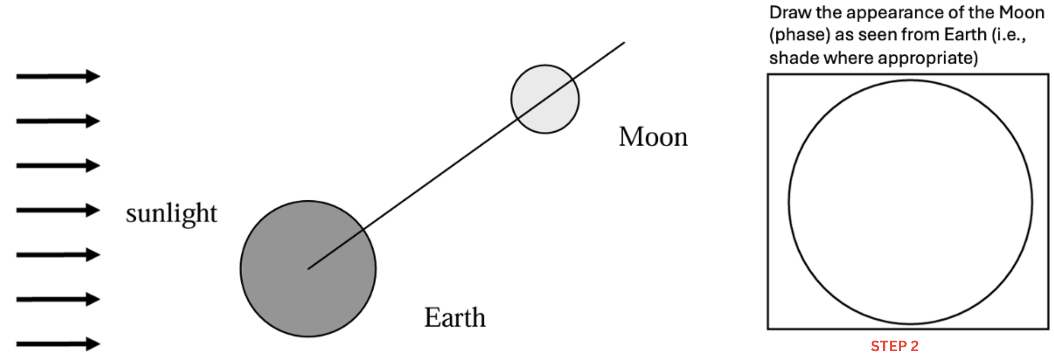
STEP 1
Use these lines as bisectors for the Moon
and Earth, just as in the simulation.
Drag and rotate them to their correct
positions in the drawing below.
STEP 2
To draw the appearance of the Moon, click on “Draw” at the top menu,
click on ”Add Pen” and choose a highlighter, for example,
and then choose a color (black, for example),
to shade the non-illuminated part of the Moon.
Draw as best as you can using the computer’s mouse pad
(we know there are limitation, do your best).
You can always select the eraser to start again if needed.

