Slide 1
In scope Items
Utilize Traiana 5.6 messages.
Limit Kill Switch. -(Targeted for May)
Implement Traiana warning Messages for all limits. -(Targeted for May)
New Carve Out Message(Targeted for May)
Managed the combined Limits and Utilization between CCM and CLM.
Modified existing Limit Structure within CCM to match Traiana.*
Upload Spreadsheet template directly. (Targeted for May)
Create a download template in Excel at any limit level. (Targeted for May)
New Search Functionality (Targeted for May)
Management screen to be automatically update every 5 minutes.
New entitlement implement to restrict by individual components on a page. (Targeted for May)

Slide 2
API GUI Interface
In order to enable PS and Credit Risk to effectively manage limits which are set across multiple clients, SEFs and CCPs a simple, intuitive GUI is required which will update and search credit limits and utilisation stored not only within Traiana but also within the UBS credit check module
(CCM) This GUI will be required to communicate with Traiana via the existing API connection delivered as part of the February IT release.
In order for an effective GUI to be built, the limit taxonomies across both Traiana and CCM need to be standardised. This will require the existing limit structure with CCM to be modified to match the structure used by Traiana.
It should be possible to search by RXM, Group RXM, Fund Manager and Client and pull back the limits stored.
The results should bring back current limits and utilisation. If a limit is 80%+ or 95%+ utilised, amber and red alerts respectively should be generated.
Examples of requirements are shown below. The first screen shot showing the group RXM level, the second showing the Fund level:
It should be possible to click on the fund names in the first screen to move through to the second screen.
Users will need to be able to edit limits directly in the above screens or via the existing Traiana spreadsheet updload functionality.
It should be possible to download any existing limits in the upload spreadsheet format for ease of editting, as well as to directly download a blank spreadsheet template.
It should not be necessary to cut and paste the limit structure into a box to upload, rather the upload should be straight from the spreadsheet itself.
Uploaded spreadsheets should automatically overwrite existing limits
Any blank values uploaded should be assumed to represent a ‘zero’ value.
When limits are added deleted or changed, a pop-up message should be received either confirming success or failure (with a reason) within the GUI (no email notification is necessary)
Access to the GUI should be configurable by user groups, who will have read/write/delete/kill access. The full scope of this access will be defined during the operational readiness sign offs
A limit kill switch should be included within the API GUI Interface. Again it should enable PS and Credit Risk to effectively manage limits in the even of credit worries across all CCPs, limit platforms and SEFs.
It should be possible to kill limits by RXM, Group RXM, Fund Manager, Client or SEF (May only for SEF's)
As shown in the examples above the kill switch should be accessed directly from the limit search pages. The kill switch should be a simple click button.
Upon clicking the kill switch, an “are you sure?” pop-up message should be displayed.
When limits are killed, a pop-up message should be received either confirming success or failure (with a reason) within the GUI (no email notification is necessary)
When limits are killed, they should be cached or similarly stored, with the ability to easily restore limits via a push button.

Slide 4
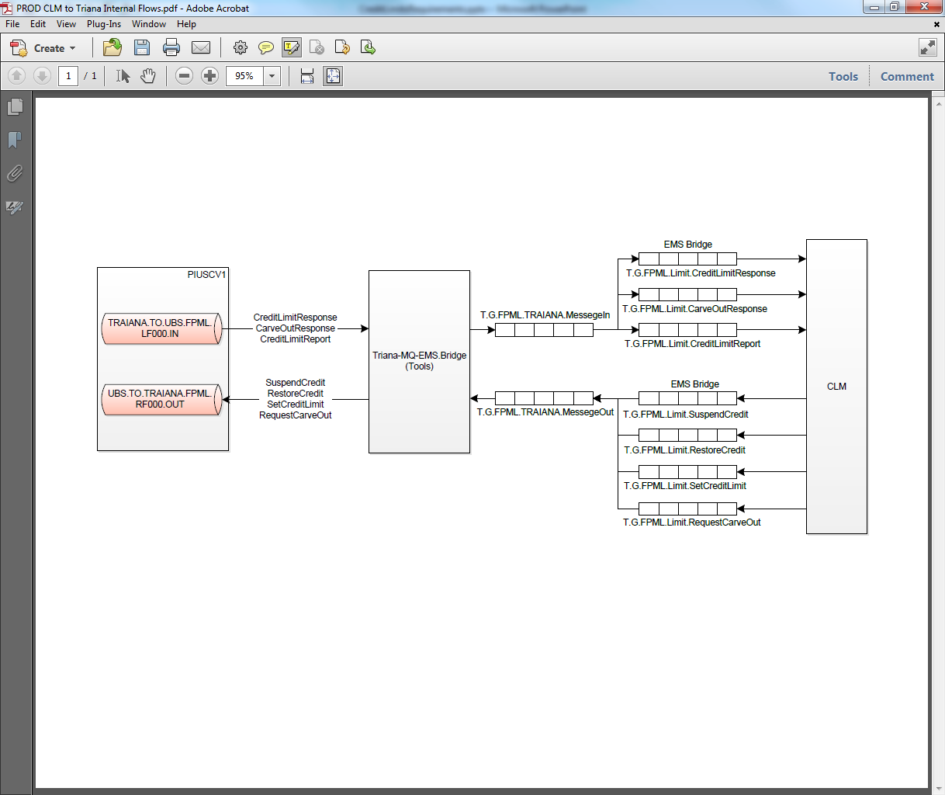

Slide 5
Manager & Search Tab
Manager & Client Tab
Fund(RXM Detail)
History of Recent Mgs
Manager/RXM Group Search
Fund Name Search
RMX Number Search
Live Filters with the user selecting RXM number or group.
Upload Limits XLS
Download Limits XLS
Selection should be selected content , all, or blank.
Comment Area is actually generated . Need formula

Slide 6

Manager & Search Tab
Manager & Client Tab
Fund(RXM) Detail
History of Recent Mgs
Download Template
Kill
Kill
Kill
Kill
Kill
Kill
Kill
Kill
Kill
Kill
Kill
Kill
Kill
Kill
Kill
Kill
Kill
Kill
Kill
Kill

Slide 7
Manager & Search Tab
Manager & Client Tab
Fund(RXM Detail)
History of Recent Mgs
IRS
CDS
FX
Download Template
Download Limits XLS
Edit
Kill
Submit
Kill
Kill
Edit
Kill
Edit
Kill
FR2- Sit and wait and display POP-Up. When response is sent.
Re-Address FR1.1-F1.6 . Nee to identify workflow.
Missing FR1.7 Defining a Traiana Threshold
Warning Limit..
Edit
Kill
Edit
Kill
Edit
Kill
Edit
Kill
Edit
Kill
Edit
Kill
Submit Changes

Slide 8
Manager & Search Tab
Manager & Client Tab
Fund(RXM Detail)
History of Recent Mgs
IRS
CDS
FX
Download Limits XLS
CDS LIMITS Yet to be defined.

Slide 9
Upon clicking the kill switch, an “are you sure?” pop-up message should be displayed.
Manager & Search Tab
Manager & Client Tab
Fund(RXM Detail)
History of Recent Mgs

Slide 10
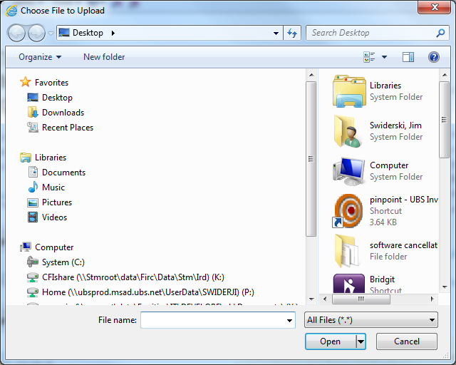
Manager & Search Tab
Manager & Client Tab
Fund(RXM Detail)
History of Recent Mgs

Slide 11
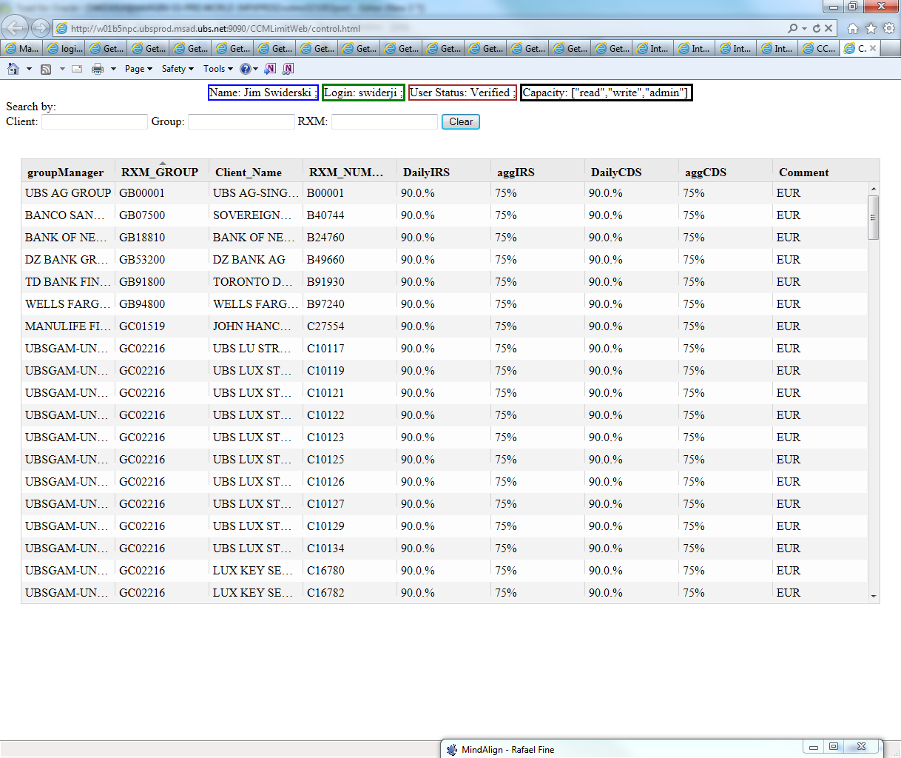

Slide 12
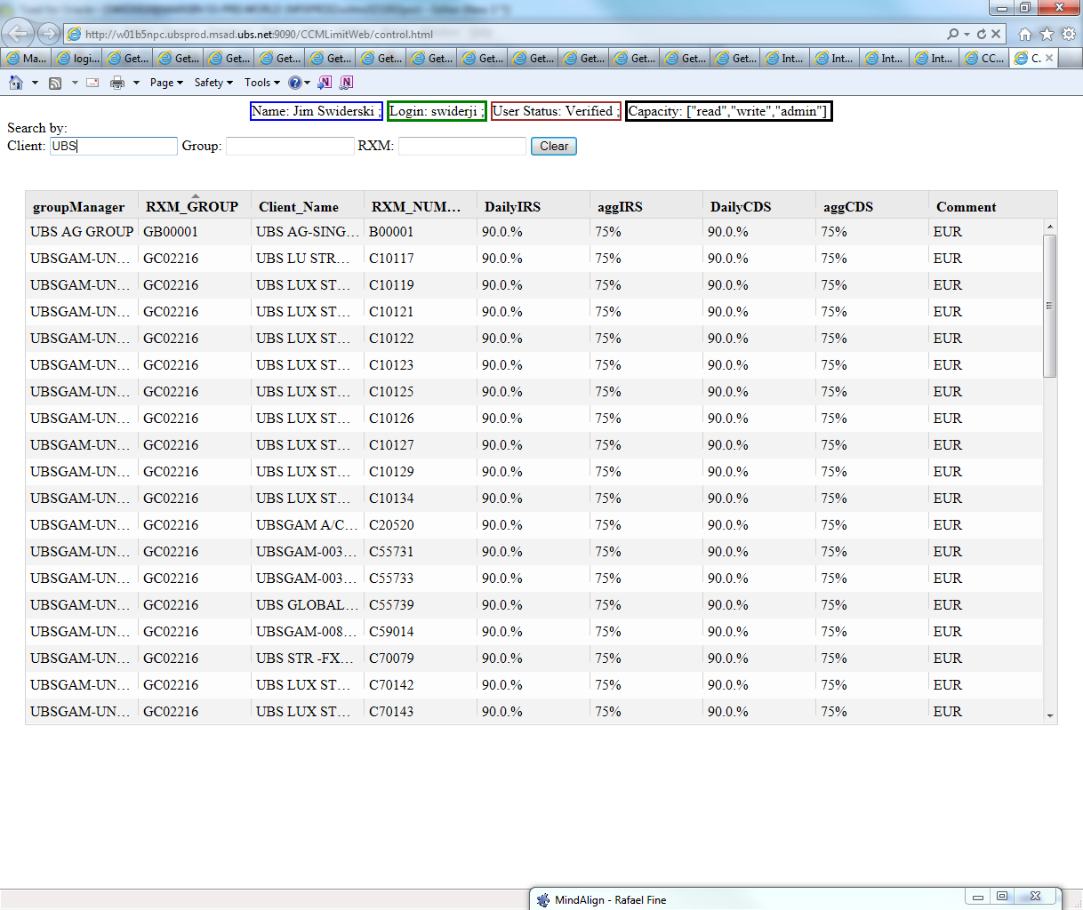

Slide 13
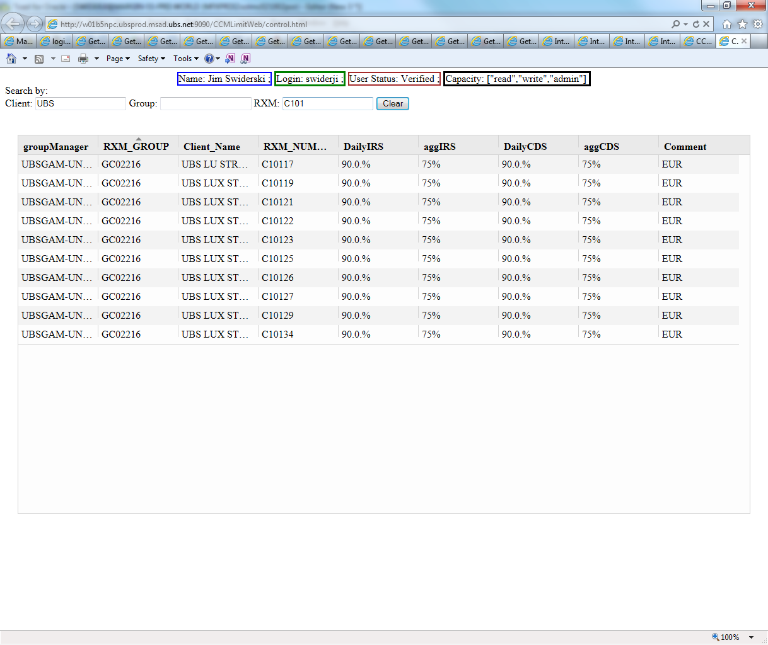

Slide 14
