Slide 1
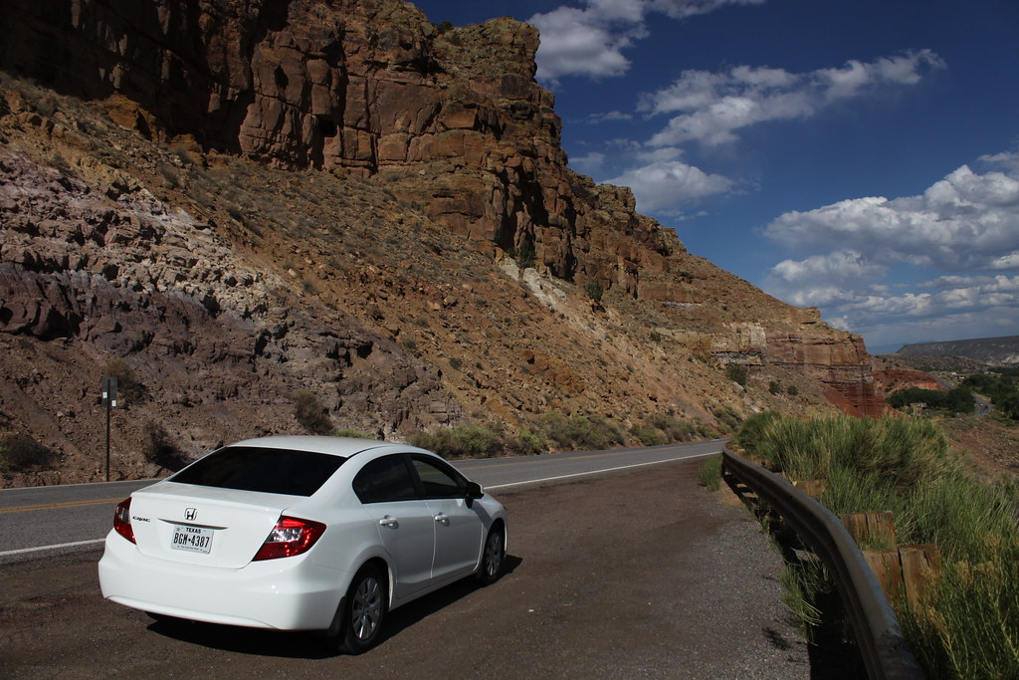
2019 Business Plan for Lariat rental car
By Gauri Deodhar
Notes:
https://live.staticflickr.com/3773/9145649134_6d48bf8772_b.jpg

Slide 2
Agenda
2018 Summary Results and 2019 Goals
Objective
Strategies
Conclusion and recommendation

Slide 3
2018 Summary Results and 2019 Goals
 | Baseline Results (Million $)
Revenue | 529
Yearly Cost | 331
Profit | 198
Profit Margin | 37.4%
Across all branches net profit margin was 37.4%
2019 Goal is to increase profit margin

Slide 4
Objective
Increase Profit Margin (%)
Maximize Revenue
Reduce Cost

Slide 5
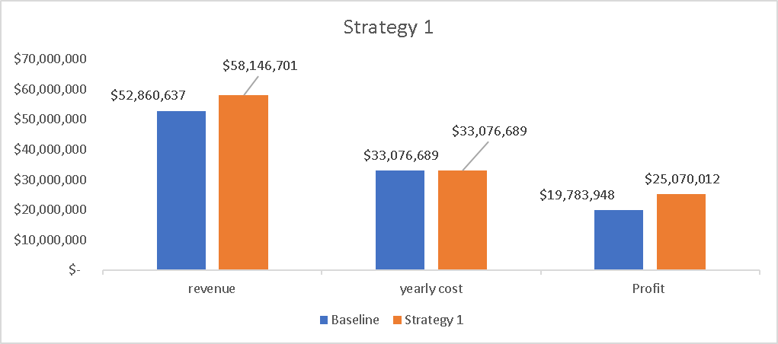
Strategy 1
Increase the revenue by increasing rental price per day by 10%
Results in 5.7% increase in profit margin

Slide 6
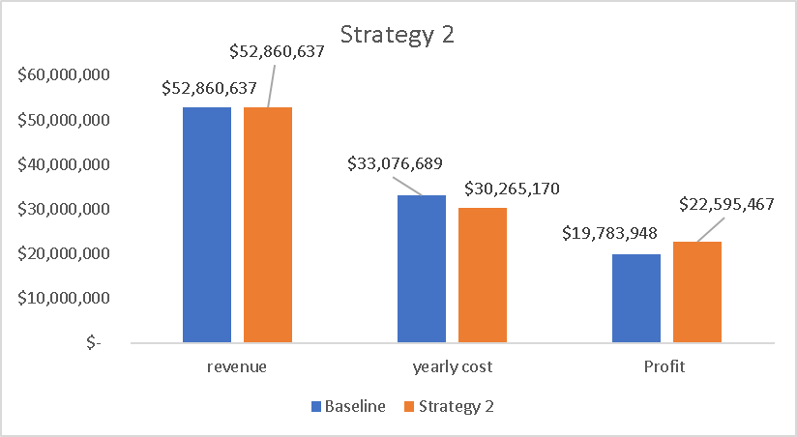
Strategy 2
Reduce the monthly cost by 10%, that reduces the yearly cost by 8.5%,
Results in increase the profit margin by 0.94%

Slide 7
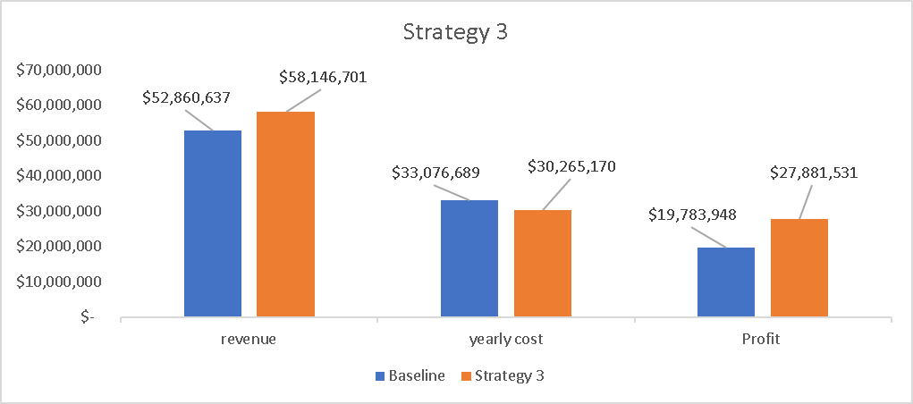
Strategy 3
Combined strategy 1 and 2
Increase 10% in revenue (by 10% increase in rental price) and 8.5% reduction cost (by reducing monthly cost by 10%)
Result in an increase of profit margin by 10.52%

Slide 8

Strategy 4
Reduce car insurance by 10% results in only 1.4% reduction in cost,
Resulting in 0.88% increase in profit margin

Slide 9
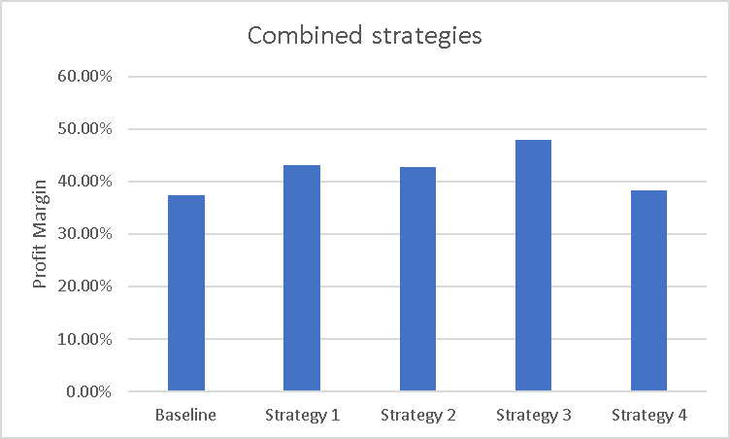
Recommended strategy

Slide 10
Call to action
Strategy 3 is best which is combining Strategy 1 and 2
Strategy 3 gives 10.5% increase in profit margin
If one of the options is only available ( either reducing cost/increase revenue), Strategy 1 is the better option with profit margin increase of 5.7%
Rental price has highest impact while insurance cost has least impact.

Slide 11
Thank you! Questions?

