Slide 1

Team Tight Rain: Gabi, Rachel, Grant, Riz, Adam
Notes:
Show of hands: How many of you have attempted to find a new doctor over the last 1-2 years and spent hours on the phone trying to figure out which doctor is the best for your needs, AND takes your insurance, AND has availability that aligns with your schedule?
[Pause to review the room]
You’re not alone.

Slide 2
Millennials, in particular, avoid the doctor the most, with nine in 10 (93 percent) not scheduling medical appointments.
Over half of millennials (51 percent) also reported visiting a doctor less than once a year.
Roughly two-thirds of women (66 percent) would rather "wait it out" than make a doctor's appointment as soon as they notice symptoms.
Notes:
Access to affordable and timely healthcare is a big topic everywhere, particularly in the US, so here are some important stats to bear in mind:

Slide 3
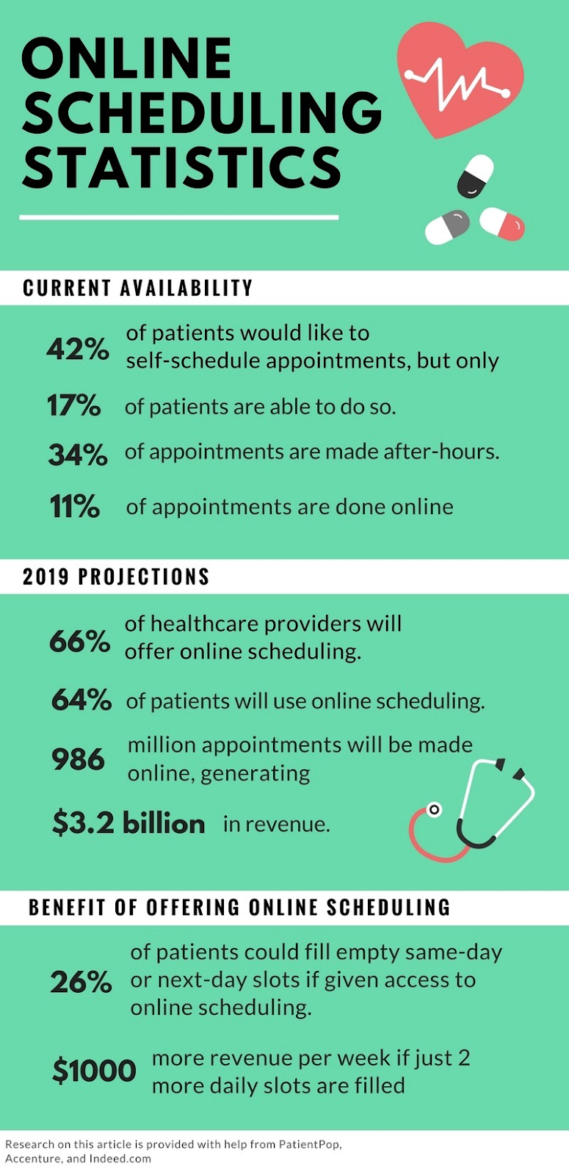
Notes:
Turns out, despite advances in technology, scheduling a doctor’s visit is still a pretty big problem:
42% of patients would like to schedule appointments but only 17% are able to do so
34% - more than 1 in 3 – appointments are made after-hours
Fixing the scheduling piece alone is a $3.2 billion market opportunity that will also improve the efficiency of service delivery AND reduce outcomes.

Slide 4
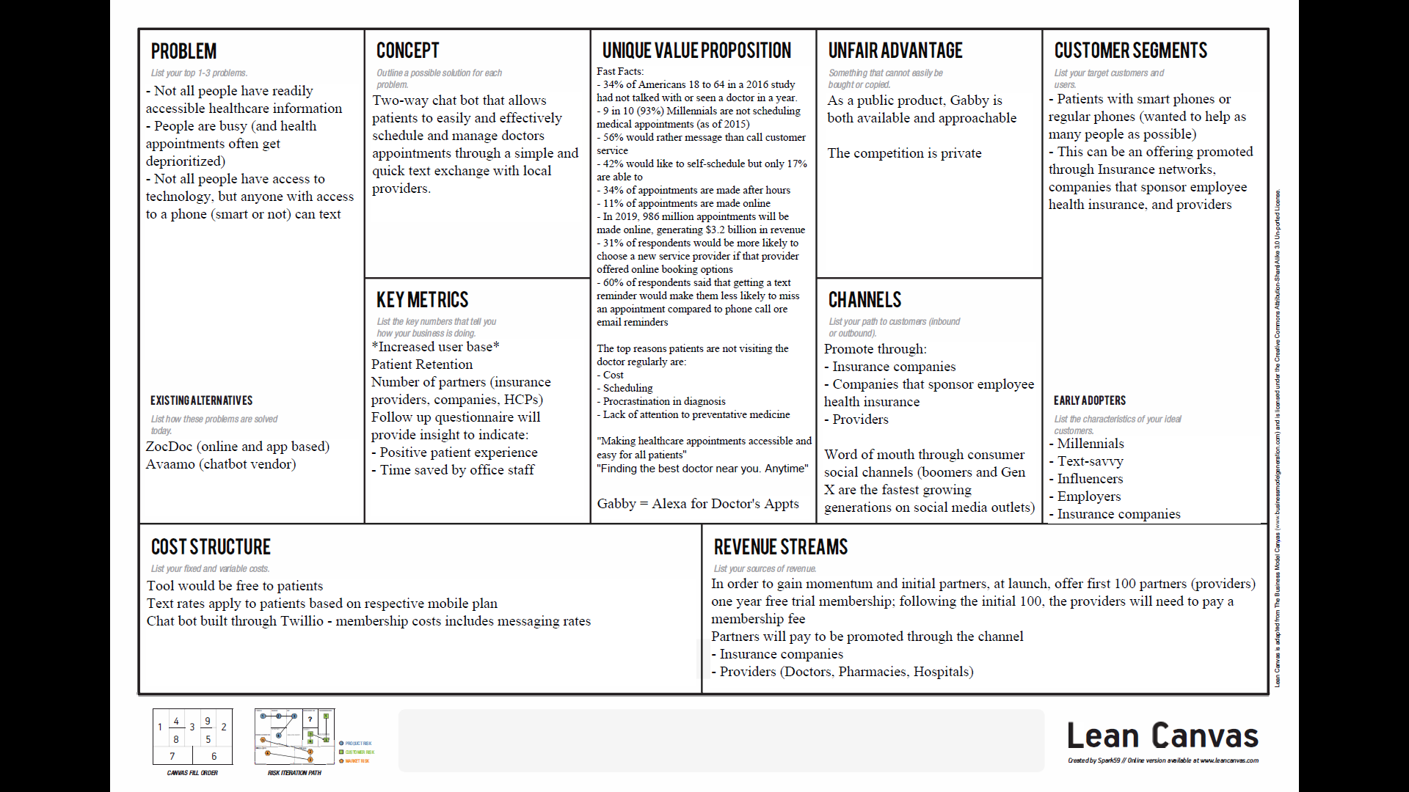
Notes:
So this is how we see the opportunity to use AI to solve three key healthcare problems:
People being too busy to make timely healthcare appointments due to
Lack of easy and flexible scheduling tools which leads to
Exacerbating people’s medical conditions, driving up healthcare costs and hurting outcomes

Slide 5
Notes:
Introducing our solution:
Gabby: An Artificial-Intelligence driven scheduling assistant, to help you find the best doctor, make an appointment, anytime.

Slide 6
Multi-sided marketplace
Our key customer segments:
Patients with phones (smart or regular) – we aimed to make this the most accessible solution possible.
No need to download an app.
Providers (Doctors, hospitals)
Insurance companies

Slide 7
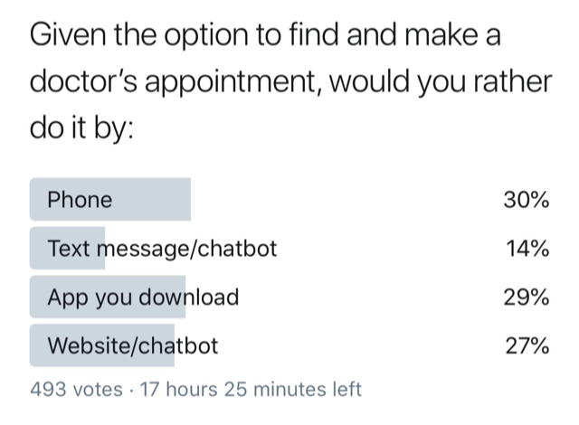
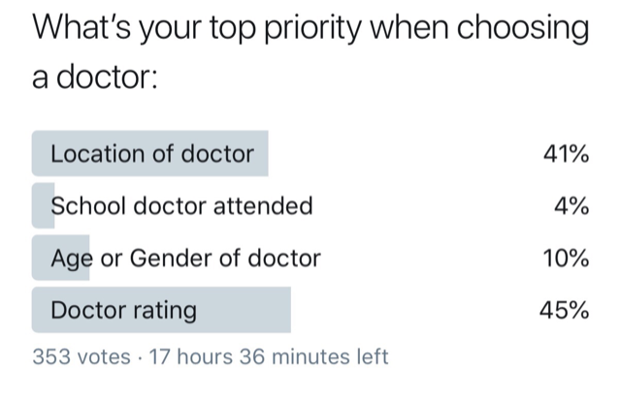
Notes:
We used surveys (which got over 1000 responses) to validate some of our key assumptions, such as how people would use such a service and what to prioritize in terms of offering such a service. We were not surprised to hear confirmation that most of the respondents said they would prefer a chatbot-type solution over using a phone to talk to a live person.
Most also said they’d like to know a doctor’s rating when making an appointment.

Slide 8
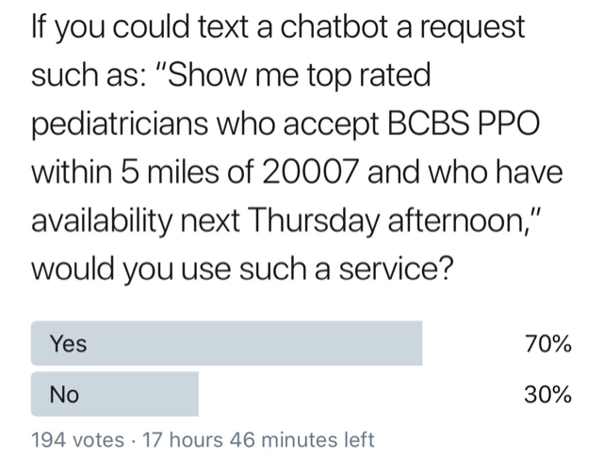
Notes:
Finally, people also said they would want any solution to be as simple as this:
[Read the quoted text]
[Okay, enough of the slides. Let us show you Gabby in action]

Slide 9



Manage Alerts
Welcome, Rachel
Dr. Amy Seskind, DO
Dermatologist
Hi Rachel, your appointment with Dr. Seskind is confirmed for 10:00 AM on Wednesday, April 3, 2019. To cancel or change your appointment, please call your doctor or select another time slot below.
“Very caring and thorough!”
Available Appointments
Date | Time | Change Appointment
Thursday, April 4, 2019 | 2:30 PM
Friday, April 5, 2019 | 10:30 AM
Copyright © 2019 Gabby Health, Inc
Notes:
We’ve also thought about data privacy issues and are augmenting Gabby’s capabilities with a web portal, where you can manage your profile information, data storage preferences, alert notifications frequency and more.
We’re also pleased to learn that one of the hackathon teams here today (HealthySkin.ai) has liked our solution so much, they feel it would be a nice hook to their service, which you’ll find out about in a few moments.

Slide 10
Questions?

