Slide 1
Magnesium diboride (MgB₂)
Conventional superconductor with special features
double gap model
highest Tc among BCS superconductors (39K)

Slide 2
MgB₂ thin films
Two samples (#2, #3) out of three have undergone neutron scattering:
destroys anisotropy
makes film properties similar to a single-gap BCS superconductor

Slide 3
BCS model predictions
Single gap, plus a phenomenological parameter (Dynes' Γ)

Slide 4
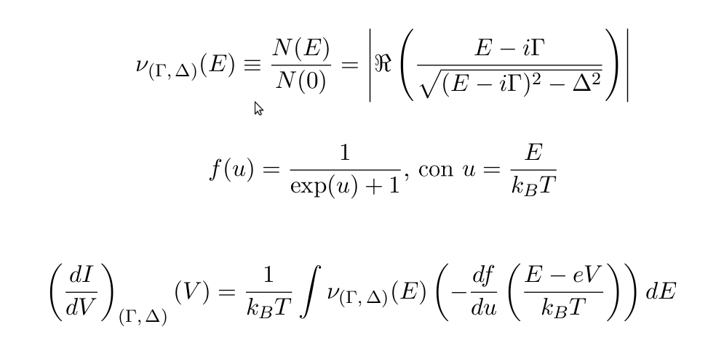
BCS model predictions

Slide 5
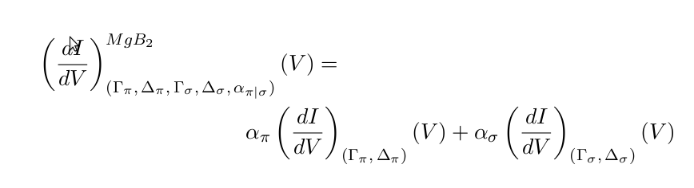
Double gap
DoS (hence, dI/dV) as a linear combination of two single-gap Densities of States
“normalized” coefficients α_{π} + α_{σ} = 1
w/ constraint 0.66 < α_{π} < 1

Slide 6
Computational difficulties
The conductivity curve depends non linearly on Γ and Δ through a numerical integral (no analytical solution)
Double-gap model leads to five independent parameters: Γ_{π}, Δ_{π}, Γ_{σ}, Δ_{σ}, and one coefficient e.g. α_{π}

Slide 7
Finding the best fit (method 1)
Simplex
most powerful method, with limitations
doesn't need derivatives
χ² is “yet another function” to find a minimum for
can't estimate statistical errors

Slide 8
Finding the best fit (method 2)
gsl_multifit_*()
not a generic minimization procedure
less robust than Simplex on “irregular” functions but...
...can estimate statistical covariances and sigmas!
min χ²(Γ_{π}, Δ_{π}, Γ_{σ}, Δ_{σ}, α_{π}) Levenberg-Marquardt

Slide 9
Best of both worlds?
Simplex method to find a good minimum
Starting from the last result, gsl_multifit_fdfsolver_iterate() to (slightly) improve the fit, but most importantly compute statistical errors

Slide 10
https://www.youtube.com/watch?v=LLLq7-0DivI
https://bitbucket.org/gderosa/didvsuperc/src

Slide 11
Results
Sample #1; single gap
Γ = 0.2639±0.0023
Δ = 2.2327±0.0023
χ²/DoF = 17.669

Slide 12
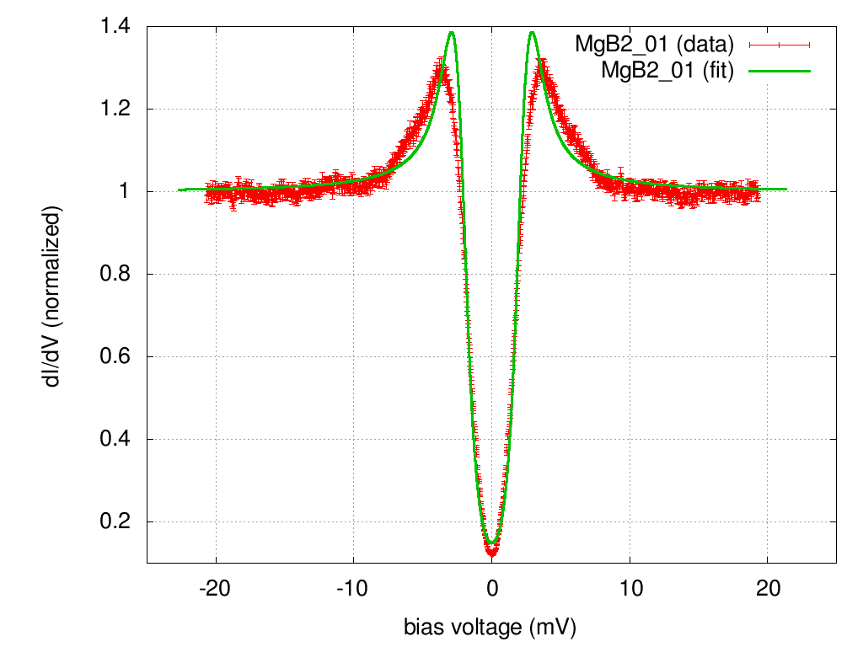

Slide 13
A better fit with a double gap
Sample #1; double gap
Γ = 0.1866±0.0019
Δ_{π} = 1.7895±0.0050
Δ_{σ} = 3.2348±0.0073
α_{π} = 0.6660±0.0027
χ²/DoF = 3.4737

Slide 14
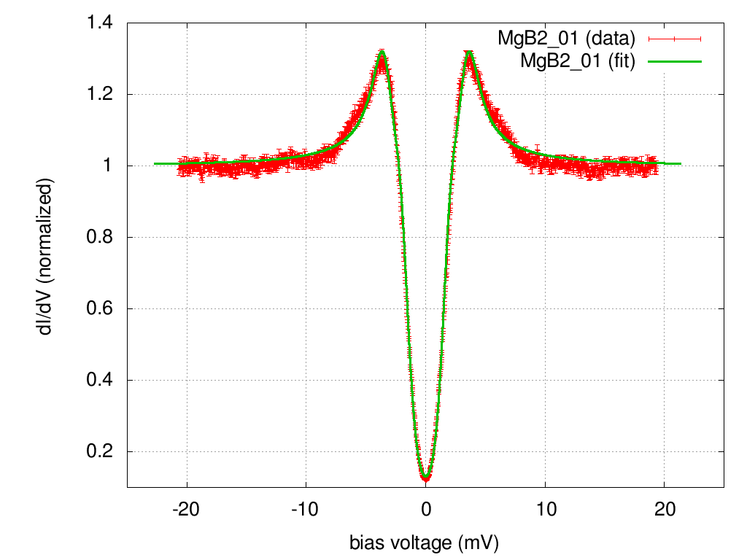

Slide 15
The single gap model fits better with “disordered” (neutron-scattered) films
Samples #2 and #3, single-gap first (Γ, Δ), then double-gap (Γ_{π}, Δ_{π}, Γ_{σ}, Δ_{σ}, α_{π})

Slide 16
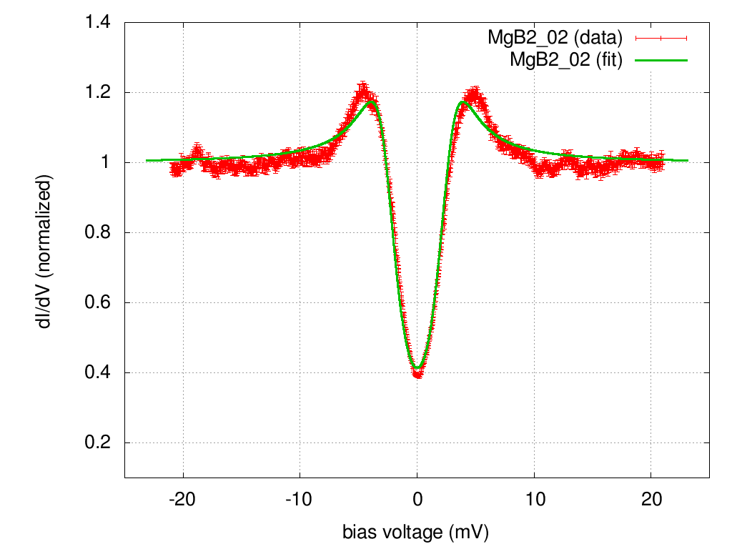

Slide 17
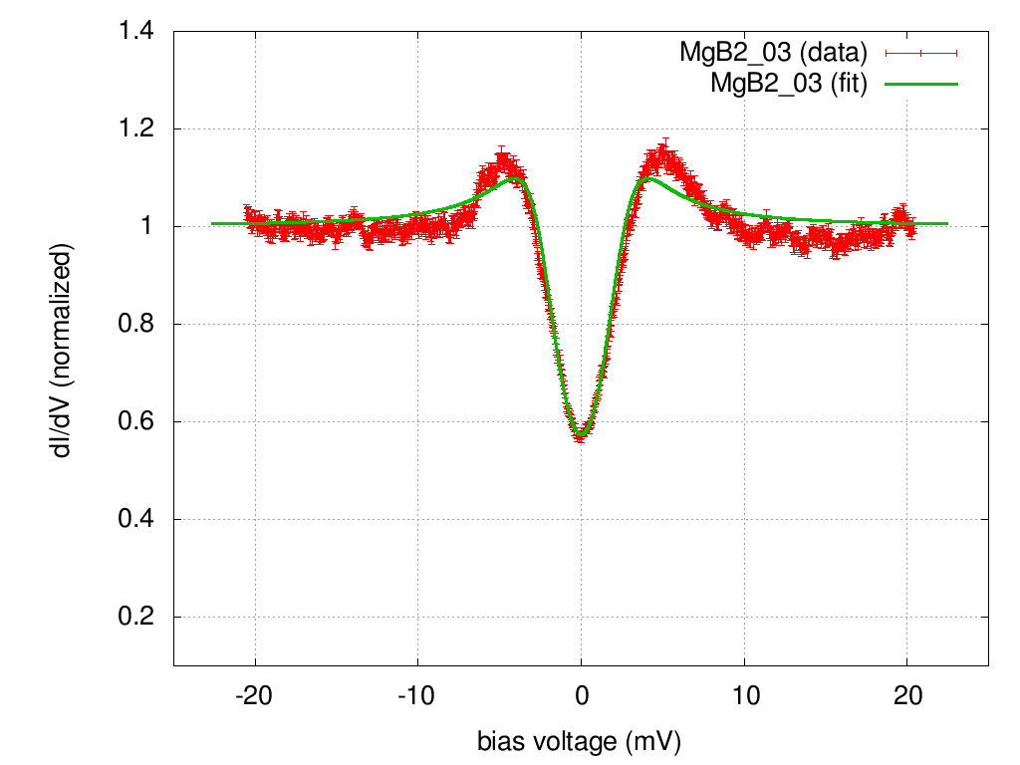

Slide 18
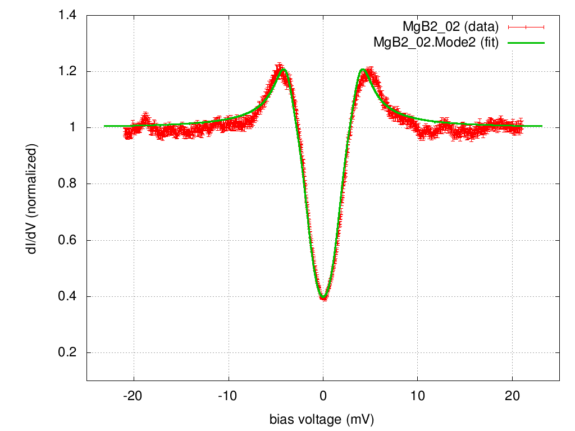

Slide 19
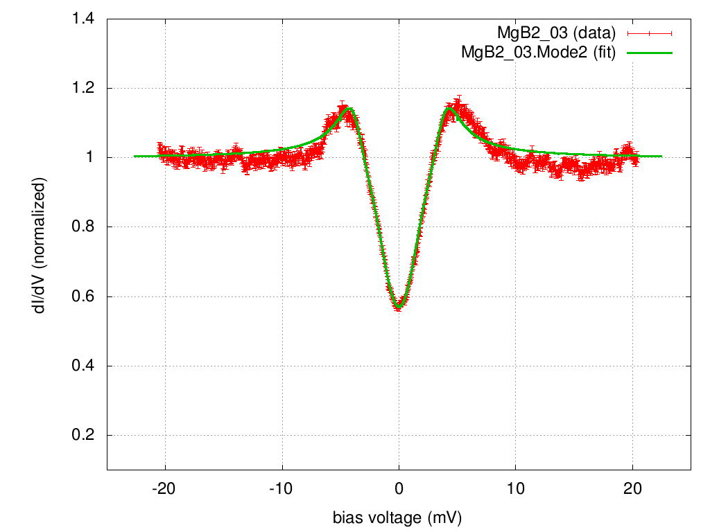

Slide 20
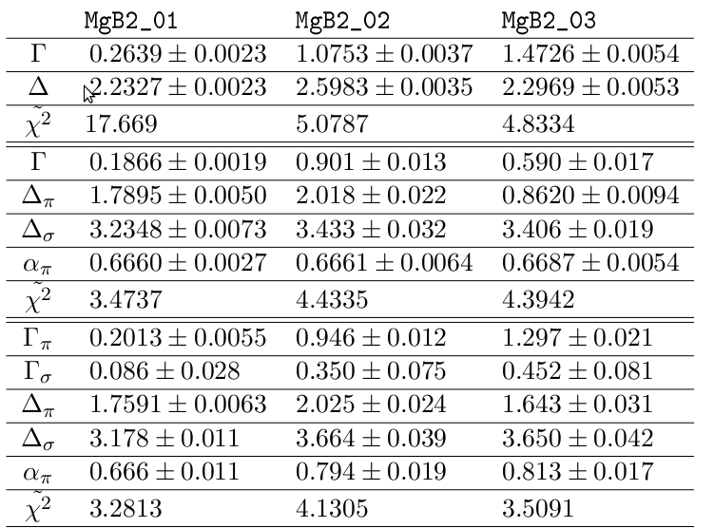
Results

