Slide 1
Text-to-SQL Fine-Tuning for Llama 3
Glenn DeSouza
266 – UC Berkeley MIDS

Slide 2
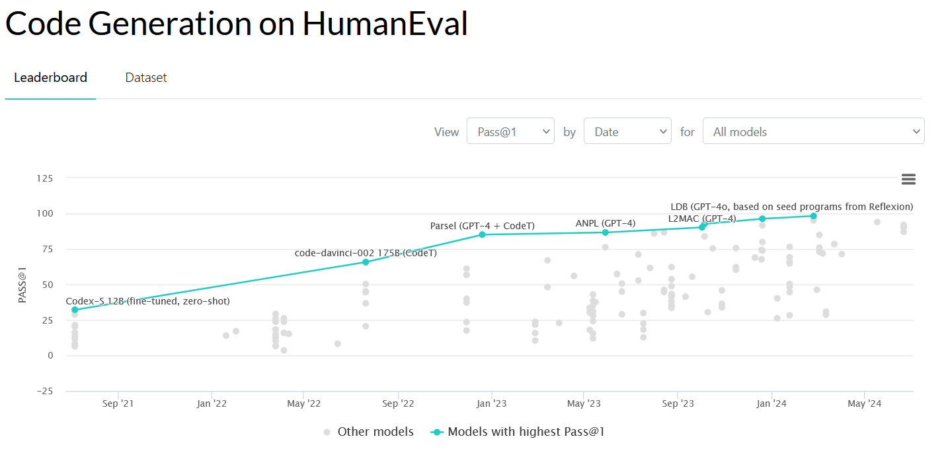

Slide 3
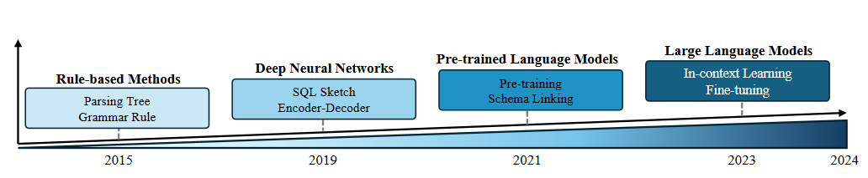
Evolution of Text-to-SQL Models

Slide 4
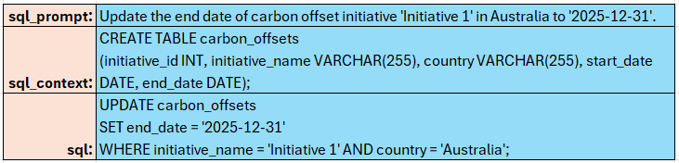
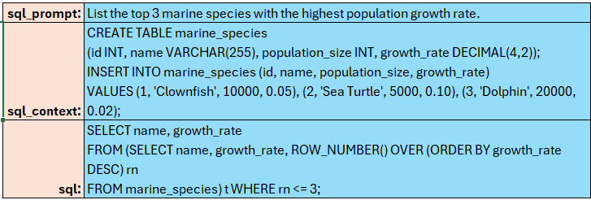
Synthetic text-to-SQL Dataset Sample Records
easy
hard

Slide 5
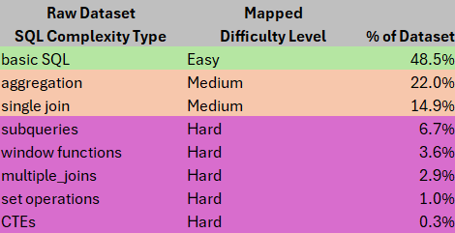
Mapping Dataset

Slide 6
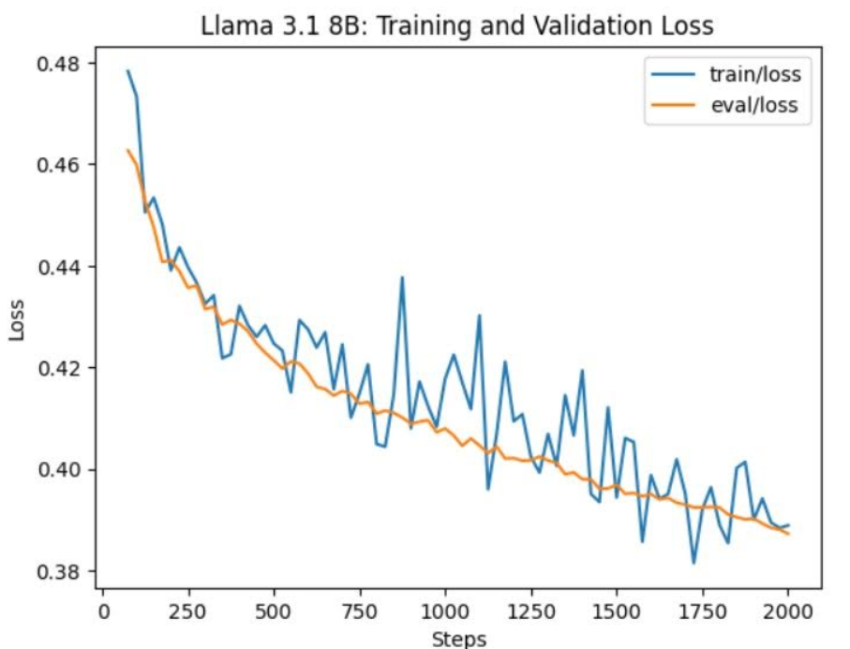
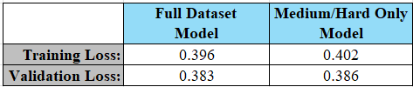
Training vs Validation Loss
No steep drop indicative of overfitting
Training and Validation Loss mostly in line for both models

Slide 7
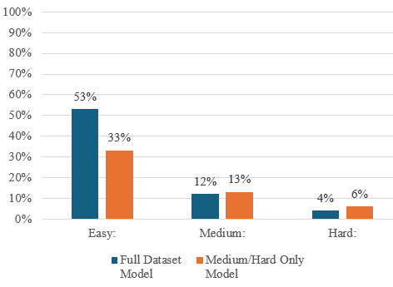
Experiment 1: Poor Exact Match Results on Medium/Hard SQL
Model trained on just medium/hard questions only marginally better
Stick with model trained on all difficulty categories – plenty of records in all categories
Exact Match Accuracy, by Category

Slide 8
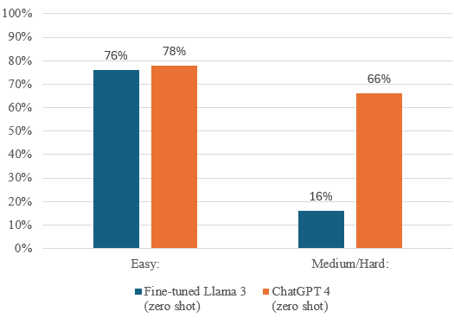
Experiment 2: Code Execution Accuracy Yields Better Accuracy Results
Model trained on just medium/hard questions only marginally better
Stick with model trained on all difficulty categories – plenty of records in all categories
Code Execution Accuracy, by Category

Slide 9
Conclusion & Takeaways:
Not an easy problem to solve
Better results perhaps on larger parameter models
Combination of fine-tuning + RAG retrieval methods likely best
Larger context window sizes (128k token limit in latest Llama version) leads to more possible improvements simply from prompt engineering

