Slide 1

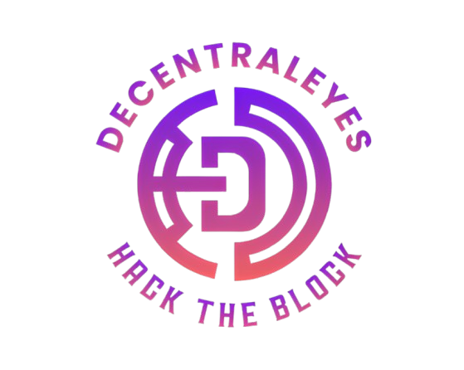


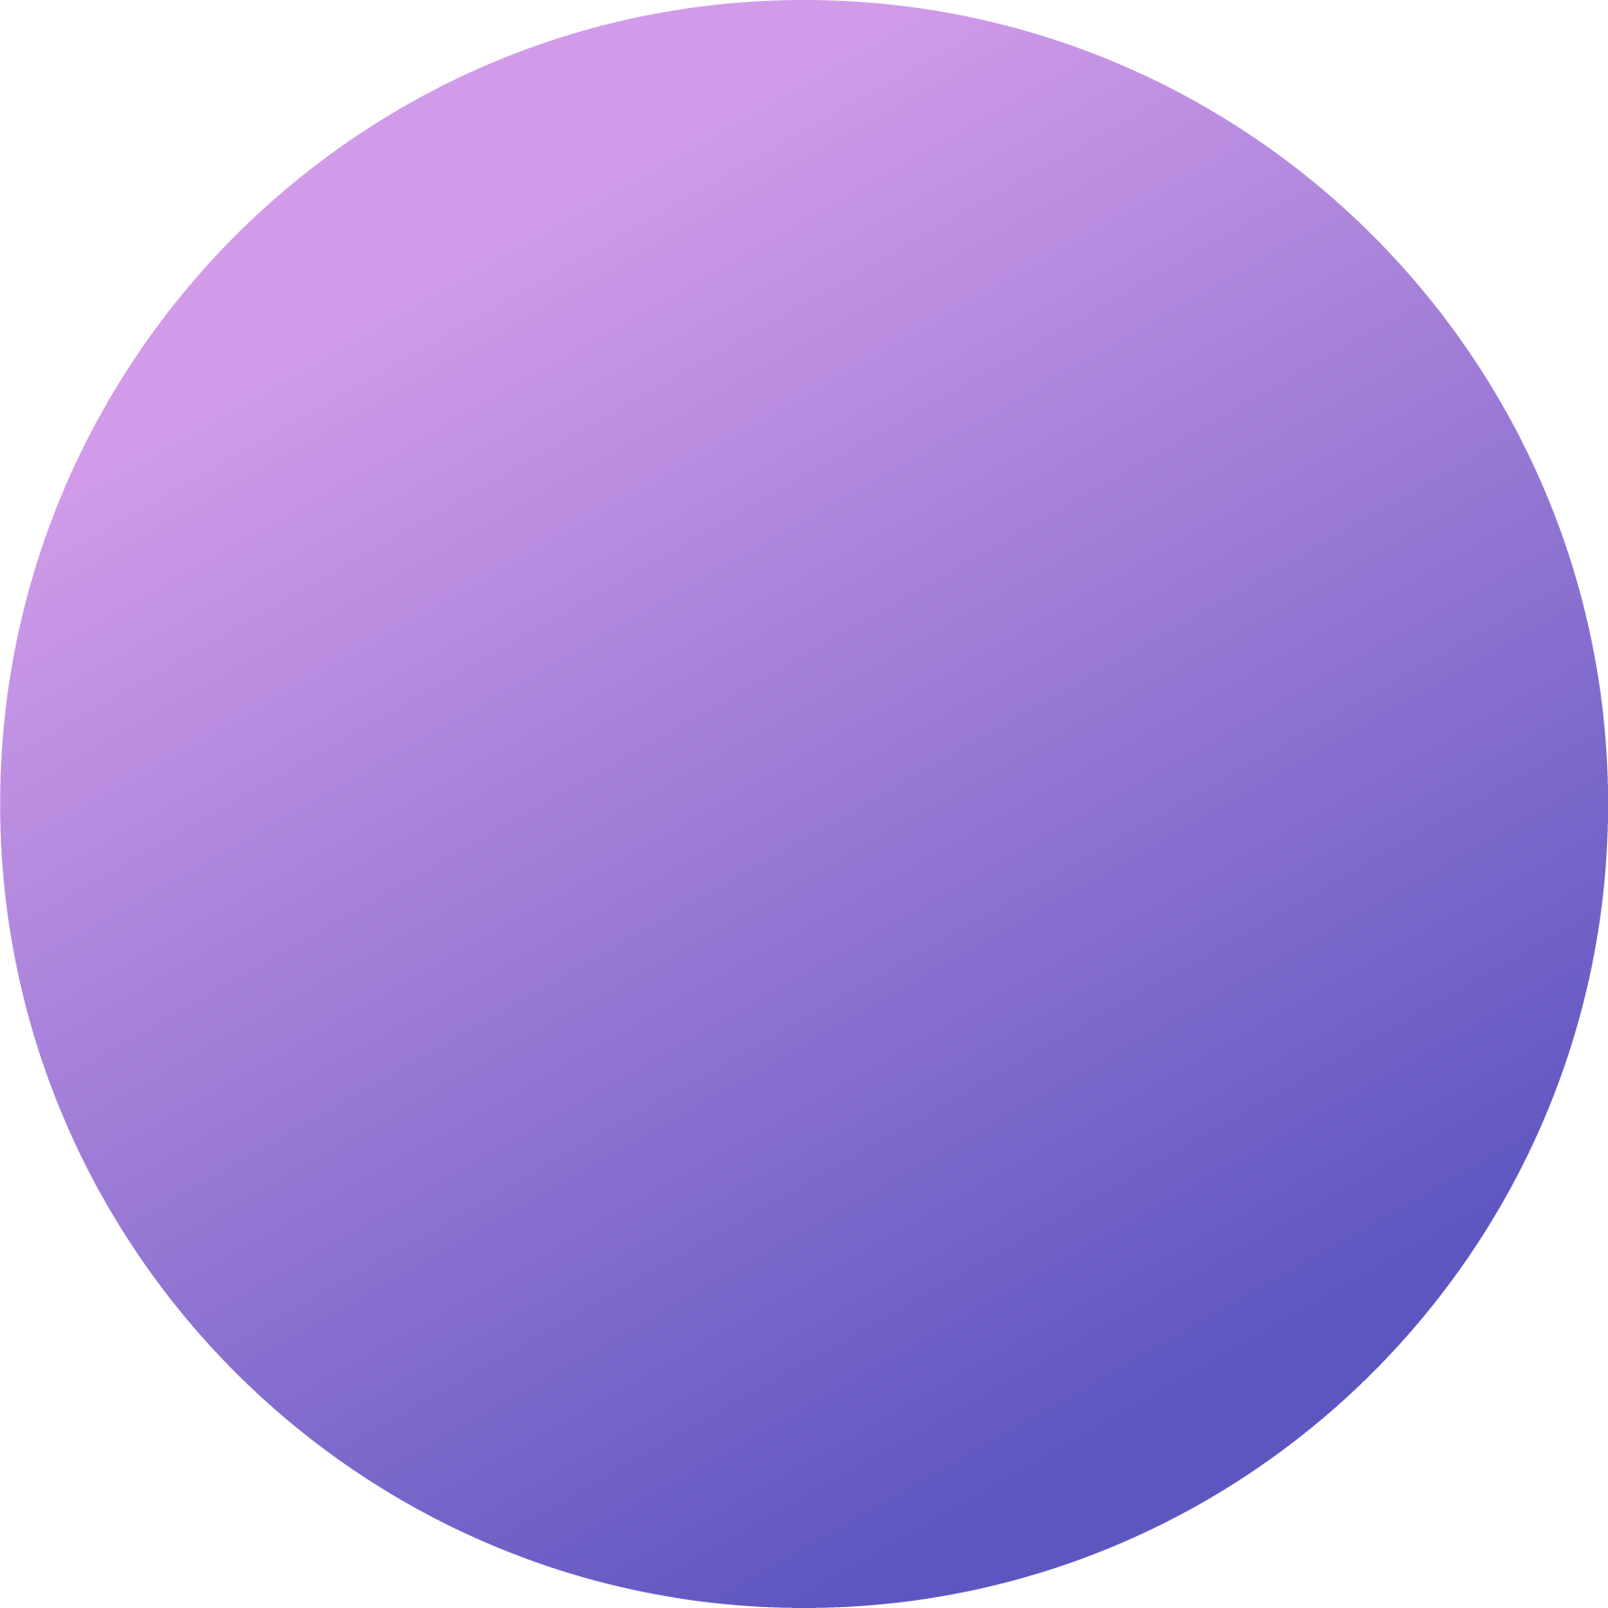

Title: Decentralized Arbitration System
Subtitle: Optimizing Token-Based Dispute Resolution
Presented by: DecentralEyes
Date: 20/10/24

Slide 2
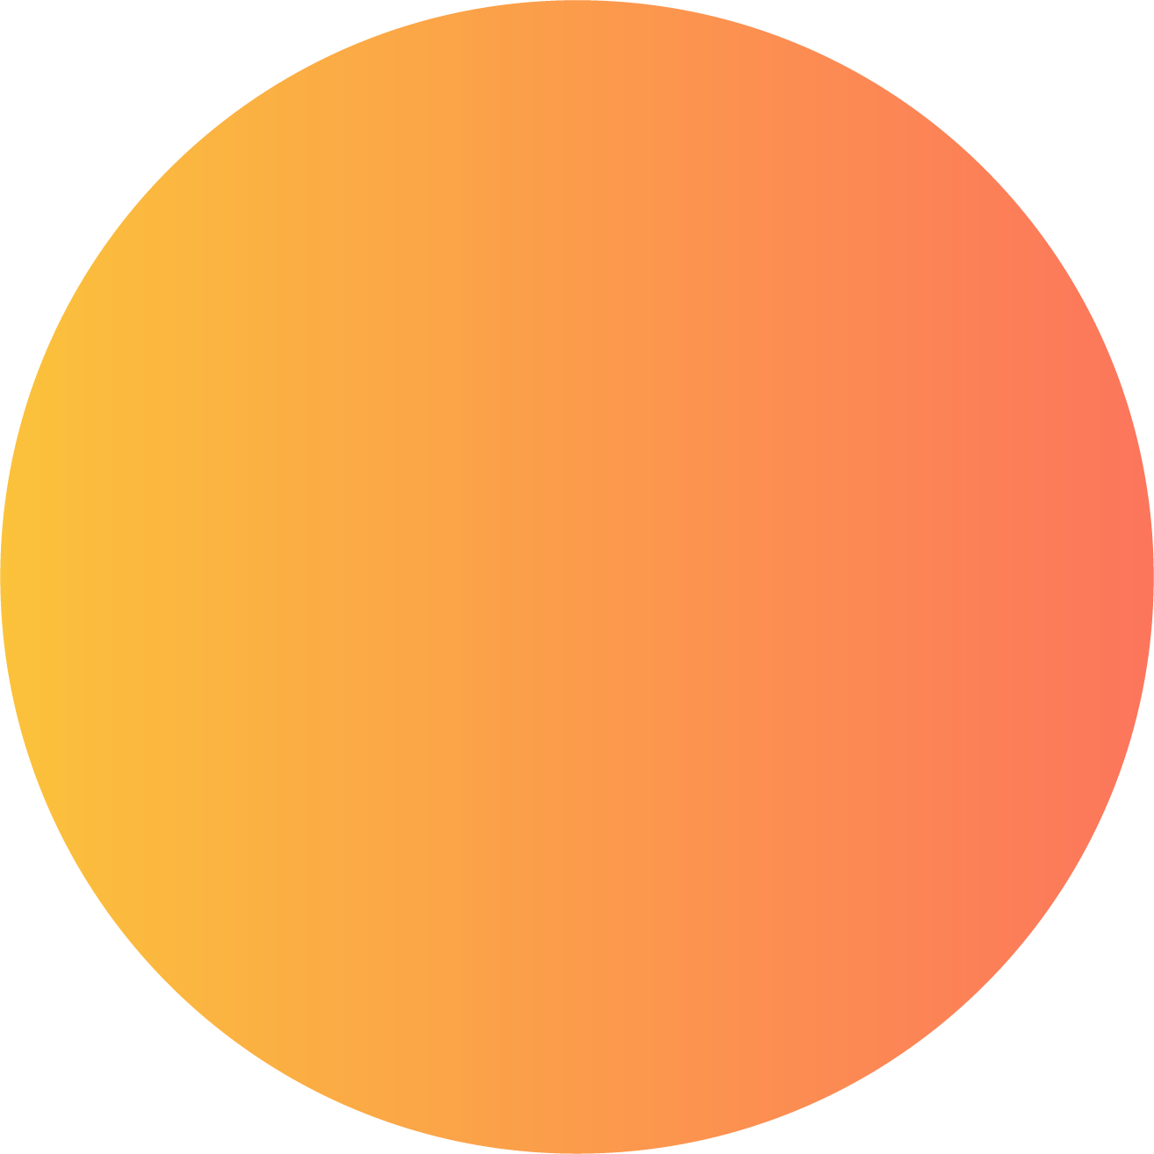

Introduction to Decentralized Arbitration
Definition: A dispute resolution process where jurors are selected through a decentralized mechanism.
Importance: Fosters trust among users in online marketplaces and platforms.
Challenges: Ensuring fairness, transparency, and efficiency amidst increasing global interactions.
Role of Tokens: Jurors stake tokens (e.g., GRULL) to participate, enhancing engagement.
Objective: Create a system that is impartial, cost-effective, and scalable.

Slide 3
Key Challenges
Efficient Juror Selection: Engage only active jurors to prevent inactive participants.
Fairness Optimization: Balance selection probability to avoid monopolization by large stakeholders.
Sybil Attack Prevention: Protect against bad actors creating multiple accounts.
Token Accumulation Risk: Prevent single entities from controlling the selection process.
Incentive Misalignment: Ensure jurors have the right economic motivations to vote honestly.

Slide 4
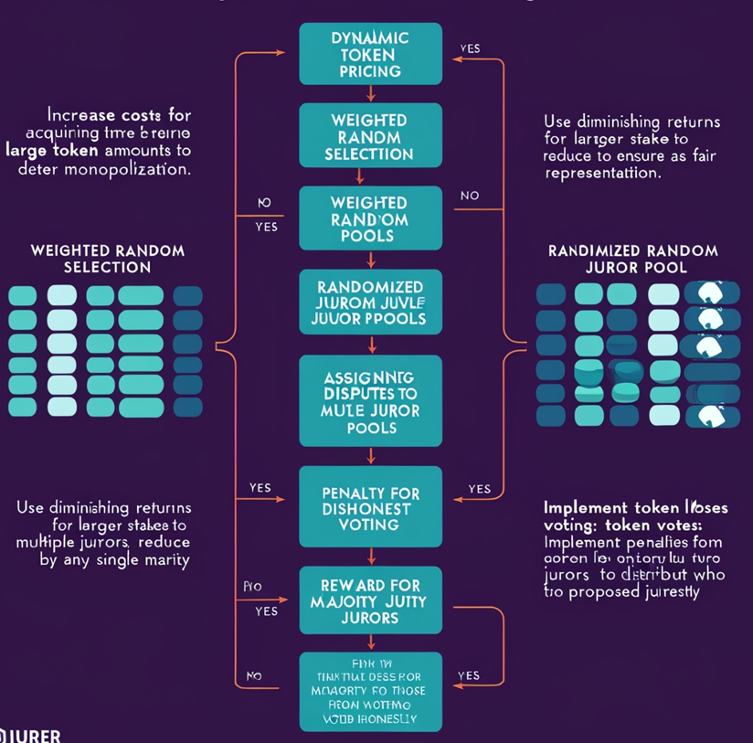
Proposed Solutions
Dynamic Token Pricing: Increase costs for acquiring large token amounts to deter monopolization.
Weighted Random Selection: Use diminishing returns for larger stakes to ensure fair representation.
Randomized Juror Pools: Assign disputes to multiple juror pools to reduce control by any single party.
Penalty for Dishonest Voting: Implement token losses for jurors voting against the majority.
Reward for Majority Jurors: Distribute penalties from dishonest voters to those who voted honestly.

Slide 5
System Workflow
Jurors chosen based on token stakes using weighted probability.
Majority decision is determined and impacts token distribution.
Juror Selection
Outcome Calculation
Voting Process
Token Distribution Update
Selected jurors vote on the dispute (options: 'X' or 'Y').
Adjust tokens for jurors based on their voting alignment.

Slide 6
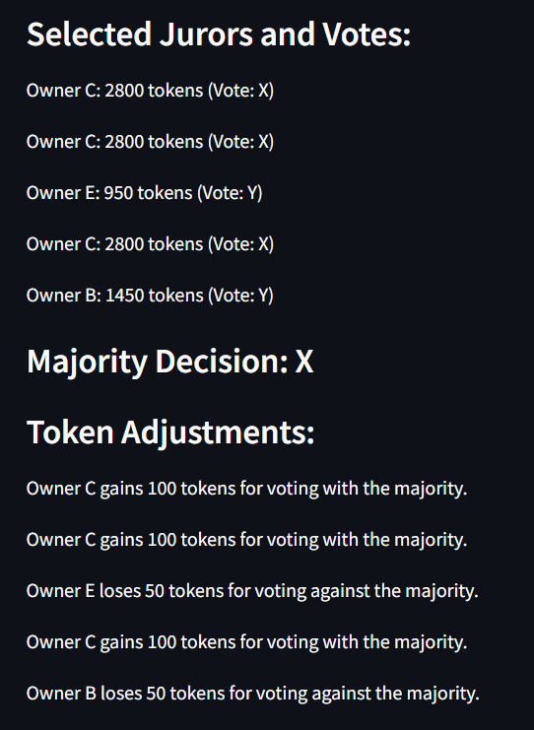
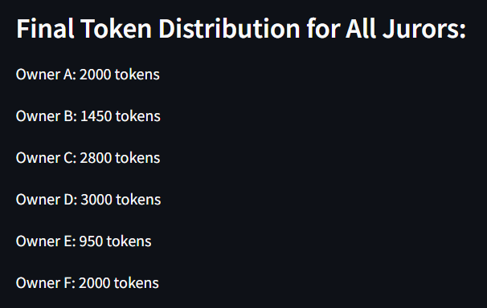
Example Scenario
Participants: Six token owners with a total of 12,000 tokens.
Voting Results: Majority decision in favor of 'X' with various owners voting.
Outcome:
Majority gains tokens from the losing party.
Token redistribution based on voting alignment.

Slide 7
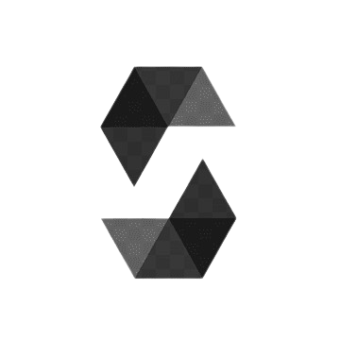
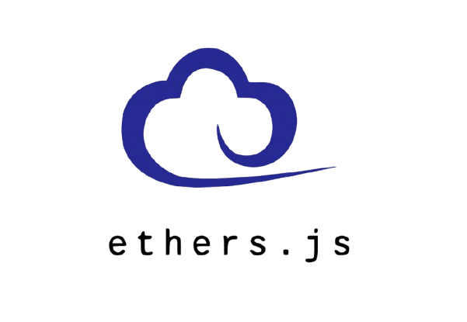

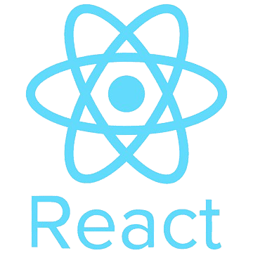

Tech Stack And Outputs
React: Frontend library for building dynamic user interfaces.
Solidity: Language for writing Ethereum smart contracts.
Hardhat: Development environment for compiling and testing smart contracts.
Ether.js: JavaScript library for blockchain interactions.
Sepolia Testnet: Safe environment for testing Ethereum contracts.

Slide 8
Future Enhancement
Layer 2 Solutions:
Description: Integrate Layer 2 protocols like Optimistic Rollups or zk-Rollups.
Zero-Knowledge Proofs (ZKP):
Description: Use ZKP protocols like zk-SNARKs or zk-STARKs for privacy and verification.
Work to Earn:
Description: Implement a reward mechanism where users earn tokens or NFTs by completing tasks or contributing to the network.

Slide 9
THANK YOU

