Slide 1
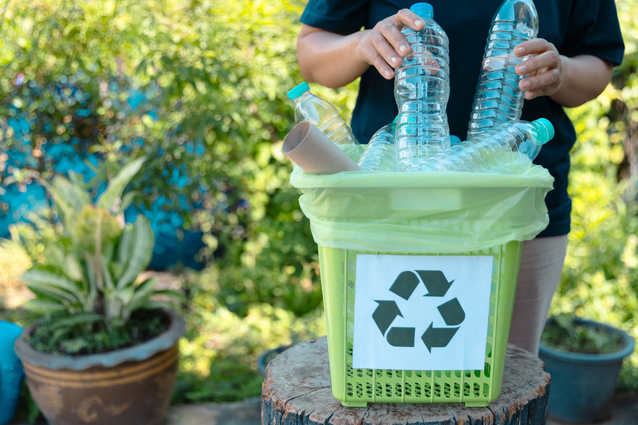
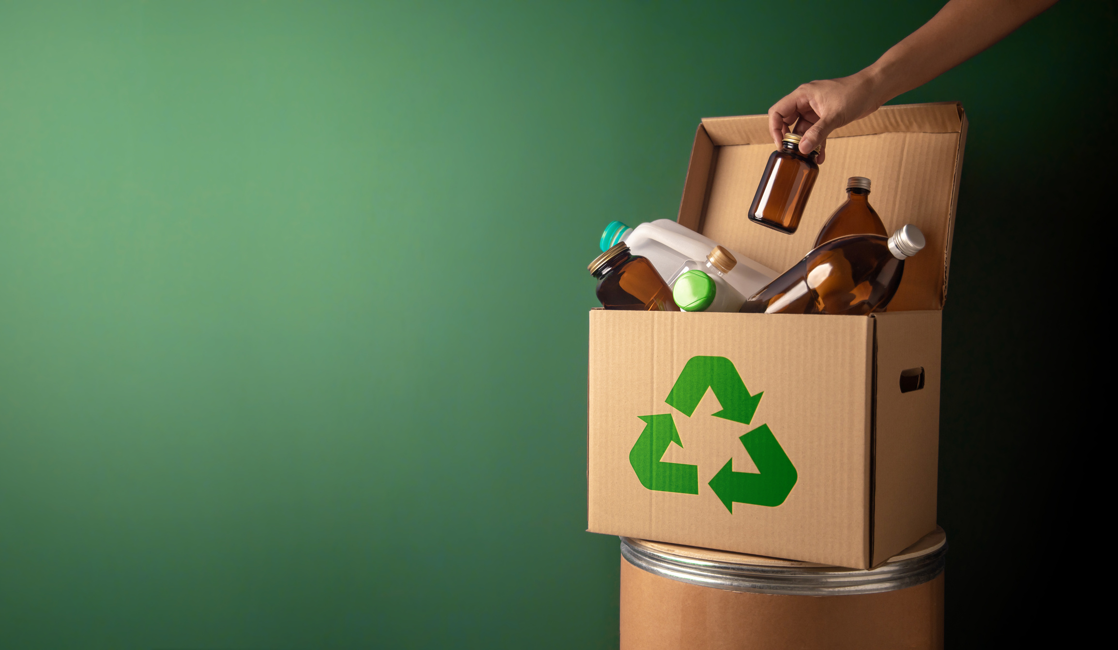
WASTE SORT AI :
AN AI ASSISTED WASTE SEGREGATION AND RECYCLING SYSTEM FOR LANDFILL REDUCTION .
Team Members :
Sanyukta Salvi ,
Mubashara Shaikh ,
Gourav Dev

Slide 2
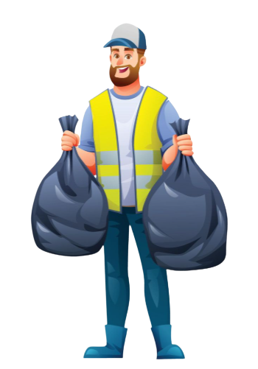


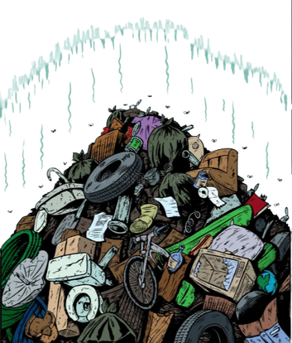
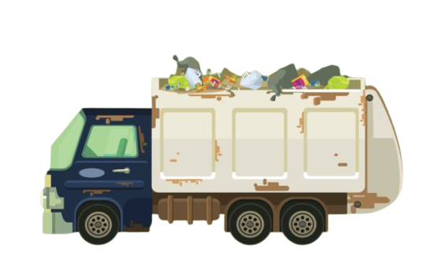
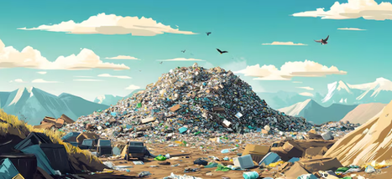
The Journey of Waste
1,62,000 tones of waste collected everyday ( ~pib.gov.in)
Let’s first get to know what’s the route of waste that’s been travelling every-day to this dump yards .
Home , Schools , colleges , offices , Etc...
Garbage van
Dump Yard
Garbage Collectors
Refuse Transfer Station

Slide 3
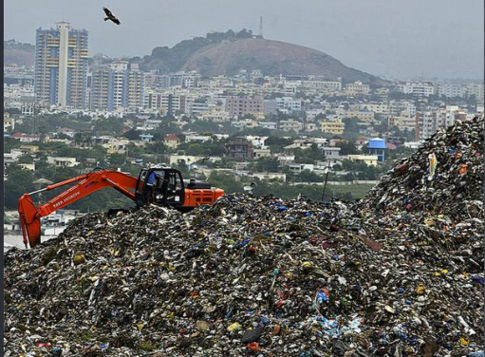




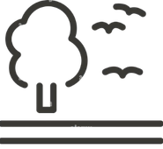



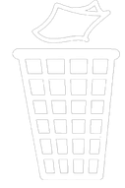


THE PROBLEMS WITH
DUMP YARDS
Dump yards are not just piles of waste - they are a grown
crisis for our environment, health & cities.
Air Pollution
Land Degradation
01
04
  Rotting waste releases CH4, CO2, and other bad odours.
  Large areas remains occupied and contaminated for years.
Water Pollution
Overflowing Waste
02
05
  Rainwater passing through garbage , creating toxic leachate.
  Dump yards recieve massive amounts of waste everyday.
Health Risks
Impact on Community
03
06
  Nearby residents face eye, throat and respiratory infections .
  Foul smell, pests and pollution affect the quality of life .

Slide 4

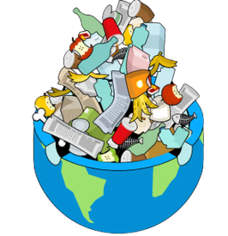

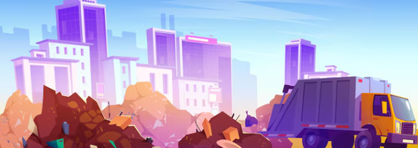
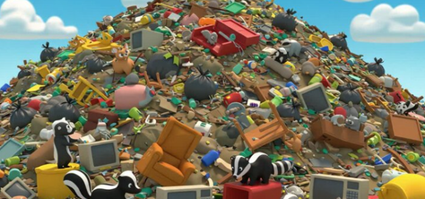
  DUMP YARDS IN INDIA
~THE NUMBERS
~pib.gov.in
  2,479
  25 Crore MT
  15,000 Acres
  436 MILLION TONNES
Dumpsites across India
Total waste accumulated
Land occupied by waste
Projected by waste generation by 2050
1,000+ tonnes at each sites
= 250 million tonnes
= 21,000 football grounds
165 MT by 2030

Slide 5
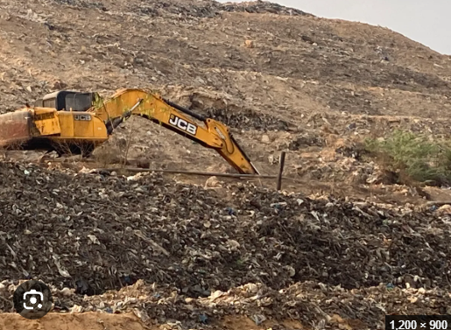






Government’s Ongoing Project
Lakshya Zero Dumpsites by October 2026
DRAP - Dumpsites Remediation Accelerator Program
~ pib.gov.in
1,428
dumpsites cleared
62%
of legacy waste
183 lakh
metric tonnes of waste remediated
Reclaimed land -
sanitation & processing infrastructure

Slide 6

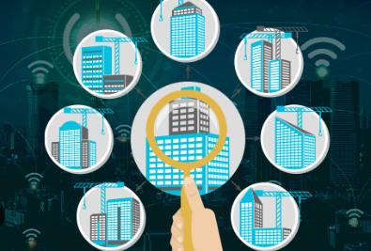


Companies Working on
Eco Wrap -
Tech-enabled waste management
Dump Yard Waste Management
  waste collection &segregation
  Recycling solutions
  Door-to-door collection (~ecowrap.in)
Ishitva -
AI-powered automation & robotics
  Automated waste sorting
  Plastic & metal segregation
  Recycling support (~ishitva.in)
Bio Mining India -
Legacy dump-site remediation
  Excavtion of old waste
  Waste treatment & sorting
  Resource recovery (~biomining.in)

Slide 7
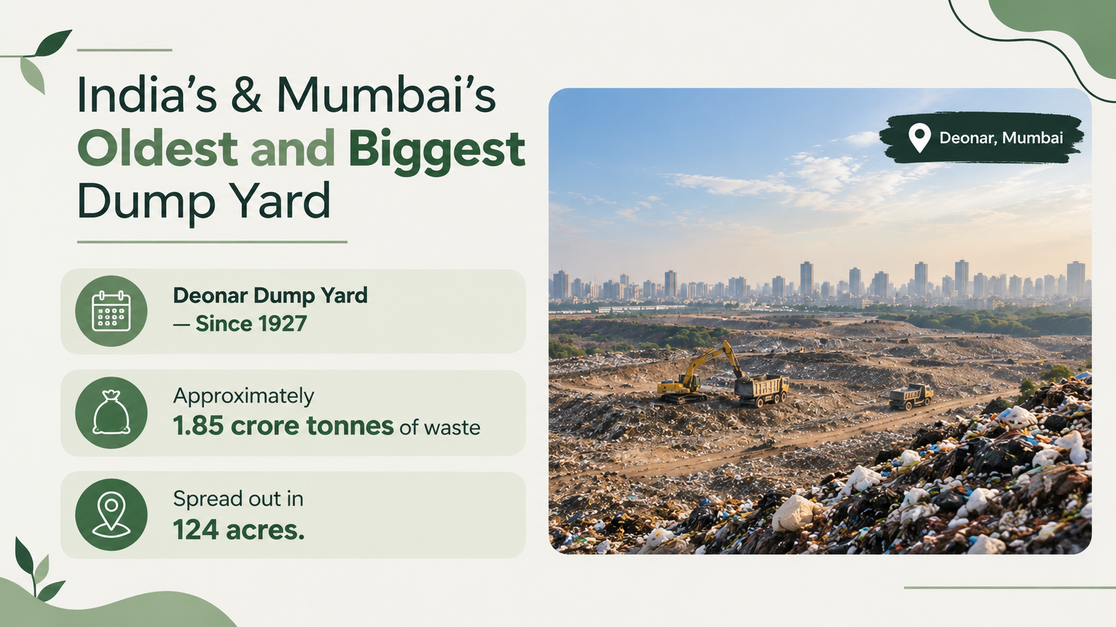
~indianexpress.com

Slide 8


Waste Management : India vs. Foreign Countries
India
Foreign Segregation
  Four-way segregation at dump yards.
  All the waste that’s been collected is sent to dumping grounds.
  Fresh waste dumping restricted at remediation sites [Rule 15(7)].
  Waste segregated at source.
  Less waste reaches dumping grounds.
  Waste-to-energy used at large scale.
~(env.go.ip) (avfallsverige.se)
(mcgm.gov.in)

Slide 9



HOW SEGREGATION WOULD BE DONE
BIO-DEGRADABLE WASTE
NON-BIODEGRADABLE WASTE
  Naturally decomposes
  Sent for composting
  Used for biogas/agriculture
  Plastic, metal & glass
  E-waste & medical waste
  Residue

Slide 10






Results of Cleaning Dumping Grounds Across India
What we recover once dumping grounds are cleaned and waste is properly segregated ?
Cleaner Air
Safer Water & Soil
Better Public Health
Land Recovery
Employment
Improved City Image

Slide 11
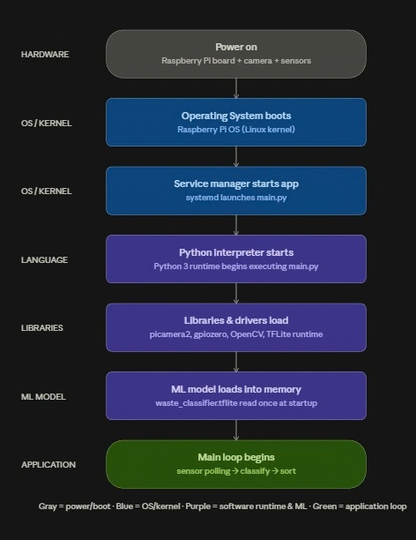
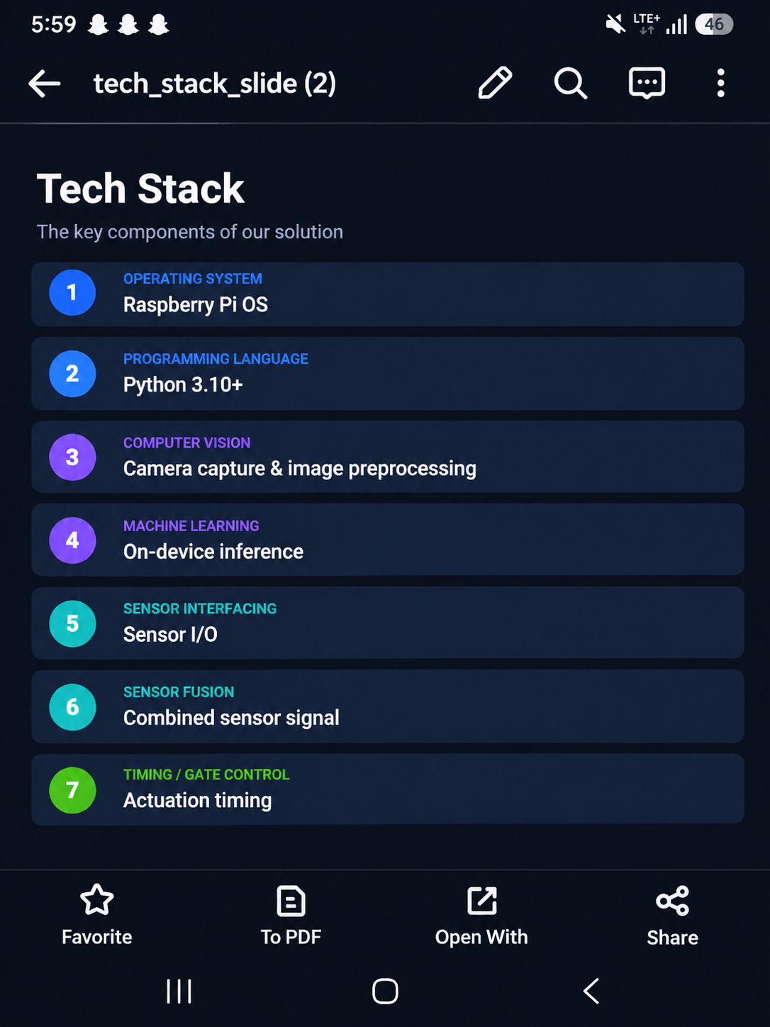
System Architecture & Tech Stack
Boot-to-loop execution flow, and the stack powering each layer

Slide 12
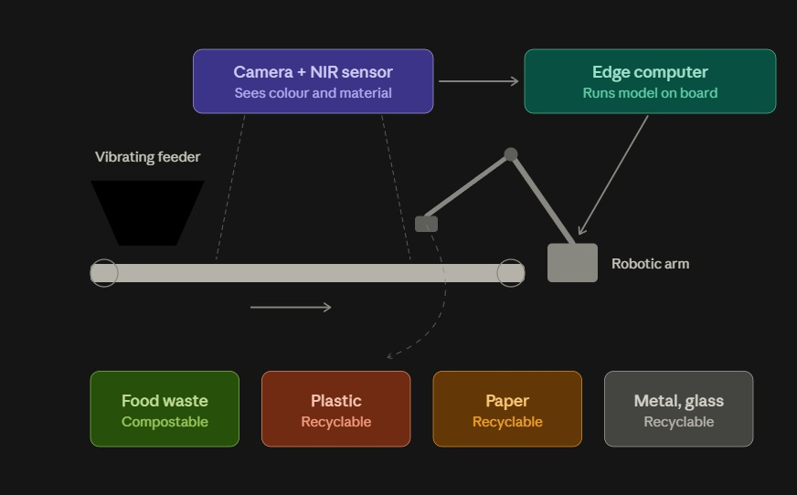
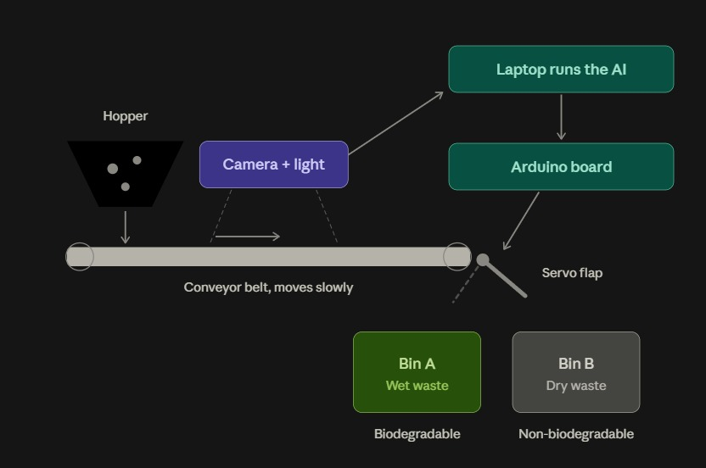

Slide 13


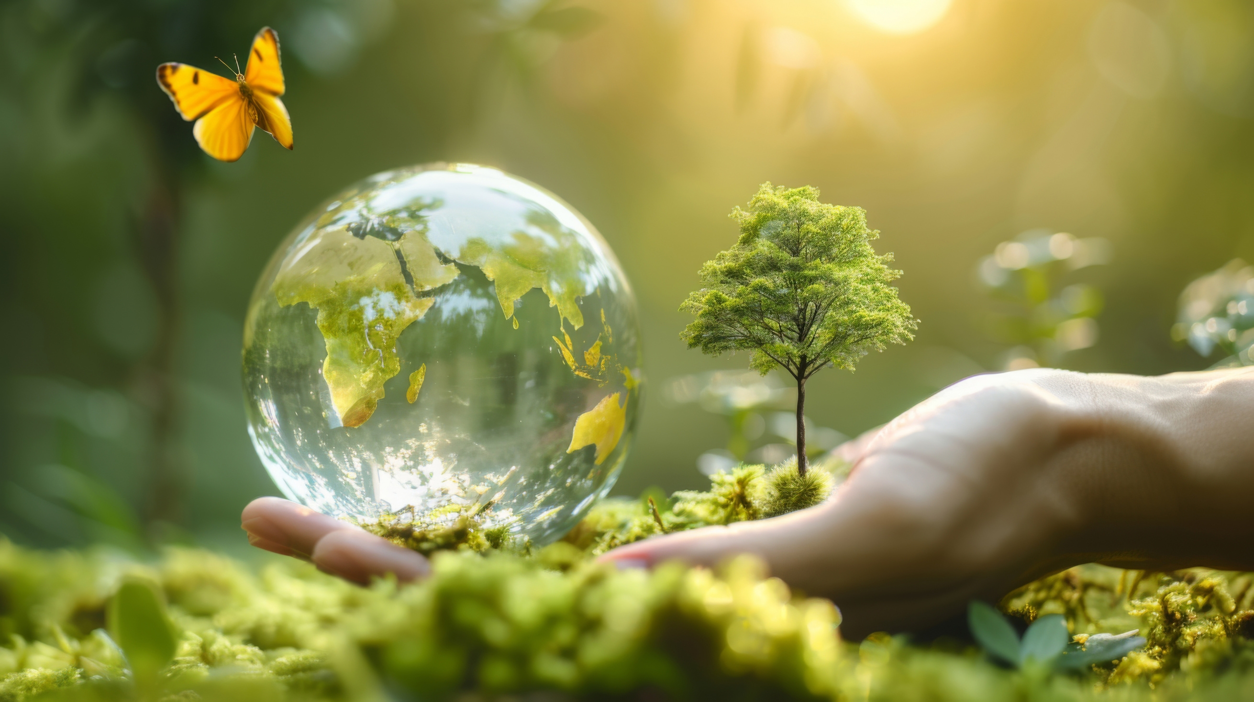
Gourav & team
THANK YOU

