Slide 1
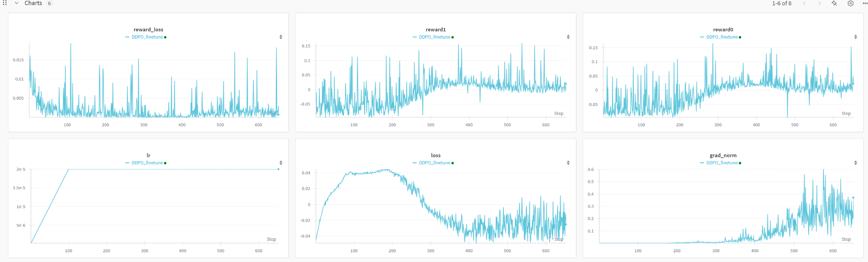
Week 5
Changed the reward model from simple MSE to combination of optical flow, frame difference, spatial gradient and MSE.
Use 2d convolution with average frame + text embedding and cross attention as the latent reward model.

Slide 2
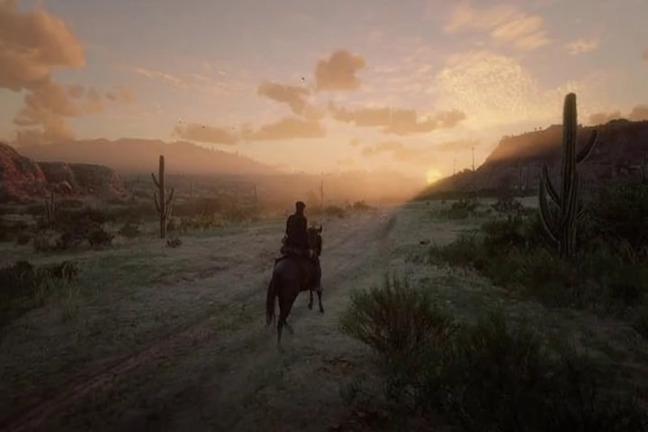
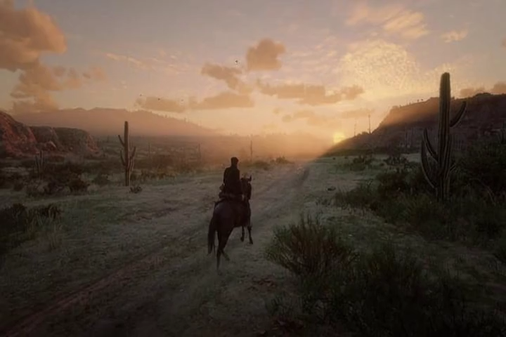
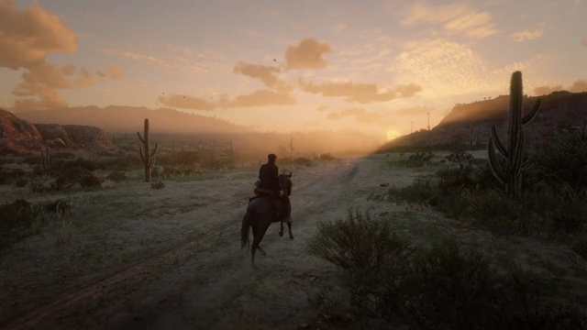
Week 5
Result of checkpoint 510
After finetune
Reference
Before finetune

