Slide 1
Introduction to Kubernetes

Slide 2
Containers

Slide 3
Why Containers?
Immutable infrastructure
Small size
Developer friendly – focus on app and its dependencies and not on environment
Ease of distribution – develop and deploy everywhere
Better utilization of resources – dynamic scaling
Control cost especially in cloud

Slide 4
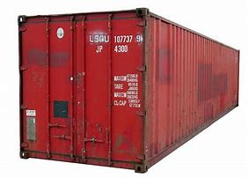
Container
A technology popularized by Docker
A container is a standard unit of software that packages up code and all its dependencies so the application runs quickly and reliably from one computing environment to another.
A Docker container image is a lightweight, standalone, executable package of software that includes everything needed to run an application: code, runtime, system tools, system libraries and settings.

Slide 5
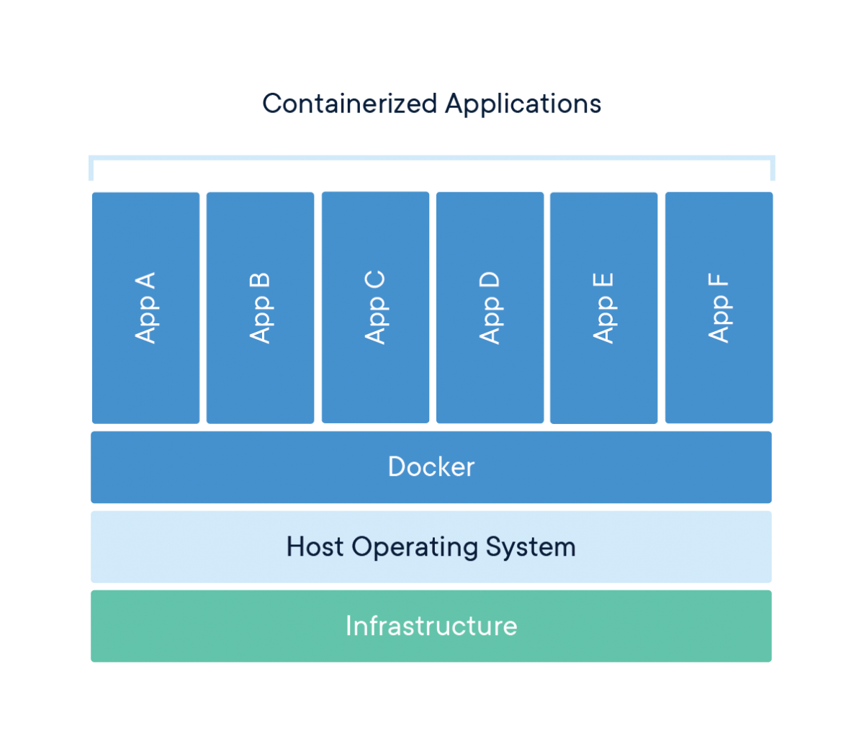
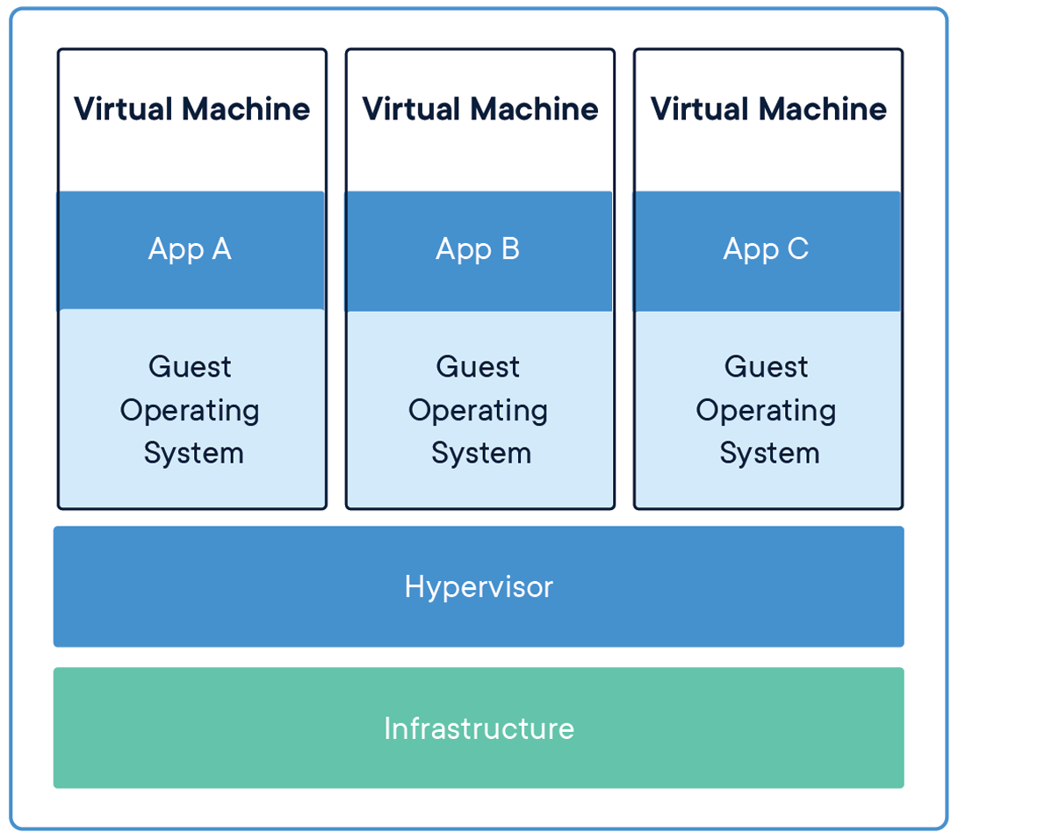
Container & Virtual Machine

Slide 6
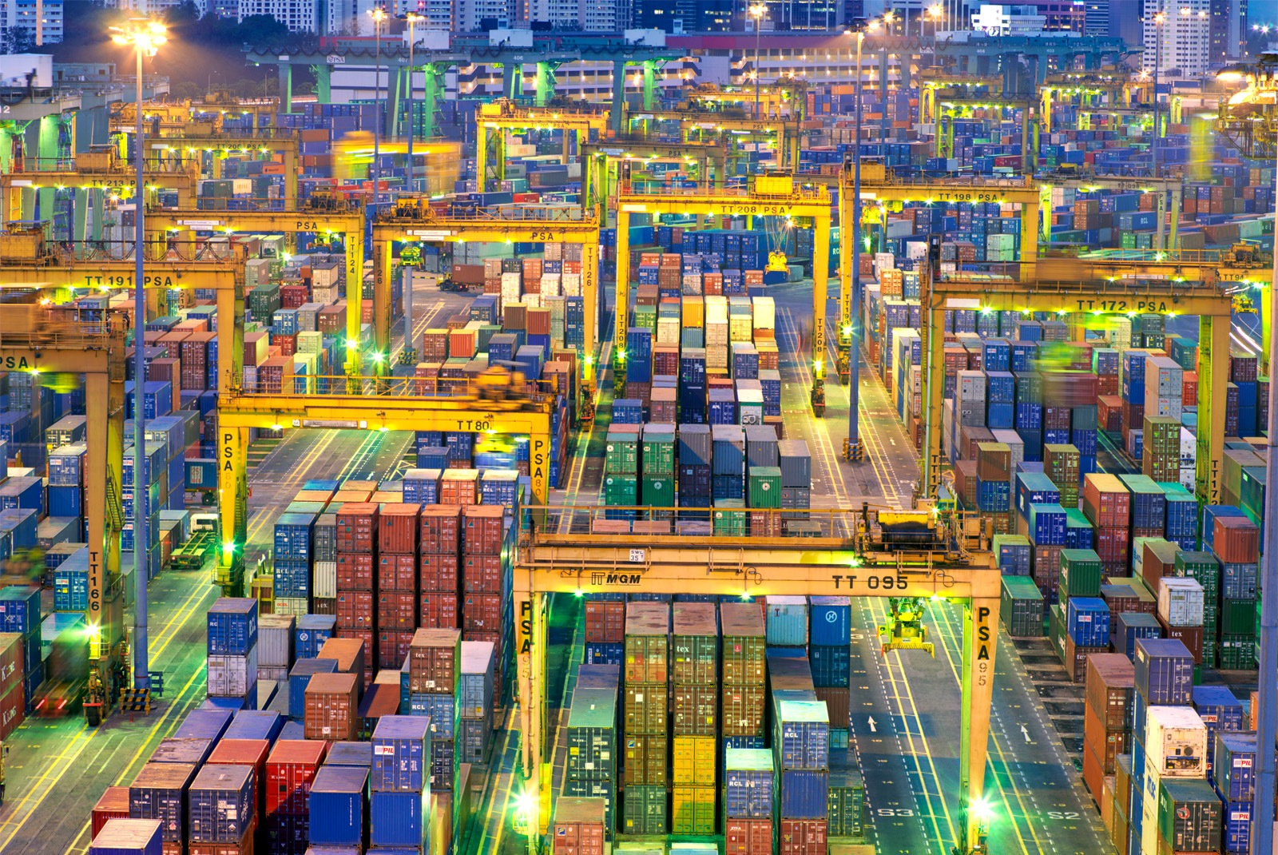
Kubernetes (K8s)
Is an open-source system for automating deployment, scaling, and management of containerized applications.
It groups containers that make up an application into logical units for easy management and discovery.
Created by Google now it is open-source

Slide 7
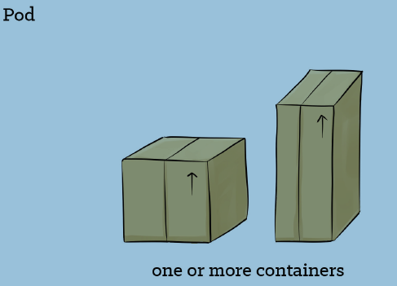
Pods
Pods are the basic unit for running containers inside of K8
A pod provides a way to set environment variables mount storage and feed other information into a container
In Kubernetes, Pods are responsible for running your containers. Every Pod holds at least one container, and controls the execution of that container. When the containers exit, the Pod dies too.

Slide 8
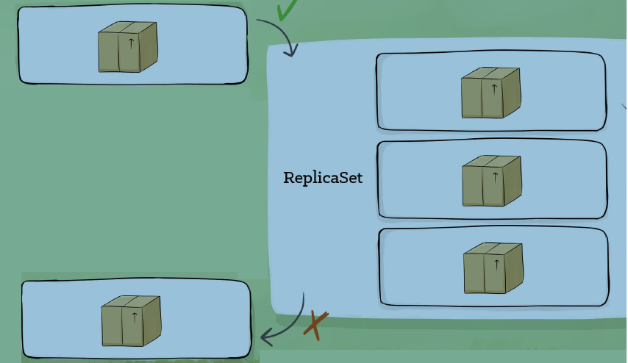
Replicasets
A ReplicaSet ensures that a set of identically configured Pods are running at the desired replica count. If a Pod drops off, the ReplicaSet brings a new one online as a replacement.
Replicasets are considered “low-level” type in K8
Typically users use Deployments and DaemonSets

Slide 9
Secrets
Secrets are used to store non-public information, such as tokens, certificates, or passwords. Secrets can be attached to Pods at runtime so that sensitive configuration data can be stored securely in the cluster.
Secrets are Base 64 encoded “at rest” but the data is automatically decoded when attached to a Pod
Secrets can be attached as files or environment variables.

Slide 10
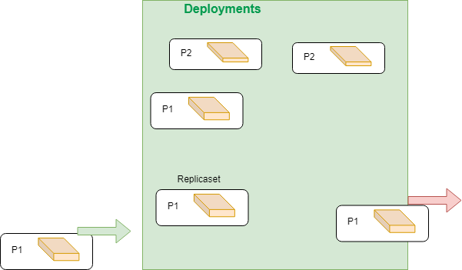
Deployments
A Deployment is a higher-order abstraction that controls deploying and maintaining a set of Pods. Behind the scenes, it uses a ReplicaSet to keep the Pods running, but it offers sophisticated logic for deploying, updating, and scaling a set of Pods within a cluster.
Support rolling updates and rollbacks
Rollouts can be paused

Slide 11
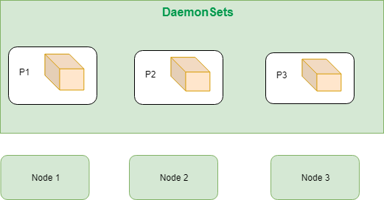
Daemonsets
DaemonSets provide a way to ensure that a copy of a Pod is running on every node in the cluster. As a cluster grows and shrinks, the DaemonSet spreads these specially labeled Pods across all of the nodes.
One frequent pattern install or configure software on each host node

Slide 12
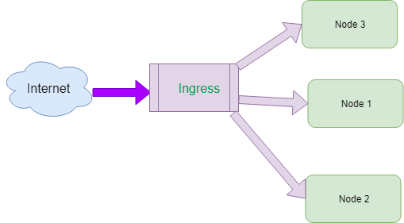
Ingresses
Ingresses provide a way to declare that traffic ought to be channeled from the outside of the cluster into destination points within the cluster. One single external Ingress point can accept traffic destined to many different internal services.
Route traffic to and from the cluster
Provide a single SSL endpoint for multiple applications

Slide 13
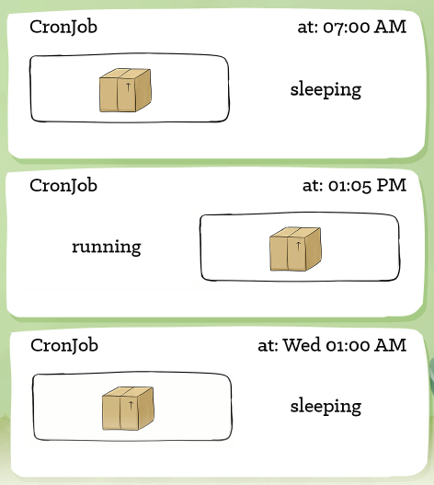
Cronjobs
CronJobs provide a method for scheduling the execution of Pods. They are excellent for running periodic tasks like backups, reports, and automated tests.
Used to schedule tasks
Are part of the batch API for creating short lived non-server tools

Slide 14
CRD’s
CustomResourceDefinitions, or CRDs, provide an extension mechanism that cluster operators and developers can use to create their own resource types.
CRD defines new resource type and tell K8 about it
Once a new resource type is added, new instances of that resource may be created
Notes:
We have to handle resource type changes

Slide 15
Service
is an abstraction which defines a logical set of Pods and a policy by which to access them
The set of Pods targeted by a Service is usually determined by filters based on labels

Slide 16
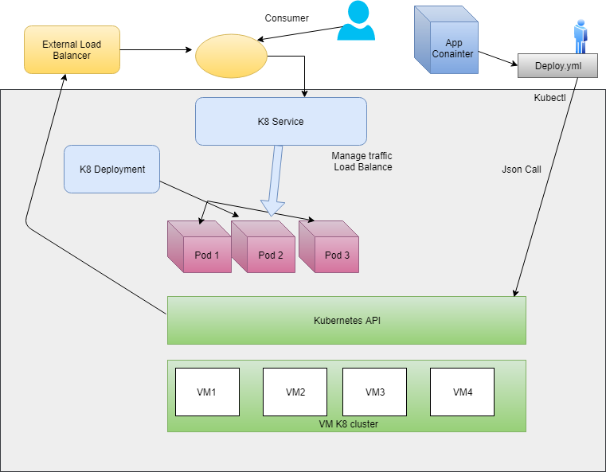
How Kubernetes works
Notes:
Scale up and down ( increase/dec # of pods)
progressive upgrade and rollbacks of pods without user

Slide 17
How k8 deployments work
Pods
Liveness check – should be automatically restarted or not
Readiness check – app is ready to serve?
Termination grace period – how long container remains “up “ after marked for deletion by def 30 seconds

Slide 18
Deployment
Service LB
Pod (v1)
Pod (v1)
Pod (v1)
Img:V1
Deployment
Service LB
Img:V2
Pod (v1)
Pod (v1)
Pod (v1)
Pod (v2)
Check of liveness
Check for readiness

Slide 19
Deployment
Service LB
Pod (v1)
Pod (v1)
Pod (v1)
Pod (v2)
Check of liveness
Check for readiness
Deployment
Service LB
After term grace period
Pod (v1)
Pod (v1)
Pod (v1)
Pod (v2)
Check of liveness
Check for readiness

Slide 20
How k8 Scheduler work
controls performance, capacity and availability through policies and topology awareness.
In layman’s term “for each pod that is created, it finds the "best" machine for that pod, and if no machine is suitable, the pod remains unscheduled until a machine becomes suitable.”
Kubernetes scheduler is configurable with two different policies:
PriorityFunction - soft constraints “nice to have”
FitPredicate – hard constraints which cannot be violated
It can also pick a Node at random, which is a method to assign containers to resources with minimal computational overhead.

Slide 21
Scheduler
Predicate - Hard constraints
Memory
Hard Disk – space , speed, HA
Priority - Soft violated if there are no other options
Spreading – spread across to different VMs
Sick environment
Decide which node to place - selects top 1 after filter and sort
Filter on Predicate
Sort on Priority

Slide 22
Some common use Cases
Serve microservices
Cloud migration
Hybrid environments
Platform independent
Autoscaling in cloud for apps which is not serverless ( vs VMs?)
Jobs
Workflows based on K8 using Jobs
Tensorflow machine leaning ( assumes K8)

Slide 23
Demo
Demo of K8
Deploy a container
scale up and scale down

Slide 24
Resources
https://www.docker.com/resources/what-container
https://kubernetes.io/

